Slide 1
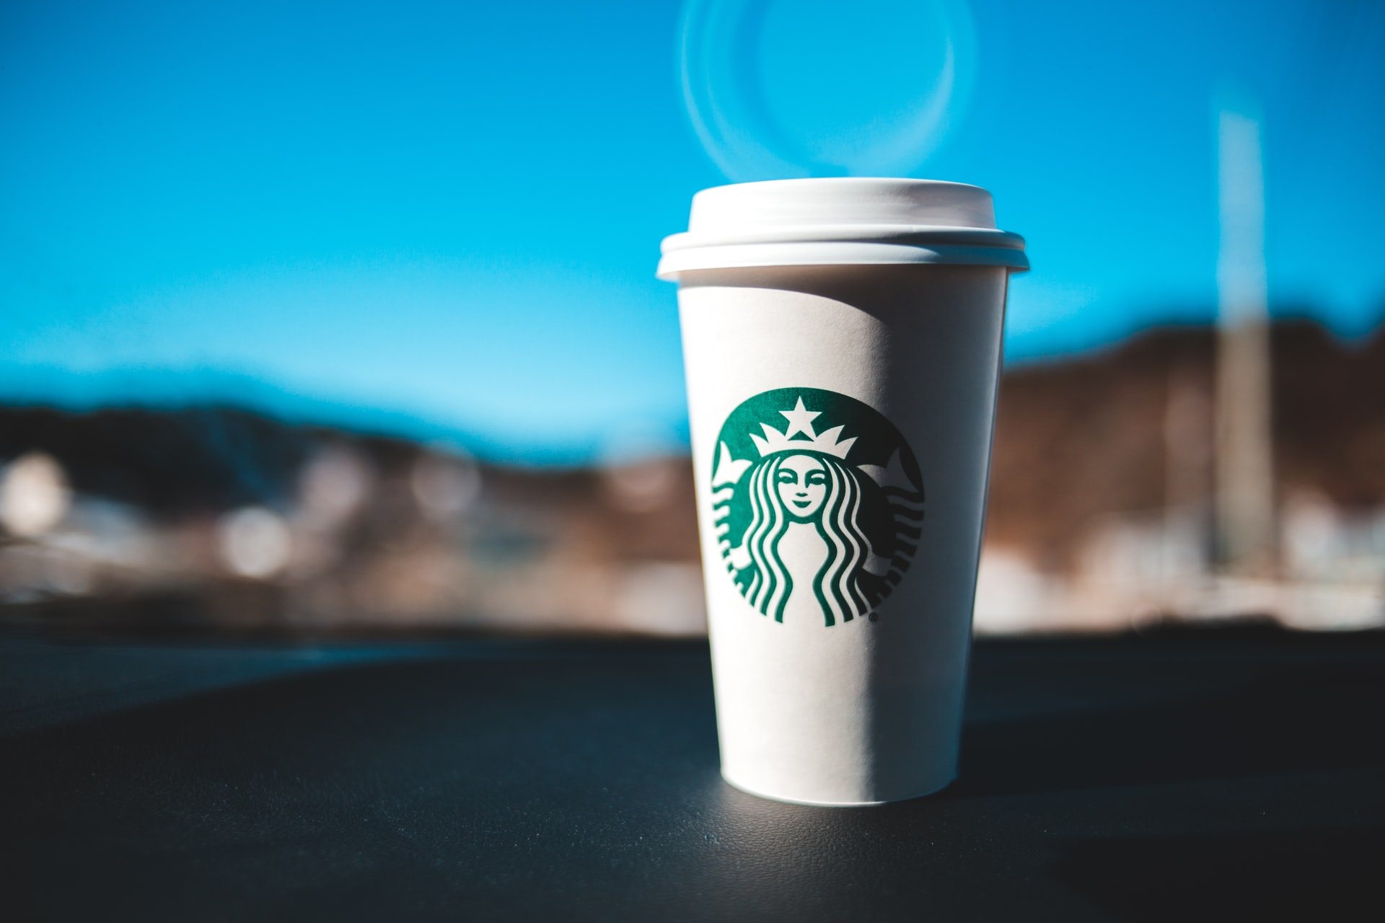
Automation Testing for Starbucks using Selenium
By
Artur
Gabriel
Dave
Olu

Slide 2
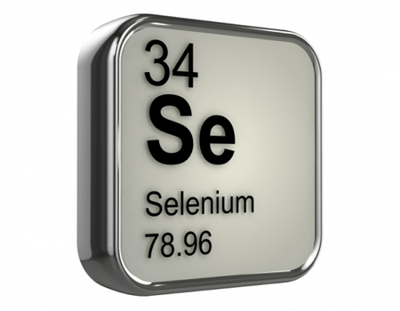
About Starbucks
Starbucks is the world’s largest coffee house chain.
Their headquarter is in Seattle, Washington.
As of November 2021, the company had 33,833 stores in 80 countries, 15,444 of which were located in the United States.

Slide 3
Test Agenda
Application Overview
Tools & Technologies Used
Test Plan
Test Data & Test Cases
Automation in NetBeans
GIT Repository
Jenkins Implementation
Learning & Challenges
Live Demo
Bug Report

Slide 4
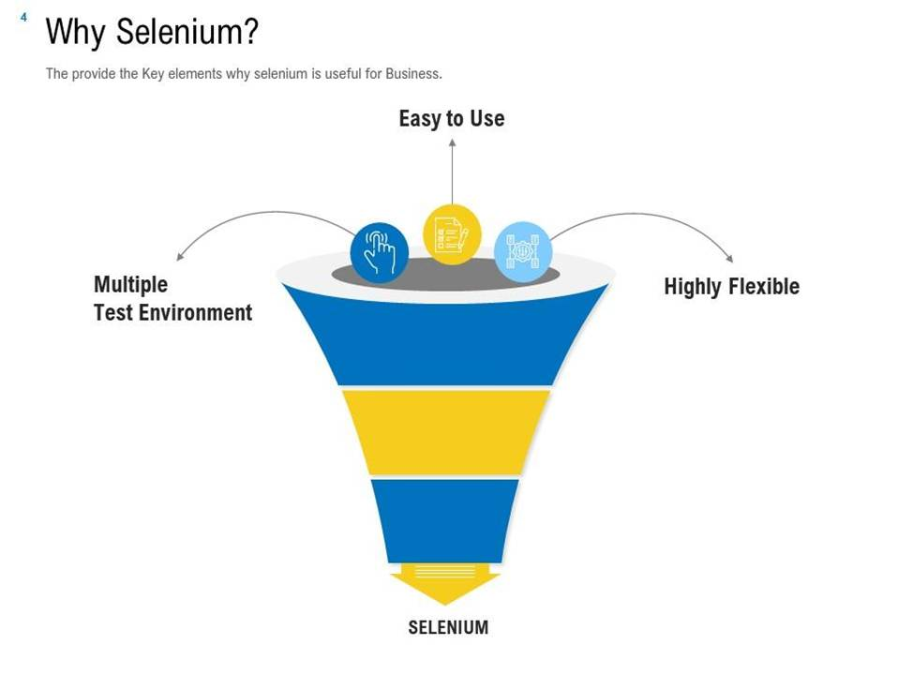

Slide 5
Tools & Technologies Used
Java
Selenium WebDriver
JUnit Framework
GitHub
Katalon
NetBeans
Jenkins

Slide 6
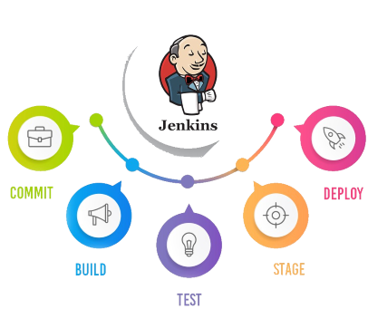
CI/CD Pipeline

Slide 7
Automation in NetBeans

Slide 8
GIT Repository

Slide 9
Jenkins Implementation

Slide 10
Learning & Challenges
We spent a whole day finding a solution to click on one particular element.

