Slide 1
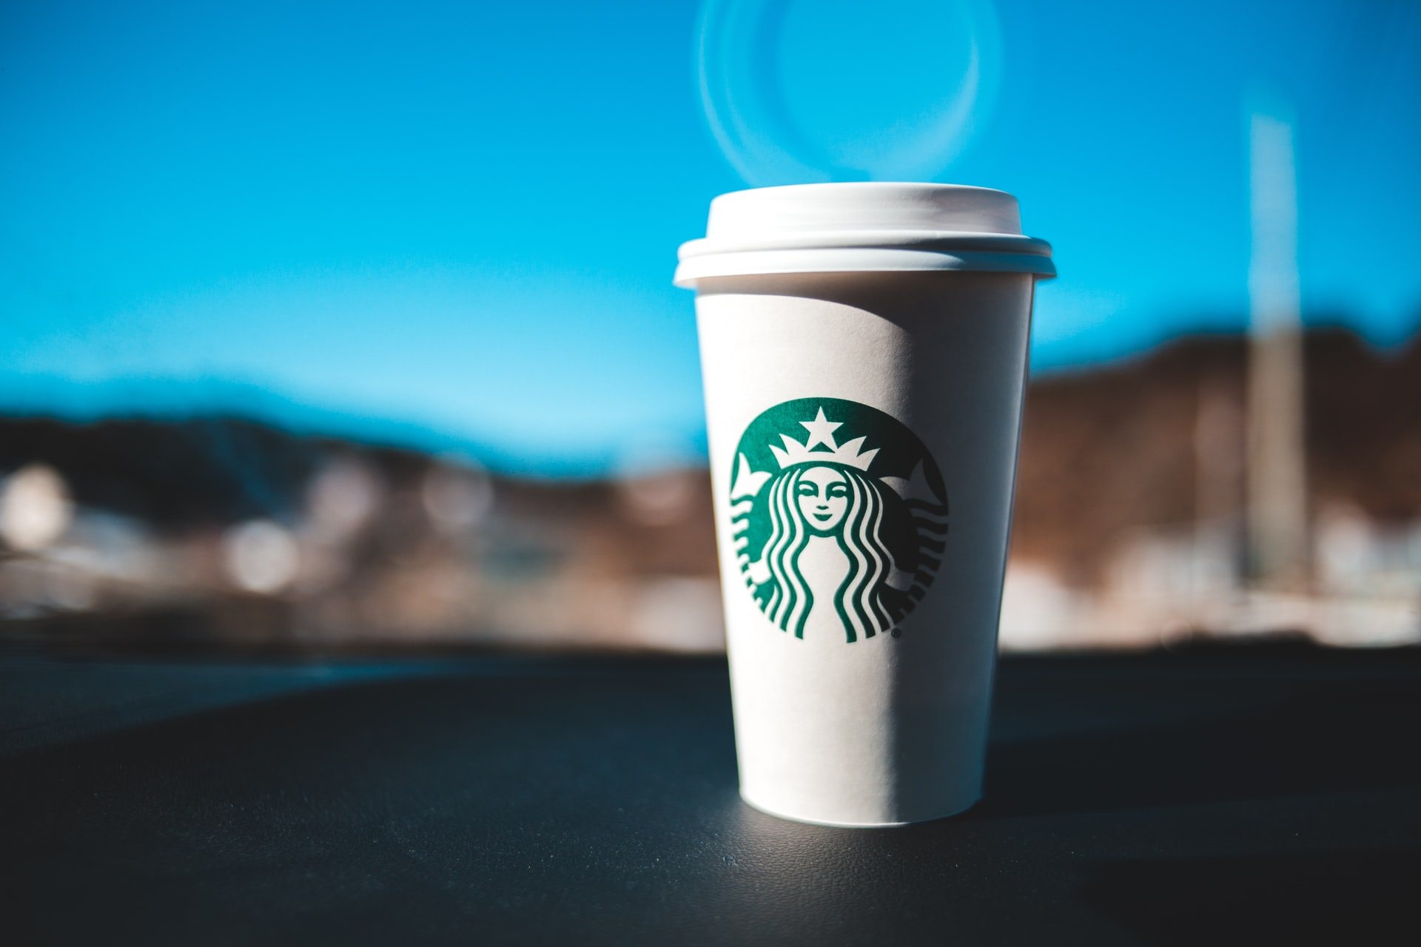
Automation Testing for Starbucks using Selenium
By
Artur
Gabriel
Dave
Olu

Slide 2
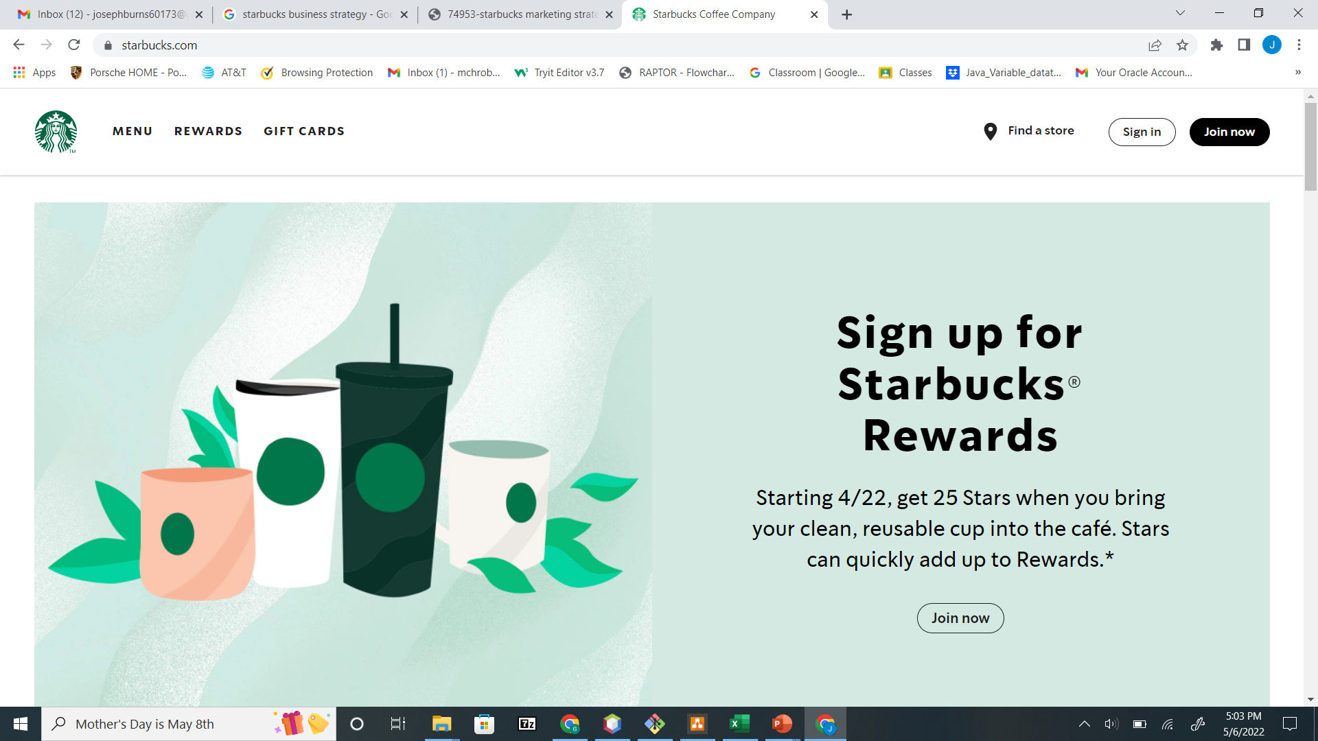
Starbucks.com Homepage

Slide 3
About Starbucks
Starbucks is the world’s largest coffee house chain.
Their headquarter is in Seattle, Washington.
As of November 2021, the company had 33,833 stores in 80 countries, 15,444 of which were located in the United States.

Slide 4
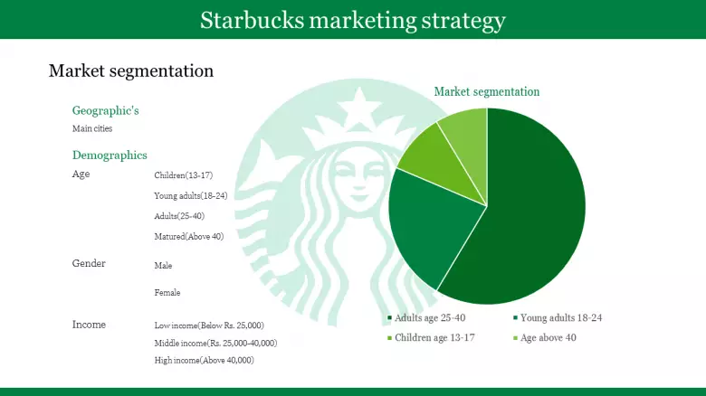
Starbucks Marketing Strategy

Slide 5

Test Agenda
Application Overview
Tools & Technologies Used
Test Plan
Test Data & Test Cases
Automation in NetBeans
GIT Repository
Jenkins Implementation
Page Object
Draw.IO
Learning & Challenges
Live Demo
Bug Report

Slide 6
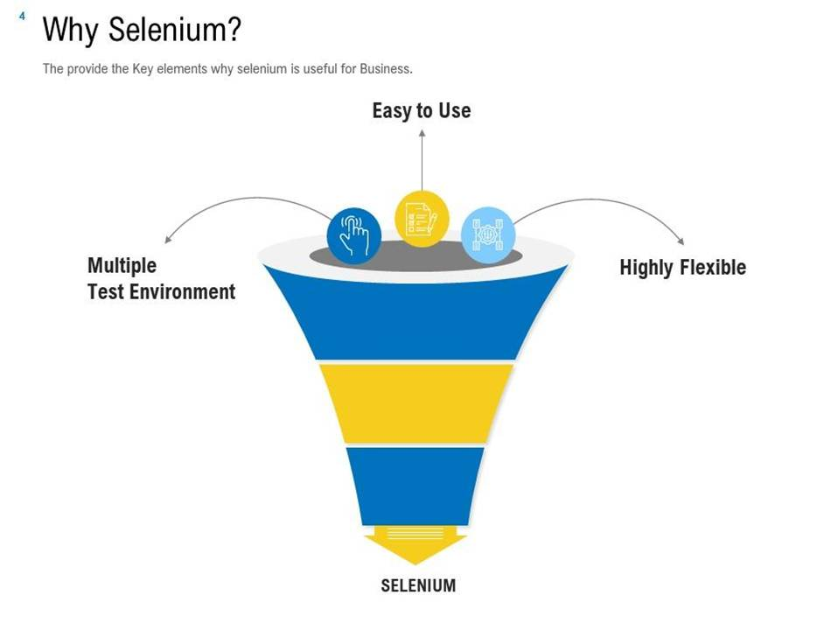

Slide 7
Tools & Technologies Used
Java
Selenium WebDriver
JUnit Framework
GitHub
Katalon
NetBeans
Jenkins

Slide 8
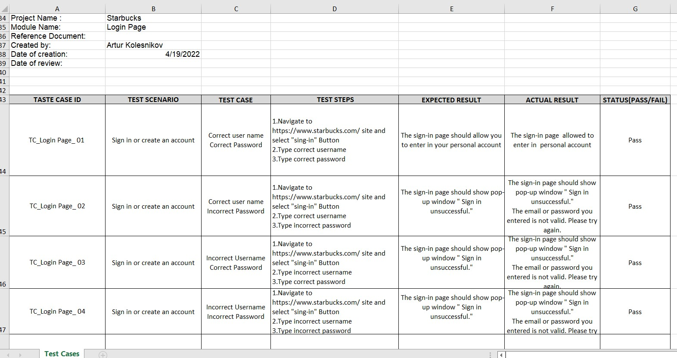
Test cases

Slide 9
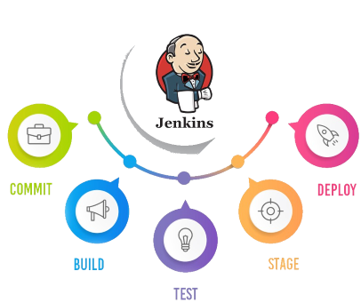
CI/CD Pipeline

Slide 10
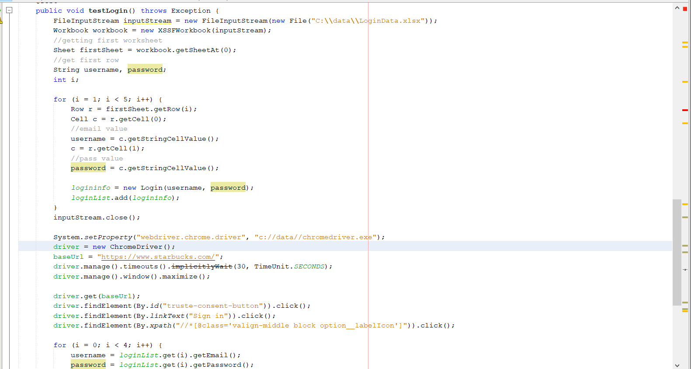
Data Driven Automation of LoginTest using Page Object

Slide 11
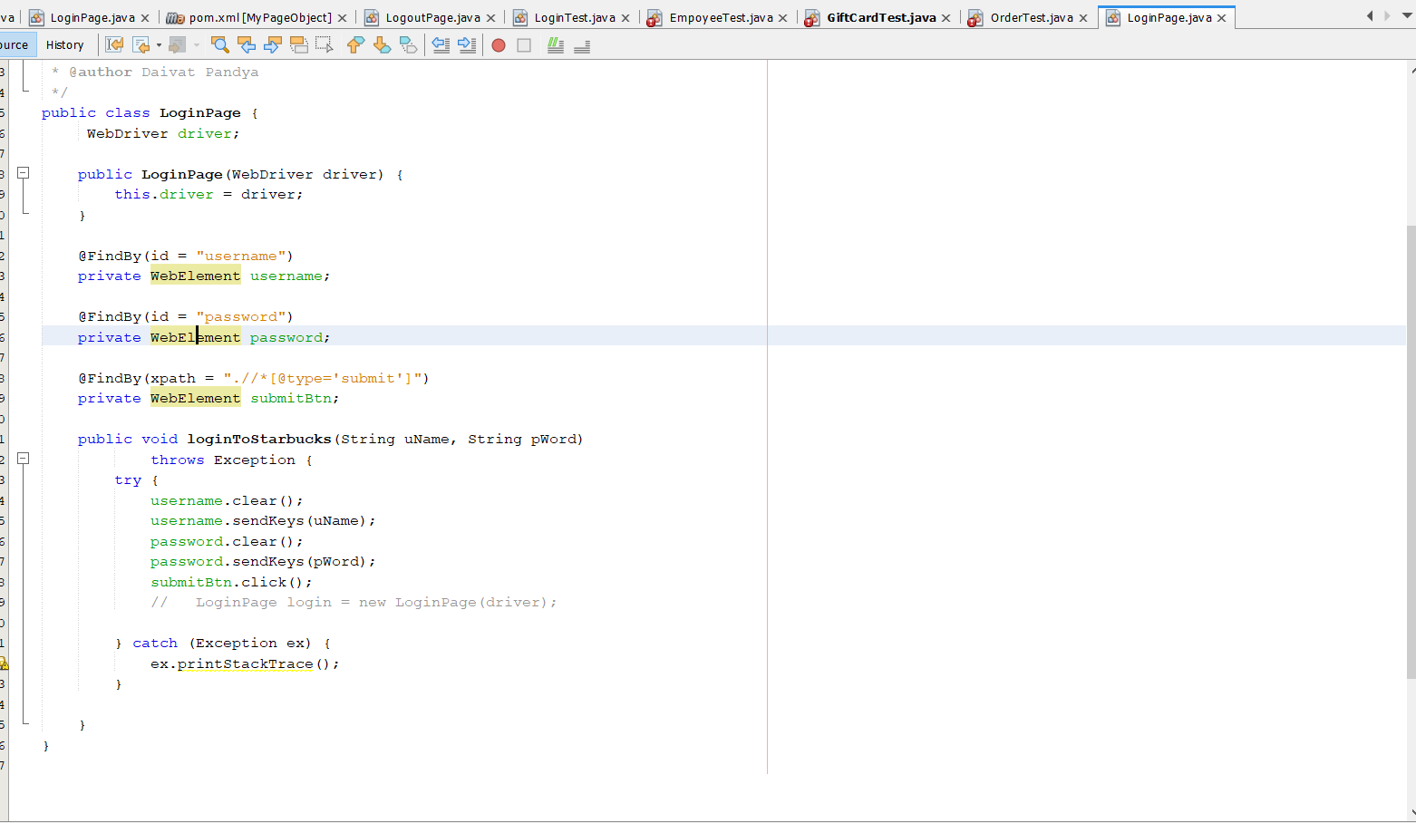
Page Object

Slide 12
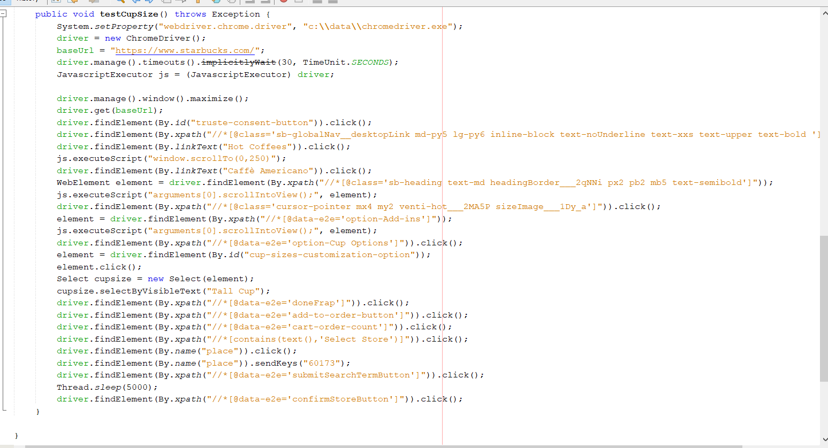
Automation of Ordering a Drink

Slide 13
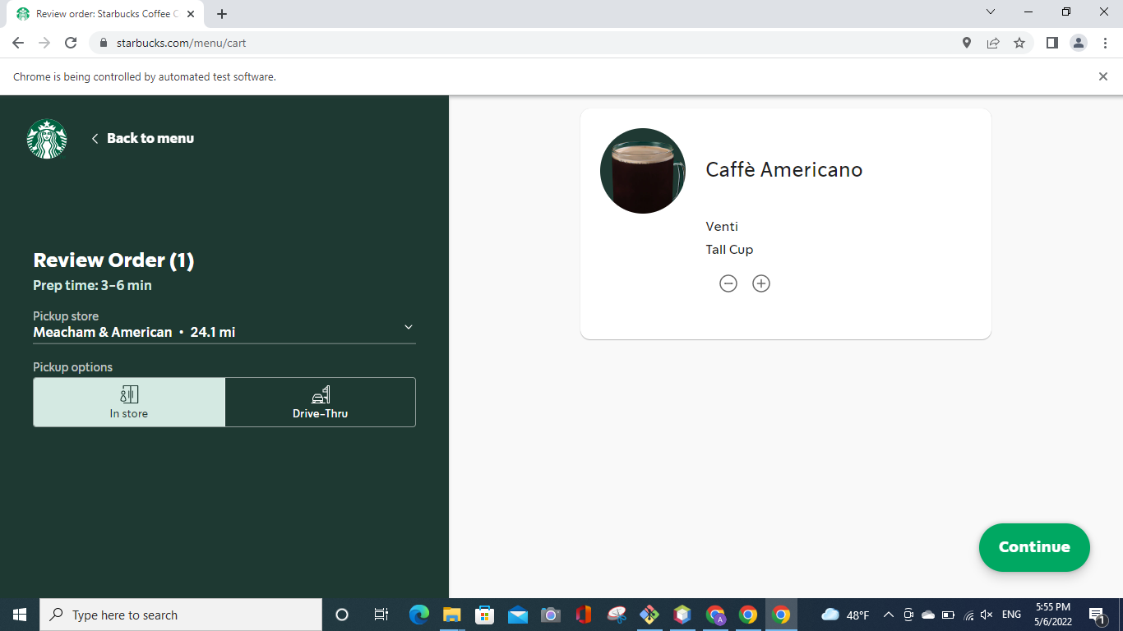
Bug #1: Incompatibility of Cup Sizes

Slide 14
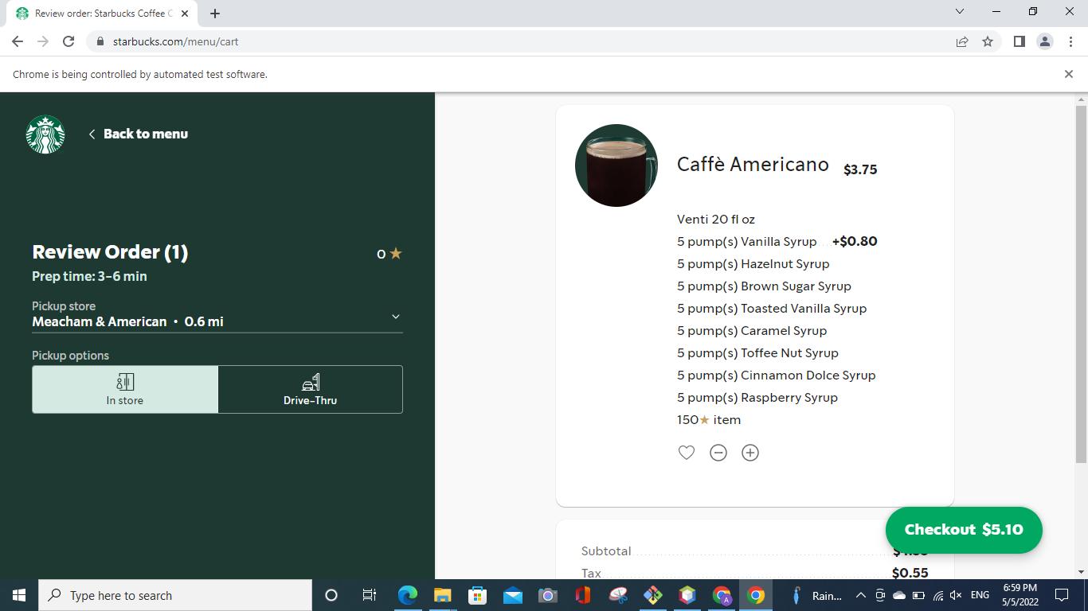
Bug #2: Multiple Flavors

Slide 15
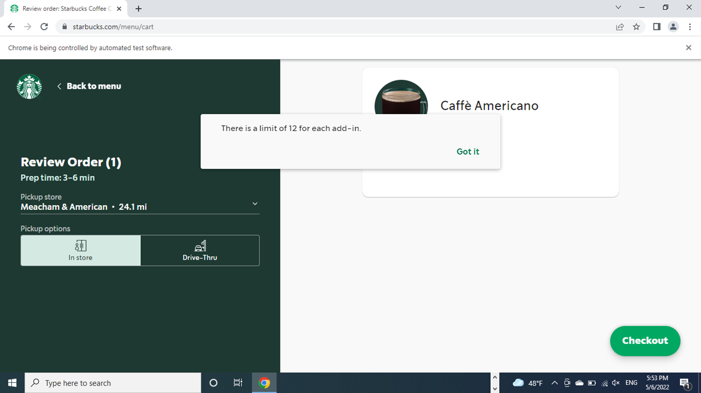
Bug #3: Same Flavor with 50 Pumps

Slide 16
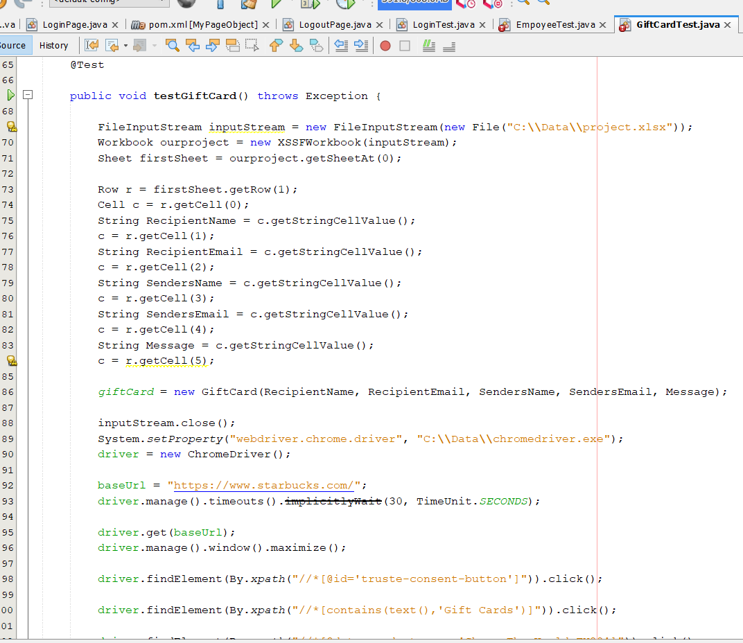
Data Driven Automation Test of Gift Card Functionality

Slide 17
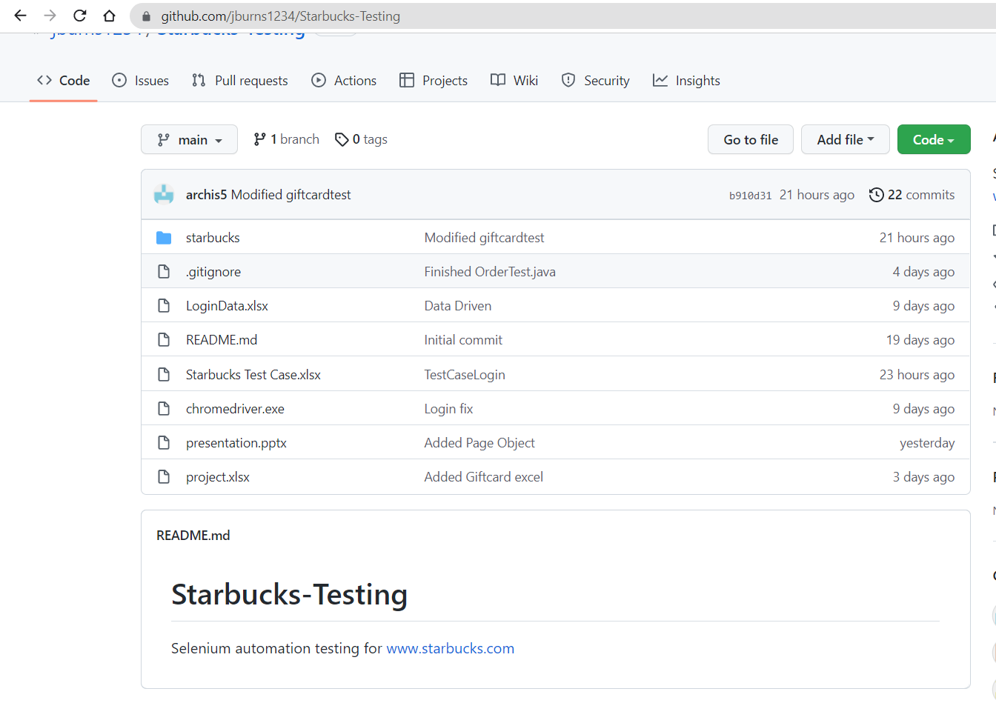
GIT Repository

Slide 18
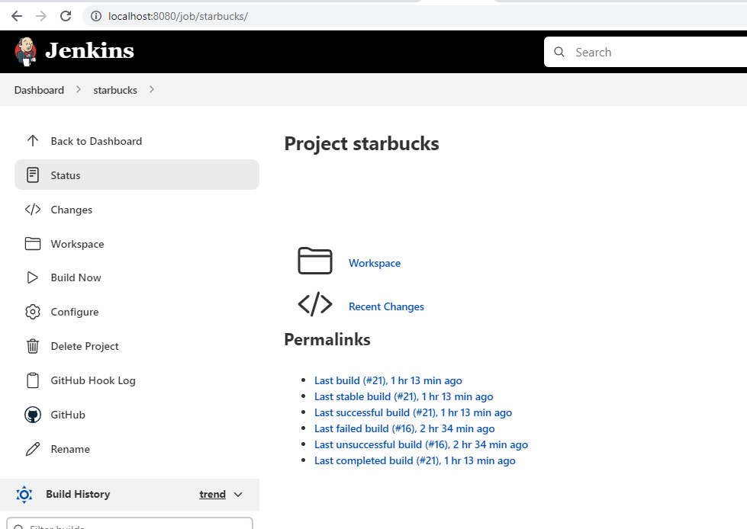
Jenkins Implementation

Slide 19
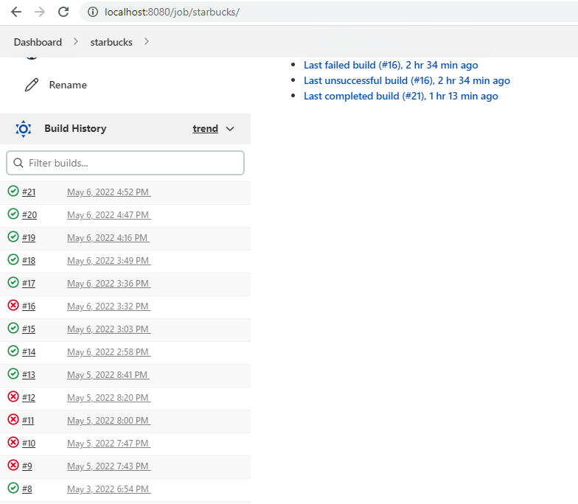
Jenkins Build History

Slide 20
Learning & Challenges
Websites were detecting Selenium in our login attempts. So, we had to fix the internal code of Chromedriver.exe so that websites wouldn’t recognize we were using Selenium.
Data Driven testing required us to use for loop to loop through multiple data rows.
We spent a whole day finding a solution to click on one particular element.
Jenkins didn’t compile “/div” xpaths.
Java versions conflict(17vs18).

Slide 21

Tushar
Patel
IT Expert System

