Slide 1
SPM Modes and Methods

Slide 2
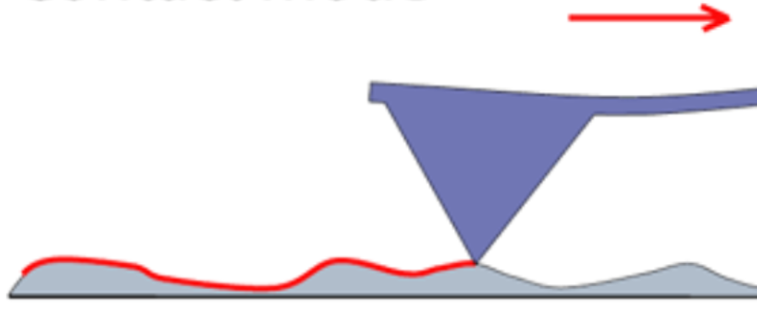
Contact Modes: Static Force
Static force mode – Dragging probe across with constant force between sample and tip
Constant force (deflection feedback) mode – Cantilever deflection is kept constant
Constant height mode – Cantilever maintains constant height above sample
Error mode – Adding deflection feedback signal to topography image

Slide 3
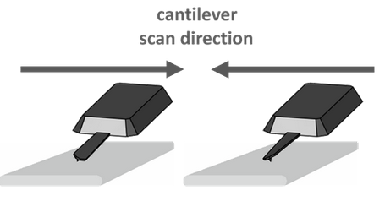
Contact Modes: Lateral Force
Lateral force mode – Measuring lateral twist of cantilever probe tip along sample
Good for analyzing friction

Slide 4
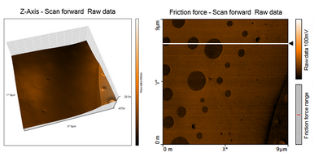
Contact Modes: Lateral Force
Lateral force mode – Measuring lateral twist of cantilever probe tip along sample
Good for analyzing friction

Slide 5
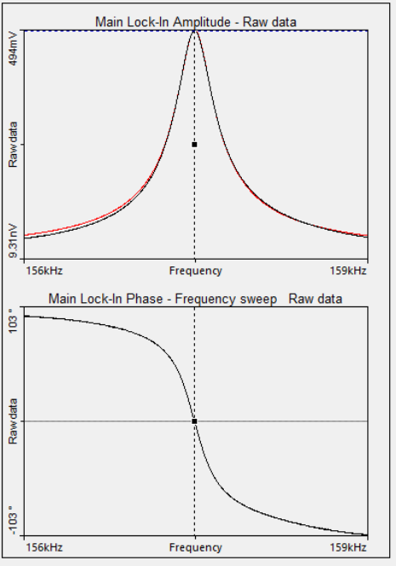
Dynamic Modes: Modulation
AM AFM – Using the amplitude as a feedback parameter
FM AFM – Using the resonance frequency as a feedback parameter
Phase-Modulation AFM – Using the phase lag as a feedback parameter

Slide 6
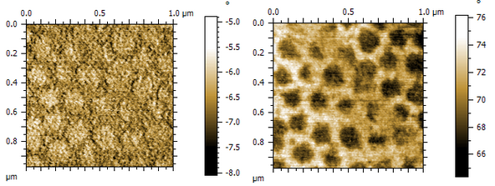
Dynamic Modes: Phase Contrast Imaging
Phase Image – AFM image that uses phase modulation to convey contrast between sample properties
Topography Image – AFM image that uses AM to create a topograph

Slide 7

Scanning Methods
Single pass – Tip is scanned at a predefined height above the sample’s topography to measure non-Van der Vaals forces
Interlaced Pass – Tip is scanned forward to analyze topography, then backwards at a height above the topography to measure non-Van der Vaals forces
Dual pass – Tip is first scanned forwards and backwards along topography, then forwards and backwards at a height above
Contour following – Tip is scanned at a height above the topography, mirroring the topography of the sample

Slide 8
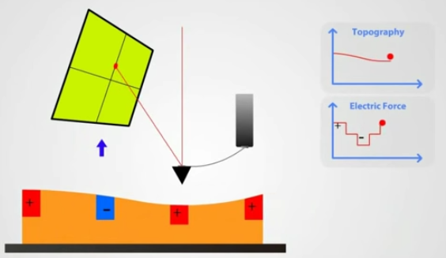
Electrostatic Force Microscopy (EFM)
EFM – Measures electric field gradient
A conductive probe tip is scanned above the sample at a range where electrostatic forces dominate. These can be measured

Slide 9
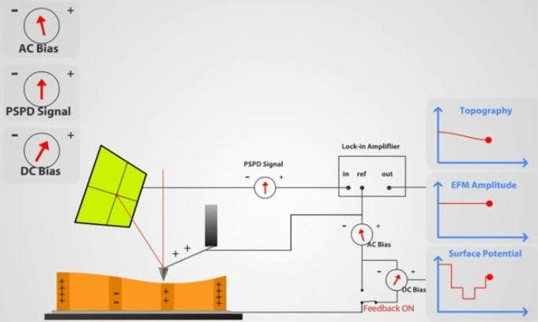
Kelvin Probe Force Microscopy (KPFM)
KFPM – Measures surface potential and work function

Slide 10
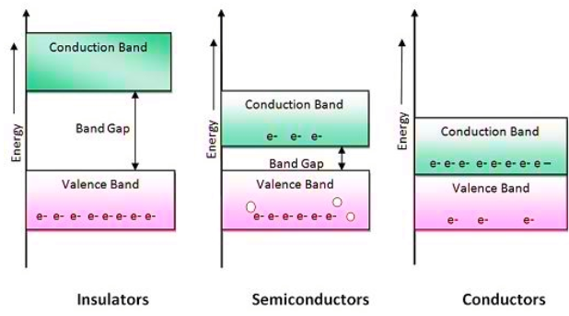
KPFM: Band Structure
Energy band - Energy real-estate where electrons can live
Band gap - Energy levels where electrons cannot occupy

Slide 11
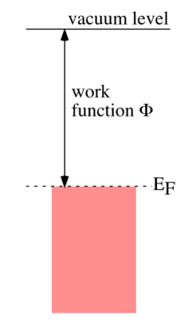
KPFM: Work Function
Work function - Energy required to pull electron from Fermi Energy to vacuum
Fermi energy - Energy of highest-energy electron in material at 0K

Slide 12
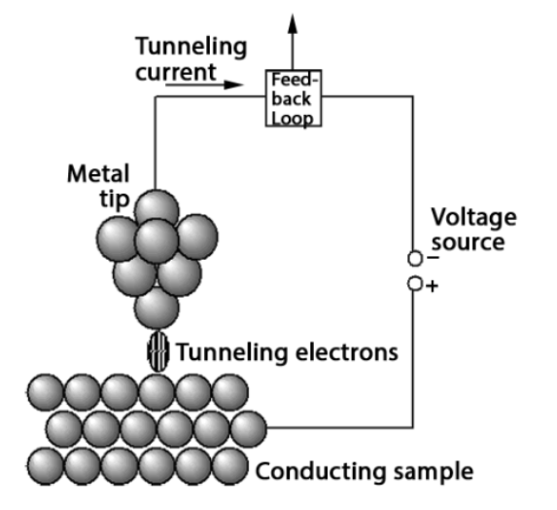
Scanning Tunneling Microscopy (STM)
STM – Measures topography through quantum tunneling
Atomically-wide tip is brought into sub-nanometer range of sample.
This reduces the width of the potential barrier between the tip of the probe and that of the sample, enabling electrons to tunnel
By measuring the tunneling current, one can analyze the sample
Tunneling current can be kept constant in Constant Current Mode

Slide 13
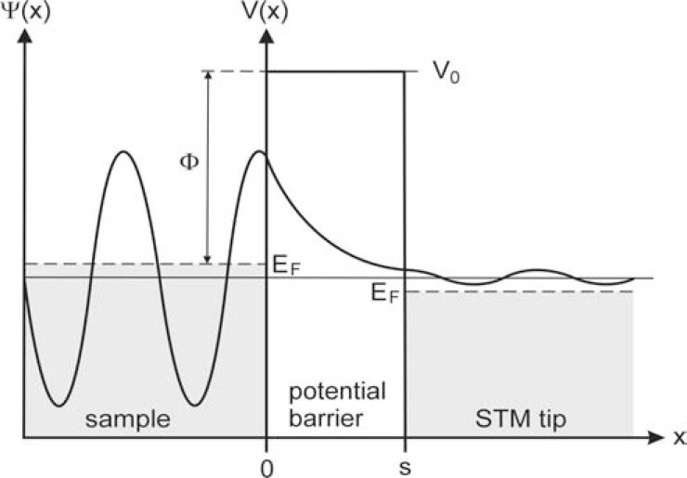
Scanning Tunneling Microscopy (STM)
STM – Measures topography through quantum tunneling
Atomically-wide tip is brought into sub-nanometer range of sample.
This reduces the width of the potential barrier between the tip of the probe and that of the sample, enabling electrons to tunnel
By measuring the tunneling current, one can analyze the sample
Tunneling current can be kept constant in Constant Current Mode

Slide 14
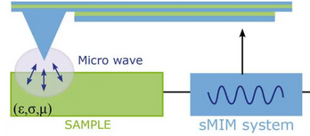
Near Field Microwave-Impedance Microscopy (MIM)
MIM – Measures conductivity and permittivity
Microwaves are sent to probe tip via shielded path (waveguide). Within the near-field range of the tip, evanescent waves probe the sample
Near-field – Portion of EM radiation within one wavelength of source
Evanescent wave – EM waves that decay exponentially, as opposed to sinusoidally
Some evanescent waves are reflected by the sample
their amplitude and phase can be measured to characterize conductivity and permittivity
Sample-tip interface can be treated as a circuit. The dielectric constant and conductance of the sample alters the impedance, hence the name of MIM

