Slide 1
Team Husk - Final Project Presentation
Team Leader: John Busha
Team Members: Max Moeller, Justin Selby
1/8

Slide 2
Wiki Features
Downloadable Wiki Pages
Formats: PDF, MD, TXT
Download file-size preview
User Registration/Login
Show/Hide Password
2/8

Slide 3
Wiki Page Download Feature
Overview:
Allows for pages to be downloaded in many formats. Useful for reasons including:
Offline browsing
Archival
Printing
Appending to papers
Machine-readable
TTS, etc.
Implementation:
Appends a download link to the actions toolbar
On the download page, there are:
Buttons for each format
File size for each format
Text and pdf files are created when a page is saved or created
Files are ready to download before users request them
Allows for scalability
3/8

Slide 4
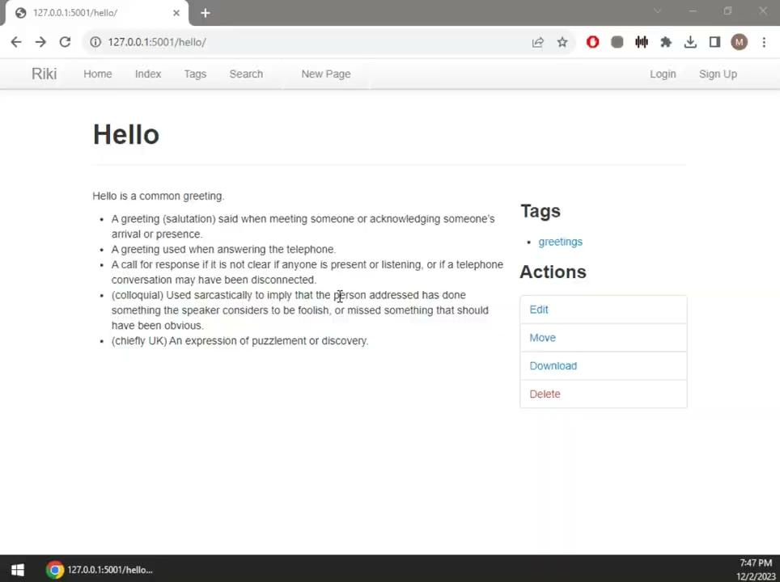
Wiki Page Download Demo
4/8

Slide 5
User Signup Feature
Overview:
Provides the opportunity for new users to register for a profile.
Works to increase community engagement.
Enables personalized interactions and user identification.
Implementation:
Embedded a hyperlink on the login screen that will direct users to a sign up form.
Created input fields the user is required to fill out (username, password, confirm password)
If all information is validated, they will be granted access to the wiki.
If the data encounters any errors, the user will be notified through an error message
5/8

Slide 6

User Signup Demo
6/8

Slide 7
Progress Summary
Initial Repository LoC: 12,463
Final Repository LoC: 13,535
Features and Tests | Lines of Code
File Download / File-size | 566
User Signup / Show/Hide Password | 506
7/8

Slide 8
Testing Results
2 Unit Test Files
2 Integration Test Files
27 Total Test Cases
No Indications of Regression
100% Acceptance Test Pass Rate
8/8

