Slide 1
UMKC HACKATHON SPRING 2017 Use Case U13: Food game CODE CRUNCHERS: Sandeep pabolu, Jackie Batson, nancy YANg, AKHILA katta

Slide 2
Use Case U13: Food Game
The goal of the use case is to create an application that classifies foods based on images.
An image is submitted by the user for analysis. The user is then given the name of the food, the number of calories, a nutritional breakdown, and whether the food is healthy or not.
If reviews are available for the food, then reviews are given along with a sentiment analysis that assigns a review score of 1 to 5 for the food.

Slide 3
User Interface Design by Sandeep Pabolu

Slide 4
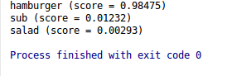
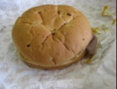
Image Analysis by Nancy Yang
Pittsburgh Fast-Food Image Dataset
Created 3 food categories (due to training time limitation): hamburger, salad, and sub (submarine sandwich)
Used TensorFlow google inception model. Trained last layer and got the bottleneck data.
Left picture: Tensorflow testing result with accuracy 98%. Right: testing image.
Dataset: Pittsburgh Fast-Food Image Dataset.

Slide 5
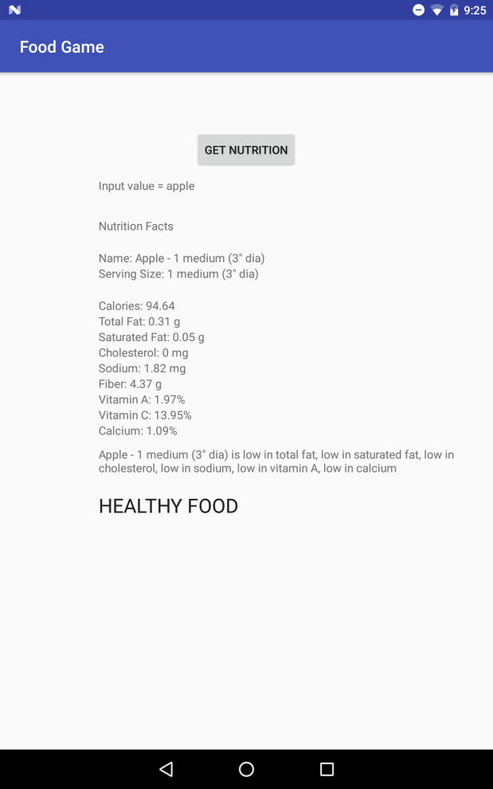
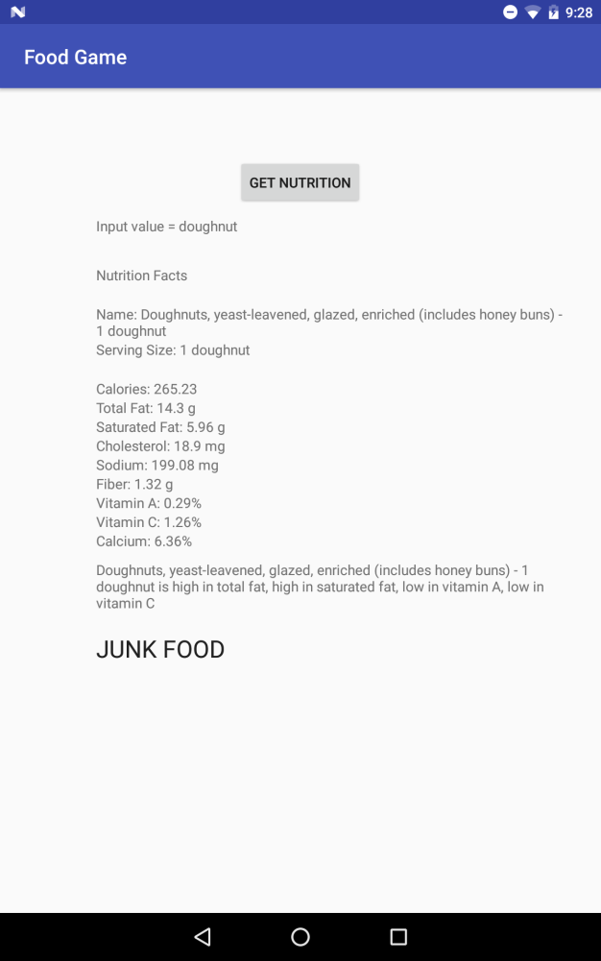
Nutrition Analysis by Jackie Batson
This analysis begins after the user’s image has been identified by the TensorFlow model. It assumes that we have a string name for the food, e.g. “cheeseburger”, from the model. I subbed in example strings before image classification was done. Here are some examples:
On the left, the input from the food classification output is “apple”, shown at the top. A nutritional breakdown, including calories, is then shown, powered by the Nutritionix API. I then analyzed the nutritional results, anything less than 5% daily value is low and greater than 20% dv is high. Healthy foods are high in vitamins, calcium, and fiber and low in saturated fats, cholesterol, and sodium. I decided that if a food had at least two healthy traits and more healthy than unhealthy traits, it is a healthy food. If it has two or more unhealthy traits and more unhealthy than healthy traits, it is a junk food. Otherwise, it is a neutral food. On the right, we see the same results for “doughnut”.

Slide 6
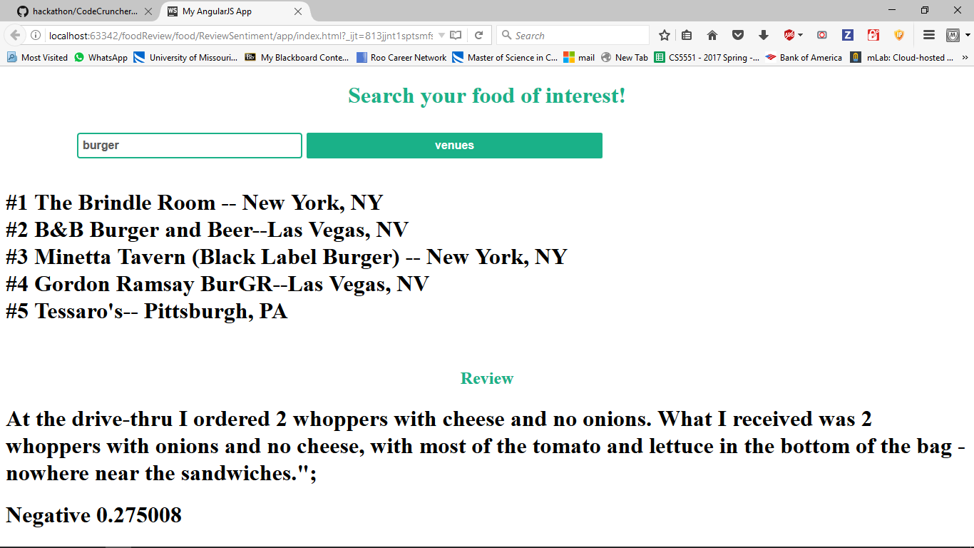
Review Analysis by Akhila Katta
In this section I have used Four square Api to retrieve some of the top useful reviews about a particular food and made sentiment analysis for that top reviews and displayed is positive or negative. And also displayed the most rated places for that particular food
Sentiment analysis is done only on few of reviews and not on all the reviews provided by all the users so the sentiment analysis may change if all the reviews are considered.

