Slide 1
Attachable Motion-Detector Security System
Caleb Stewart
John Wilkes

Slide 2
Concept Overview
Use the Laird BL600 platform to develop motion-detecting devices
Devices physically attached to objects (e.g. use adhesive and stick to door, TV, etc.)
Use accelerometer interrupt to detect spike in movement
Devices are armed/disarmed from smartphone app
If moved while armed, alerts user via smartphone

Slide 3
Market Research - Conference Paper
Constructing Intelligent Home-Security System Design With Combining Phone-Net and Bluetooth Mechanism
DIY home-security system
Bluetooth
Sensor on every door and window
Magnetic lead-switch sensors

Slide 4
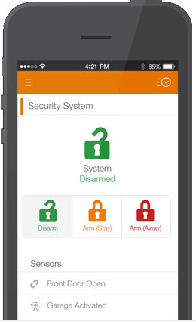
Market Research - LiveWatch
Customizable
Outside doors
Inside motion sensors
Smartphone alerts

Slide 5

Market Research - SimpliSafe
Customizable and easy to install
Supports multiple types of sensors (e.g. motion sensor, smoke detector, CO sensor, etc.)
System supports up to 41 sensors
Sends text alerts

Slide 6
Project Objectives
Develop a protocol for communicating between devices and smartphone
Experiment/discover more about Laird’s smartBASIC language and programming over-the-air capabilities
Seamless integration: smartphone easily detects device
Develop an extensible system architecture to support multiple connected devices
Develop a working prototype of the system (device, smartphone app)

Slide 7
Goals/Milestones - 1
Program the BL600 over the air
Develop communication protocol
Extend to portable applications by using Bluetooth
Support home wifi use
Create custom board (BLE 600, MCU-6150, and battery)
Add/control LEDs to provide visual indicators of “arm state”
Button/switch to allow discovery by smartphone app
3D printed housing

Slide 8
Goals/Milestones - 2
Develop smartphone app that performs following tasks:
Arm/disarm device(s)
Notify user of triggered alarm
Allow user to view diagnostic data on devices (e.g. battery voltage, accelerometer data, etc.)
Manage multiple devices (assign names, arm disarm individually, etc.)
Command a named device to self-identify (blink an LED)
Sensor discovery

Slide 9
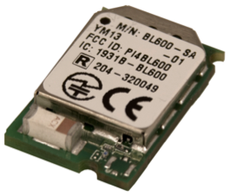
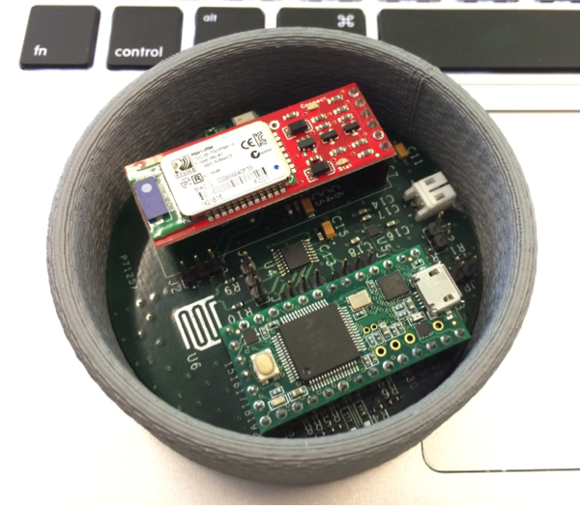
Hardware Design - BLE 600
UAH Development System
Bluetooth interface
Programmed wirelessly
smartBASIC language

Slide 10
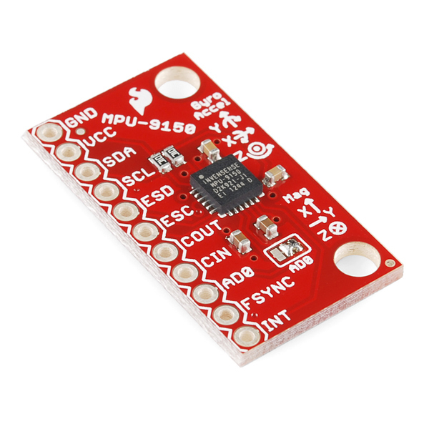
Hardware Design - Motion Sensor
MPU-6150
6 degrees of freedom (DOF)
Accelerometer and gyroscope
MPU-9150
9 degrees of freedom (DOF)
Accelerometer, gyroscope, and magnetometer

Slide 11
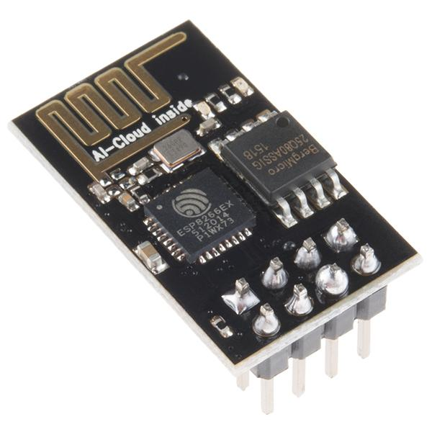

Hardware Design - Custom Board
BLE 600
MPU-6150 or MPU-9150
ESP 8266
Powered by 2032 battery
Button/switch to sync with smartphone app

Slide 12

Software Design - 1
List all connected sensors
Allow user to create custom names for sensors

Slide 13
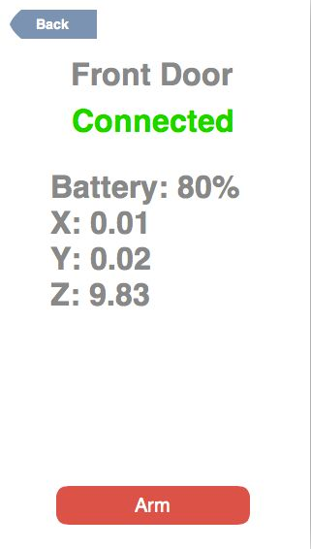
Software Design - 2
Sensor details
Connection status
Battery status
Accelerometer data
Arm/disarm sensor

Slide 14
References
https://www.fluidui.com
https://www.livewatch.com
http://simplisafe.com
http://www.sparkfun.com
Chun-Liang Hsu; Sheng-Yuan Yang; Wei-Bin Wu, "Constructing intelligent home-security system design with combining phone-net and Bluetooth mechanism," in Machine Learning and Cybernetics, 2009 International Conference on , vol.6, no., pp.3316-3323, 12-15 July 2009

