Slide 1
Attachable Motion-Detector Security System (AMDeSS)
Final Presentation
Caleb Stewart & John Wilkes
CPE 621

Slide 2
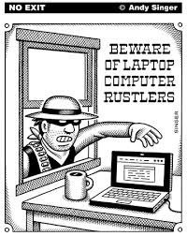
Problem
Personal belongings left unattended in a public place are an easy target for thieves
www.airsafe.com

Slide 3




Solution
AMDeSS is an attachable motion device that alerts a user via smartphone when it is moved
www.fotosearch.com www.businesswire.com www.telegraph.co.uk www.clipartpanda.com

Slide 4
Existing Products

Slide 5
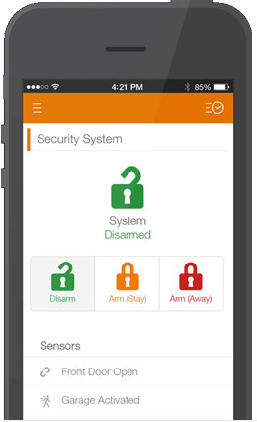
Market Research - LiveWatch
Customizable
Outside doors
Inside motion sensors
Smartphone alerts
https://www.livewatch.com

Slide 6
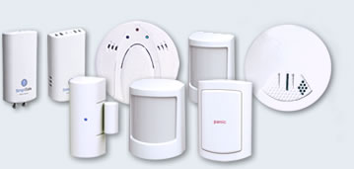
Market Research - SimpliSafe
Customizable and easy to install
Supports multiple types of sensors (e.g. motion sensor, smoke detector, CO sensor, etc.)
System supports up to 41 sensors
Sends text alerts
http://simplisafe.com

Slide 7

AMDeSS vs. Existing Products
AMDeSS leverages Bluetooth to allow easy mobile deployment
AMDeSS can be used to complement a more complete in-home security system
en.wikipedia.org

Slide 8
AMDeSS Implementation

Slide 9
Initial Project Approach
Android app for the user interface
Use the Laird BL600 module for sensor device processing
Use the MMA8653FC accelerometer for detecting movement
Communication over Bluetooth Low Energy
Implement a prototype on Dr. Jovanov’s development board
Explore over-the-air programming of the BL600

Slide 10
BLE Profile Implementation
Defined a custom BLE service
Arm state characteristic
Read/write
0 – disarmed
1 – armed
Alarm characteristic
Notify only
0 – No alarm
1 – Alarm

Slide 11
Unexpected Issues
Getting Over-The-Air programming to work was slower than expected
Needed a BL620 dongle for OTA to work (this was not immediately obvious)
Development kit pin configuration example confusion
Unable to get the MMA8653FC accelerometer on Dr. Jovanov’s development board to work
Verified the I2C signals coming from the BL600 were correct
Verified the BL600 could communicate over I2C to the capacitance-to-digital converter
Tried 3 different development boards

Slide 12
Modified Project Approach
Use the capacitance-to-digital converter with a touch sensor attached to a water bottle
Grasping the water bottle will be treated as the alarm condition

Slide 13
Project Test Plan
Verify the app can pair with the device when the device is powered
Verify the device is shown to be initially disarmed in app
Verify the device does not trigger an alarm when in disarm state
Verify the device can be armed from app
Verify the device triggers an alarm when in armed state
Verify the alarm is triggered when the water bottle is grasped with the whole hand
Verify the app alerts the user when the alarm is triggered
Verify the app can disarm the device when it is in the alarm state

Slide 14
Demo

Slide 15
Questions?

