Slide 1
Attachable Motion-Detector Security System (AMDeSS)
Final Presentation
Caleb Stewart & John Wilkes

Slide 2
Original Problem

Slide 3

Problem
Personal belongings left unattended in a public place are an easy target for thieves
www.airsafe.com

Slide 4
Solution

Slide 5



AMDeSS Solution
AMDeSS is an attachable motion device that alerts a user via smartphone when it is moved
www.fotosearch.com www.businesswire.com www.telegraph.co.uk

Slide 6
Existing Products

Slide 7
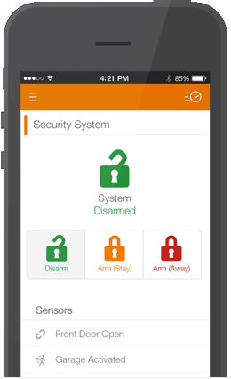
Market Research - LiveWatch
Customizable
Outside doors
Inside motion sensors
Smartphone alerts
https://www.livewatch.com

Slide 8
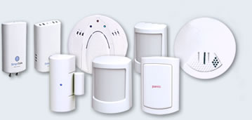
Market Research - SimpliSafe
Customizable and easy to install
Supports multiple types of sensors (e.g. motion sensor, smoke detector, CO sensor, etc.)
System supports up to 41 sensors
Sends text alerts
http://simplisafe.com

Slide 9
Solution Details

Slide 10
Issues

Slide 11
Modified Project

Slide 12
Testing

Slide 13
Demo

Slide 14
Questions?

