Slide 1
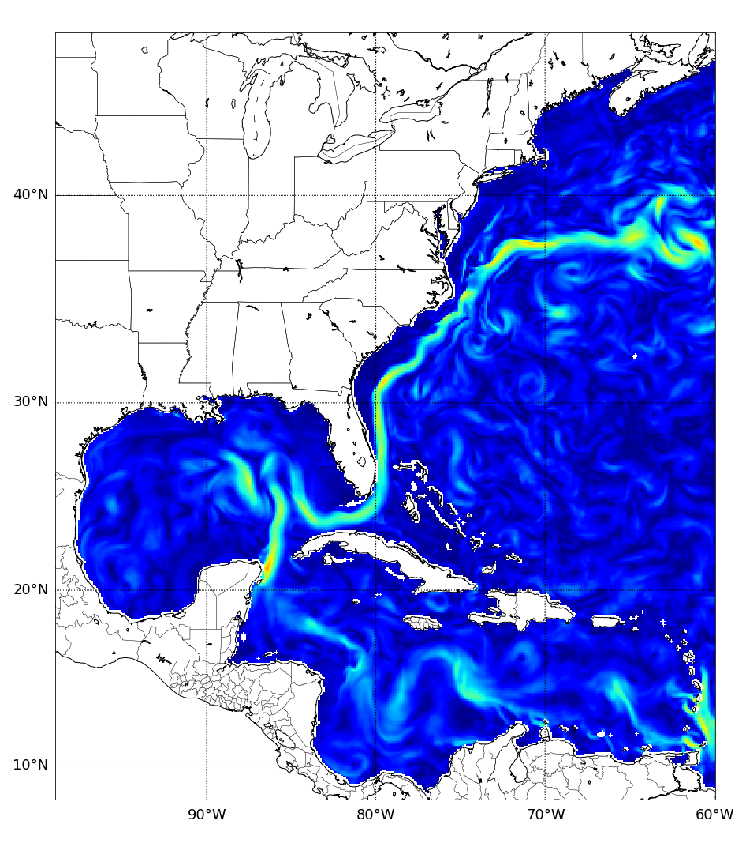
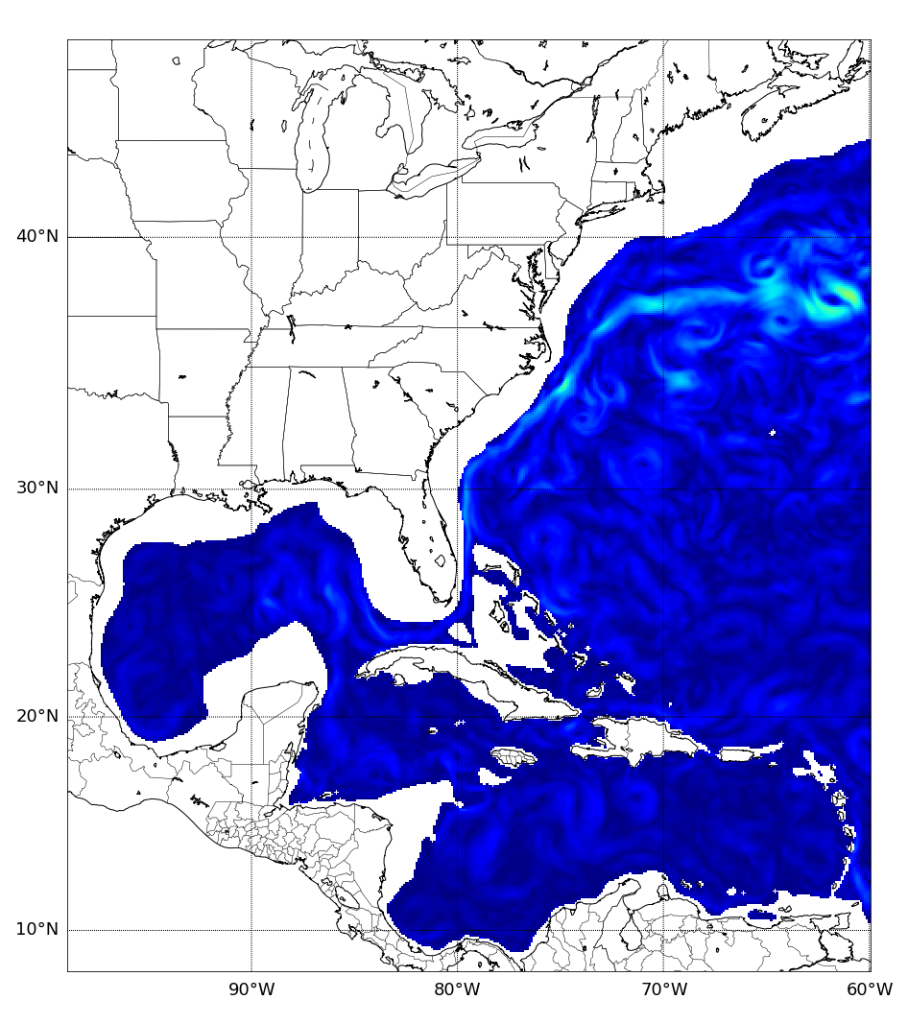
CNAPS Ocean Current Velocity (m/s)
Valid 0000 UTC 6 April 2020
Depth: 0m, Max: 1.85m/s
Depth: 500m, Max: 1.31m/s
0.0
0.5
1.0
1.5
2.0
2.5

