Slide 1
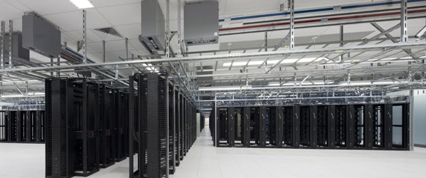

Cloud@eBay For developers and business agility
JC Martin – Cloud Architect

Slide 2
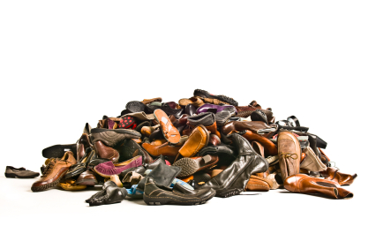



900 pairs of shoes
540 cellphones
135 pairs of men sunglasses
108 neckties

Slide 3

A new application can be deployed on 100 new servers and be ready to serve traffic in less than 45 minutes

Slide 4
2
9
2B page views/day
23
9 Petabytes of data storage
$62
23M lines of code
$69B 2011 gross merchandise volume
108
300
108M active users
300M live listings
6,000
75
6,000 application servers
75B database calls/day

Slide 5












Prod
Prod
QA
DEV
PCI
Secure
QA
DEV
QA
DEV

Slide 6
Simplify
Automate Everything
Any Application Anywhere
Plan for Failure
Proportional Security

Slide 7
SIMPLIFY

Slide 8
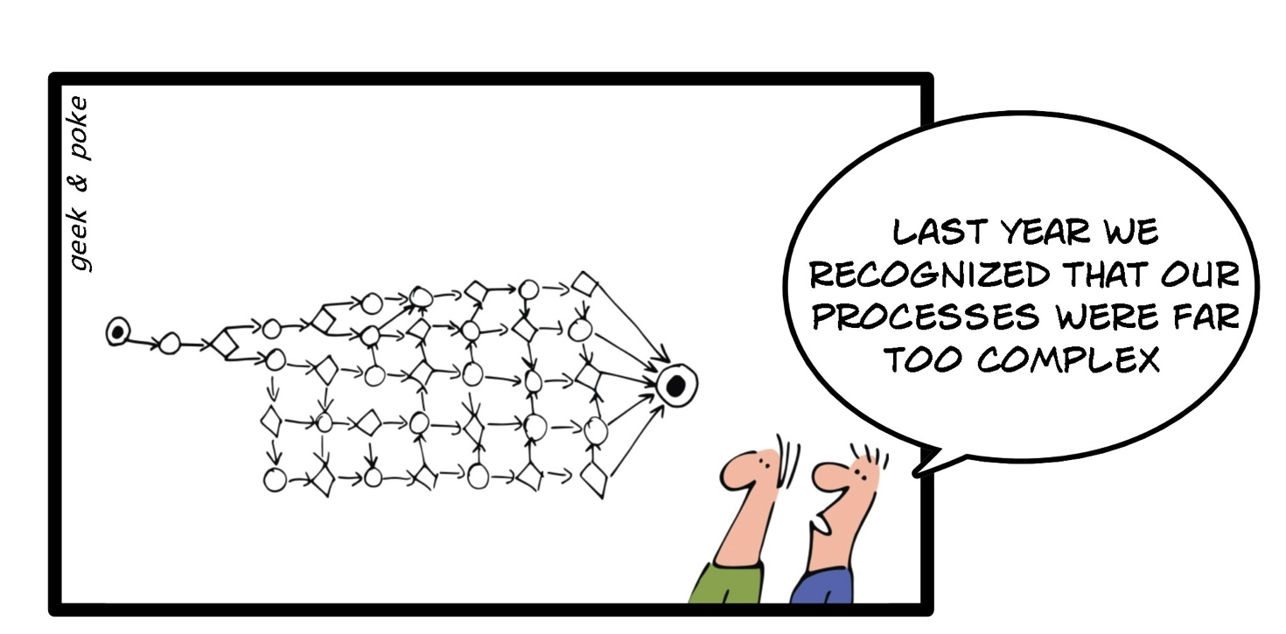
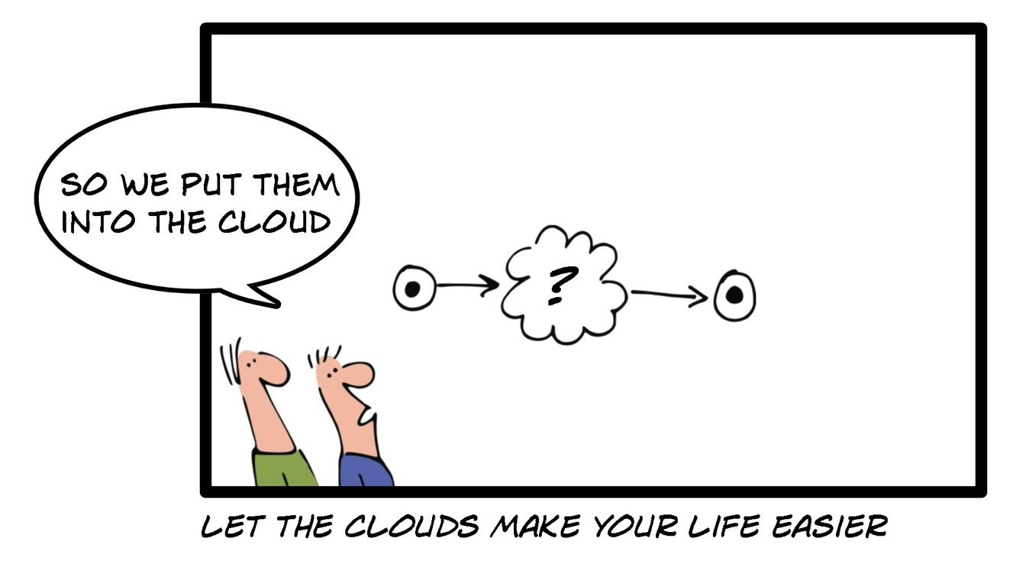
Process

Slide 9
Technology
Single SKU
Fewer models
Fewer versions
Commodity H/W
Multi vendor options
Lowest cost
Consolidate
Less platforms (e.g. OS)
Less tools
“Common denominator”
Failure will happen
Open source options

Slide 10
Organization
"organizations which design systems ... are constrained to produce designs which are copies of the communication structures of these organizations”
Conway’s law

Slide 11
Tickets are for …
Recording
Approval
Approval
Assignment
Assignment

Slide 12
AUTOMATE everything

Slide 13
Cannot be automated
The task requires human involvement (e.g. racking and wiring)
No support for
automation
Component lacks API or requires UI based actions
Limited rate of change
Configuration requires restart, reload, file sync
No permission
Configuration requires special credential/role

Slide 14
Service Catalog
REST APIs
Ticket driven run book automation
State driven close loop
automation
Monitoring
Big Data / Machine Learning
Configuration Management
Database (CMDB)
Distributed state Management
Financial Management
Pay as you go

Slide 15
Based on Openstack
Community
Vendor ecosystem
Technology
Adoption

Slide 16
Any application anywhere

Slide 17
Virtual Environments
Prod
QA
Exp.
Prod
QA
Exp.
Application
App
App
App
Application
App
App
App
Spare
spare
spare
spare
Global resource pool
Infra
Infra
Infra
Infra
Shared Infrastructure
Silos with custom design
Virtualized infrastructure

Slide 18
Network Virtualization
Overlay Networks
Physical Networks

Slide 19
Silo’ed
Virtualized / Shared
Costly to automate
Easier to automate
Specialized skills
Fewer skill sets
Low utilization
Increased utilization
Custom Order
Bulk order
Local Optimization
Global Optimization

Slide 20
Plan for failure

Slide 21

Monolithic
Functional Split
Horizontal Split

Slide 22
Single availability zone
Multiple availability zones
Multiple Fault domains

Slide 23
Proportional security

Slide 24
Class of Service
Physical Environments
Isolation/Access Control
Requirements
Support
Services
Classes of Service

Slide 25
Simplify
Automate Everything
Any Application Anywhere
Plan for Failure
Proportional Security

