Slide 1
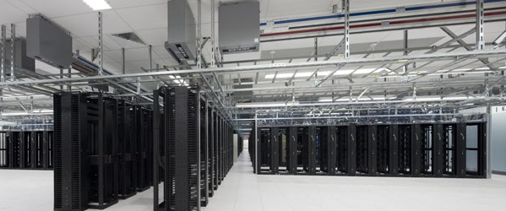
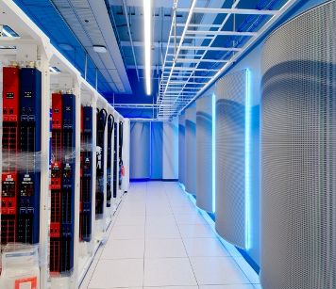
Cloud@eBay Open Network Summit 2013
JC Martin – Cloud Architect (@jchmartin)

Slide 2


Efficiency
Agility

Slide 3
Virtual Environments
Prod
QA
Exp.
Prod
QA
Exp.
Application
App
App
App
Application
App
App
App
Spare
spare
spare
spare
Global resource pool
Infra
Infra
Infra
Infra
Shared Infrastructure
Silos with custom design
Virtualized infrastructure

Slide 4
Silo’ed
Virtualized / Shared
Costly to automate
Easier to automate
Specialized skills
Fewer skill sets
Low utilization
Increased utilization
Custom Order
Bulk order
Local Optimization
Global Optimization

Slide 5
Infrastructure designed for scale
Core
4 spines
Spine
(Nx10Gb)
N leaves
Leaves
(48x10Gb)
48 -> N “½ racks”
M servers
(10Gb)

Slide 6
L2 Isolation
Dedicated Network
VLAN Based
VLAN trunk
vlan 1
Prod
QA
vlan n
Production
QA

Slide 7
L3 Isolation
ACL in network devices
Security Groups/Virtual Firewall

Slide 8
Overlay Networks
Virtual Networks using Software Defined Networks
Overlay 1
Other
Networks
Prod
QA
Overlay n
Cloud Fabric

Slide 9
COS
User environment
Private Virtual Network
Tenant
logical
router
compute
DHCP
Shared Physical Network
Public Networks
DHCP
Shared Virtual Network
Admin
logical
router
Nova
VLAN
Firewall
Quantum
DHCP agent
Hypervisor
Hypervisor
NVP Gateway
vswitch
vswitch
vswitch
NVP Service
Node
Infrastructure Network
Shared Physical
Network
Backbone
NVP Controller

Slide 10
Hardware Integration
Interoperability
Operationalization
Switch/Routers
Control Protocol
overlay “traceroute”
LB/NAS
Tunneling
Port Counters

