Slide 1
Future of DNS in Openstack

Slide 2
Use Cases
Internals (A & PTR)
Instance IPs
Floating IPs
Network Services IP (Quantum), e.g. LB VIPs
External
Simple CNAME (CNAME)
Route 53 type (ANY)

Slide 3
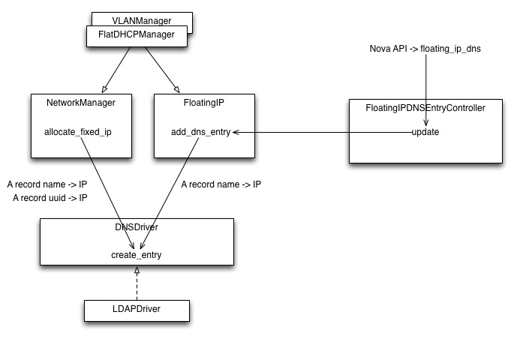
Today: Fixed & Floating IPs

Slide 4
Other implementation
Grid Dynamic’s nova-dns
https://github.com/griddynamics/nova-dns
Kiall@managedit.ie
eBay Unified DNS (Nominum+Bind)
Comcast ?
Others ?

Slide 5
Next ?
Do Nothing
Refactor nova dns code in Quantum
Align DNS with Quantum (follow melange): A/PTR
Add other record types: CNAME, A->many IP
Add more DNS Drivers
DNSaaS
Full blown DNS management : Views, zones, ANY

Slide 6
Drivers
PowerDNS / Mysql
PowerDNS/LDAP
Bind DDNS
Nominum
Windows DNS Servers

Slide 7
Implementation options
Quantum extension
Separate Service

Slide 8
Resource Model
DNS
Service
View
Policy
Template
Zone
SOA
Tenant
RecordSet
NS
A
Record
PTR
CNAME
…

Slide 9
REST API
Path | Operations | Description
/dns/templates | GET/POST | Templates to create zones
/dns/templates/<uuid> | GET/PUT/DELETE | Template management
/dns/views | GET/POST | Views/split horizon
/dns/views/<uuid> | GET/PUT/DELETE | Views management
/dns/views/<uuid>/policies | GET/POST | ACL to configure views
/dns/views/<uuid>/policies/<uuid> | GET/PUT/DELETE | Manage ACL
/dns/views/<uuid>/zones | GET/POST | DNS Zones
/dns/views/<uuid>/zones/<uuid> | GET/PUT/DELETE | Zones management
/dns/views/<uuid>/zones/<uuid>/recordsets | GET/POST | Set of multiple records
/dns/views/<uuid>/zones/<uuid>recordsets/<uuid> | GET/PUT/DELETE | Recordset management
/dns/views/<uuid>/zones/<uuid>recordsets/<uuid>/records | GET/POST | Records management
/dns/views/<uuid>/zones/<uuid>recordsets/<uuid>/records/<uuid> | GET/PUT/DELETE | Records management

Slide 10
Open question
Slave management
E.g. zone creation

