Slide 1
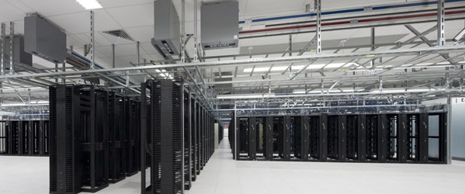
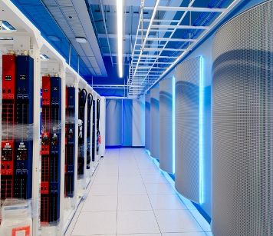
Cloud@eBay For developers and business agility
JC Martin – Cloud Architect

Slide 2
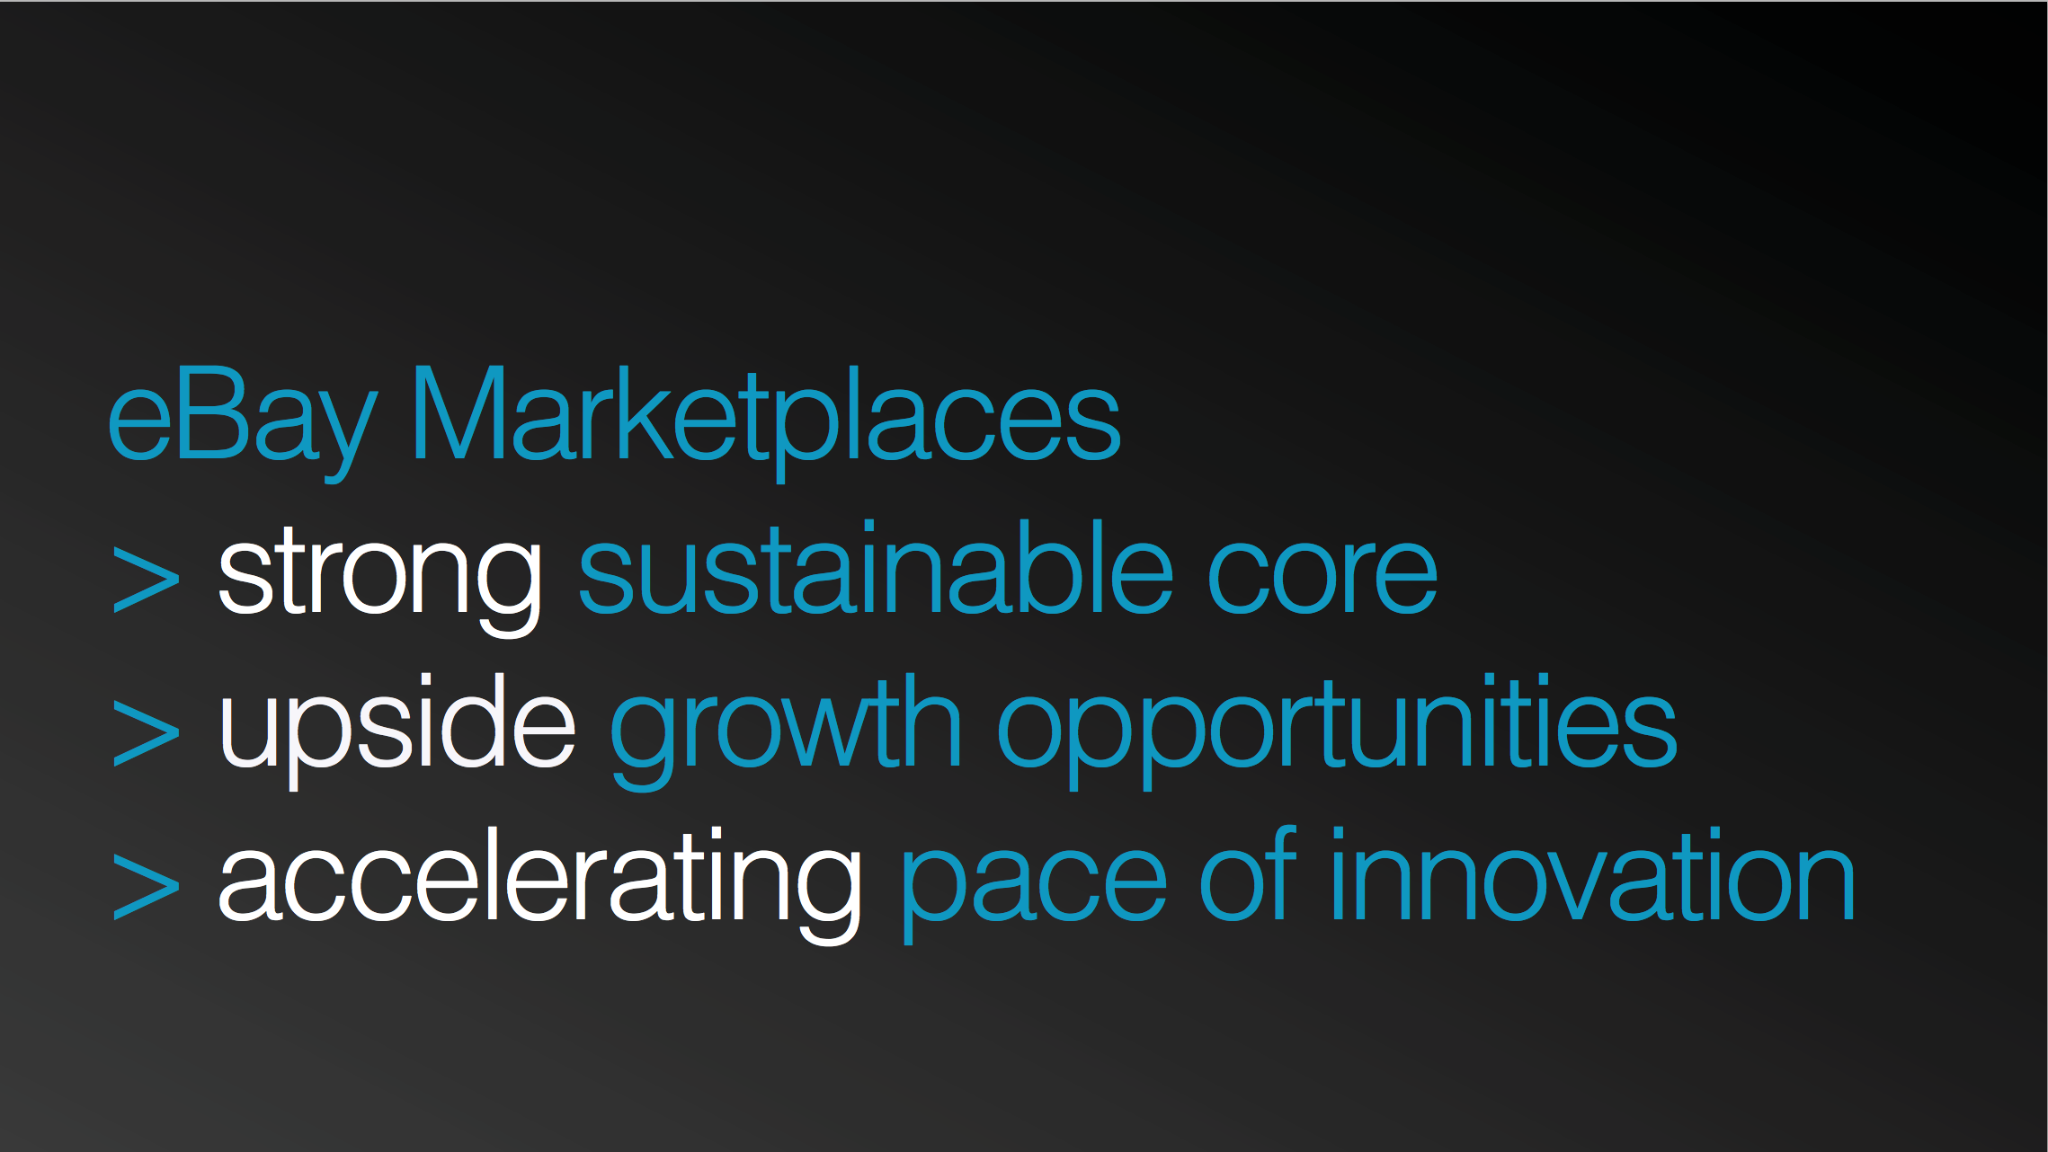
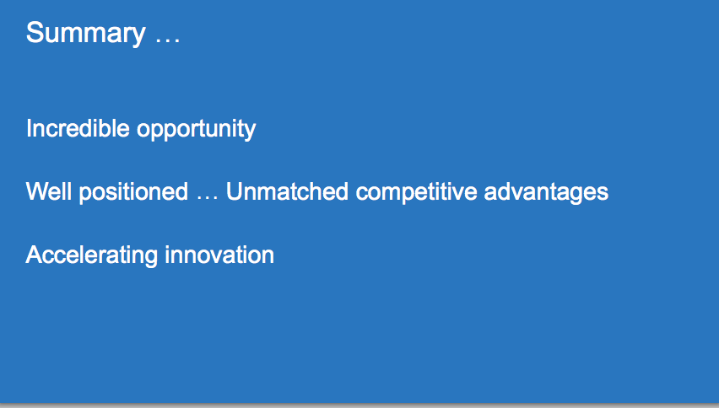
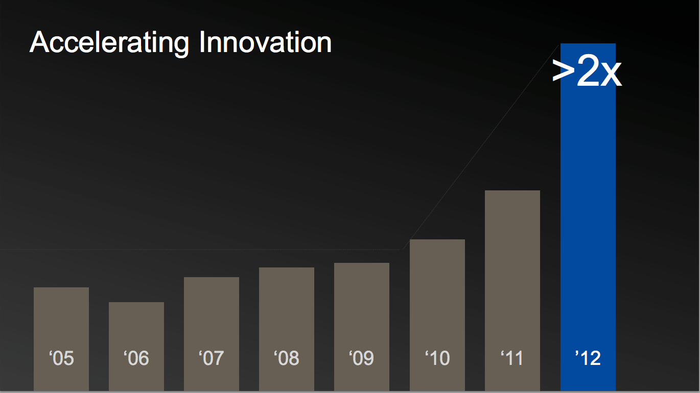
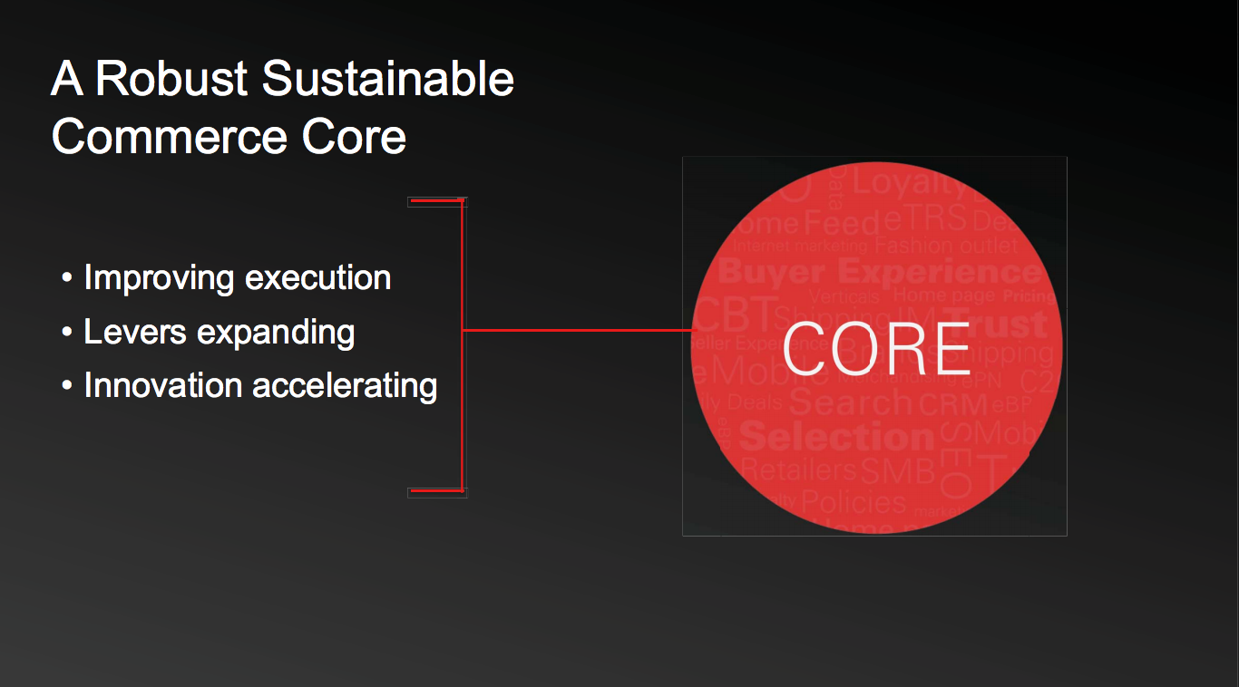
Analyst Conference 2013
John Donahoe- CEO
Bob Swan - CFO
Marc Carges - CTO
Devin Wenig – President eBay NA

Slide 3
Concretely …
30 days
30 min
Rack onboarding time
Capacity add of 50 vms
70 min
Rack bootstraping time
90 %
90 %
Site traffic on cloud
Footprint

Slide 4
Simplify
Automate
Any Application Anywhere

Slide 5
SIMPLIFY

Slide 6
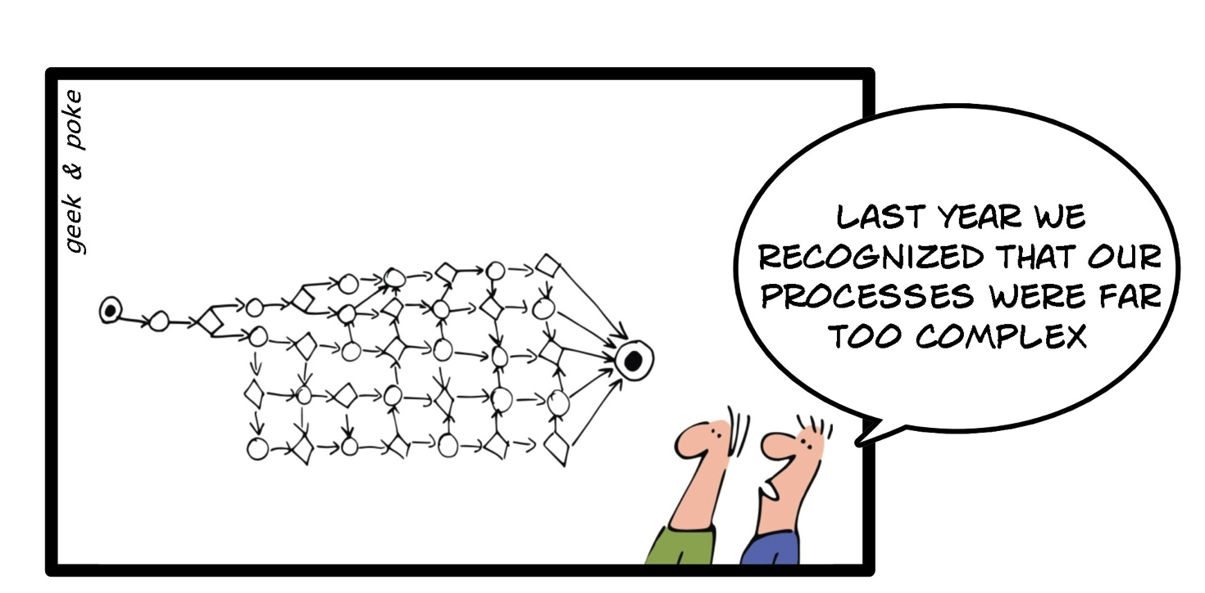
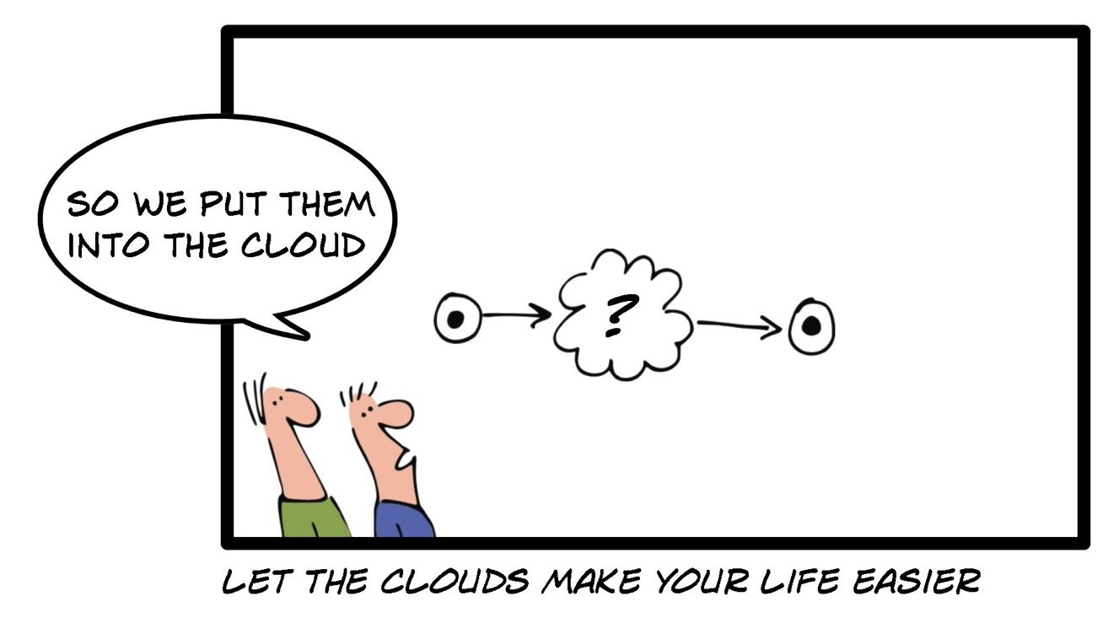
Process

Slide 7
Technology
Single SKU
Fewer models
Fewer versions
Commodity H/W
Multi vendor options
Virtualization
Standard
Based
Open Source
Standard patterns

Slide 8
Organization
"organizations which design systems ... are constrained to produce designs which are copies of the communication structures of these organizations”
Conway’s law

Slide 9
AUTOMATE

Slide 10
Cannot be automated
The task requires human involvement (e.g. racking and wiring)
No support for
automation
Component lacks API or requires UI based actions
Limited rate of change
Configuration requires restart, reload, file sync
No permission
Configuration requires special credential/role

Slide 11
Service Catalog
REST APIs
Ticket driven run book automation
State driven close loop
automation
Monitoring
Big Data / Machine Learning
Configuration Management
Database (CMDB)
Distributed state Management
Financial Management
Pay as you go

Slide 12
Platform Services
Raptor
Hadoop
DBaaS
Cassini
Platform Management Services
File distribution
Software
Deployment
Application
Deployment
Infrastructure Services
Stratus
Openstack
Baremetal
IaaS
Boostraping
Onboarding
Storage
Compute
Network
Framework services
Monitoring
Log
Aggregation
Configuration
Management
Infrastructure Management Services
Load Balancer
Management
Storage
Management
Network
Management
DNS
Management
Access
Management
Server
Management

Slide 13
Any application anywhere

Slide 14
Silo’ed
Shared
Costly to automate
Easier to automate
Specialized skills
Fewer skill sets
Low utilization
Increased utilization
Custom Order
Bulk order
Local Optimization
Global Optimization

Slide 15
Virtual Environments
Prod
QA
Exp.
Prod
QA
Exp.
Application
App
App
App
Application
App
App
App
Spare
spare
spare
spare
Global resource pool
Infra
Infra
Infra
Infra
Shared Infrastructure
Silos with custom design
Virtualized infrastructure

Slide 16

PROD
QA
Prod
QA
GSI

Slide 17
Simplify
Automate
Any Application Anywhere

