Slide 1
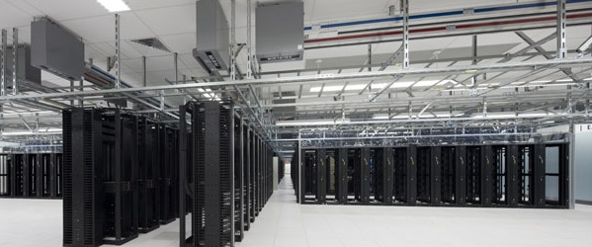

Cloud @ eBay Openstack Havana Summit
JC Martin, Cloud Architect

Slide 2


Why A CLOUD AT EBAY ?
Efficiency
Agility

Slide 3
Efficiency

Slide 4












Prod
Prod
QA
DEV
PCI
Secure
QA
DEV
QA
DEV

Slide 5
Isolated physical environments cause fragmentation
Prod
QA
Exp..
Costly to automate
Application
App
App
App
Specialized skills
Low utilization
Spare
spare
spare
spare
Custom Order
Infra
Infra
Infra
Infra
Local Optimization
Silos with custom design

Slide 6
Agility

Slide 7





“Build to Order” leads to delays
request
deliver
order
receive & rack & wire
“several”
weeks
3 w
1 w
“BTO is the oldest style of order fulfillment and is the most appropriate approach used for highly customized or low volume products.”
- wikipedia

Slide 8
Automation barriers
Cannot be automated
The task requires human involvement (e.g. racking and wiring)
No support for
automation
Component lacks API or requires UI based actions
Limited rate of change
Configuration requires restart, reload, file sync
No permission
Configuration requires special credential/role

Slide 9
eBAY ON PREMISE CLOUD

Slide 10
Goals
Provide a multitenant cloud infrastructure
Allow easy onboarding of acquisitions
Provide an Public Cloud like user experience
Allow easy integration of 3rd party developers
Increase developer productivity and fun
Support eBay Inc. production use cases

Slide 11
Virtualization of physical environments
Virtual Environments
Prod
QA
Exp..
Prod
QA
Exp.
Application
App
App
App
Application
App
App
App
Spare
spare
spare
spare
Global resource pool
Infra
Infra
Infra
Infra
Shared Infrastructure
Silos with custom design
Virtualized infrastructure

Slide 12
Classes of Service
Production
DEV
Obligations | Restrictions | Capabilities
QA Approved Builds | Proxied Internet | Core DB access
Prod OS version | No Corp Access | 24/7 Incident Mgt
Monitoring | No QA Access | Site traffic Access
Obligations | Restrictions | Capabilities
Corporate policies | Limited Prod Access | Full root
 | Limited QA Access | Corp identity
 | No site Traffic | Filtered Internet
Experimentation
Obligations | Restrictions | Capabilities
 | No Prod Access | Private networks
Certified OS Versions | No Corp Access | 24/7 Incident Mgt
Self Monitoring | No QA Access | Full Internet Access

Slide 13
Virtual Environment
Class of Service
Physical Environment

Slide 14










Infrastructure
As a Service
Ops
Excellence
SEC
Onboarding &
Capacity
management
Cloud
‘NOC’
Cloud Infrastructure
Hosting
On demand
compute
storage
network
LB
DNS
Fulfillment &
Supply Chain
Network &
Environmental
‘NOC’
Datacenter Infrastructure
datacenters
racks
firewalls
networks
CDN

Slide 15

Openstack compliant Compute, Network, & Storage
OpenStratus
Self Service Portal
CLI
REST API
Bare Metal
Compute, LB
Cloud Formations
eBay
Glue
Monitoring & administration
Virtual
Compute
Block & Object
Storage
Virtual
LB
Virtual
DNS
Virtual
Networks
Stratus
Bare Metal
Onboarding
OS Provisioning
DNS
Provisioning
LB Provisioning

Slide 16
Virtual Compute on demand
Block and Object Storage
Virtual Networks
Load Balancer Service on demand (private/public)
DNS Service on demand (private zones / public zones)

Slide 17
Network virtualization
COS
User environment
Private Virtual Network
Tenant
logical
router
Public Networks
compute
DHCP
Shared Physical Network
DHCP
Admin
logical
router
LB
Nova
Shared Virtual Network
VLAN
Firewall
Quantum
DHCP agent
Hypervisor
Hypervisor
NVP Gateway
vswitch
vswitch
vswitch
NVP Service
Node
LB
Infrastructure Network
Shared Physical
Network
Backbone
NVP Controller

