Slide 1

Book Recommendation System
Timeline: October 5th - December 15th
Xiaohui Chen - Rajendra Bhagroo - Shelly Gupta

Slide 2
Problem & Goal

Slide 3
Problem & Goal
What do you want to solve? - Why do you think it is important? - What results do you expect?
Problem
Users need a recommendation system that is relevant in regards to a users rating history.
Goal
Our goal is to use collaborative filtering and information retrieval techniques to recommend books users are likely to read.
We think this is important because we are avid readers who experience sub-optimal recommendations based on book categories rather than on the book contents.
We expect to accurately recommend at least three books based on previous user ratings.

Slide 4
Formalization Into IR Related Task
How Is Our Project Related To IR?

Slide 5
Formalization Into IR Related Task
How is our project related to IR?
Collaborative Filtering & Recommender System
For our project we will implement a collaborative filtering recommendation system. We will apply ALS (alternating least squares) algorithm in Spark.ml library to do model-based collaborative filtering.
Unlike user collaborative filtering and item collaborative filtering, model-based collaborative filtering does not directly predict the new items or give recommendations for different users, instead it will train a model based on user preference data and use the model to do predictions and compute recommendations.
Matrix factorization, take latent factors into account -> predict ratings for new items
Throw new data into training set and update the ALS Model each time.
Notes:
/* MLlib fits into Spark's APIs and interoperates with NumPy in Python and R libraries. You can use any Hadoop data source (e.g. HDFS, HBase, or local files), making it easy to plug into Hadoop workflows. High-quality algorithms, 100x faster than MapReduce. Runs everywhere Spark runs, on Hadoop, Apache Mesos, Kubernetes, standalone, or in the cloud, against diverse data sources. */

Slide 6
Data Plan

Slide 7
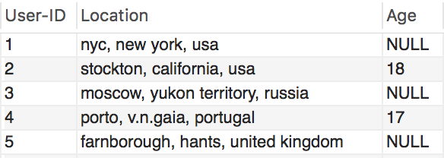
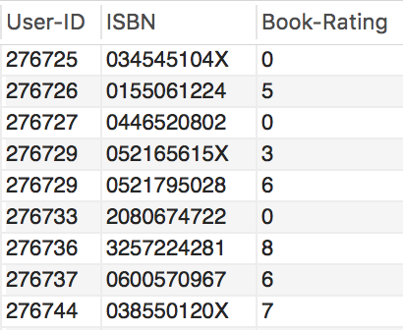
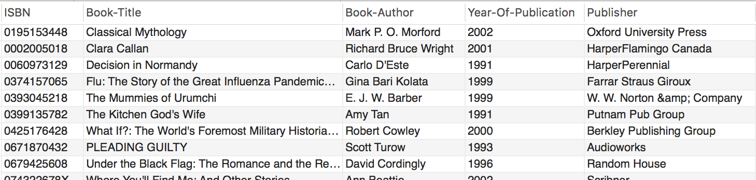
Data Plan
What kind of data? - Where and how do you get the data?
What Kind Of Data?
CSV Data
Book-Crossing data set
Information about…
Users (User-ID, Location, Age)
Books (ISBN, Book-Title, Book-Author, Year-Of-Publication, Publisher)
Book Ratings (0-10)
Where Will We Get Our Data?
http://www2.informatik.uni-freiburg.de/~cziegler/BX/
Improving Recommendation Lists Through Topic Diversification,
Cai-Nicolas Ziegler, Sean M. McNee, Joseph A. Konstan, Georg Lausen; Proceedings of the 14th International World Wide Web Conference (WWW '05), May 10-14, 2005, Chiba, Japan. To appear.
* Data needs to be cleaned before we process with it.

Slide 8
Schedule

Slide 9
Schedule
November 2nd - November 9th (Week 1)
Project Setup (Github, Jupyter Notebook, Etc)
Refine Project Plan
Book-Crossing Dataset - Processing Into dataframe & Cleaning data
November 9th - November 16th (Week 2)
Construct our model
Use Spark Library to manipulate Book Crossing Dataset & Finalize our model
November 16th - November 23rd (Week 3)
Begin User Interface Design
Tweak model & prepare interface from model to UI
November 23rd - November 30th (Week 4)
Finish UI
Merge UI with Model
Begin technical documentation
November 30th - December 7th (Week 5)
Testing & Debugging of model and interface
Refine & finish technical documentation

