Slide 1

Book Recommendation System
Timeline: October 5th - December 15th
Xiaohui Chen - Rajendra Bhagroo - Shelly Gupta

Slide 2
Problem Statement

Slide 3
Problem Statement
Online recommendation systems have become a trend in recent history.
Recommendation systems are broadly used to recommend specific products to end users based on user statistics.
A recommendation system is one of the strongest tools to increase profits and retain customers and increase customer satisfaction.
The existing systems lead to extraction of irrelevant information and lead to lack of user satisfaction.

Slide 4
Model

Slide 5
Data preprocessing
BX-Books.csv, BX-Users.csv, BX-Book-Ratings.csv
Dataset we use: Collected by Cai-Nicolas Ziegler in 2004 from August - September from the Book-Crossing community with kind permission from Ron Hornbaker, CTO of Humankind Systems. Contains 278,858 users (anonymized but with demographic information) providing 1,149,780 ratings (explicit / implicit) about 271,379 books.
http://www2.informatik.uni-freiburg.de/~cziegler/BX/
Drop image urls of book dataset
Replace nAn for string-type values with ‘unknown’ after double check
Check data validity & fix data type problems
i.e. yearOfPublication contains some non-integer values, values for different columns were misplaced.
Fix logical data problems
i.e. yearOfPublication should be less than 2004 (dataset publication year) and greater than 0
i.e. age of users should be within a reasonable range (5, 90)
Replace nAn for integer-type values with the arithmetic mean of other values in that column
Fix data consistency problems
i.e. all books exist in the rating dataset should also exist in the book dataset
I.e. all users exist in the rating dataset should also exist in the user dataset

Slide 6
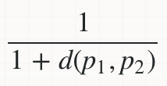
Algorithm
Collaborative Filtering using Euclidean Distance
Core idea of collaborative filtering
Compute Distance-based Similarity
Euclidean Distance: the square root of the sum of squared differences between corresponding elements of the two vectors.
Similarity:
Inversely Proportional

Slide 7
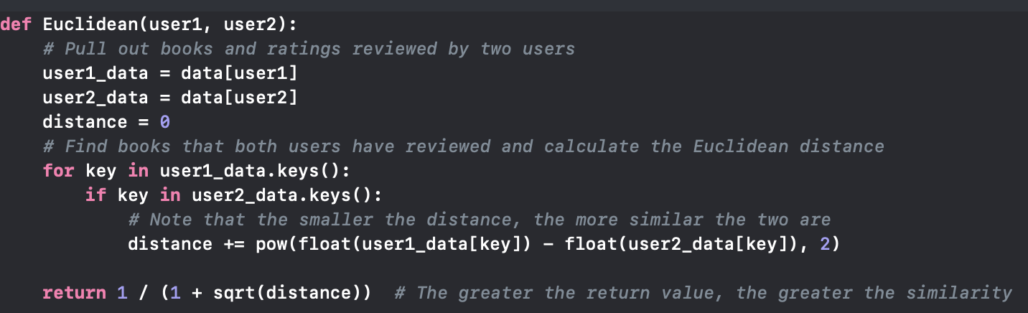
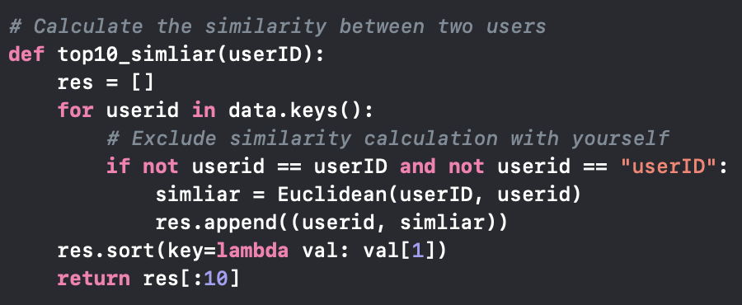
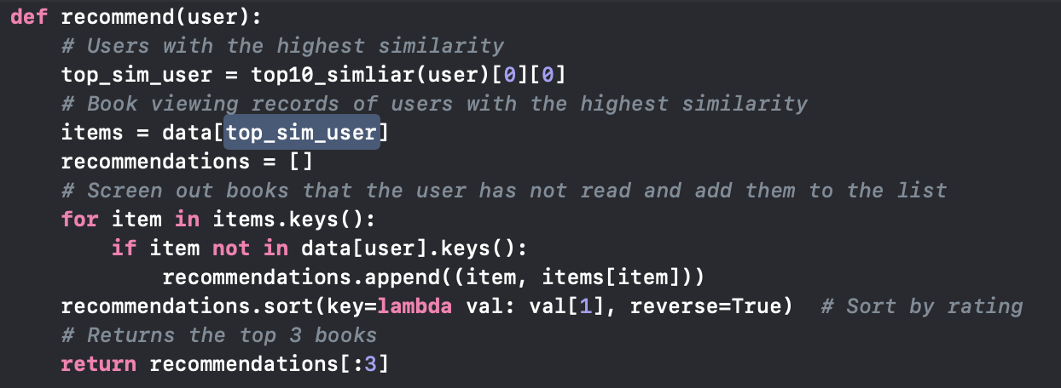
Code
books = pd.read_csv('BX-Books.csv', sep=';', error_bad_lines=False, encoding="cp1252")
users = pd.read_csv('BX-Users.csv', sep=';', error_bad_lines=False, encoding="cp1252")
ratings = pd.read_csv('BX-Book-ratings.csv', sep=';', error_bad_lines=False, encoding="cp1252")
--------------------------------------------------- After Data Cleaning ----------------------------------------------------------
data = pd.merge(books, ratings, on='ISBN')
data[['userID', 'bookRating', 'ISBN', 'bookTitle']].sort_values('userID').to_csv('data.csv', index=False)
* data contains the book and rating for each user
------------------------------------------------------------ Computation-----------------------------------------------------------

Slide 8
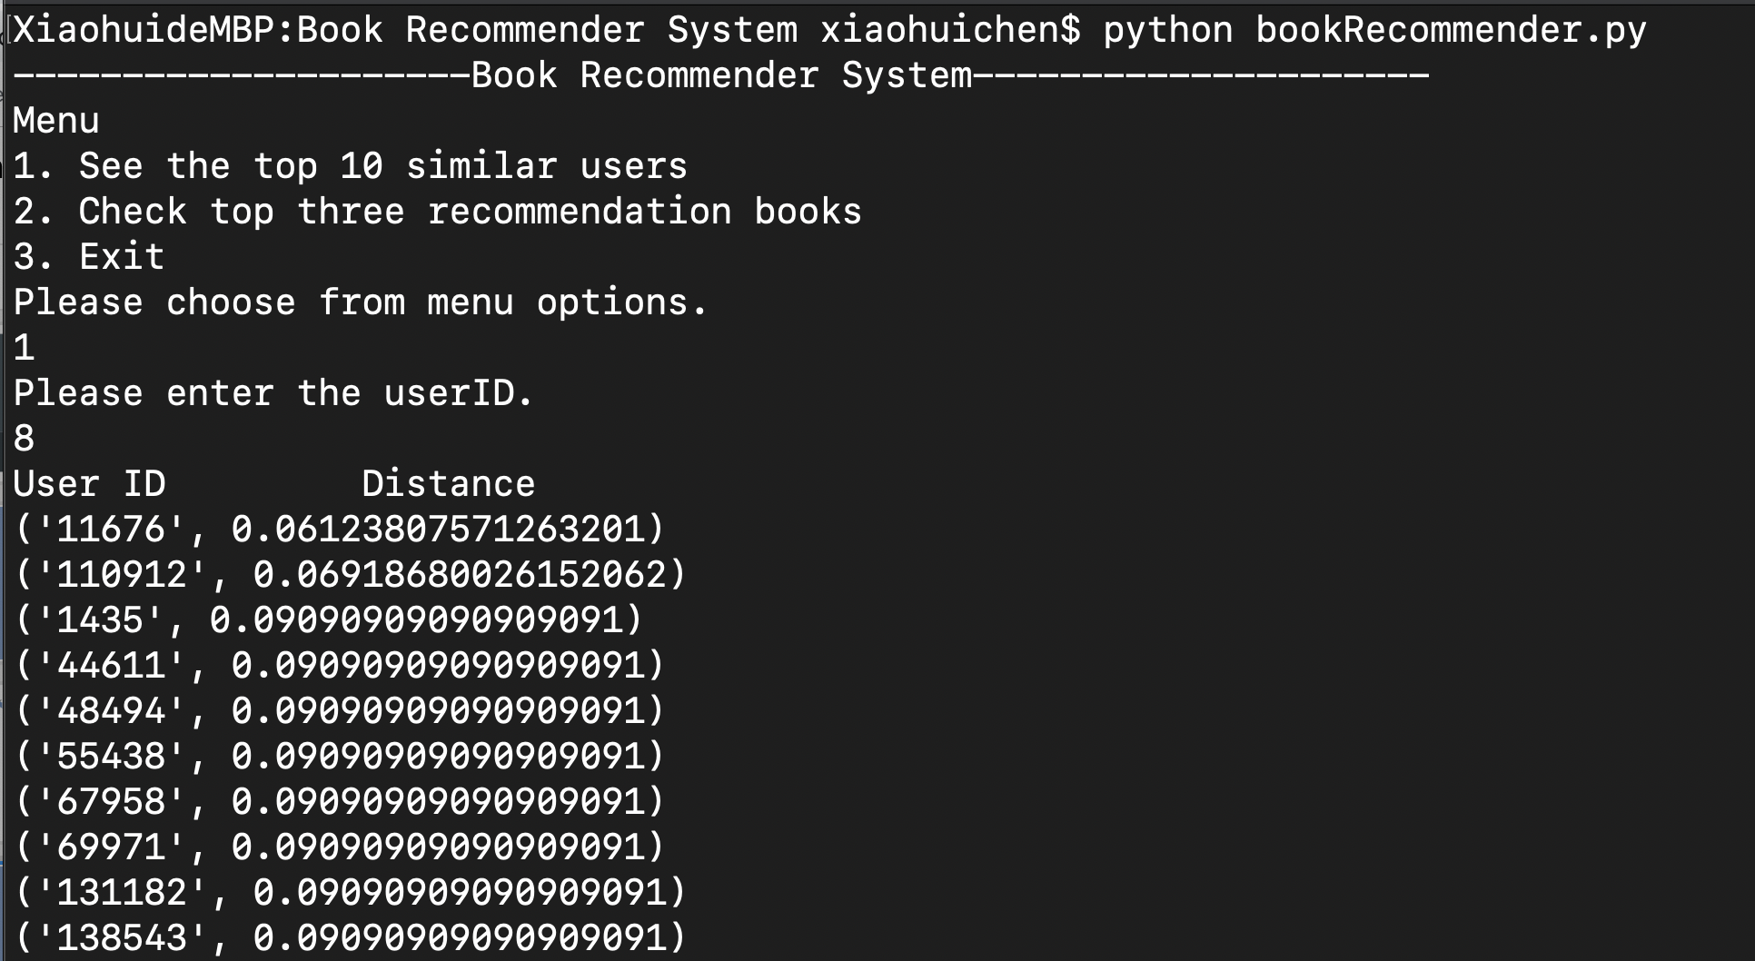
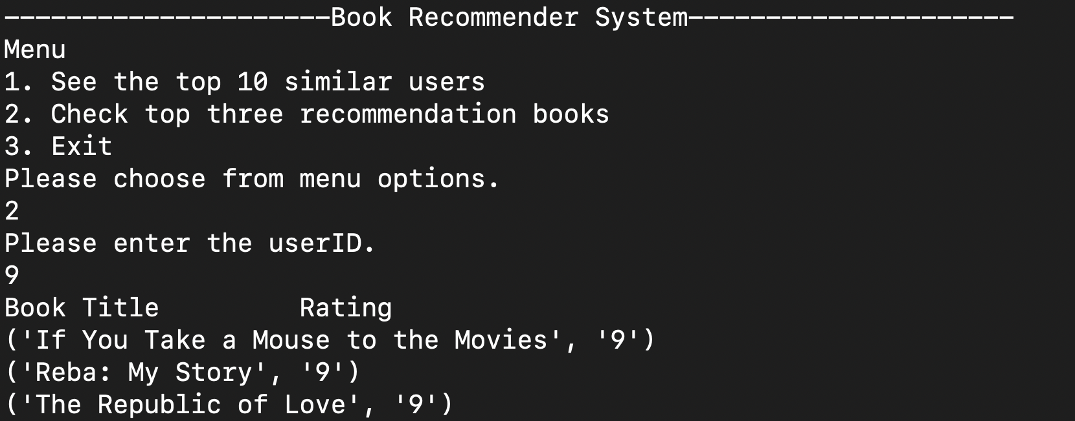
See top10 similar users
See top3 recommendation books

Slide 9
User Interface

Slide 10
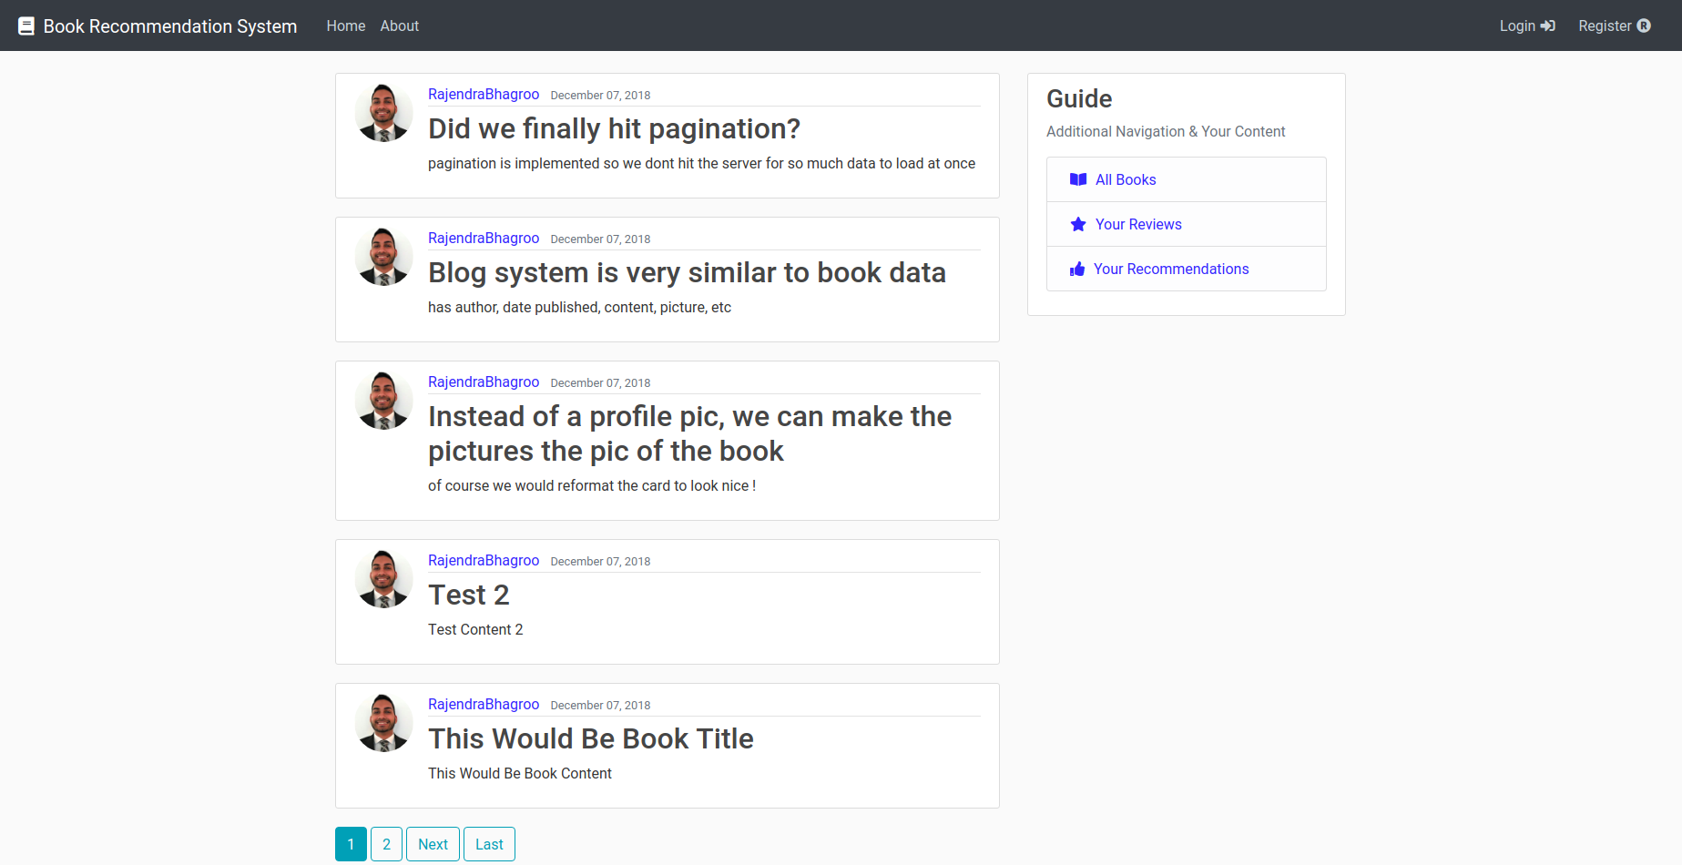
User Interface
Django
Our User Interface was developed in Python using the Django Framework

Slide 11
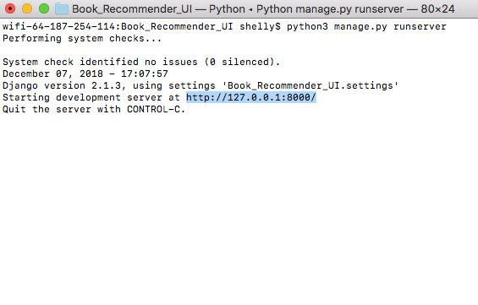
Running the Server

Slide 12
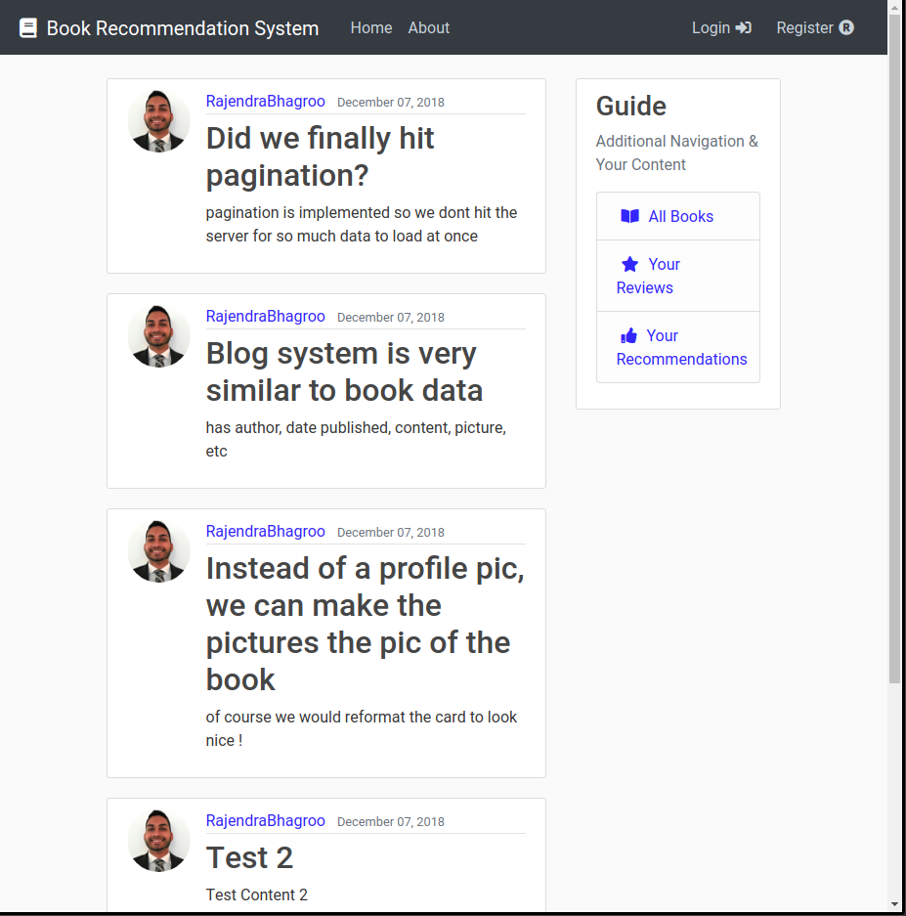
Homepage
Blog

Slide 13
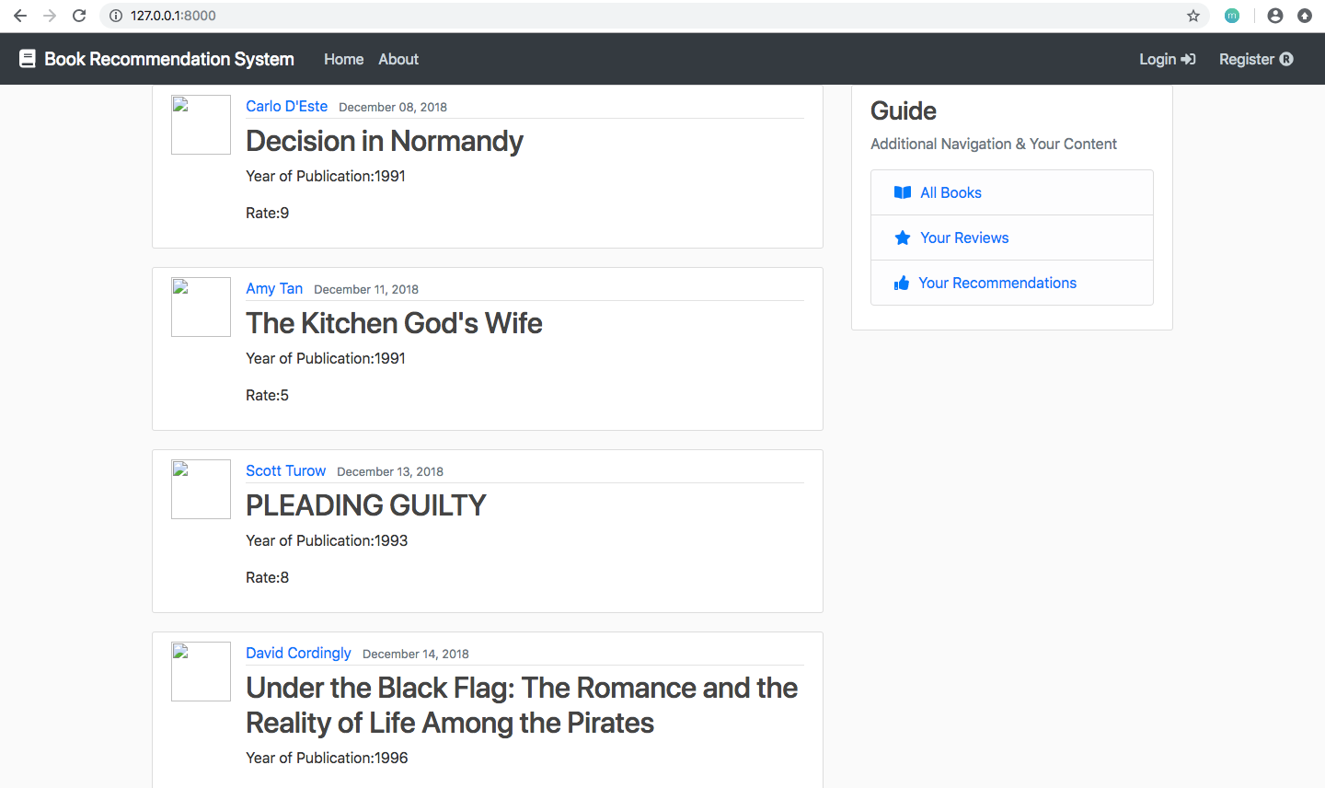
Homepage
Books

Slide 14
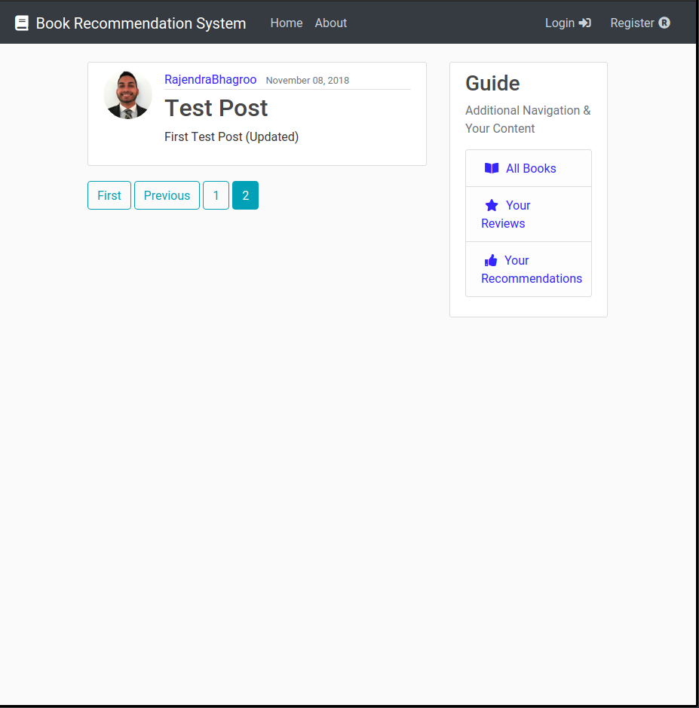
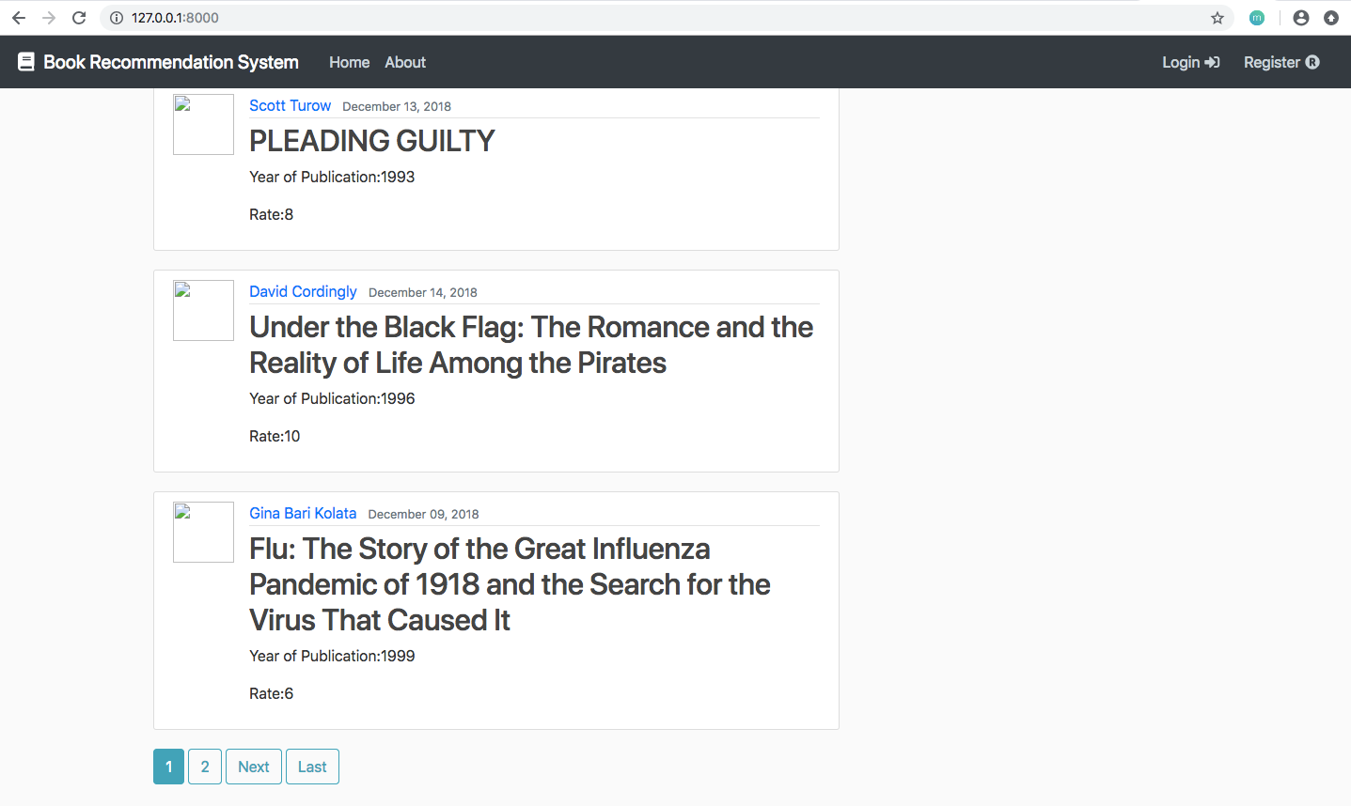
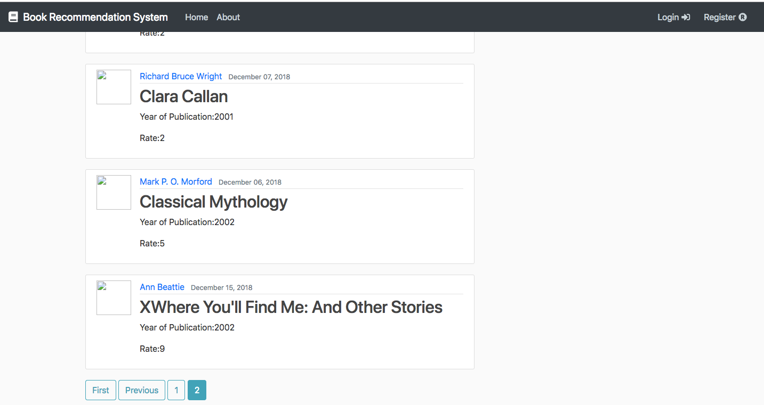
Pagination

Slide 15
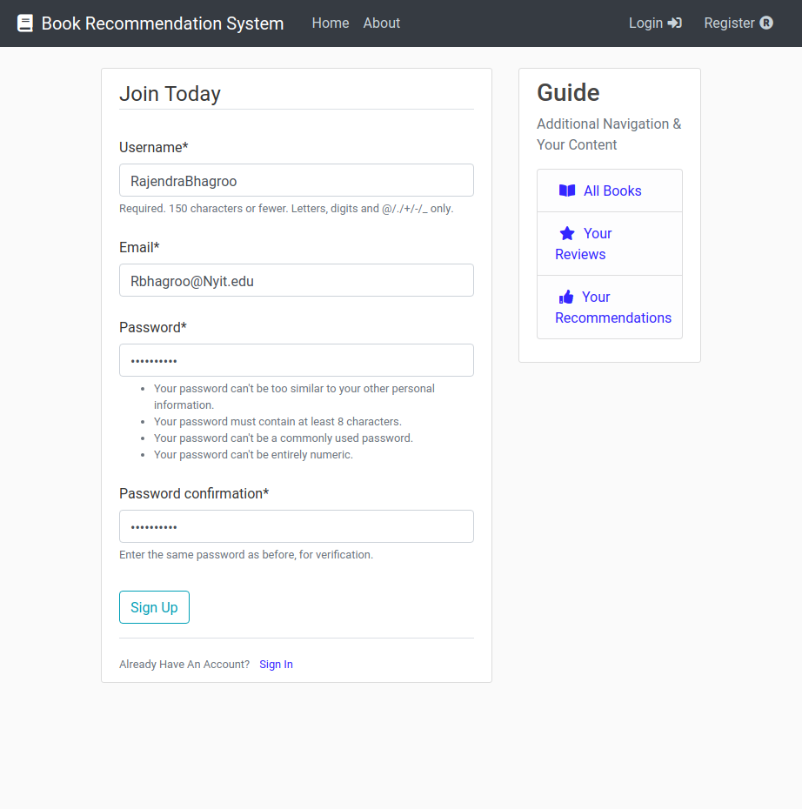
Register

Slide 16
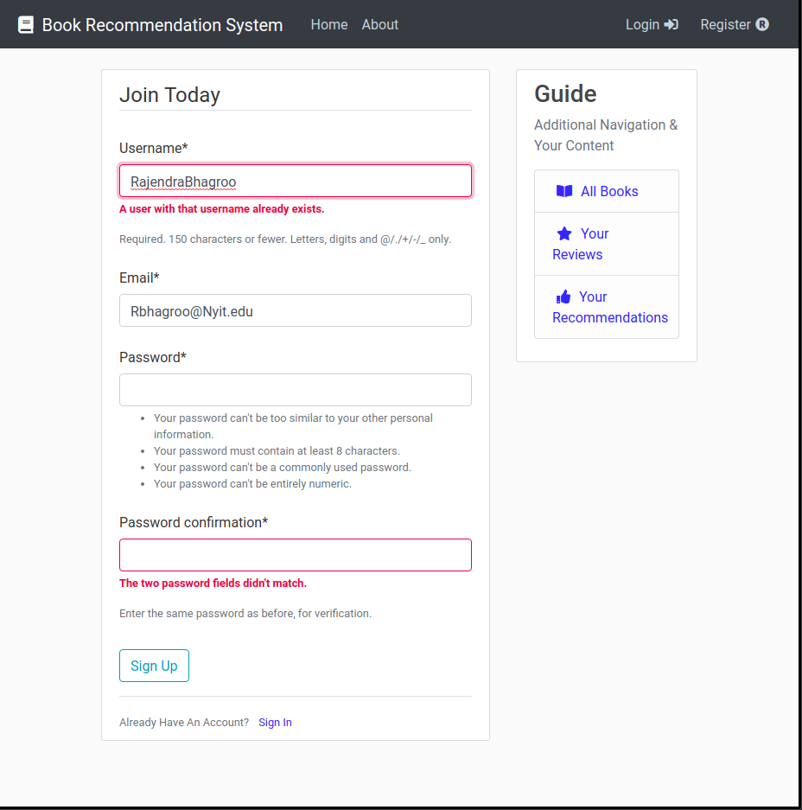
Register
Verification

Slide 17
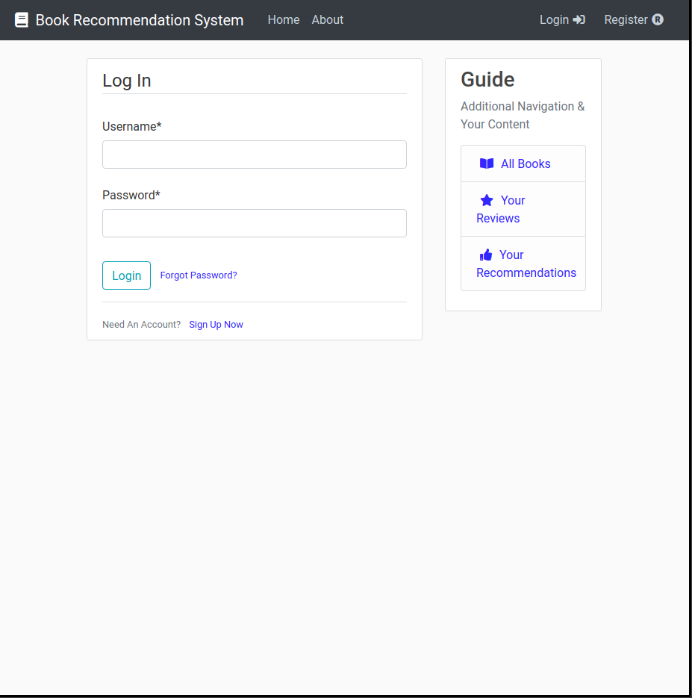
Login

Slide 18
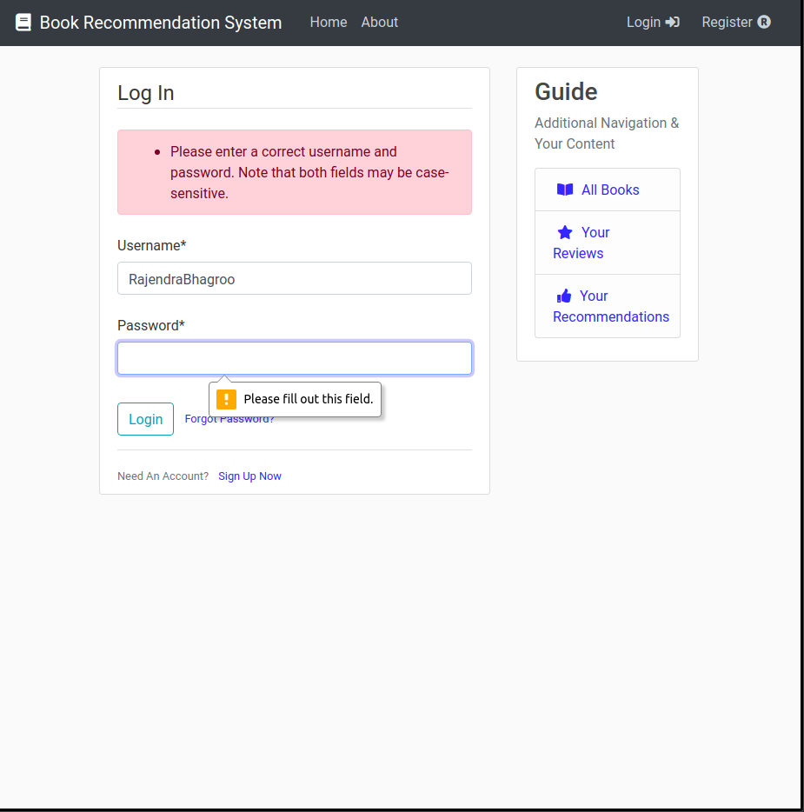
Login
Verification

Slide 19
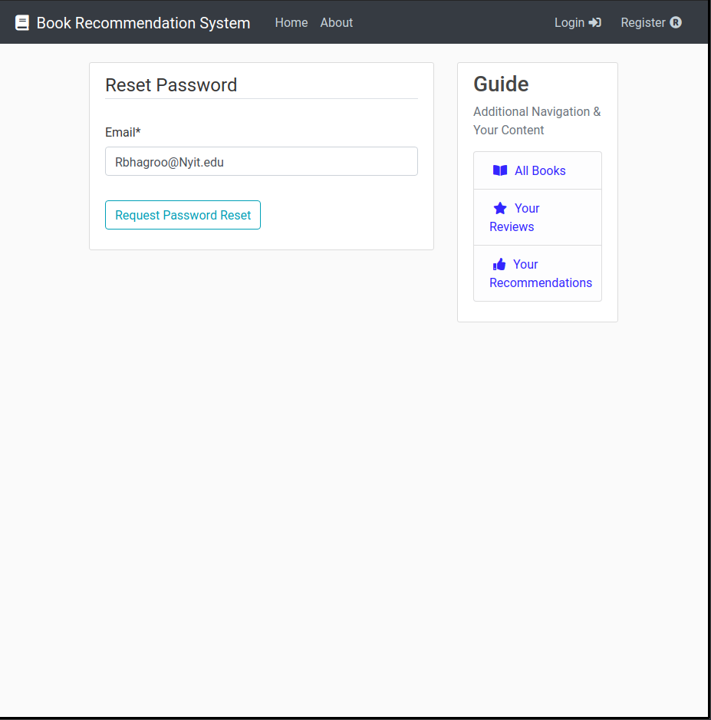
Password
Reset

Slide 20
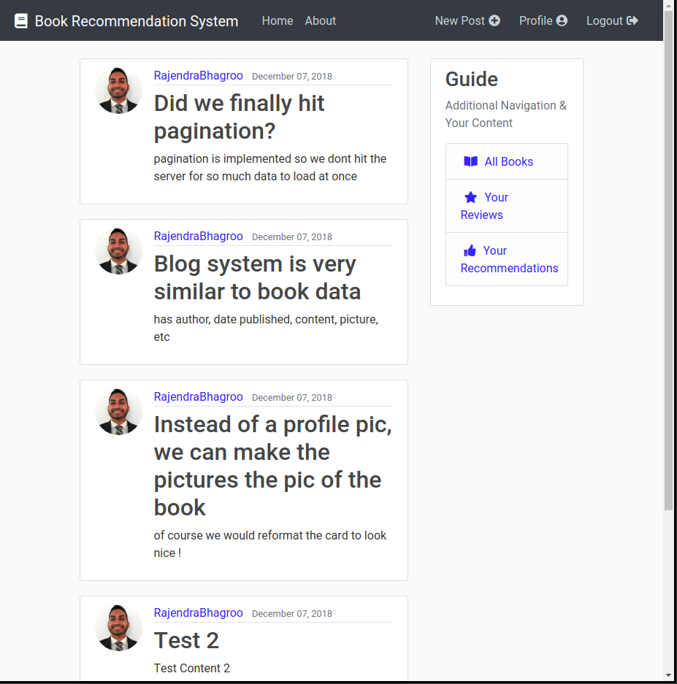
Logged
In
Note: Top Right Bar Changed

Slide 21
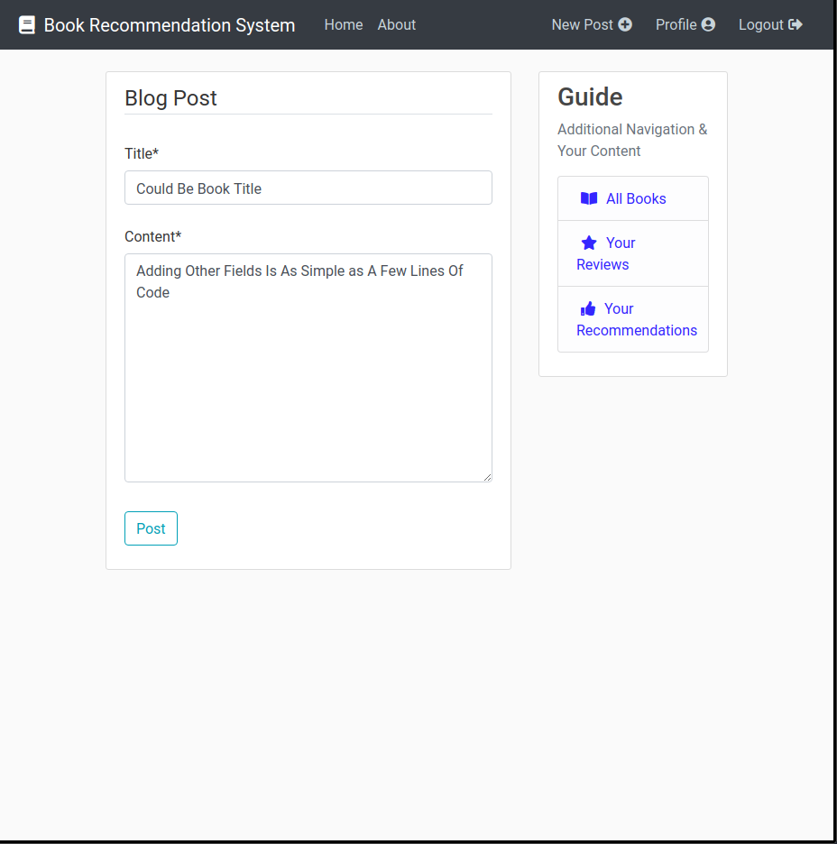
New Post
If this was book recommender, new book!

Slide 22
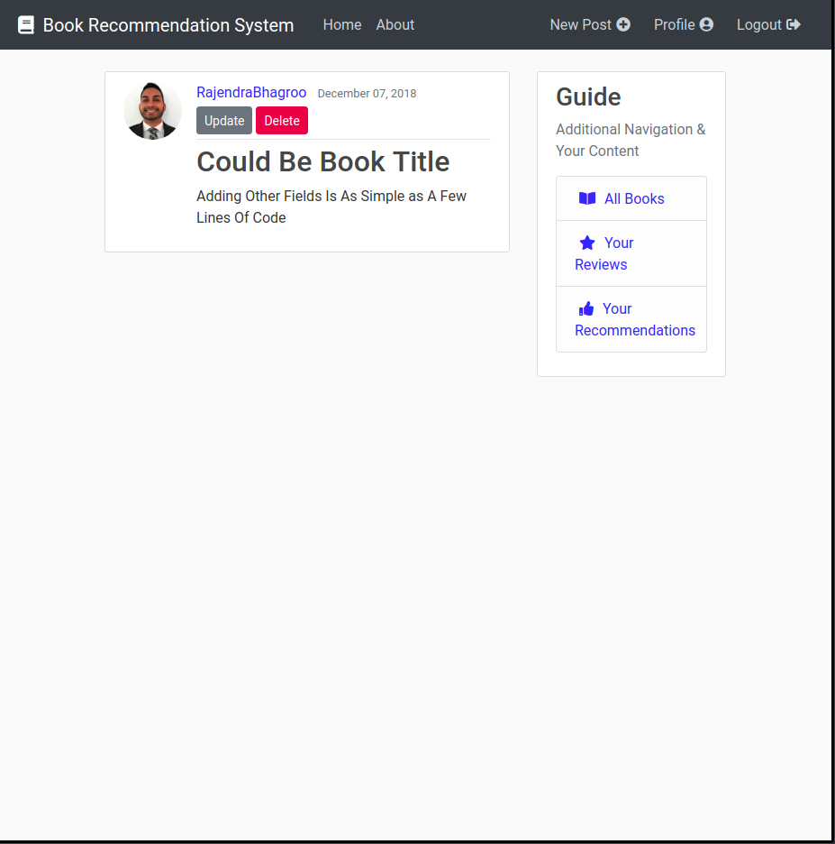
Post
Update / Delete
Only the original user can edit post when logged in

Slide 23
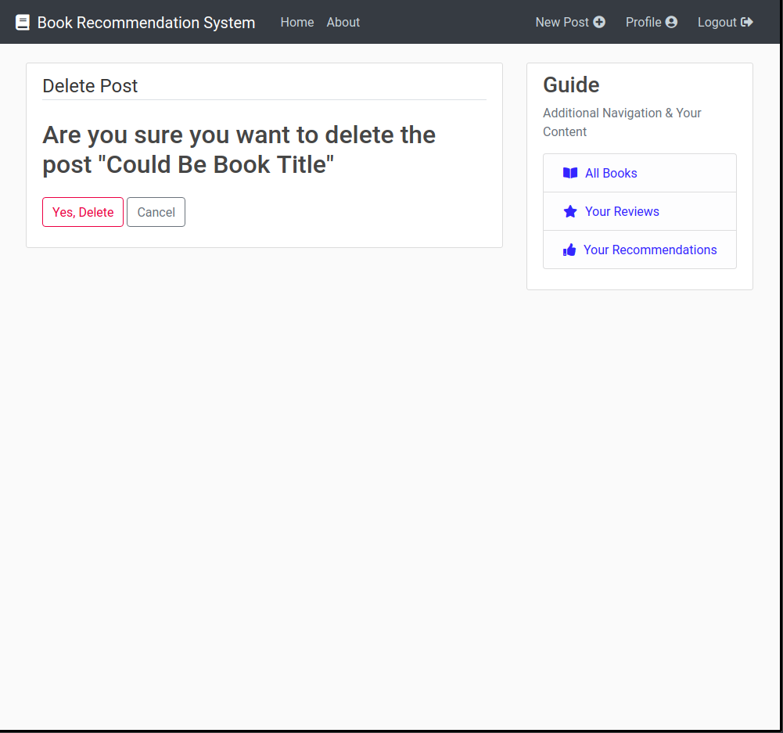
Delete
Post

Slide 24
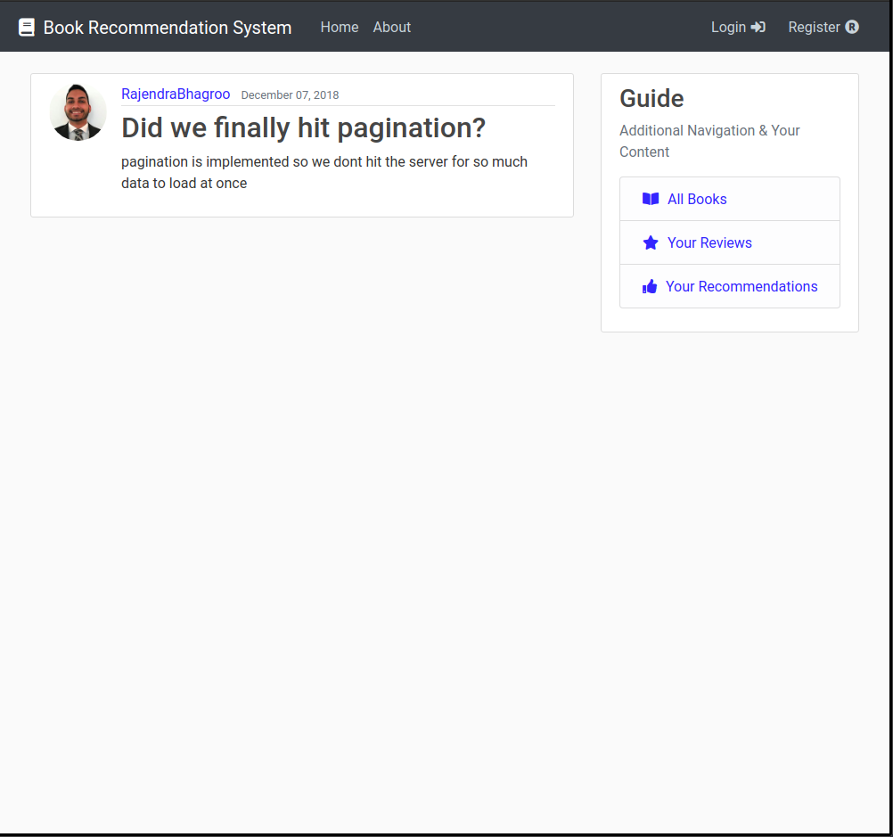
Logged Out
Post

Slide 25
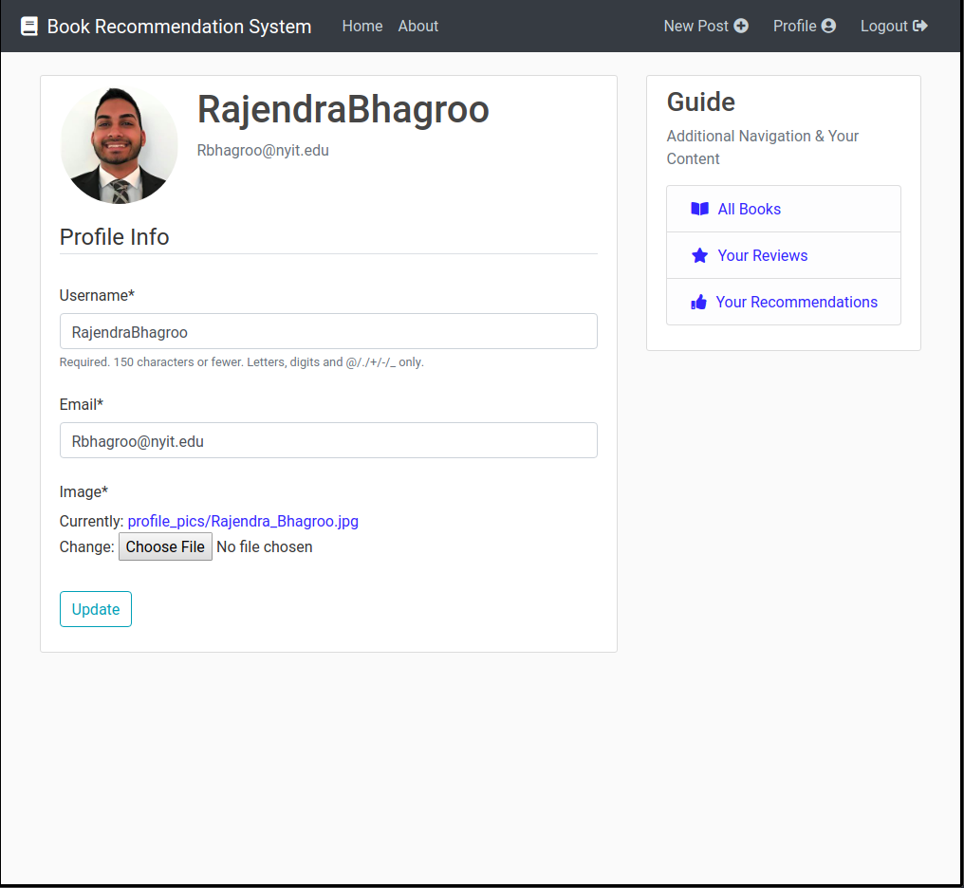
Profile

Slide 26
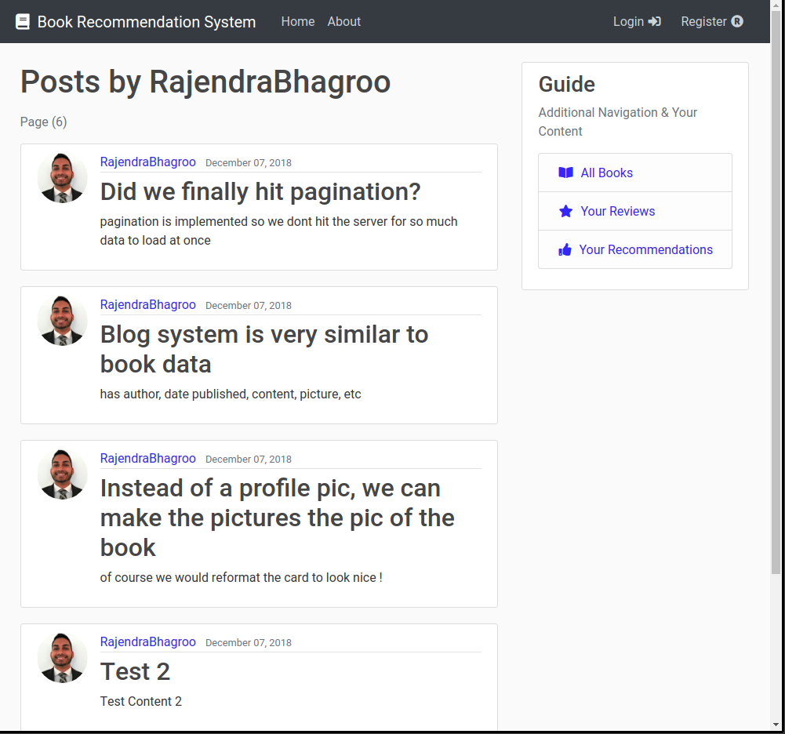
Posts By User

Slide 27
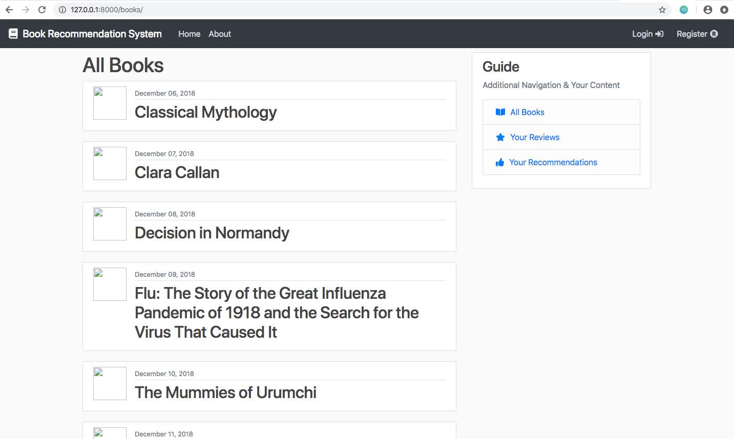
All Books

Slide 28
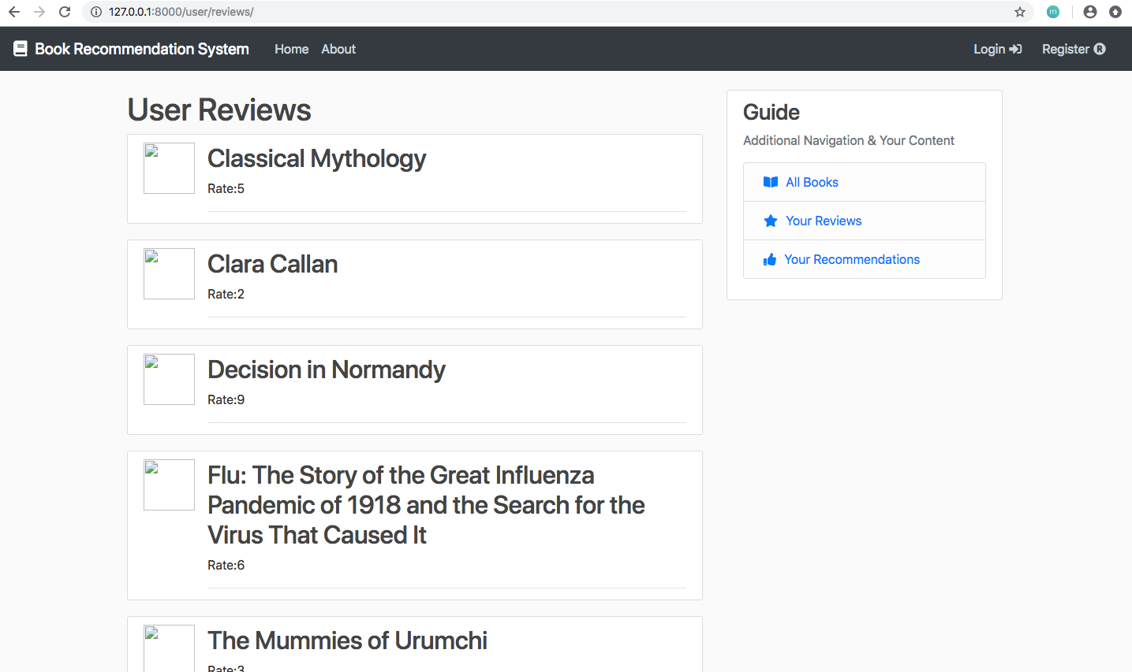
User
Reviews

Slide 29
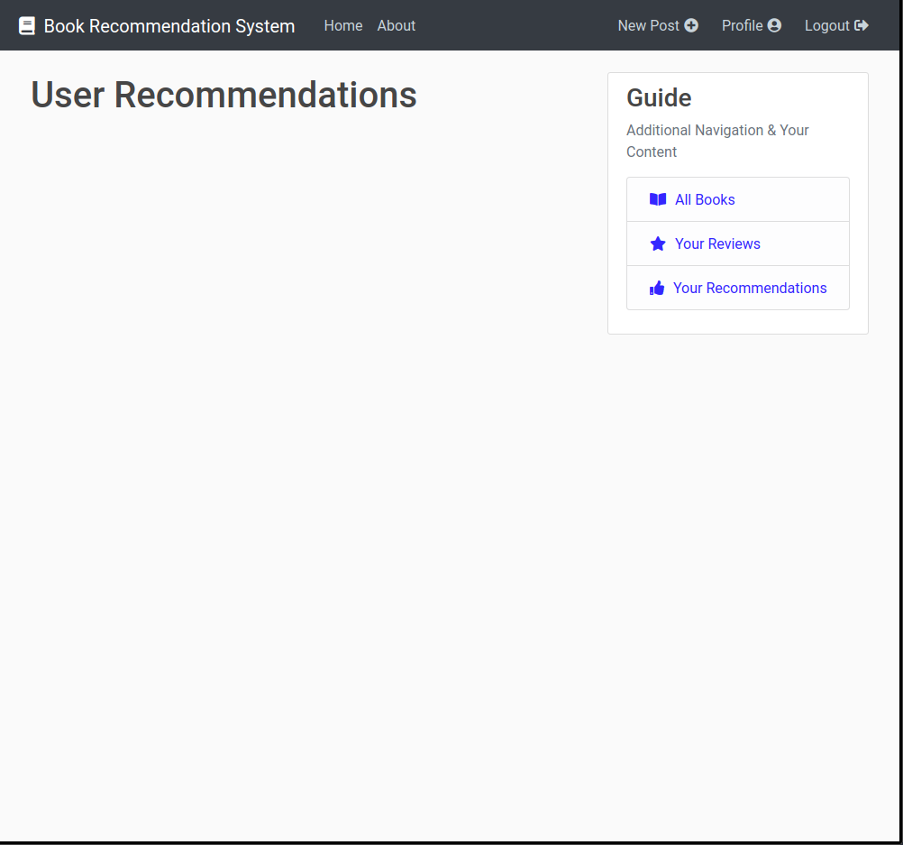
User Recommendations

Slide 30
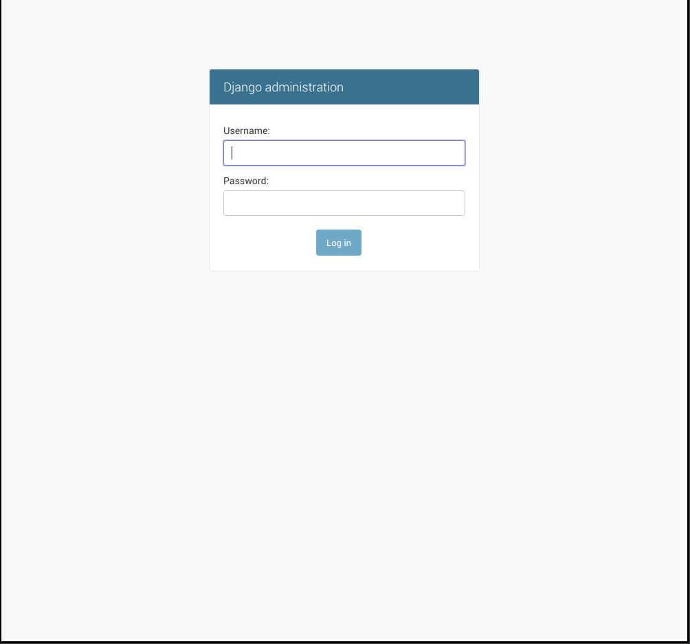
Django
Admin

Slide 31
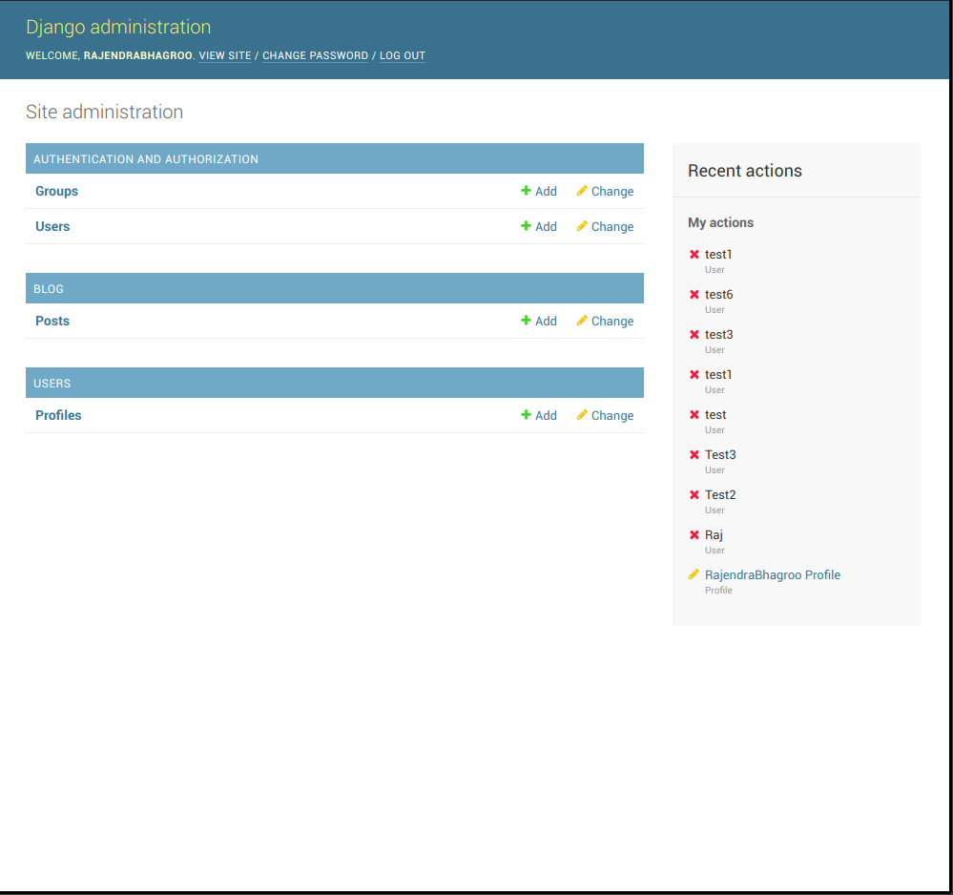
Admin
Homepage

Slide 32
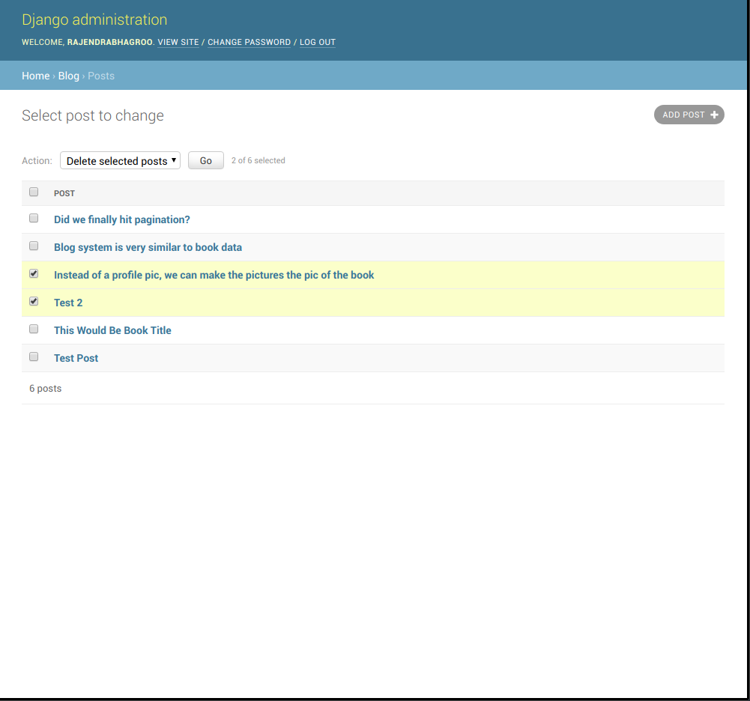
Admin
Database
View

Slide 33
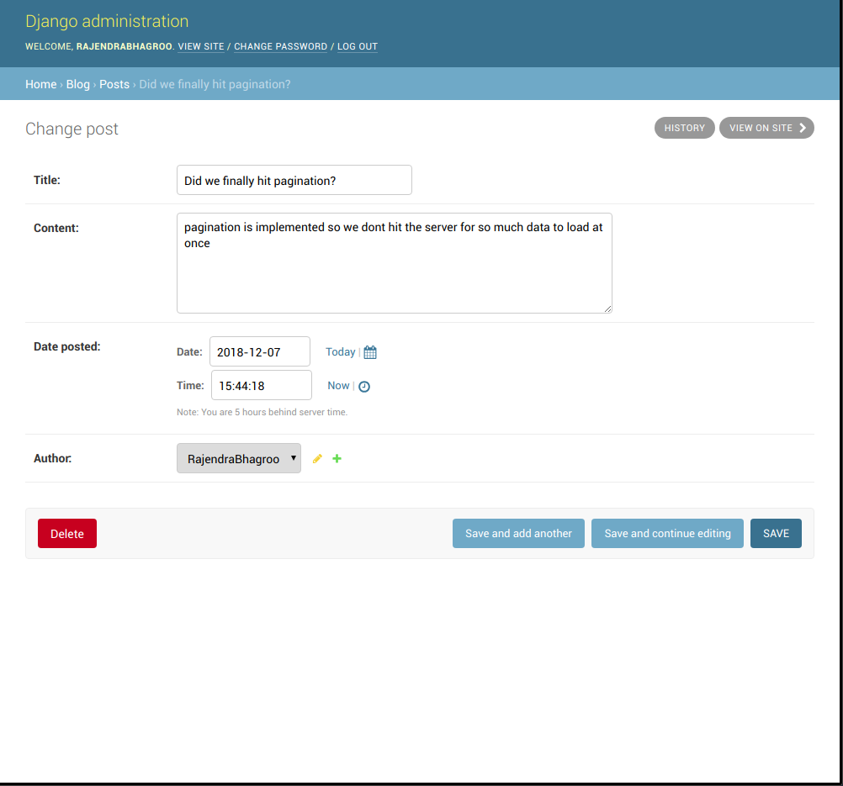
Admin
Database
Change Data

Slide 34
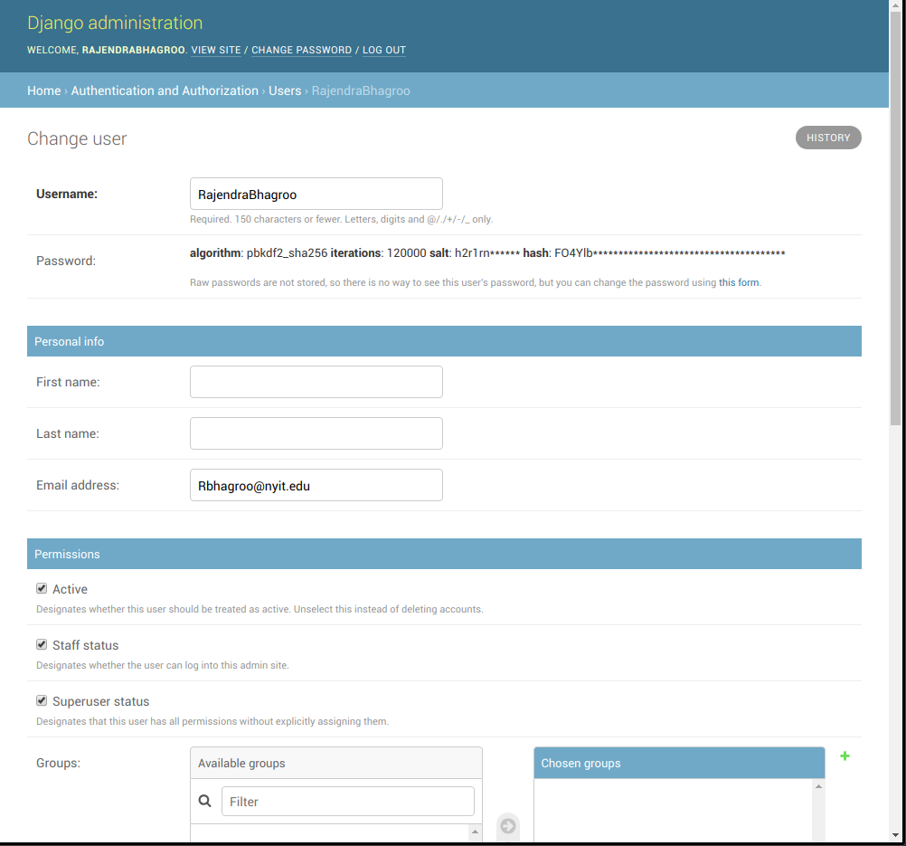
Admin
Edit User

Slide 35
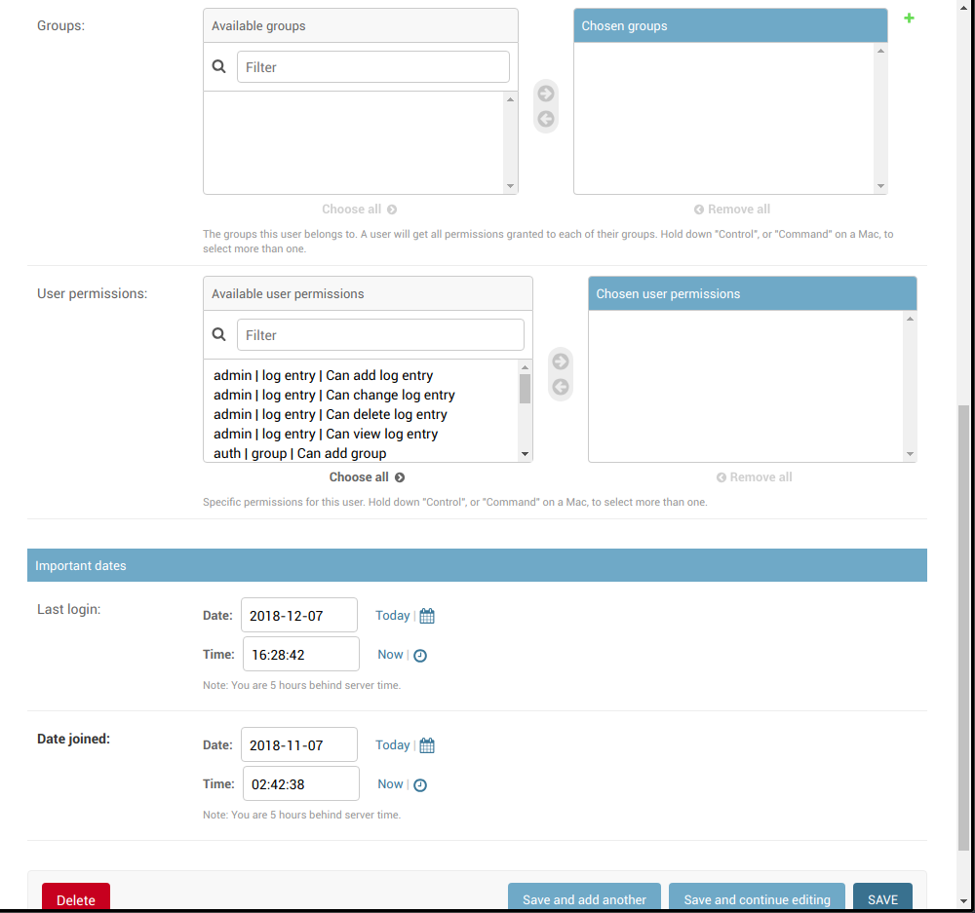
Admin
User
Permissions

Slide 36
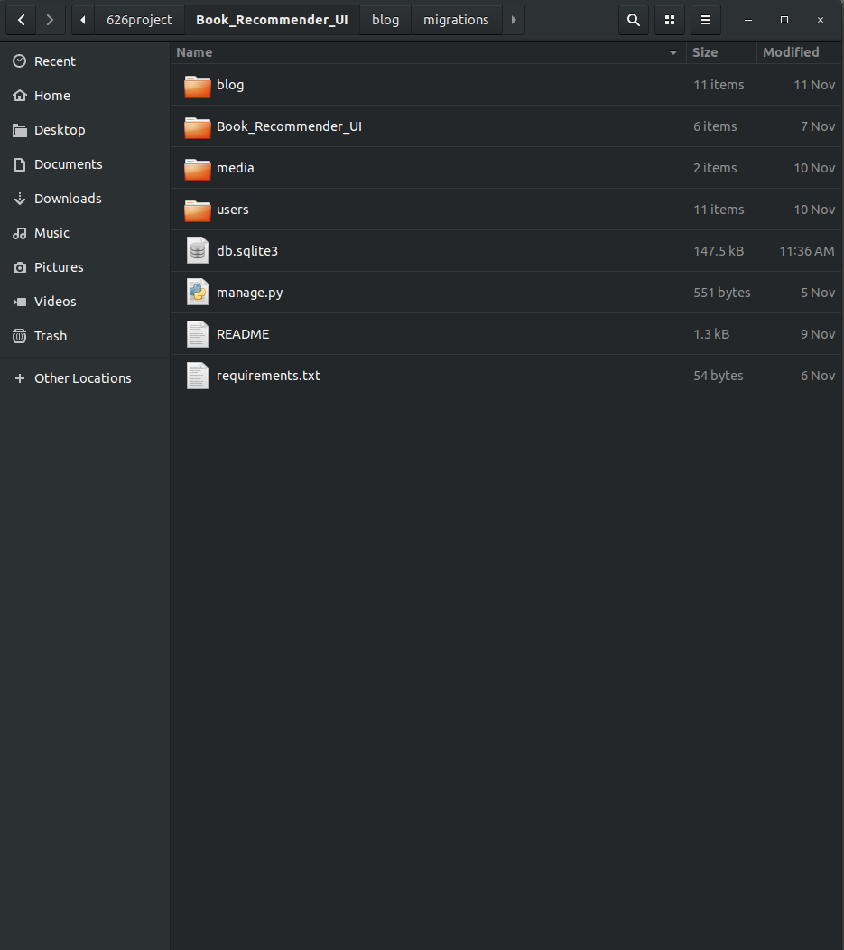
File
Structure
UI

Slide 37
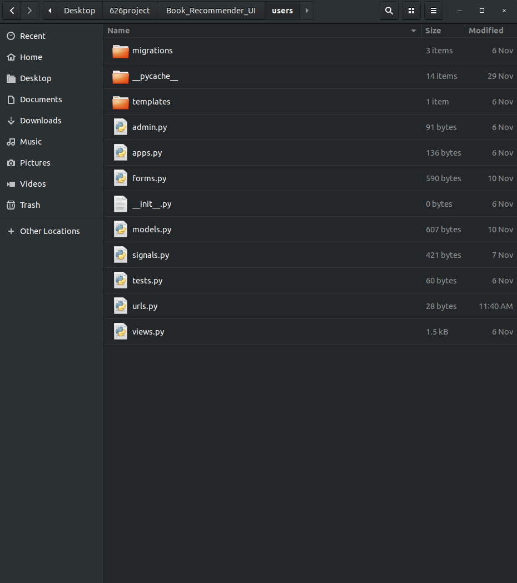
File
Structure
App

Slide 38
Conclusion

Slide 39
Conclusion
Our book recommendation system will recommend the appropriate books for customers according to their interests and Django will store the recommendations in the customers web profile.
The system will store the details of the book which users have previously rated and it will use collaborative filtering to recommend new books.
Collaborative filtering will show a list of all books that are searched based on the content and rating of the book.
Future Work
In the future, we would like to use clustering algorithms to discover unique groups of users within our application and implement content based filtering to tailor recommendations for all users.
We would CLEARLY also like to integrate the model into our user interface!

