Slide 1
Personal Health coach (PHC)
Another Weekend project ☺

Slide 2
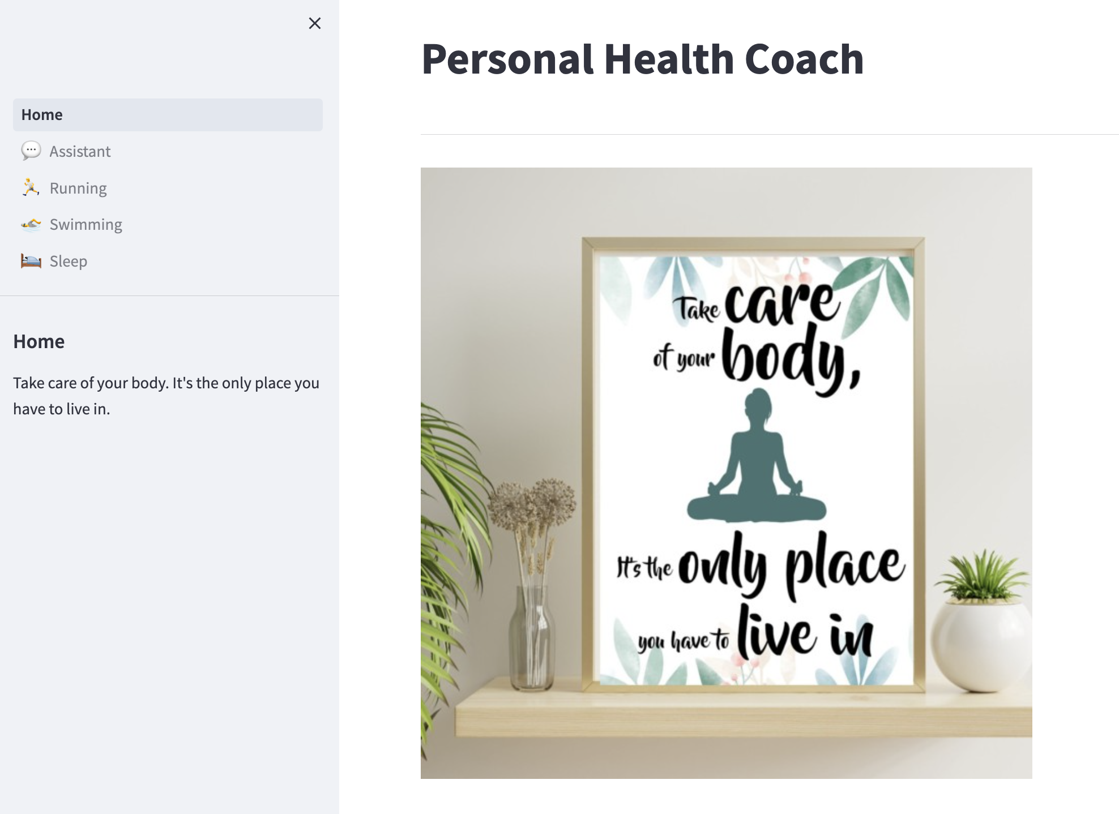

Slide 3
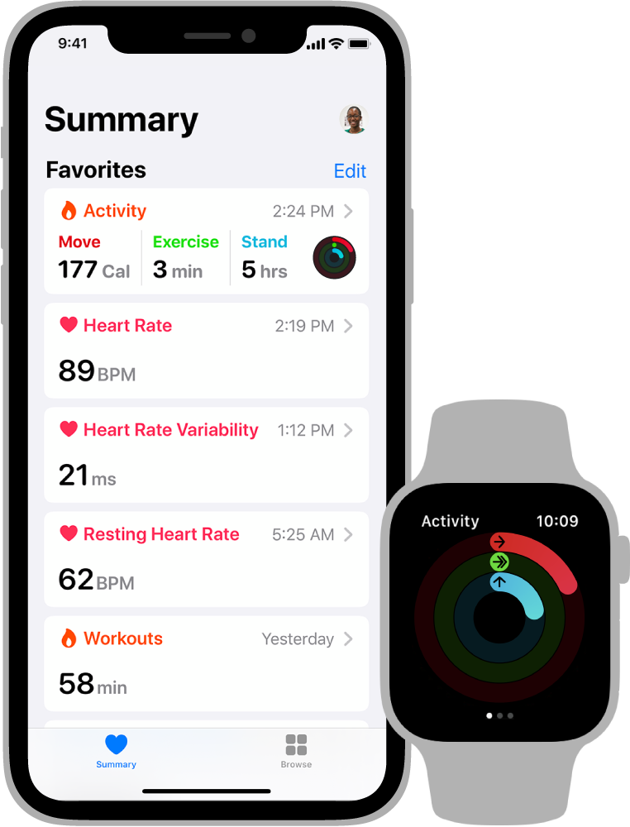
Data
Apple Health app collects health and fitness data from your iPhone, iPad, the built-in sensors on your Apple Watch, compatible third-party devices and apps that use HealthKit.
E.g. electrocardiogram (ECG), cardio fitness (VO2), medications, workouts and sleeps.

Slide 4
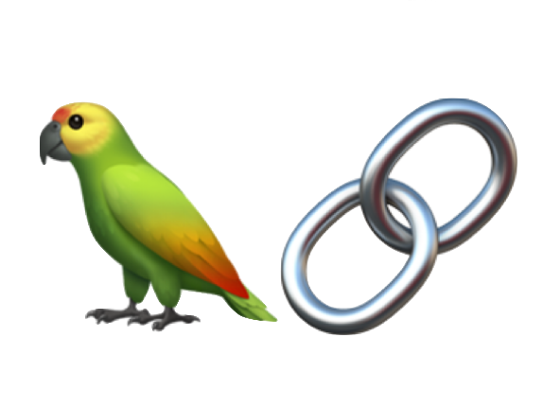
Backend Framework
LangChain is an open source framework for developing applications powered by language models.
Components - abstractions for working with language models), along with a collection of implementations for each abstraction.
Off-the-shelf chains - a structured assembly of components for accomplishing specific higher-level tasks.
LangChain

Slide 5
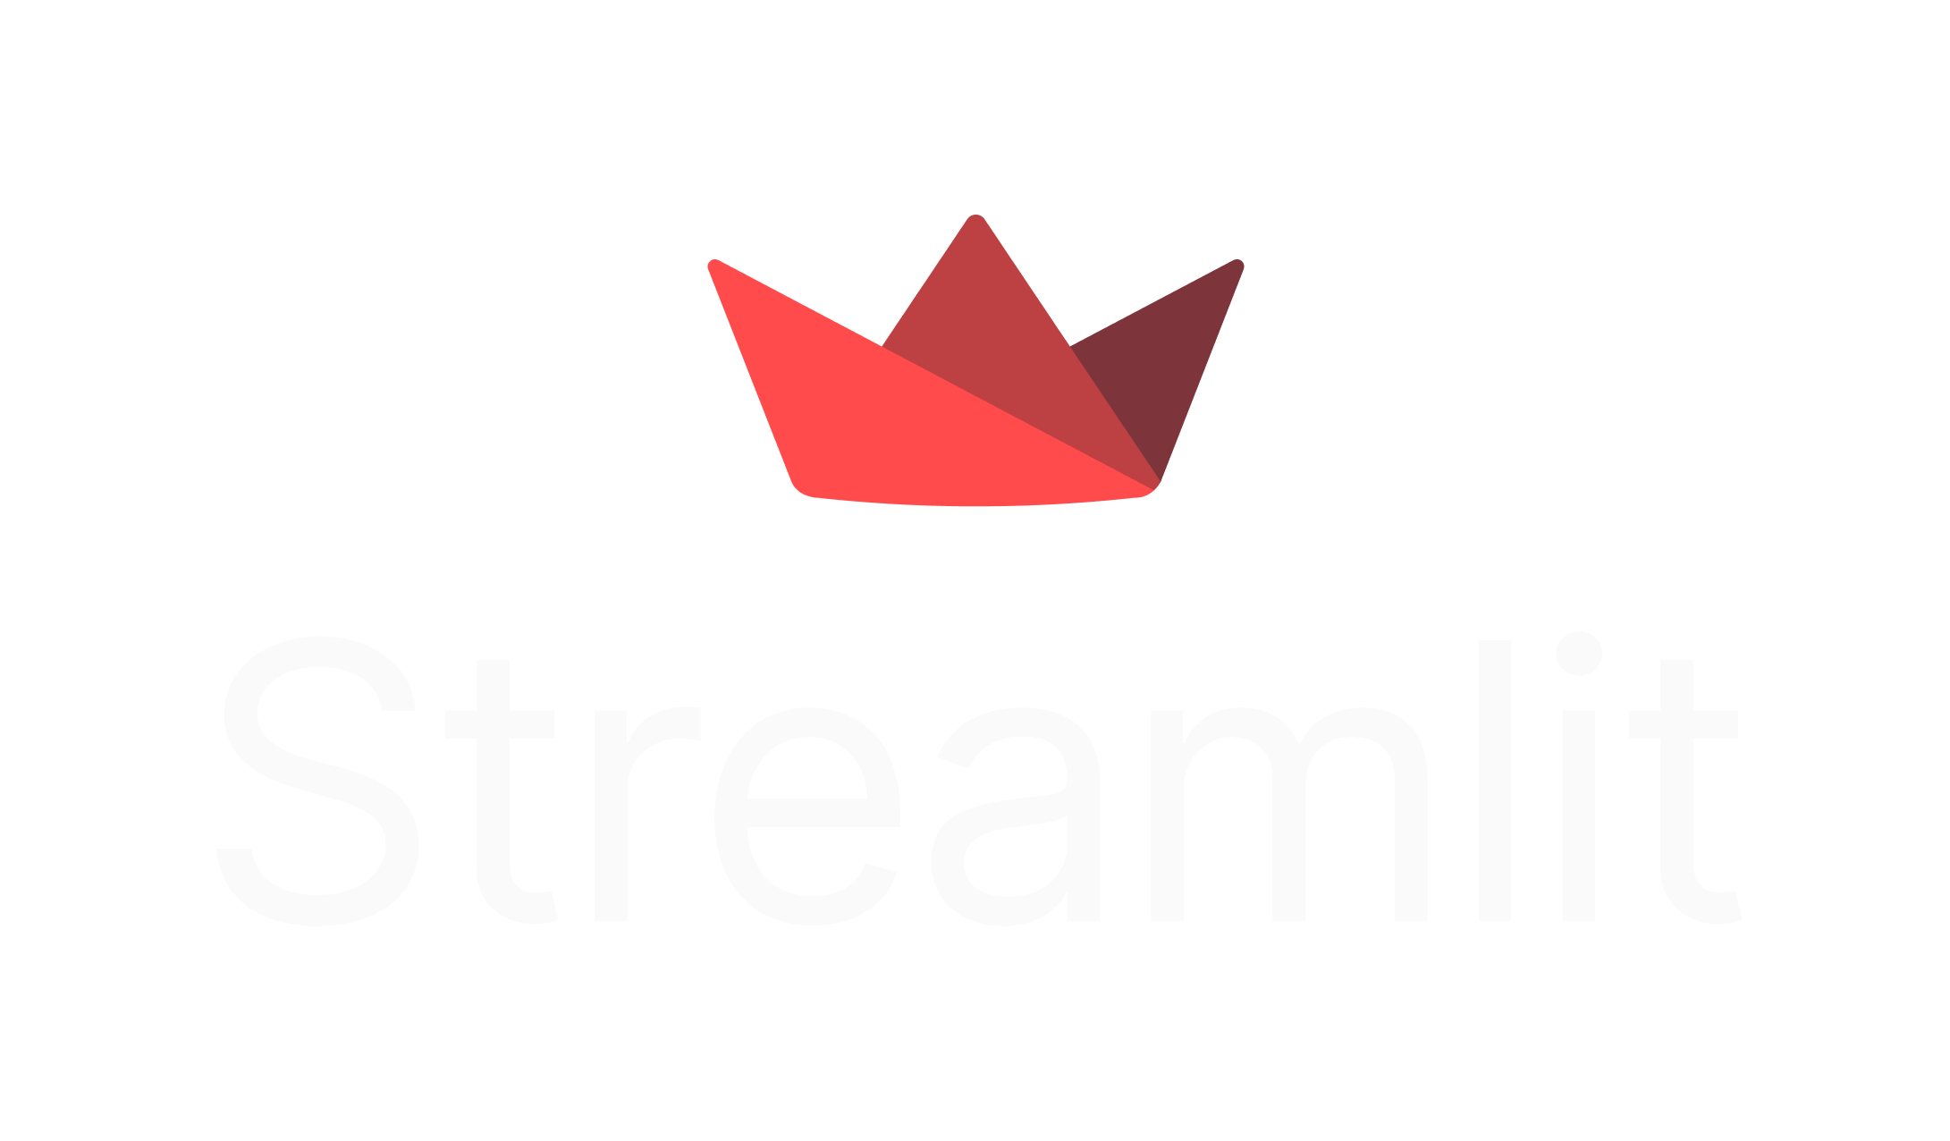
Frontend Framework
Streamlit is an open source framework that can turn data scripts into shareable web apps in minutes.
All in pure Python. No front‑end experience required.
Generative AI and Streamlit is a perfect match.

