Slide 1
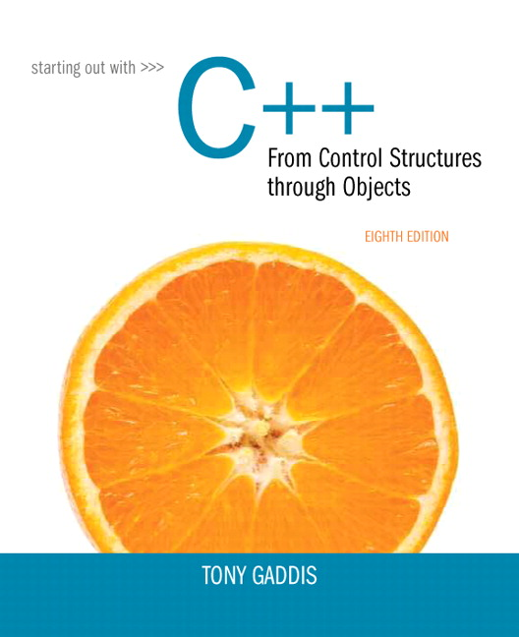
Starting out With C++: From Control Structures Through Objects
Eighth Edition
Chapter 1
Introduction to Computers and Programming
Copyright © 2015, 2012, 2009 Pearson Education, Inc. All Rights Reserved
Notes:
If this PowerPoint presentation contains mathematical equations, you may need to check that your computer has the following installed:
1) MathType Plugin
2) Math Player (free versions available)
3) NVDA Reader (free versions available)

Slide 2
1.1 Why Program?

Slide 3
Why Program?
Computer – programmable machine designed to follow instructions
Program – instructions in computer memory to make it do something
Programmer – person who writes instructions (programs) to make computer perform a task
So, without programmers, no programs; without programs, a computer cannot do anything

Slide 4
1.2 Computer Systems: Hardware and Software

Slide 5
Main Hardware Component Categories:
Central Processing Unit (C P U)
Main Memory
Secondary Memory / Storage
Input Devices
Output Devices

Slide 6
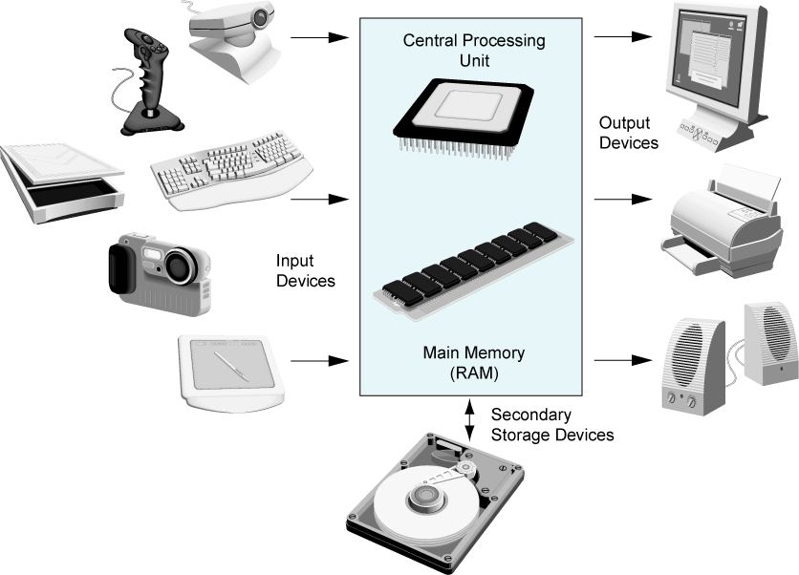
Figure 1-2 Main Hardware Component Categories

Slide 7
Central Processing Unit (C P U)
Comprised of:
Control Unit
Retrieves and decodes program instructions
Coordinates activities of all other parts of computer
Arithmetic & Logic Unit
Hardware optimized for high-speed numeric calculation
Hardware designed for true/false, yes/no decisions

Slide 8
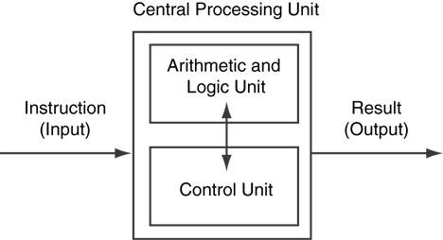
Figure 1-5 C P U Organization

Slide 9
Main Memory (1 of 3)
It is volatile. Main memory is erased when program terminates or computer is turned off
Also called Random Access Memory (RAM)
Organized as follows:
bit: smallest piece of memory. Has values 0 (off, false) or 1 (on, true)
byte: 8 consecutive bits. Bytes have addresses.

Slide 10
Main Memory (2 of 3)
Addresses – Each byte in memory is identified by a unique number known as an address.

Slide 11
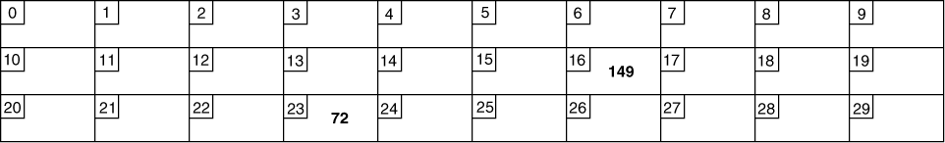
Main Memory (3 of 3)
In Figure 1-6, the number 149 is stored in the byte with the address 16, and the number 72 is stored at address 23.

Slide 12
Secondary Storage
Non-volatile: data retained when program is not running or computer is turned off
Comes in a variety of media:
magnetic: floppy disk, hard drive
optical: CD-ROM, DVD
Flash drives, connected to the U S B port

Slide 13
Input Devices
Devices that send information to the computer from outside
Many devices can provide input:
Keyboard, mouse, scanner, digital camera, microphone
Disk drives, CD drives, and DVD drives

Slide 14
Software-Programs That Run on a Computer
Categories of software:
System software: programs that manage the computer hardware and the programs that run on them. Examples: operating systems, utility programs, software development tools
Application software: programs that provide services to the user. Examples: word processing, games, programs to solve specific problems

Slide 15
1.3 Programs and Programming Languages

Slide 16
Programs and Programming Languages (1 of 2)
A program is a set of instructions that the computer follows to perform a task
We start with an algorithm, which is a set of well-defined steps.

Slide 17
Example Algorithm for Calculating Gross Pay
Display a message on the screen asking “How many hours did you work?”
Wait for the user to enter the number of hours worked. Once the user enters a number, store it in memory.
Display a message on the screen asking “How much do you get paid per hour?”
Wait for the user to enter an hourly pay rate. Once the user enters a number, store it in memory.
Multiply the number of hours by the amount paid per hour, and store the result in memory.
Display a message on the screen that tells the amount of money earned. The message must include the result of the calculation performed in Step 5.

Slide 18
Machine Language (1 of 2)
Although the previous algorithm defines the steps for calculating the gross pay, it is not ready to be executed on the computer.
The computer only executes machine language instructions

Slide 19
Machine Language (2 of 2)
Machine language instructions are binary numbers, such as
1011010000000101
Rather than writing programs in machine language, programmers use programming languages.

Slide 20
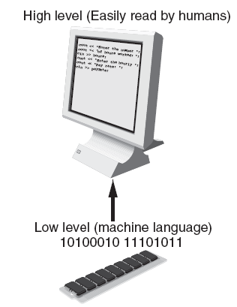
Programs and Programming Languages (2 of 2)
Types of languages:
Low-level: used for communication with computer hardware directly. Often written in binary machine code (0’s/1’s) directly.
High-level: closer to human language

Slide 21
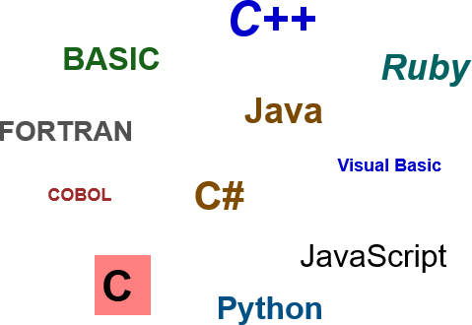
Some Well-Known Programming Languages (Table 1-1 on Page 10)

Slide 22
From a High-Level Program to an Executable File (1 of 2)
a. Create file containing the program with a text editor.
b. Run preprocessor to convert source file directives to source code program statements.
c. Run compiler to convert source program into machine instructions.
d. Run linker to connect hardware-specific code to machine instructions, producing an executable file.
Steps b–d are often performed by a single command or button click.
Errors detected at any step will prevent execution of following steps.

Slide 23
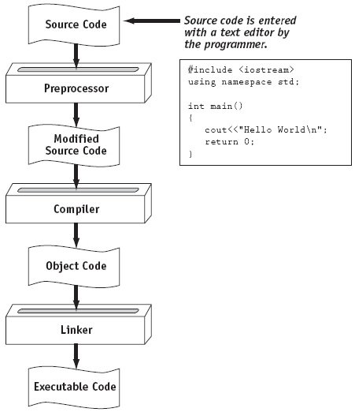
From a High-Level Program to an Executable File (2 of 2)

Slide 24
Integrated Development Environments (I D Es) (1 of 2)
An integrated development environment, or I D E, combine all the tools needed to write, compile, and debug a program into a single software application.
Examples are Microsoft Visual C++, Turbo C++ Explorer, CodeWarrior, etc.

Slide 25
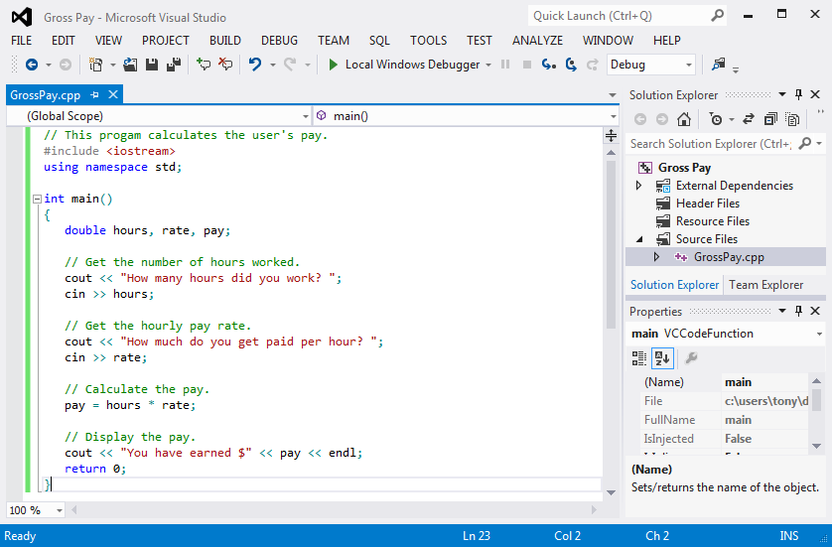
Integrated Development Environments (I D Es) (2 of 2)

Slide 26
1.4 What is a Program Made of?

Slide 27
What is a Program Made of?
Common elements in programming languages:
Key Words
Programmer-Defined Identifiers
Operators
Punctuation
Syntax

Slide 28
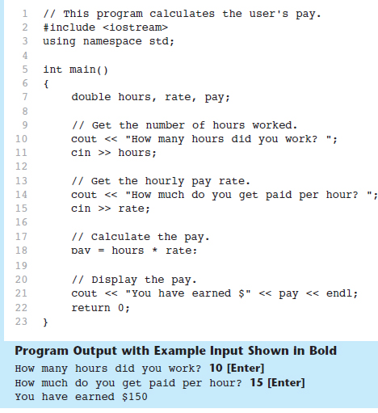
Program 1-1

Slide 29
Key Words (1 of 2)
Also known as reserved words
Have a special meaning in C++
Can not be used for any other purpose
Key words in the Program 1-1: using, namespace, int, double, and return

Slide 30
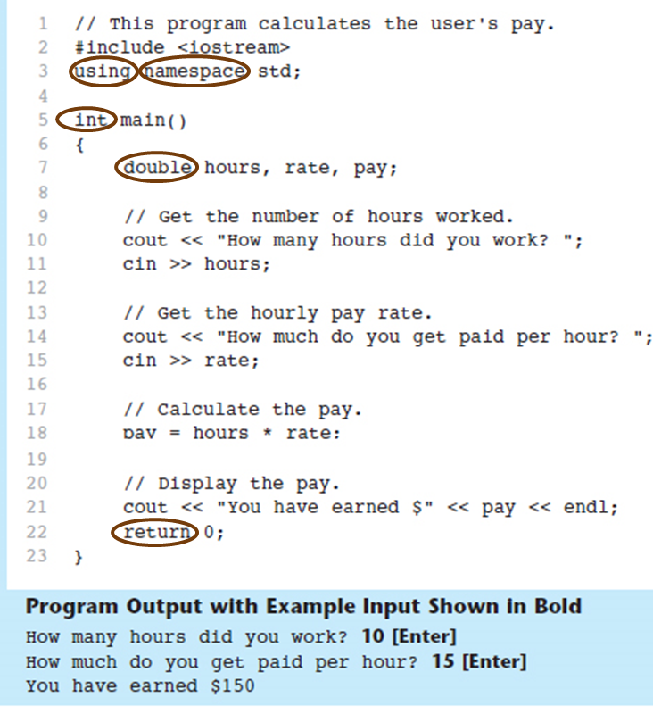
Key Words (2 of 2)

Slide 31
Programmer-Defined Identifiers
Names made up by the programmer
Not part of the C++ language
Used to represent various things: variables (memory locations), functions, etc.
In Program 1-1: hours, rate, and pay.

Slide 32
Operators (1 of 2)
Used to perform operations on data
Many types of operators:
Arithmetic -
Assignment - example: =
Some operators in Program 1-1:

Slide 33
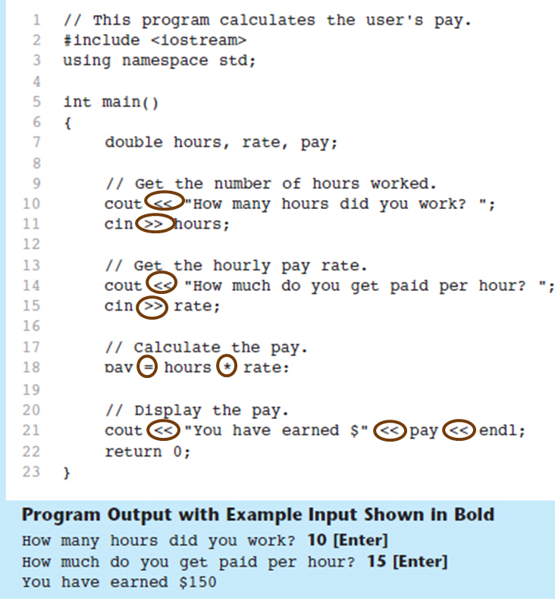
Operators (2 of 2)

Slide 34
Punctuation (1 of 2)
Characters that mark the end of a statement, or that separate items in a list
In Program 1-1: , and ;

Slide 35
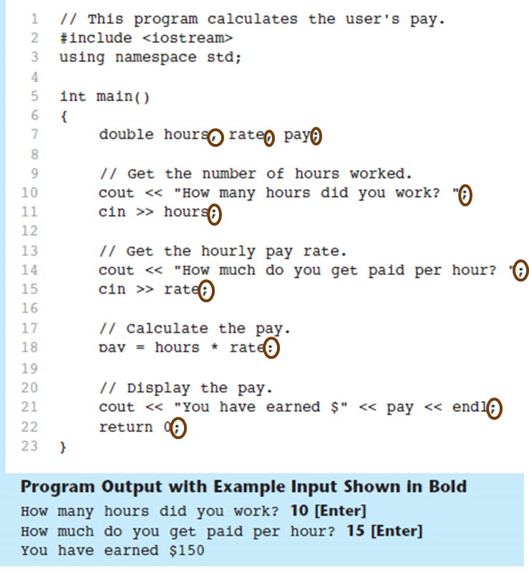
Punctuation (2 of 2)

Slide 36
Syntax
The rules of grammar that must be followed when writing a program
Controls the use of key words, operators, programmer-defined symbols, and punctuation

Slide 37
Variables
A variable is a named storage location in the computer’s memory for holding a piece of data.
In Program 1-1 we used three variables:
The hours variable was used to hold the hours worked
The rate variable was used to hold the pay rate
The pay variable was used to hold the gross pay

Slide 38
Variable Definitions (1 of 3)
To create a variable in a program you must write a variable definition (also called a variable declaration)
Here is the statement from Program 1-1 that defines the variables:
double hours, rate, pay;

Slide 39
Variable Definitions (2 of 3)
There are many different types of data, which you will learn about in this course.
A variable holds a specific type of data.
The variable definition specifies the type of data a variable can hold, and the variable name.

Slide 40
Variable Definitions (3 of 3)
Once again, line 7 from Program 1-1:
double hours, rate, pay;
The word double specifies that the variables can hold double-precision floating point numbers. (You will learn more about that in Chapter 2)

Slide 41
1.5 Input, Processing, and Output

Slide 42
Input, Processing, and Output
Three steps that a program typically performs:
Gather input data:
from keyboard
from files on disk drives
Process the input data
Display the results as output:
send it to the screen
write to a file

Slide 43
1.6 The Programming Process

Slide 44
The Programming Process (1 of 2)
Clearly define what the program is to do.
Visualize the program running on the computer.
Use design tools such as a hierarchy chart, flowcharts, or pseudocode to create a model of the program.
Check the model for logical errors.
Type the code, save it, and compile it.

Slide 45
The Programming Process (2 of 2)
Correct any errors found during compilation. Repeat Steps 5 and 6 as many times as necessary.
Run the program with test data for input.
Correct any errors found while running the program. Repeat Steps 5 through 8 as many times as necessary.
Validate the results of the program.

Slide 46
1.7 Procedural and Object-Oriented Programming

Slide 47
Procedural and Object-Oriented Programming
Procedural programming: focus is on the process. Procedures/functions are written to process data.
Object-Oriented programming: focus is on objects, which contain data and the means to manipulate the data. Messages sent to objects to perform operations.

Slide 48

Copyright

