Slide 1
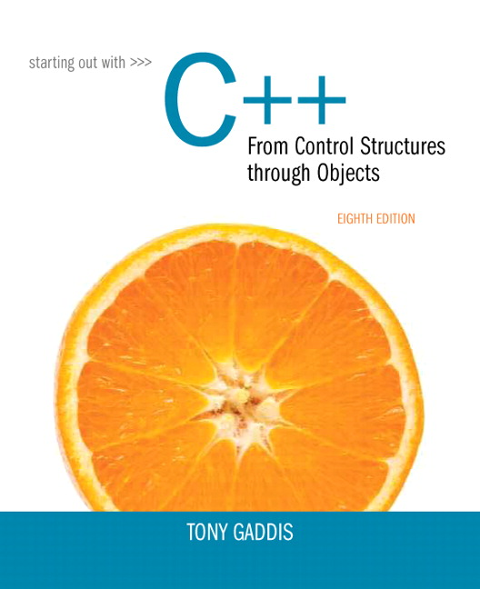
Starting out With C++: From Control Structures Through Objects
Eighth Edition
Chapter 2
Introduction to C++
Copyright © 2015, 2012, 2009 Pearson Education, Inc. All Rights Reserved
Notes:
If this PowerPoint presentation contains mathematical equations, you may need to check that your computer has the following installed:
1) MathType Plugin
2) Math Player (free versions available)
3) NVDA Reader (free versions available)

Slide 2
2.1 The Parts of a C++ Program

Slide 3
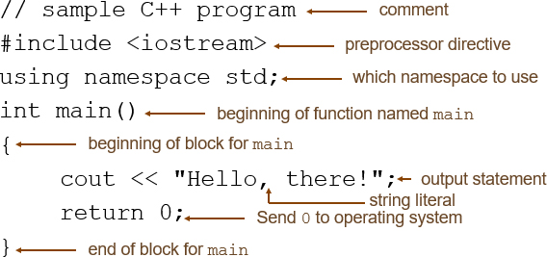
The Parts of a C++ Program

Slide 4
Special Characters
Character | Name | Meaning
Slash symbol | Double slash | Beginning of a comment
# | Pound sign | Beginning of preprocessor directive
Lessthan greaterthan | Open/close brackets | Enclose filename in #include
( ) | Open/close parentheses | Used when naming a function
{ } | Open/close brace | Encloses a group of statements
" " | Open/close quotation marks | Encloses string of characters
; | Semicolon | End of a programming statement

Slide 5
2.2 The cout Object

Slide 6
The cout Object (1 of 3)
Displays output on the computer screen
You use the stream insertion operator
to send output to cout:

Slide 7

The cout Object (2 of 3)
Can be used to send more than one item to cout:
Or:

Slide 8

The cout Object (3 of 3)
This produces one line of output:

Slide 9
The endl Manipulator (1 of 3)
You can use the endl manipulator to start a new line of output. This will produce two lines of output:

Slide 10
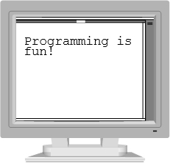
The endl Manipulator (2 of 3)

Slide 11

The endl Manipulator (3 of 3)
You do Not put quotation marks around endl
The last character in endl is a lowercase L, not the number 1.

Slide 12
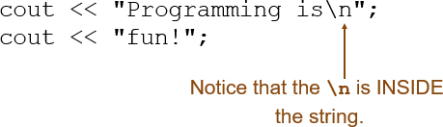
The \n Escape Sequence (1 of 2)
You can also use the \n escape sequence to start a new line of output. This will produce two lines of output:

Slide 13

The \n Escape Sequence (2 of 2)

Slide 14
2.3 The #include Directive

Slide 15
The #include Directive
Inserts the contents of another file into the program
This is a preprocessor directive, not part of C++ language
#include lines not seen by compiler
Do not place a semicolon at end of #include line

Slide 16
2.4 Variables and Literals

Slide 17
Variables and Literals
Variable: a storage location in memory
Has a name and a type of data it can hold
Must be defined before it can be used:

Slide 18
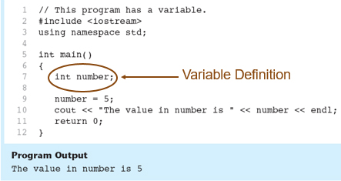
Variable Definition in Program 2-7

Slide 19

Literals
Literal: a value that is written into a program’s code.

Slide 20
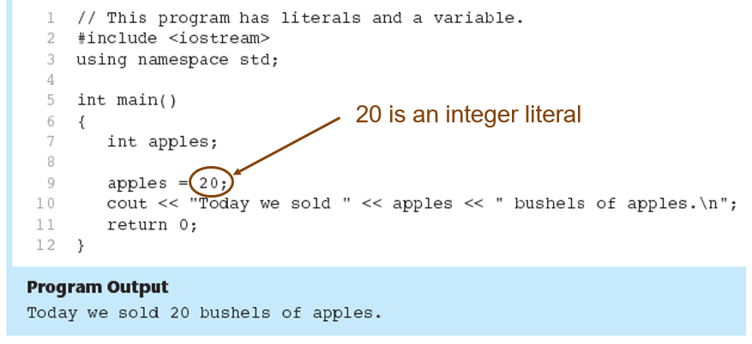
Integer Literal in Program 2-9

Slide 21
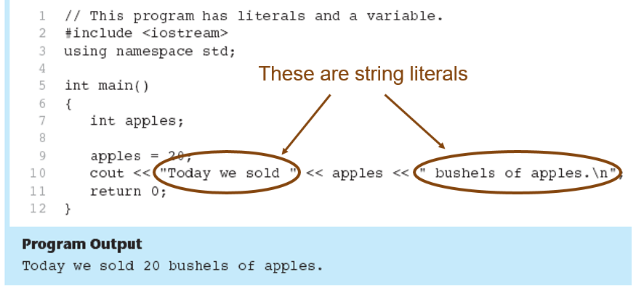
String Literals in Program 2-9

Slide 22
2.5 Identifiers

Slide 23
Identifiers
An identifier is a programmer-defined name for some part of a program: variables, functions, etc.

Slide 24
Table 2-4 The C++ Key Words (1 of 3)
alignas
alignof
and
and_eq
asm
auto
bitand
bitor
bool
break
case
catch
char
char16_t
char32_t
class
compl
const
constexpr
const_cast
continue
decltype
default
delete
do
double

Slide 25
Table 2-4 The C++ Key Words (2 of 3)
dynamic_cast
else
enum
explicit
export
extern
false
float
for
friend
goto
If
inline
int
long
mutable
namespace
new
noexcept
not
not_eq
nullptr
operator
or
or_eq
private

Slide 26
Table 2-4 The C++ Key Words (3 of 3)
protected
public
register
reinterpret_cast
return
short
signed
sizeof
static
static_assert
static_cast
struct
switch
template
this
thread_local
throw
true
try
typedef
typeid
typename
union
unsigned
using
virtual
void
volatile
wchar_t
while
xor
xor_eq
You cannot use any of the C++ key words as an identifier. These words have reserved meaning.

Slide 27
Variable Names
A variable name should represent the purpose of the variable. For example:
The purpose of this variable is to hold the number of items ordered.

Slide 28
Identifier Rules
The first character of an identifier must be an alphabetic character or and underscore ( _ ),
After the first character you may use alphabetic characters, numbers, or underscore characters.
Upper- and lowercase characters are distinct

Slide 29
Valid and Invalid Identifiers
Identifier | Valid? | Reason If Invalid
totalSales | Yes | Blank
total_Sales | Yes | Blank
total.Sales | No | Cannot contain .
4thQtrSales | No | Cannot begin with digit
totalSale$ | No | Cannot contain $

Slide 30
2.6 Integer Data Types

Slide 31
Integer Data Types
Integer variables can hold whole numbers such as 12, 7, and −99.
Data Type | Typical Size | Typical Range
short int | 2 bytes | −32,768 to +32,767
unsigned short int | 2 bytes | 0 to +65,535
int | 4 bytes | −2,147,483,648 to +2,147,483,647
unsigned int | 4 bytes | 0 to 4,294,967,295
long int | 4 bytes | −2,147,483,648 to +2,147,483,647
unsigned long int | 4 bytes | 0 to 4,294,967,295
long long int | 8 bytes | −9,223,372,036,854,775,808 to 9,223,372,036,854,775,807
unsigned long long int | 8 bytes | 0 to 18,446,744,073,709,551,615

Slide 32


Defining Variables
Variables of the same type can be defined
On separate lines:
On the same line:
Variables of different types must be in different definitions

Slide 33
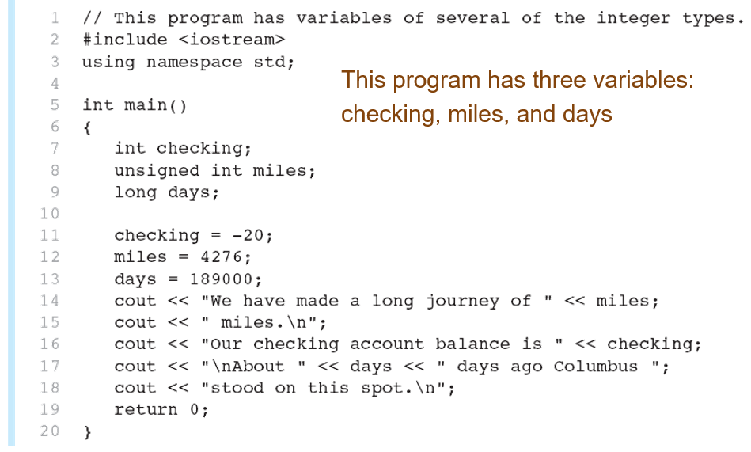
Integer Types in Program 2-10

Slide 34
Integer Literals (1 of 2)
An integer literal is an integer value that is typed into a program’s code. For example:
In this code, 15 is an integer literal.

Slide 35
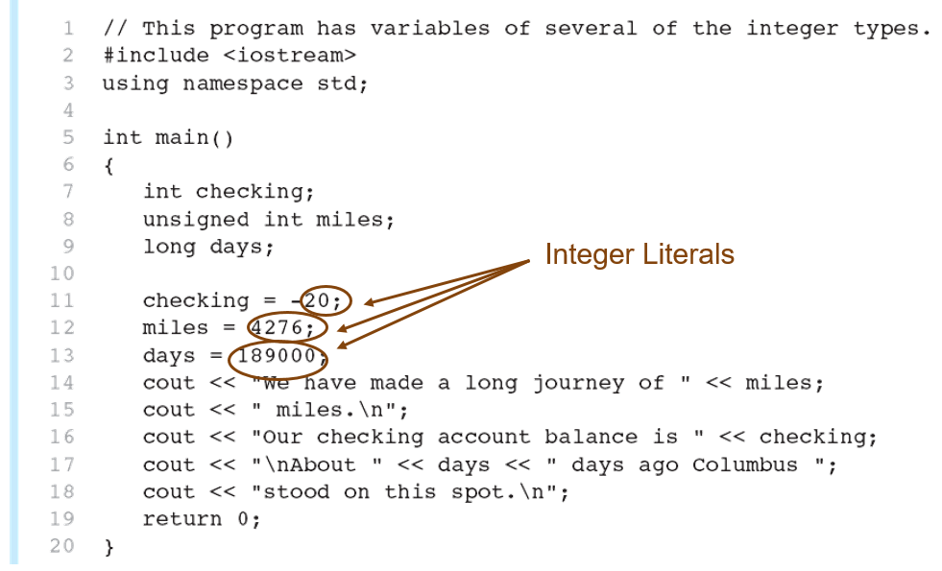
Integer Literals in Program 2-10

Slide 36
Integer Literals (2 of 2)
Integer literals are stored in memory as ints by default
To store an integer constant in a long memory location, put ‘L’ at the end of the number: 1234L
To store an integer constant in a long memory location, put ‘LL’ at the end of the number: 324LL
Constants that begin with ‘0’ (zero) are base 8: 075
Constants that begin with ‘0x’ are base 16: 0×75A

Slide 37
2.7 The char Data Type

Slide 38


The char Data Type
Used to hold characters or very small integer values
Usually 1 byte of memory
Numeric value of character from the character set is stored in memory:

Slide 39
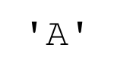
Character Literals
Character literals must be enclosed in single quote marks. Example:

Slide 40
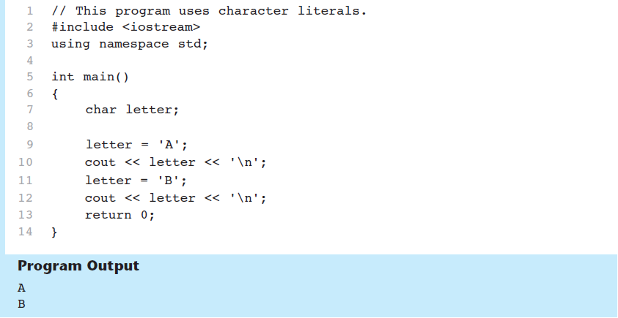
Character Literals in Program 2-14

Slide 41

Character Strings
A series of characters in consecutive memory locations:
"Hello"
Stored with the null terminator, \0, at the end:
Comprised of the characters between the " "

Slide 42
2.8 The C++ string Class

Slide 43

The C++ string Class
Special data type supports working with strings
Can define string variables in programs:
Can receive values with assignment operator:
Can be displayed via cout

Slide 44
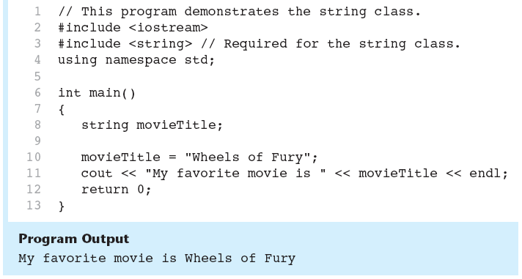
The string Class in Program 2-15

Slide 45
2.9 Floating-Point Data Types

Slide 46

Floating-Point Data Types (1 of 2)
The floating-point data types are:
They can hold real numbers such as: 12.45 −3.8
Stored in a form similar to scientific notation
All floating-point numbers are signed

Slide 47
Floating-Point Data Types (2 of 2)
Table 2-8 Floating Point Data Types on P Cs
Data Type | Key Word | Description
Single precision | float | 4 bytes. Numbers between plus or minus 3.4e negative 38 and plus or minus 3.4e 38
Double precision | double | 8 bytes. Numbers between plus or minus 1.7e negative 308 and plus or minus 1.7e 308
Long double precision | long double | 8 bytes*. Numbers between plus or minus 1.7e negative 308 and plus or minus 1.7e 308

Slide 48
Floating-Point Literals
Can be represented in
Fixed point (decimal) notation:
31.4159
0.0000625
E notation:
3.14159E1
6.25e−5
Are double by default
Can be forced to be float (3.14159f) or long double (0.0000625L)

Slide 49
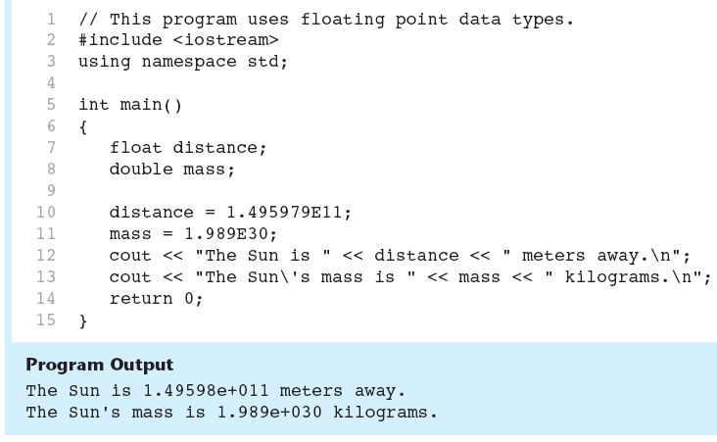
Floating-Point Data Types in Program 2-16

Slide 50
2.10 The bool Data Type

Slide 51


The bool Data Type
Represents values that are true or false
bool variables are stored as small integers
false is represented by 0,true by 1:

Slide 52
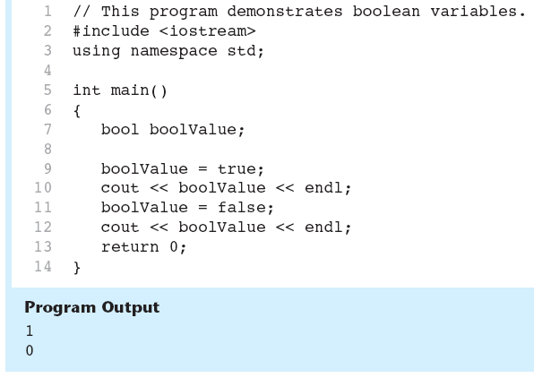
Boolean Variables in Program 2-17

Slide 53
2.11 Determining the Size of a Data Type

Slide 54
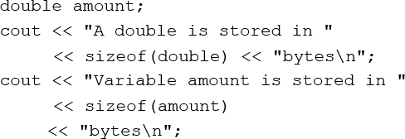
Determining the Size of a Data Type
The sizeof operator gives the size of any data type or variable:

Slide 55
2.12 Variable Assignments and Initialization

Slide 56
Variable Assignments and Initialization
An assignment statement uses the = operator to store a value in a variable.
This statement assigns the value 12 to the item variable.

Slide 57

Assignment
The variable receiving the value must appear on the left side of the = operator.
This will Not work:

Slide 58

Variable Initialization
To initialize a variable means to assign it a value when it is defined:
Can initialize some or all variables:

Slide 59
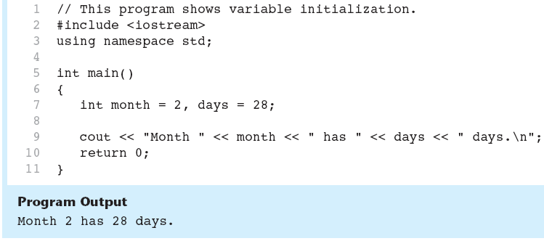
Variable Initialization in Program 2-19

Slide 60

Declaring Variables with the auto Key Word
C++ 11 introduces an alternative way to define variables, using the auto key word and an initialization value. Here is an example:
The auto key word tells the compiler to determine the variable’s data type from the initialization value.

Slide 61
2.13 Scope

Slide 62
Scope
The scope of a variable: the part of the program in which the variable can be accessed
A variable cannot be used before it is defined

Slide 63
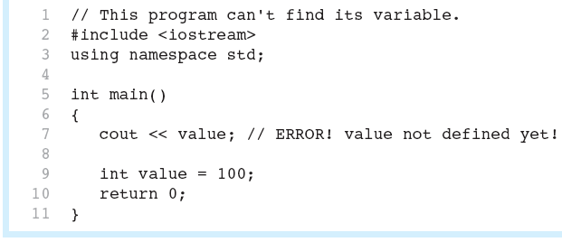
Variable out of Scope in Program 2-20

Slide 64
2.14 Arithmetic Operators

Slide 65
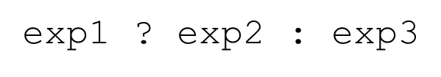
Arithmetic Operators
Used for performing numeric calculations
C++ has unary, binary, and ternary operators:
unary (1 operand) −5
binary (2 operands) 13−7
ternary (3 operands)

Slide 66
Binary Arithmetic Operators
Symbol | Operation | Example | Value of ans
+ | addition | ans = 7 + 3; | 10
− | subtraction | ans = 7 − 3; | 4
asterisk | multiplication | a n s = 7 asterisk 3 semicolon | 21
 | division | a n s = 7 forward slash 3 semicolon | 2
 | modulus | a n s = 7 percent sign 3 semicolon | 1

Slide 67
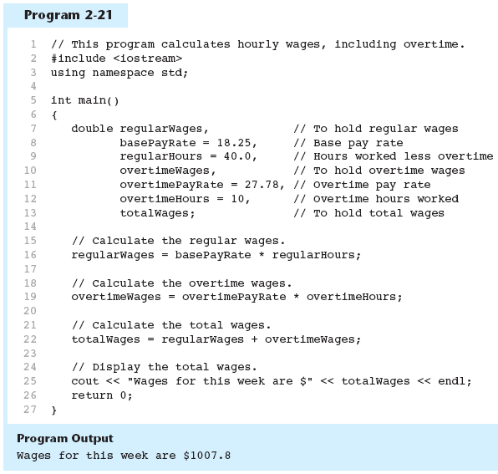
Arithmetic Operators in Program 2-21

Slide 68


A Closer Look at the Division Operator
(division) operator performs integer division if both operands are integers
If either operand is floating point, the result is floating point

Slide 69
A Closer Look at the % Operator
(modulus) operator computes the remainder resulting from integer division
requires integers for both operands

Slide 70
2.15 Comments

Slide 71
Comments
Used to document parts of the program
Intended for persons reading the source code of the program:
Indicate the purpose of the program
Describe the use of variables
Explain complex sections of code
Are ignored by the compiler

Slide 72
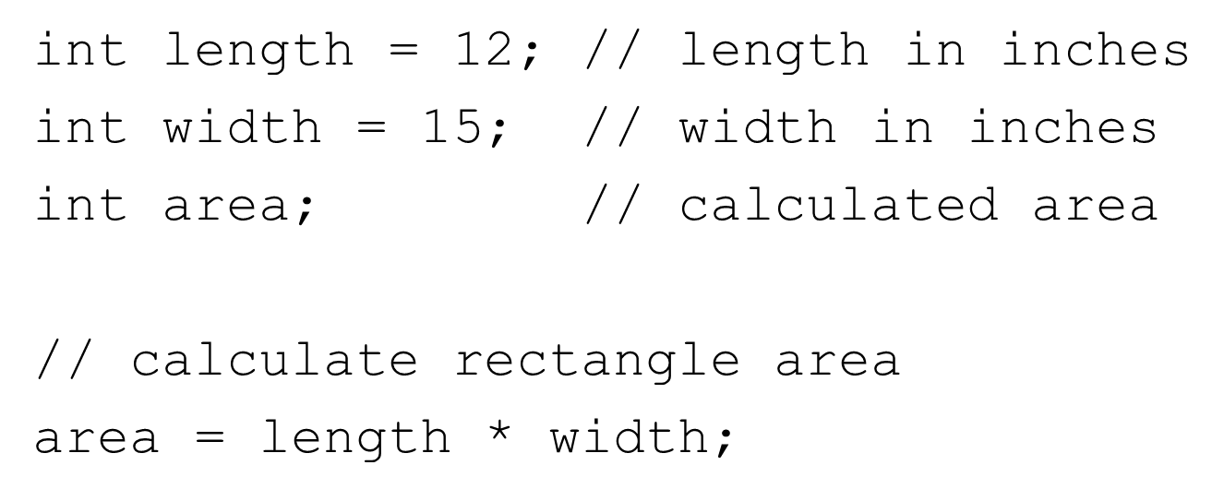
Single-Line Comments
Begin with
through to the end of line:

Slide 73
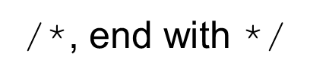

Multi-Line Comments
Begin with
Can span multiple lines:
Can begin and end on the same line:

Slide 74
2.16 Named Constants

Slide 75

Named Constants
Named constant (constant variable): variable whose content cannot be changed during program execution
Used for representing constant values with descriptive names:
Often named in uppercase letters

Slide 76
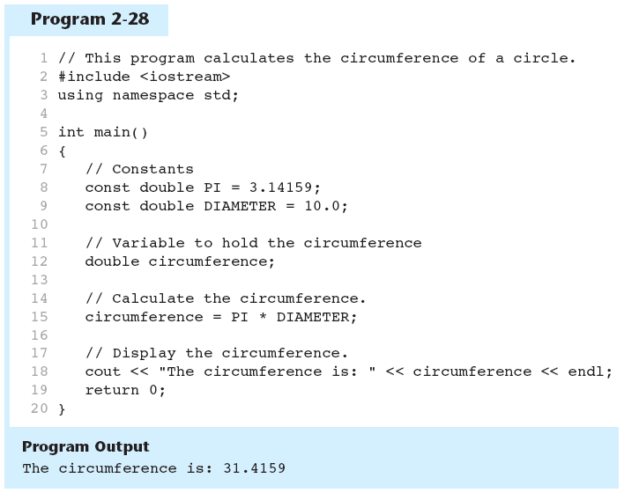
Named Constants in Program 2-28

Slide 77
2.17 Programming Style

Slide 78
Programming Style
The visual organization of the source code
Includes the use of spaces, tabs, and blank lines
Does not affect the syntax of the program
Affects the readability of the source code

Slide 79

Copyright

