Slide 1
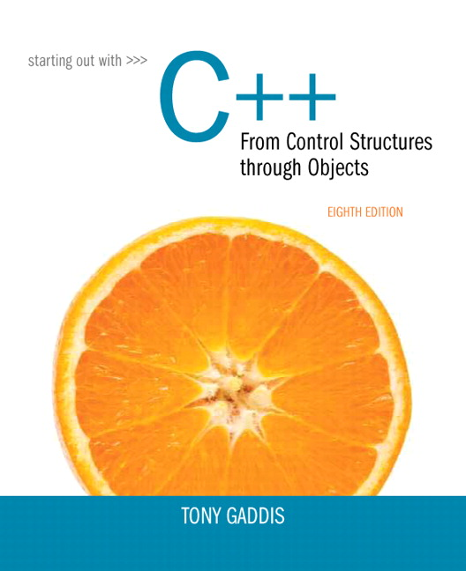
Starting out With C++: From Control Structures Through Objects
Eighth Edition
Chapter 3
Expressions
and Interactivity
Copyright © 2015, 2012, 2009 Pearson Education, Inc. All Rights Reserved
Notes:
If this PowerPoint presentation contains mathematical equations, you may need to check that your computer has the following installed:
1) MathType Plugin
2) Math Player (free versions available)
3) NVDA Reader (free versions available)

Slide 2
3.1 The cin Object

Slide 3
The C in Object (1 of 3)
Standard input object
Like c out, requires i o stream file
Used to read input from keyboard
Information retrieved from c in with >>
Input is stored in one or more variables

Slide 4
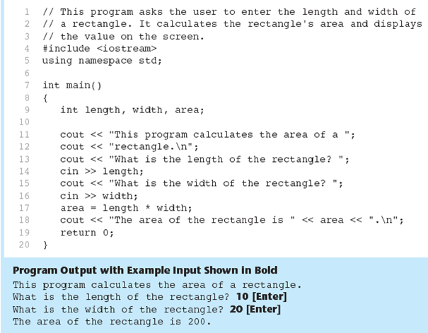
The C in Object in Program 3-1

Slide 5
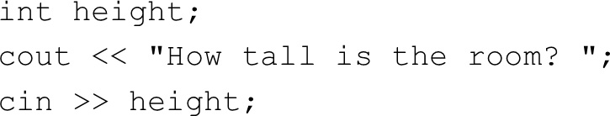
The C in Object (2 of 3)
c in converts data to the type that matches the variable:

Slide 6

Displaying a Prompt
A prompt is a message that instructs the user to enter data.
You should always use c out to display a prompt before each c in statement.

Slide 7
The C in Object (3 of 3)
Can be used to input more than one value:
Multiple values from keyboard must be separated by spaces
Order is important: first value entered goes to first variable, etc.

Slide 8
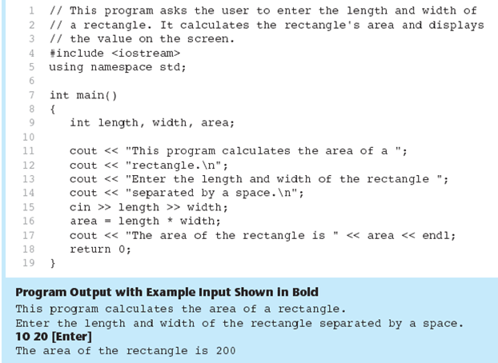
The C in Object Gathers Multiple Values in Program 3-2

Slide 9
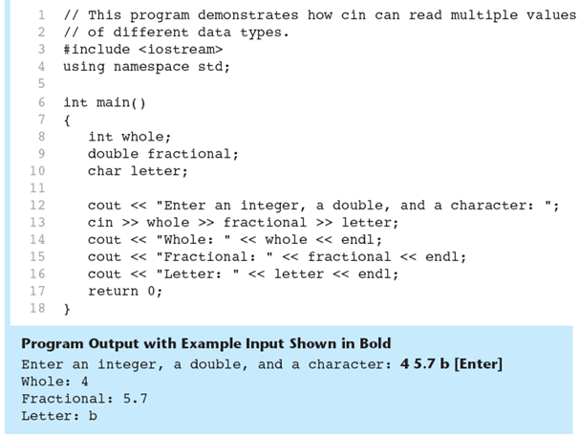
The C in Object Reads Different Data Types in Program 3-3

Slide 10
3.2 Mathematical Expressions

Slide 11

Mathematical Expressions
Can create complex expressions using multiple mathematical operators
An expression can be a literal, a variable, or a mathematical combination of constants and variables
Can be used in assignment, c out, other statements:

Slide 12
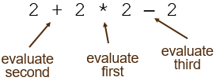
Order of Operations (1 of 2)
In an expression with more than one operator, evaluate in this order:
− (unary negation), in order, left to right
in order, left to right
+ −, in order, left to right
In the expression

Slide 13
Order of Operations (2 of 2)
Table 3-2 Some Simple Expressions and Their Values
Expression | Value
5 + 2 times 4 | 13
start fraction 10 over 2 minus 3 end fraction | 2
8 + 12 times 2 minus 4 | 28
4 + 17 times 2 minus 1 | 4
6 minus 3 times 2 + 7 minus 1 | 6

Slide 14
Associativity of Operators
- (unary negation) associates right to left
associate right to left
parentheses ( ) can be used to override the order of operations:

Slide 15
Grouping with Parentheses
Table 3-4 More Simple Expressions and Their Values
Expression | Value
5 + 2 times 4 | 28
start fraction 10 over 5 minus 3 end fraction | 5
8 + 12 times 6 minus 2 | 56
left parenthesis 4 + 17 right parenthesis % 2 minus 1 | 0
start fraction 6 minus 3 times 2 + 7 over 3 end fraction | 9

Slide 16
Algebraic Expressions (1 of 2)
Multiplication requires an operator:
Area=lw is written as
There is no exponentiation operator:
is written as
Parentheses may be needed to maintain order of operations:

Slide 17
Algebraic Expressions (2 of 2)
Table 3-5 Algebraic and C++ Multiplication Expressions
Algebraic Expressions | Operation | C++ Equivalent
6B | 6 times B | 6 times B
3 times 12 | 3 times 12 | 3 times 12
4xy | 4 times x times y | 4 times x times y

Slide 18
3.3 When You Mix Apples with Oranges: Type Conversion

Slide 19
When You Mix Apples with Oranges: Type Conversion
Operations are performed between operands of the same type.
If not of the same type, C++ will convert one to be the type of the other
This can impact the results of calculations.

Slide 20
Hierarchy of Types
Highest: long double
double
float
unsigned long
long
unsigned int
int
Lowest: Ranked by largest number they can hold

Slide 21
Type Coercion
Type Coercion: automatic conversion of an operand to another data type
Promotion: convert to a higher type
Demotion: convert to a lower type

Slide 22
Coercion Rules
​char, short, unsigned short automatically promoted to int
When operating on values of different data types, the lower one is promoted to the type of the higher one.
When using the = operator, the type of expression on right will be converted to type of variable on left

Slide 23
3.4 Overflow and Underflow

Slide 24
Overflow and Underflow
Occurs when assigning a value that is too large (overflow) or too small (underflow) to be held in a variable
Variable contains value that is ‘wrapped around’ set of possible values
Different systems may display a warning/error message, stop the program, or continue execution using the incorrect value

Slide 25
3.5 Type Casting

Slide 26
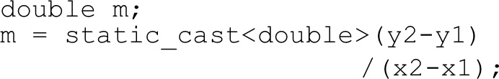
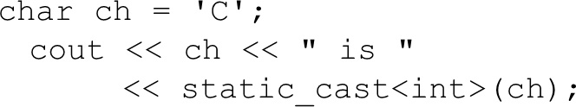
Type Casting
Used for manual data type conversion
Useful for floating point division using ints:
Useful to see int value of a char variable:

Slide 27
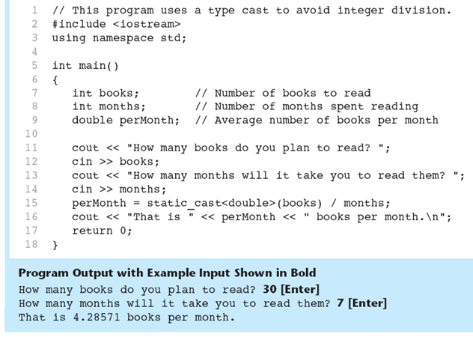
Type Casting in Program 3-9

Slide 28
C-Style and Prestandard Type Cast Expressions
C-Style cast: data type name in ()
Prestandard C++ cast: value in ()
Both are still supported in C++, although static_cast is preferred

Slide 29
3.6 Multiple Assignment and Combined Assignment

Slide 30
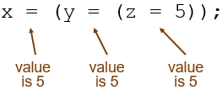
Multiple Assignment and Combined Assignment
The = can be used to assign a value to multiple variables:
x = y = z = 5;
Value of = is the value that is assigned
Associates right to left:

Slide 31
Combined Assignment (1 of 2)
Look at the following statement:
sum = sum + 1;
This adds 1 to the variable sum.

Slide 32
Other Similar Statements
Table 3-8 (Assume x = 6)
Statement | What It Does | Value of x After the Statement
x = x + 4; | Adds 4 to x | 10
x = x − 3; | Subtracts 3 from x | 3
x = x times 10; | Multiplies x by 10 | 60
x = start fraction x over 2 end fraction; | Divides x by 2 | 3
x = x % 4 | Makes x the remainder of x over 2 | 2

Slide 33
Combined Assignment (2 of 2)
The combined assignment operators provide a shorthand for these types of statements.
The statement
sum = sum + 1;
is equivalent to
sum += 1;

Slide 34
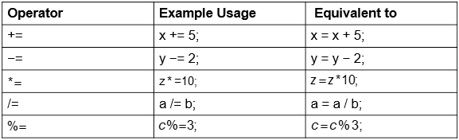
Combined Assignment Operators
Table 3-9

Slide 35
3.7 Formatting Output

Slide 36
Formatting Output
Can control how output displays for numeric, string data:
size
position
number of digits
Requires iomanip header file

Slide 37
Stream Manipulators (1 of 3)
Used to control how an output field is displayed
Some affect just the next value displayed:
set w(x): print in a field at least x spaces wide. Use more spaces if field is not wide enough

Slide 38
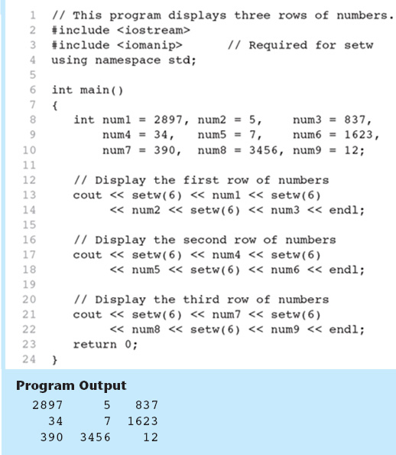
The Setw Stream Manipulator in Program 3-13

Slide 39
Stream Manipulators (2 of 3)
Some affect values until changed again:
fixed: use decimal notation for floating-point values
setprecision(x): when used with fixed, print floating-point value using x digits after the decimal. Without fixed, print floating-point value using x significant digits
showpoint: always print decimal for floating-point values

Slide 40
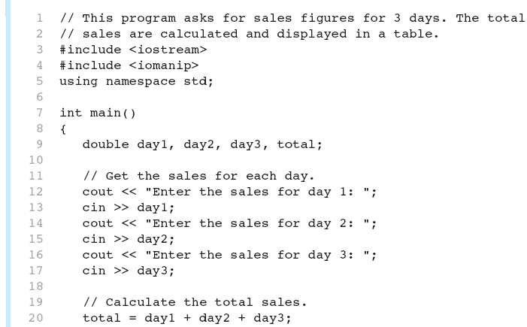
More Stream Manipulators in Program 3-17 (1 of 2)

Slide 41
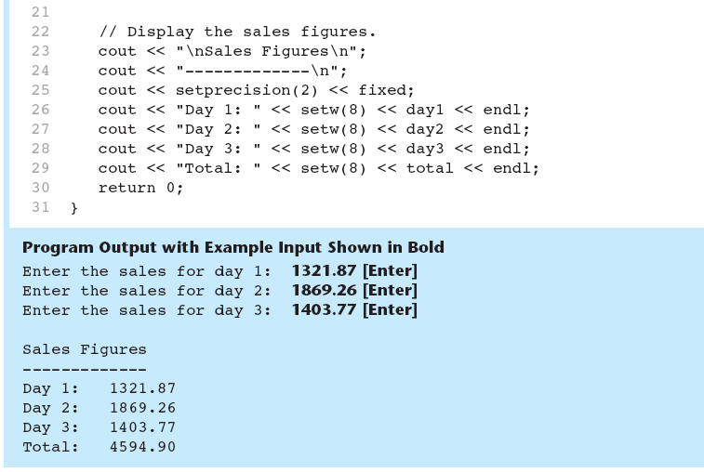
More Stream Manipulators in Program 3-17 (2 of 2)

Slide 42
Stream Manipulators (3 of 3)
Table 3-12
Stream Manipulator | Description
setw( n ) | Establishes a print field of n spaces.
Fixed | Displays floating-point numbers in fixed point notation.
Showpoint | Causes a decimal point and trailing zeroes to be displayed, even if there is no fractional part.
setprecision( n ) | Sets the precision of floating-point numbers.
Left | Causes subsequent output to be left justified.
Right | Causes subsequent output to be right justified.

Slide 43
3.8 Working with Characters and string Objects

Slide 44
Working with Characters and String Objects (1 of 3)
Using c in with the
operator to input strings can cause problems:
It passes over and ignores any leading whitespace characters (spaces, tabs, or line breaks)
To work around this problem, you can use a C++ function named getline.

Slide 45
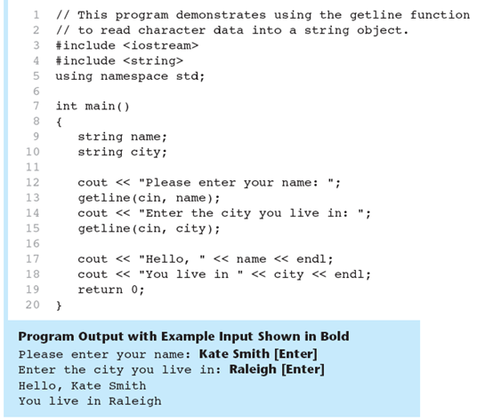
Using Getline in Program 3-19

Slide 46

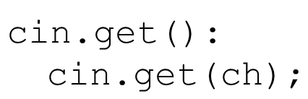
Working with Characters and String Objects (2 of 3)
To read a single character:
Use c in:
Problem: will skip over blanks, tabs, <CR>
Use
Will read the next character entered, even whitespace

Slide 47
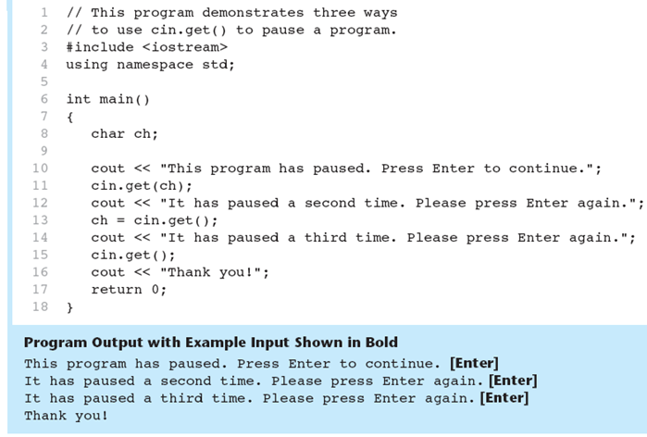
Using c in.Get()in Program 3-21

Slide 48
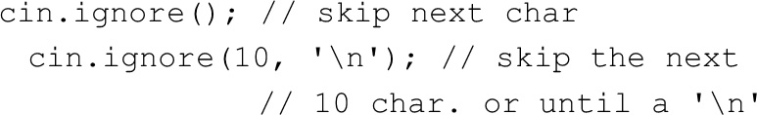
Working with Characters and String Objects (3 of 3)
Mixing c in >> and c in.get() in the same program can cause input errors that are hard to detect
To skip over unneeded characters that are still in the keyboard buffer, use c in.ignore():

Slide 49

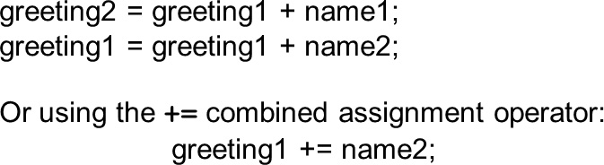
String Member Functions and Operators
To find the length of a string:
To concatenate (join) multiple strings:

Slide 50
3.9 More Mathematical Library Functions

Slide 51
More Mathematical Library Functions (1 of 2)
Require c math header file
Take double as input, return a double
Commonly used functions:
sin | Sine
cos | Cosine
tan | Tangent
sqrt | Square root
log | Natural (e) log
abs | Absolute value (takes and returns an int)

Slide 52
More Mathematical Library Functions (2 of 2)
These require cstdlib header file
rand(): returns a random number (int) between 0 and the largest int the compute holds. Yields same sequence of numbers each time program is run.
s rand (x): initializes random number generator with unsigned int x

Slide 53
3.10 Hand Tracing a Program

Slide 54
Hand Tracing a Program
Hand trace a program: act as if you are the computer, executing a program:
step through and ‘execute’ each statement, one-by-one
record the contents of variables after statement execution, using a hand trace chart (table)
Useful to locate logic or mathematical errors

Slide 55
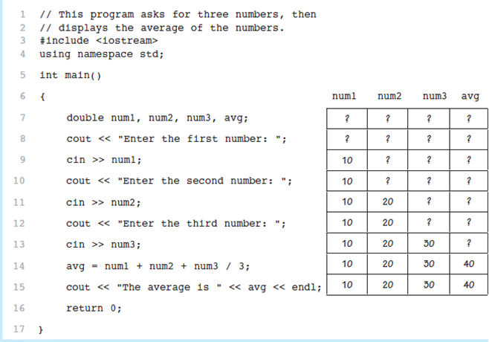
Program 3-27 with Hand Trace Chart

Slide 56
3.11 A Case Study

Slide 57
A Case Study
General Crates, Inc. builds custom-designed wooden crates.
You have been asked to write a program that calculates the:
Volume (in cubic feet)
Cost
Customer price
Profit of any crate G C I builds

Slide 58
Variables (1 of 2)
Table 3-14
Constant or Variable | Description
COST_PER_CUBIC_FOOT | A named constant, declared as a double and initialized with the value 0.23. This represents the cost to build a crate, per cubic foot.
CHARGE_PER_CUBIC_FOOT | A named constant, declared as a double and initialized with the value 0.5. This represents the amount charged for a crate, per cubic foot.
length | A double variable to hold the length of the crate, which is input by the user.
width | A double variable to hold the width of the crate, which is input by the user.

Slide 59
Variables (2 of 2)
Table 3-14 [Continued]
Constant or Variable | Description
height | A double variable to hold the height of the crate, which is input by the user.
volume | A double variable to hold the volume of the crate. The value stored in this variable is calculated.
cost | A double variable to hold the cost of building the crate. The value stored in this variable is calculated.
charge | A double variable to hold the amount charged to the customer for the crate. The value stored in this variable is calculated.
profit | A double variable to hold the profit G C I makes from the crate. The value stored in this variable is calculated.

Slide 60
Program Design
The program must perform the following general steps:
Step 1:
Ask the user to enter the dimensions of the crate
Step 2:
Calculate:
the crate’s volume
the cost of building the crate
the customer’s charge
the profit made
Step 3:
Display the data calculated in Step 2.

Slide 61
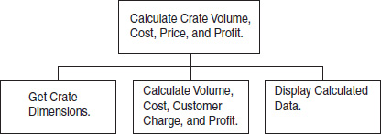
General Hierarchy Chart
Figure 3-7

Slide 62
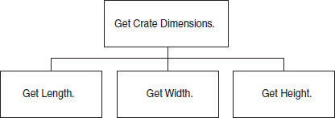
Get Crate Dimensions
Figure 3-8

Slide 63
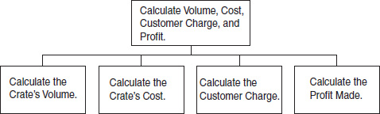
Calculate Volume, Cost, Customer Charge, and Profit
Figure 3-9

Slide 64
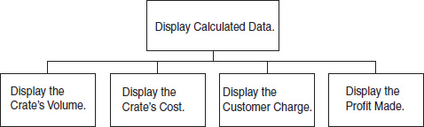
Display Calculated Data
Figure 3-10

Slide 65
Psuedocode
Ask the user to input the crate's length.
Ask the user to input the crate's width.
Ask the user to input the crate's height.
Calculate the crate's volume.
Calculate the cost of building the crate.
Calculate the customer's charge for the crate.
Calculate the profit made from the crate.
Display the crate's volume.
Display the cost of building the crate.
Display the customer's charge for the crate.
Display the profit made from the crate.

Slide 66
Calculations
The following formulas will be used to calculate the crate’s volume, cost, charge, and profit:
volume = length × width × height
cost = volume × 0.23
charge = volume × 0.5
profit = charge − cost

Slide 67
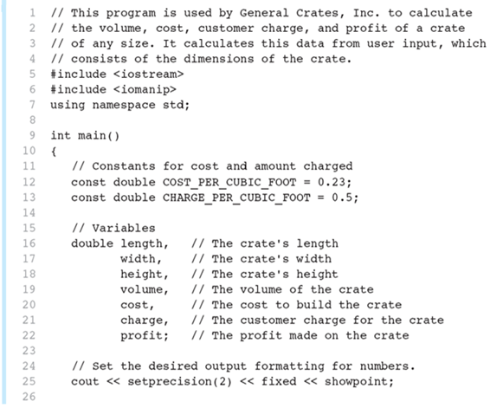
The Program 3-28 (1 of 3)

Slide 68
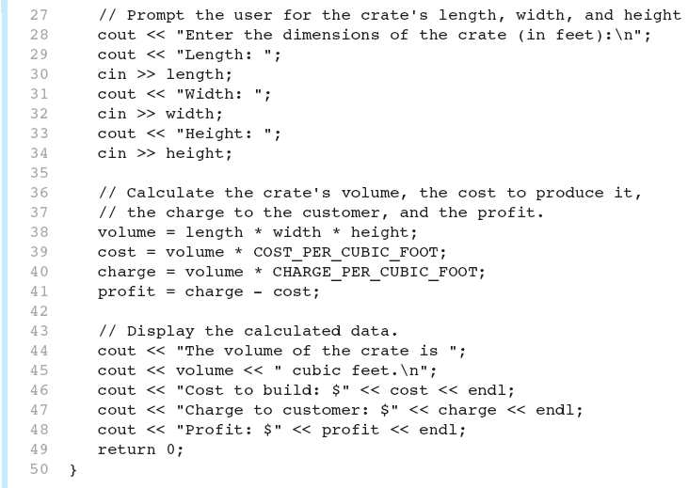
The Program 3-28 (2 of 3)

Slide 69
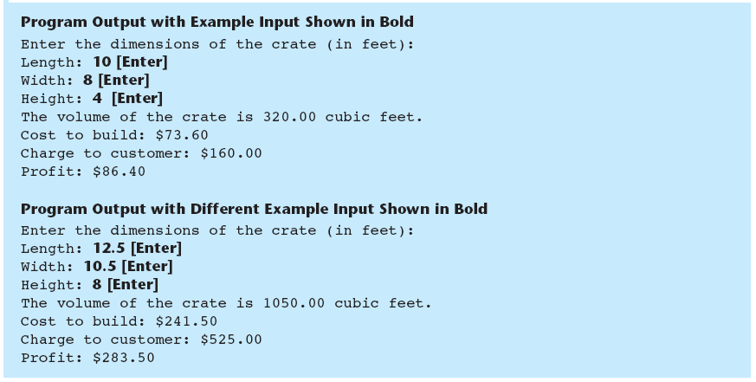
The Program 3-28 (3 of 3)

Slide 70

Copyright

