Slide 1
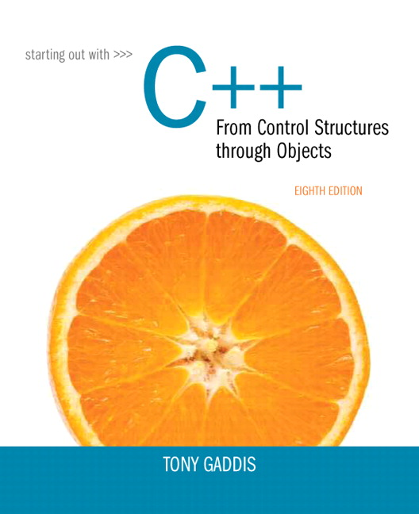
Starting out With C++: From Control Structures Through Objects
Eighth Edition
Chapter 4
Making Decisions
Copyright © 2015, 2012, 2009 Pearson Education, Inc. All Rights Reserved
Notes:
If this PowerPoint presentation contains mathematical equations, you may need to check that your computer has the following installed:
1) MathType Plugin
2) Math Player (free versions available)
3) NVDA Reader (free versions available)

Slide 2
4.1 Relational Operators

Slide 3
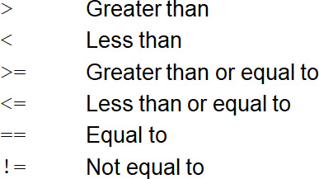
Relational Operators
Used to compare numbers to determine relative order
Operators:

Slide 4
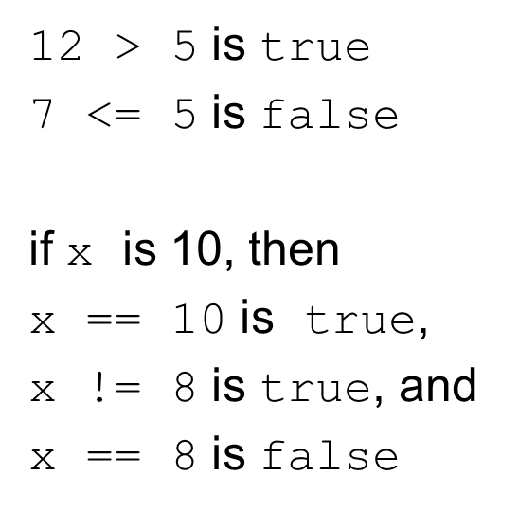
Relational Expressions (1 of 2)
Boolean expressions – true or false
Examples:

Slide 5
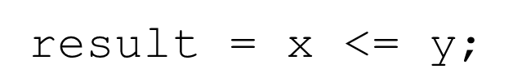
Relational Expressions (2 of 2)
Can be assigned to a variable:
Assigns 0 for false, 1 for true
Do not confuse = and ==

Slide 6
4.2 The if Statement

Slide 7
The if Statement (1 of 2)
Allows statements to be conditionally executed or skipped over
Models the way we mentally evaluate situations:
"If it is raining, take an umbrella."
"If it is cold outside, wear a coat."

Slide 8
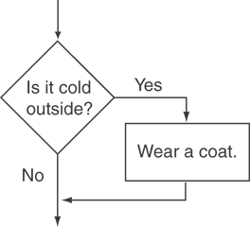
Flowchart for Evaluating a Decision (1 of 2)

Slide 9
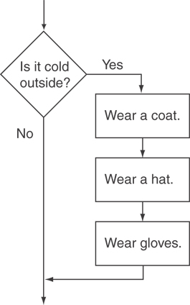
Flowchart for Evaluating a Decision (2 of 2)

Slide 10
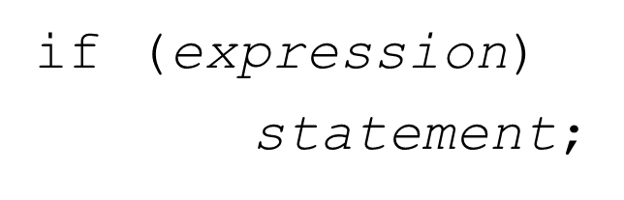
The if Statement (2 of 2)
General Format:

Slide 11
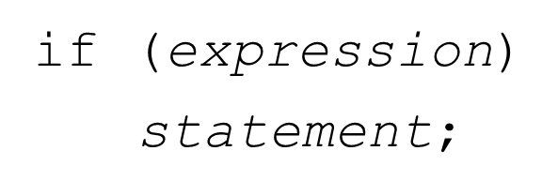
The If Statement-What Happens
To evaluate:
If the expression is true, then statement is executed.
If the expression is false, then statement is skipped.

Slide 12
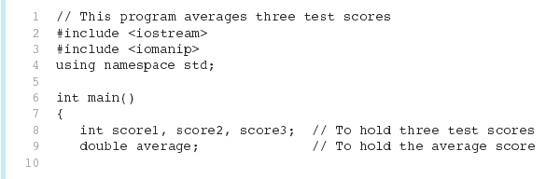
if Statement in Program 4-2 (1 of 2)

Slide 13
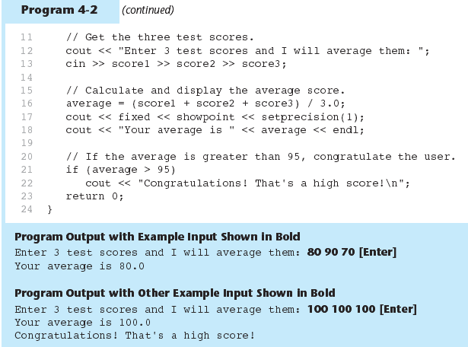
if Statement in Program 4-2 (2 of 2)

Slide 14
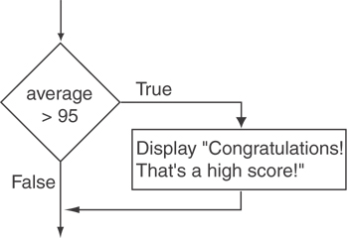
Flowchart for Program 4-2 Lines 21 and 22

Slide 15
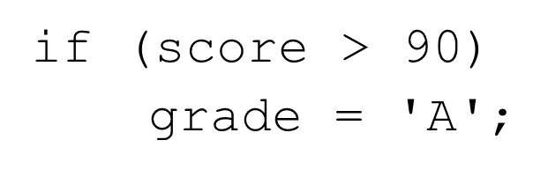
if Statement Notes
Do not place ; after (expression)
Place statement; on a separate line after (expression), indented:
Be careful testing floats and doubles for equality
0 is false; any other value is true

Slide 16
4.3 Expanding the if Statement

Slide 17
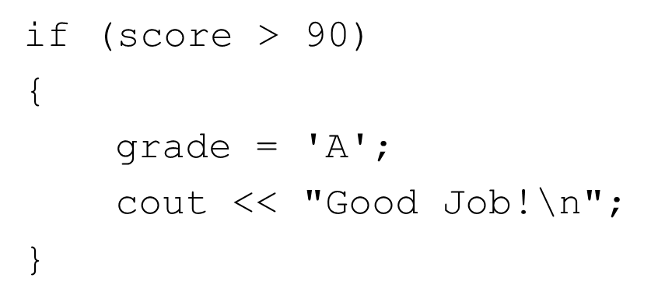
Expanding the if Statement
To execute more than one statement as part of an if statement, enclose them in { }:
{ } creates a block of code

Slide 18
4.4 The if/else Statement

Slide 19
The if/else Statement (1 of 2)
Provides two possible paths of execution
Performs one statement or block if the expression is true, otherwise performs another statement or block.

Slide 20
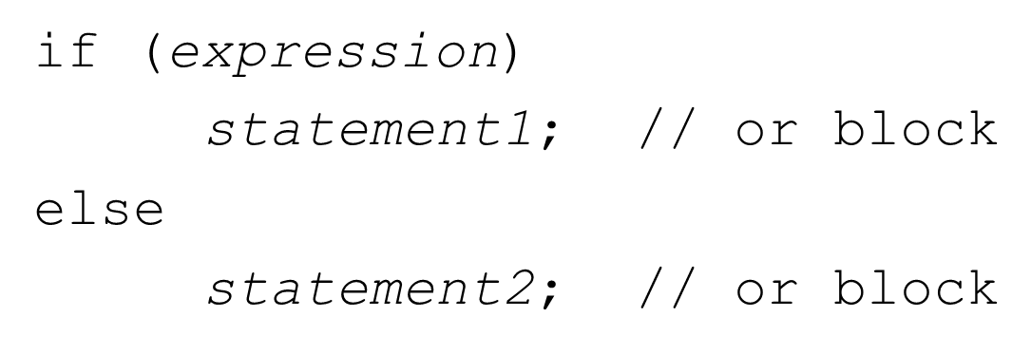
The if/else Statement (2 of 2)
General Format:

Slide 21
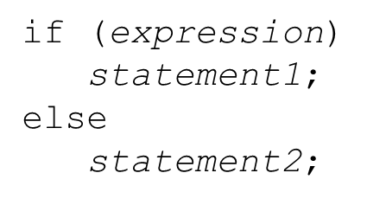
if/else-What Happens
To evaluate:
If the expression is true, then statement1 is executed and statement2 is skipped.
If the expression is false, then statement1 is skipped and statement2 is executed.

Slide 22
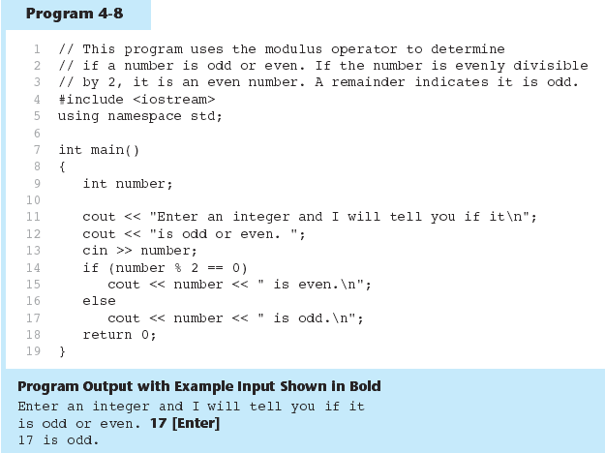
The if/else Statement and Modulus Operator in Program 4-8

Slide 23
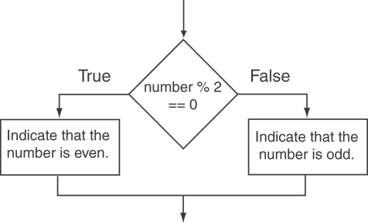
Flowchart for Program 4-8 Lines 14 through 18

Slide 24
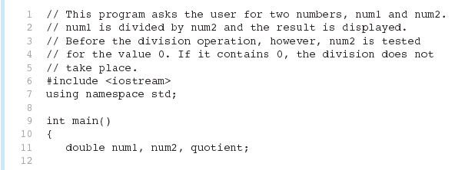
Testing the Divisor in Program 4-9 (1 of 2)

Slide 25
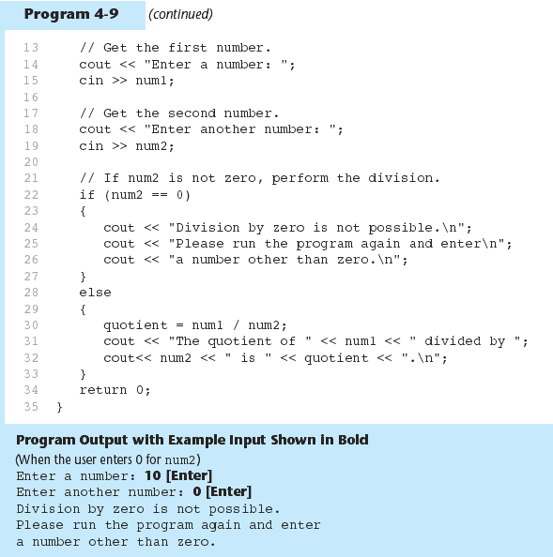
Testing the Divisor in Program 4-9 (2 of 2)

Slide 26
4.5 Nested if Statements

Slide 27
Nested if Statements (1 of 3)
An if statement that is nested inside another if statement
Nested if statements can be used to test more than one condition

Slide 28
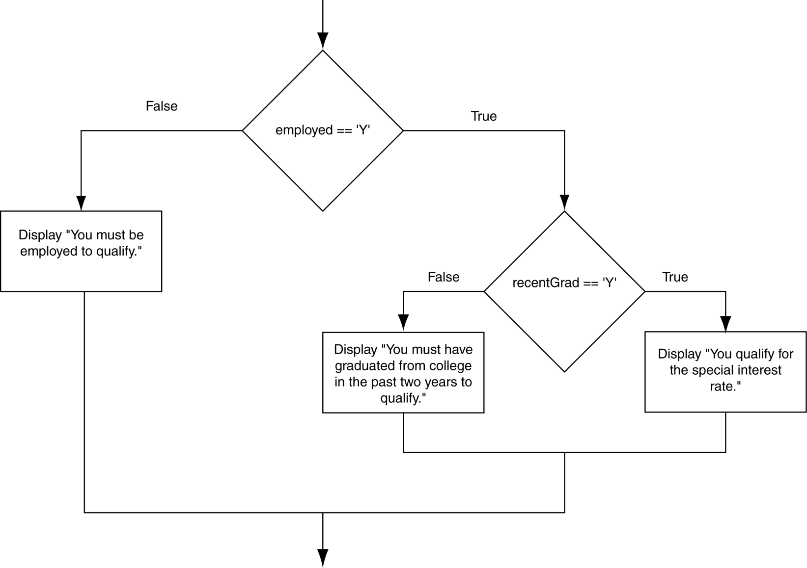
Flowchart for a Nested if Statement

Slide 29
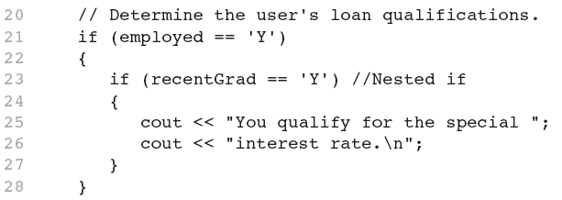
Nested if Statements (2 of 3)
From Program 4-10

Slide 30
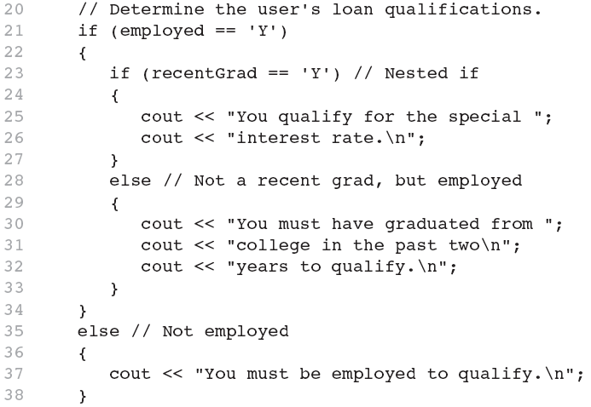
Nested if Statements (3 of 3)
Another example, from Program 4-1

Slide 31
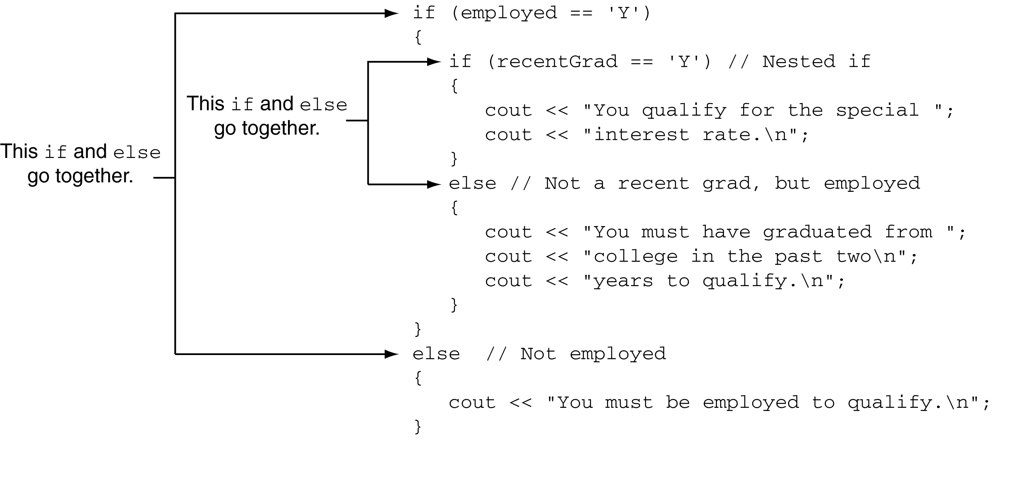
Use Proper Indentation!

Slide 32
4.6 The if/else if Statement

Slide 33
The if/else if Statement
Tests a series of conditions until one is found to be true
Often simpler than using nested if/else statements
Can be used to model thought processes such as:
“If it is raining, take an umbrella, else, if it is windy, take a hat, else, take sunglasses”

Slide 34
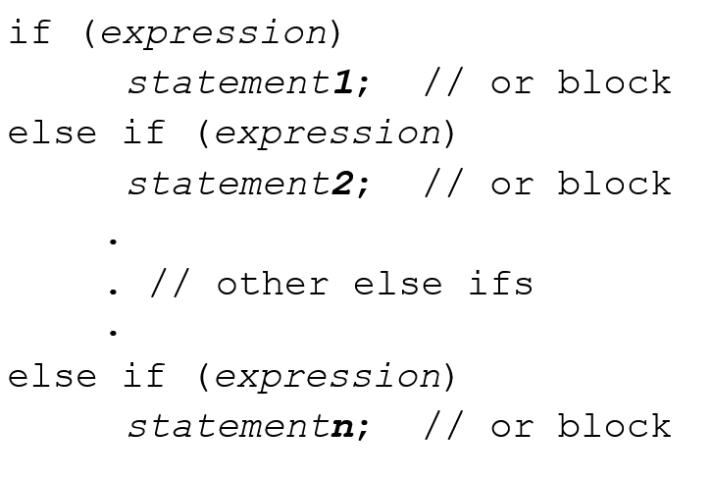
if/else if Format

Slide 35
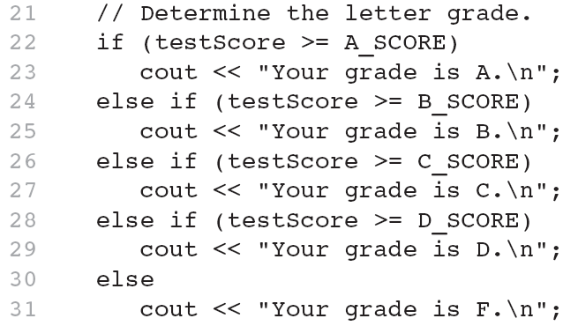
The if/else if Statement in Program 4-13

Slide 36
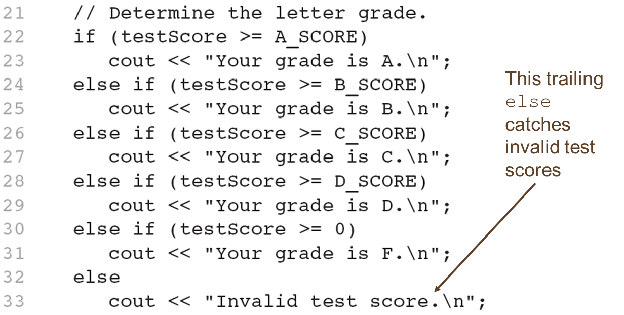
Using a Trailing else to Catch Errors in Program 4-14
The trailing else clause is optional, but it is best used to catch errors.

Slide 37
4.7 Flags

Slide 38
Flags
Variable that signals a condition
Usually implemented as a bool variable
Can also be an integer
The value 0 is considered false
Any nonzero value is considered true
As with other variables in functions, must be assigned an initial value before it is used

Slide 39
4.8 Logical Operators

Slide 40
Logical Operators
Used to create relational expressions from other relational expressions
Operators, meaning, and explanation:
ampersand ampersand | AND | New relational expression is true if both expressions are true
pipe pipe | OR | New relational expression is true if either expression is true
! | NOT | Reverses the value of an expression – true expression becomes false, and false becomes true

Slide 41
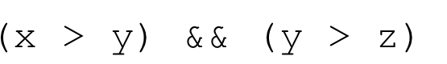
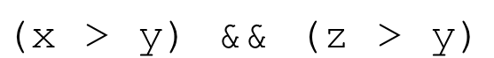
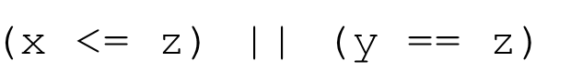
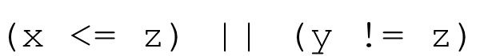
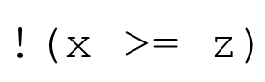
Logical Operators-Examples
int x = 12, y = 5, z = -4;
left parenthesis x right angle bracket y right parenthesis ampersand ampersand left parenthesis y right angle bracket z right parenthesis | true
left parenthesis x right angle bracket y right parenthesis ampersand ampersand left parenthesis z right angle bracket y right parenthesis | false
left parenthesis x left angle bracket equals z right angle bracket pipe pipe left parenthesis y equals equals z right parenthesis | false
left parenthesis x left angle bracket equals z right angle bracket pipe pipe left parenthesis y exclamation mark = z right parenthesis | true
exclamation mark left parenthesis x right angle bracket = z right parenthesis | false

Slide 42
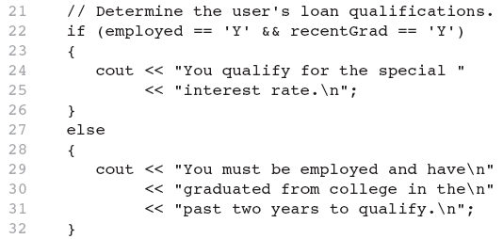
The Logical && Operator in Program 4-15

Slide 43
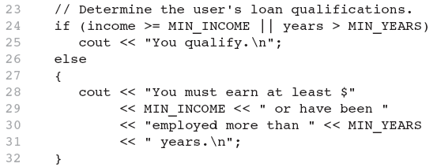
The Logical || Operator in Program 4-16

Slide 44
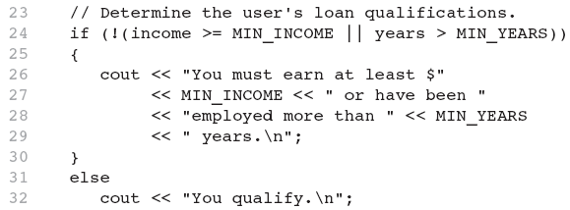
The Logical ! Operator in Program 4-17

Slide 45
Logical Operator-Notes
! has highest precedence, followed by &&, then ||
If the value of an expression can be determined by evaluating just the sub-expression on left side of a logical operator, then the sub-expression on the right side will not be evaluated (short circuit evaluation)

Slide 46
4.9 Checking Numeric Ranges with Logical Operators

Slide 47
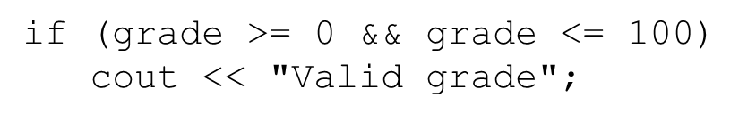
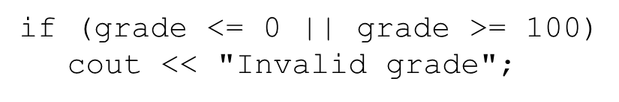
Checking Numeric Ranges with Logical Operators
Used to test to see if a value falls inside a range:
Can also test to see if value falls outside of range:
Cannot use mathematical notation:

Slide 48
4.10 Menus

Slide 49
Menus
Menu-driven program: program execution controlled by user selecting from a list of actions
Menu: list of choices on the screen
Menus can be implemented using if/else if statements

Slide 50
Menu-Driven Program Organization
Display list of numbered or lettered choices for actions
Prompt user to make selection
Test user selection in expression
if a match, then execute code for action
if not, then go on to next expression

Slide 51
4.11 Validating User Input

Slide 52
Validating User Input
Input validation: inspecting input data to determine whether it is acceptable
Bad output will be produced from bad input
Can perform various tests:
Range
Reasonableness
Valid menu choice
Divide by zero

Slide 53
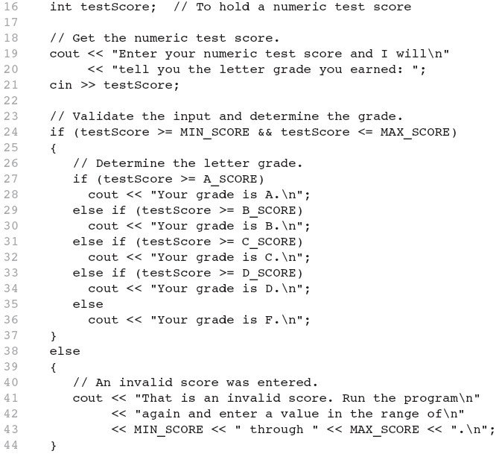
Input Validation in Program 4-19

Slide 54
4.12 Comparing Characters and Strings

Slide 55
Comparing Characters
Characters are compared using their A S C I I values
'A' < 'B'
The A S C I I value of ' A' (65) is less than the A S C I I value of ' B'(66)
'1' < '2'
The A S C I I value of '1' (49) is less than the A S C I value of '2' (50)
Lowercase letters have higher A S C I I codes than uppercase letters, so 'a' > 'Z'

Slide 56
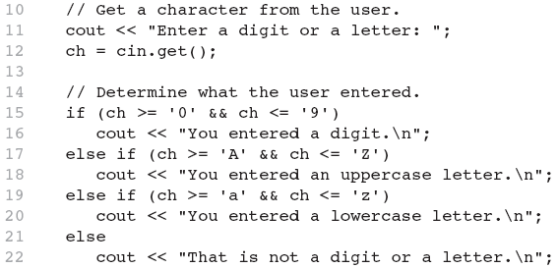
Relational Operators Compare Characters in Program 4-20

Slide 57
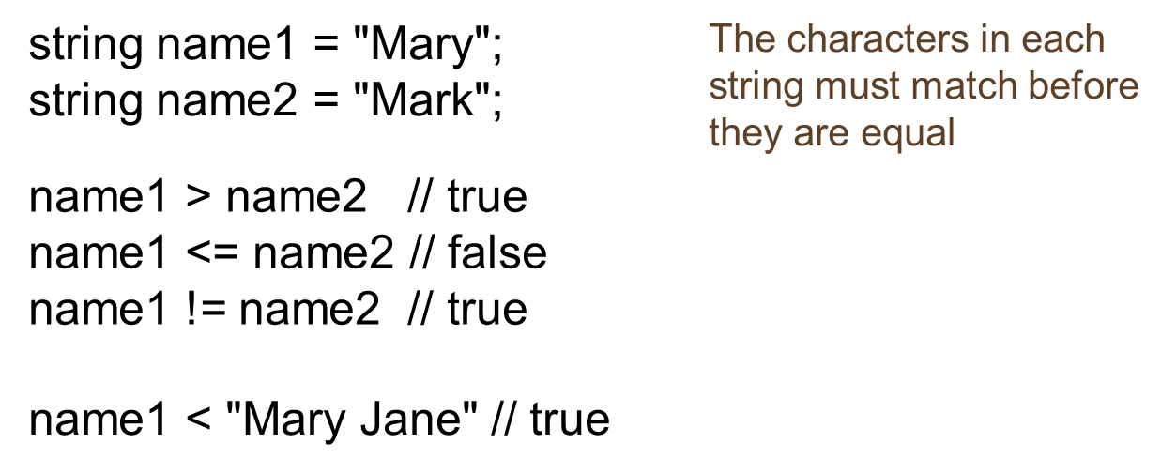
Comparing string Objects
Like characters, strings are compared using their A S C I I values

Slide 58
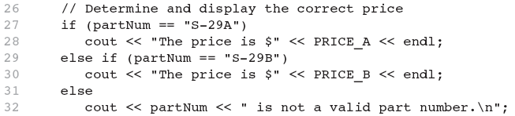
Relational Operators Compare Strings in Program 4-21

Slide 59
4.13 The Conditional Operator

Slide 60

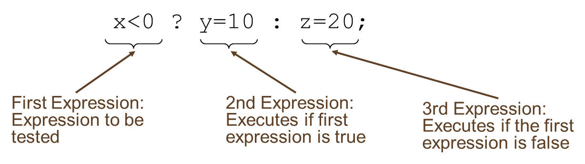
The Conditional Operator (1 of 2)
Can use to create short if/else statements
Format:

Slide 61
The Conditional Operator (2 of 2)
The value of a conditional expression is
The value of the second expression if the first expression is true
The value of the third expression if the first expression is false
Parentheses () may be needed in an expression due to precedence of conditional operator

Slide 62
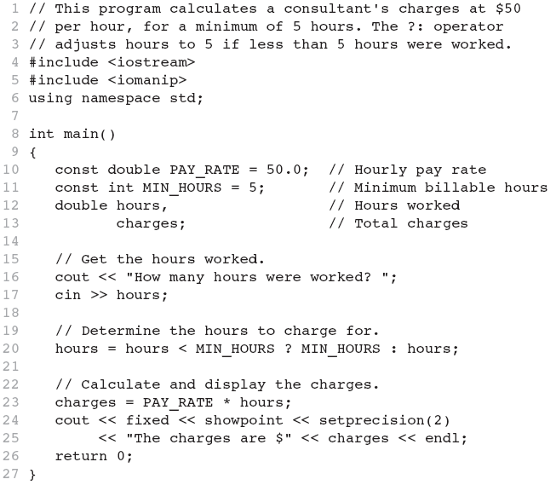
The Conditional Operator in Program 4-22

Slide 63
4.14 The switch Statement

Slide 64
The switch Statement
Used to select among statements from several alternatives
In some cases, can be used instead of if/else if statements

Slide 65
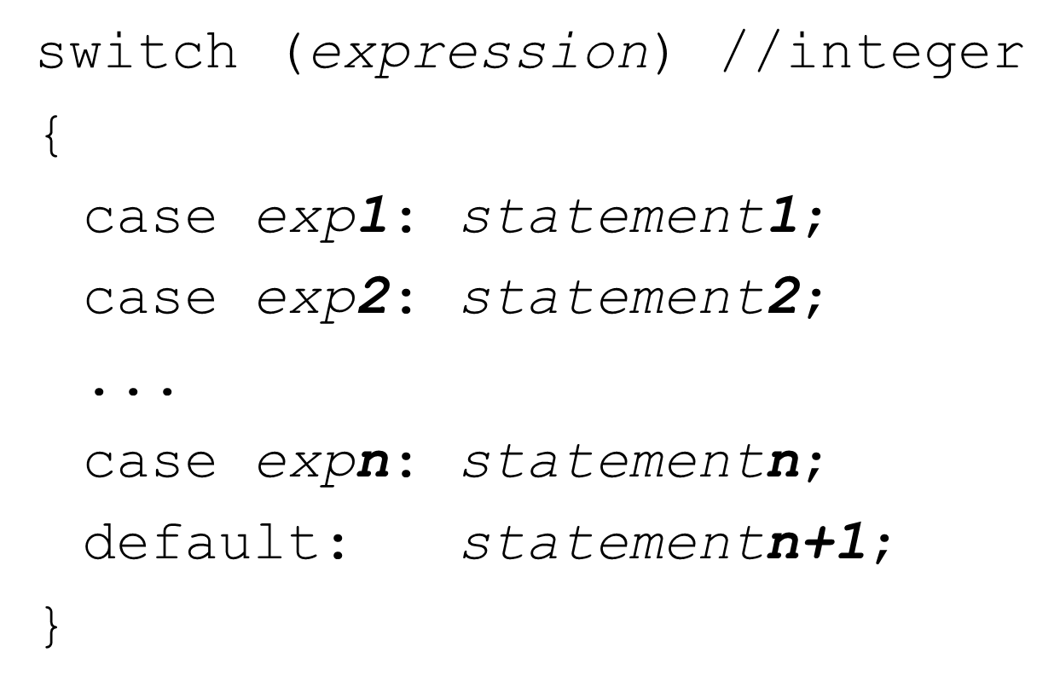
switch Statement Format

Slide 66
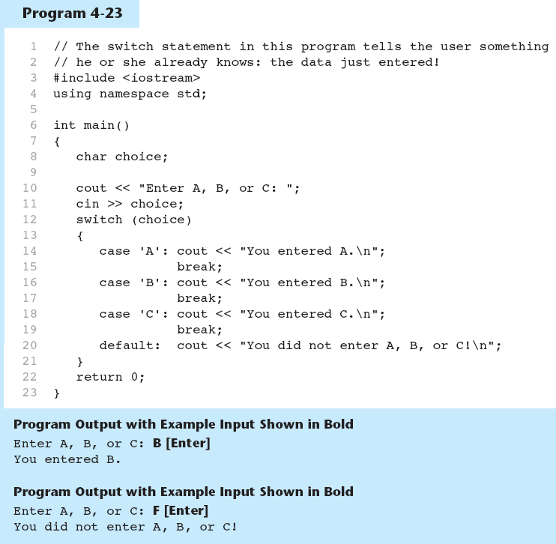
The switch Statement in Program 4-23

Slide 67
switch Statement Requirements
expression must be an integer variable or an expression that evaluates to an integer value
exp1 through exp n must be constant integer expressions or literals, and must be unique in the switch statement
default is optional but recommended

Slide 68
switch Statement-How It Works
Expression is evaluated
The value of expression is compared against exp1 through exp n.
If expression matches value exp i, the program branches to the statement following exp i and continues to the end of the switch
If no matching value is found, the program branches to the statement after default:

Slide 69
break Statement
Used to exit a switch statement
If it is left out, the program “falls through” the remaining statements in the switch statement

Slide 70
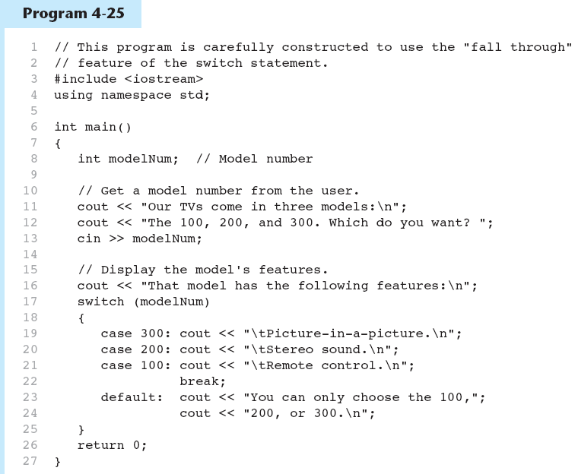
break and default Statements in Program 4-25 (1 of 2)

Slide 71
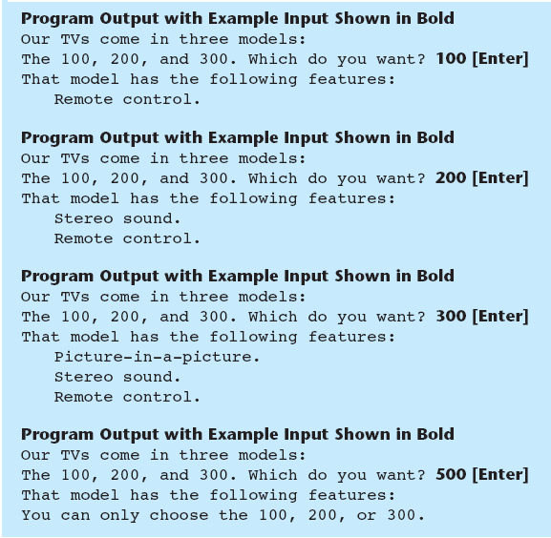
break and default Statements in Program 4-25 (2 of 2)

Slide 72
Using switch in Menu Systems
switch statement is a natural choice for menu-driven program:
display the menu
then, get the user's menu selection
use user input as expression in switch statement
use menu choices as expr in case statements

Slide 73
4.15 More About Blocks and Scope

Slide 74
More About Blocks and Scope
Scope of a variable is the block in which it is defined, from the point of definition to the end of the block
Usually defined at beginning of function
May be defined close to first use

Slide 75
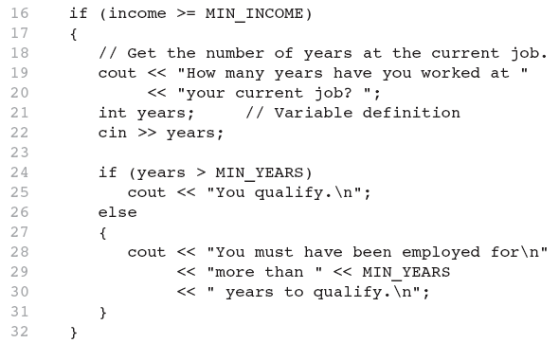
Inner Block Variable Definition in Program 4-29

Slide 76
Variables with the Same Name
Variables defined inside { } have local or block scope
When inside a block within another block, can define variables with the same name as in the outer block.
When in inner block, outer definition is not available
Not a good idea

Slide 77
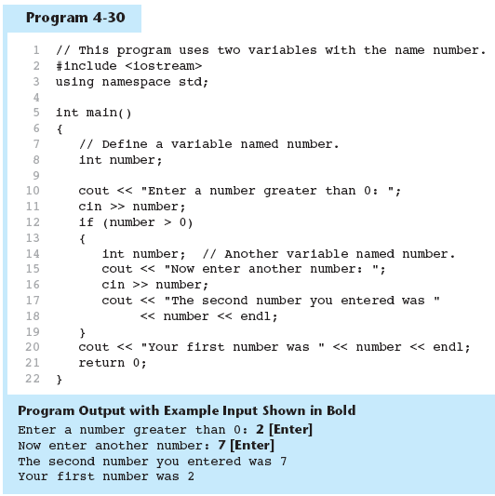
Two Variables with the Same Name in Program 4-30

Slide 78

Copyright

