Slide 1
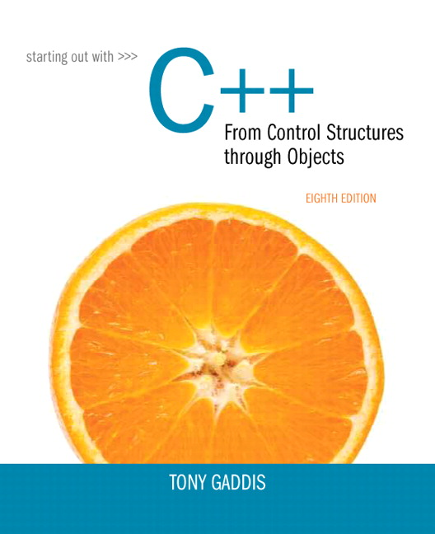
Starting out With C++: From Control Structures Through Objects
Eighth Edition
Chapter 7
Arrays
Copyright © 2015, 2012, 2009 Pearson Education, Inc. All Rights Reserved
Notes:
If this PowerPoint presentation contains mathematical equations, you may need to check that your computer has the following installed:
1) MathType Plugin
2) Math Player (free versions available)
3) NVDA Reader (free versions available)

Slide 2
7.1 Arrays Hold Multiple Values

Slide 3
Arrays Hold Multiple Values
Array: variable that can store multiple values of the same type
Values are stored in adjacent memory locations
Declared using [] operator:

Slide 4
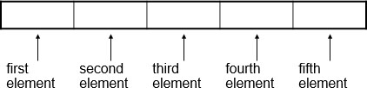
Array - Memory Layout
The definition:
allocates the following memory:

Slide 5
Array Terminology (1 of 2)
In the definition int tests[5];
int is the data type of the array elements
tests is the name of the array
5, in [5], is the size declarator. It shows the number of elements in the array.
The size of an array is (number of elements) * (size of each element)

Slide 6
Array Terminology (2 of 2)
The size of an array is:
the total number of bytes allocated for it
(number of elements) * (number of bytes for each element)
Examples:
int tests[5] is an array of 20 bytes, assuming 4 bytes for an int
long double measures[10] is an array of 80 bytes, assuming 8 bytes for a long double

Slide 7

Size Declarators
Named constants are commonly used as size declarators.
This eases program maintenance when the size of the array needs to be changed.

Slide 8
7.2 Accessing Array Elements

Slide 9

Accessing Array Elements (1 of 3)
Each element in an array is assigned a unique subscript.
Subscripts start at 0

Slide 10

Accessing Array Elements (2 of 3)
The last element’s subscript is n-1 where n is the number of elements in the array.

Slide 11
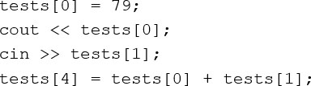
Accessing Array Elements (3 of 3)
Array elements can be used as regular variables:
Arrays must be accessed via individual elements:

Slide 12
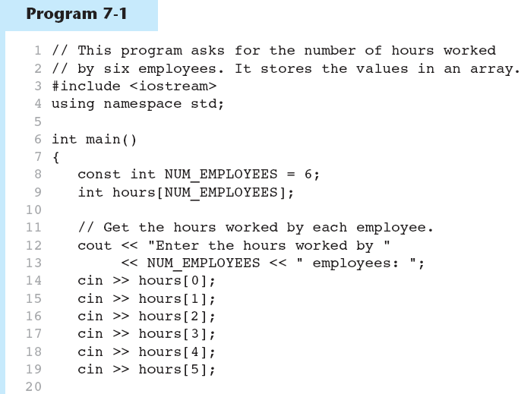
Accessing Array Elements in Program 7-1 (1 of 2)

Slide 13
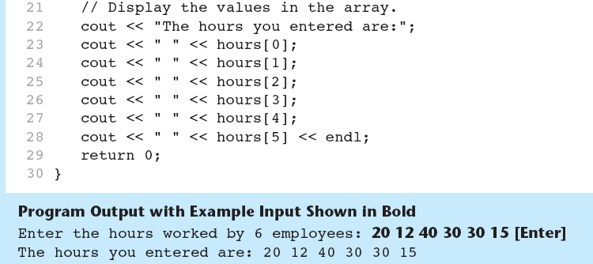
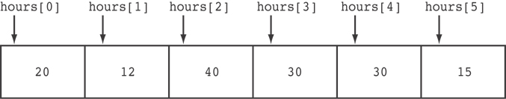
Accessing Array Elements in Program 7-1 (2 of 2)
Here are the contents of the hours array, with the values entered by the user in the example output:

Slide 14

Accessing Array Contents
Can access element with a constant or literal subscript:
Can use integer expression as subscript:

Slide 15
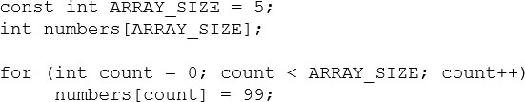
Using a Loop to Step Through an Array
Example – The following code defines an array, numbers, and assigns 99 to each element:

Slide 16
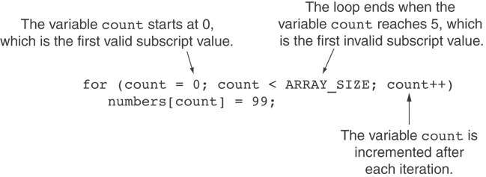
A Closer Look at the Loop

Slide 17
Default Initialization
Global array → all elements initialized to 0 by default
Local array → all elements uninitialized by default

Slide 18
7.3 No Bounds Checking in C++

Slide 19
No Bounds Checking in C++ (1 of 2)
When you use a value as an array subscript, C++ does not check it to make sure it is a valid subscript.
In other words, you can use subscripts that are beyond the bounds of the array.

Slide 20
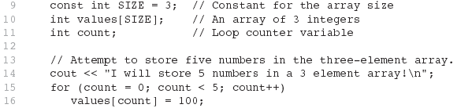
Code from Program 7-5
The following code defines a three-element array, and then writes five values to it!

Slide 21
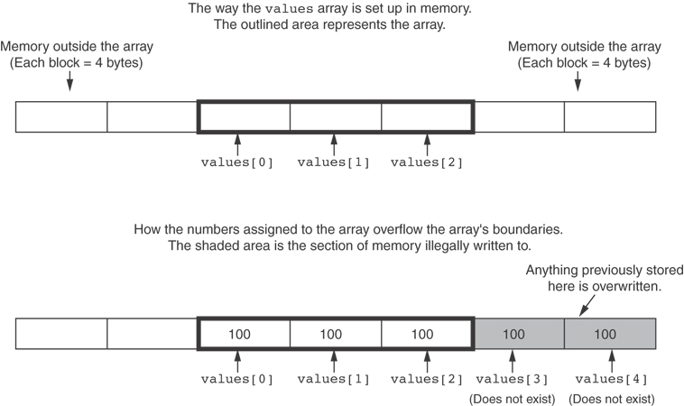
What the Code Does

Slide 22
No Bounds Checking in C++ (2 of 2)
Be careful not to use invalid subscripts.
Doing so can corrupt other memory locations, crash program, or lock up computer, and cause elusive bugs.

Slide 23

Off-By-One Errors
An off-by-one error happens when you use array subscripts that are off by one.
This can happen when you start subscripts at 1 rather than 0:

Slide 24
7.4 Array Initialization

Slide 25
Array Initialization
Arrays can be initialized with an initialization list:
The values are stored in the array in the order in which they appear in the list.
The initialization list cannot exceed the array size.

Slide 26
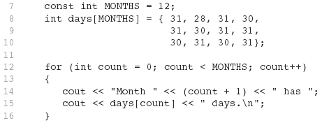
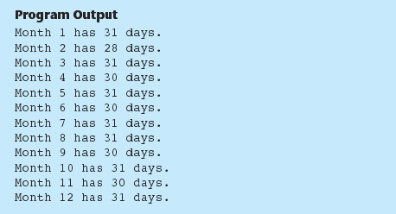
Code from Program 7-6

Slide 27
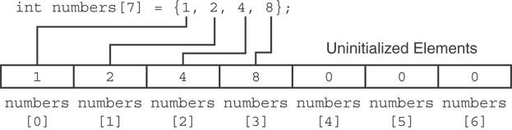
Partial Array Initialization
If array is initialized with fewer initial values than the size declarator, the remaining elements will be set to 0:

Slide 28

Implicit Array Sizing
Can determine array size by the size of the initialization list:
Must use either array size declarator or initialization list at array definition

Slide 29
7.5 The Range-Based for Loop

Slide 30
The Range-Based for Loop (1 of 2)
C++ 11 provides a specialized version of the for loop that, in many circumstances, simplifies array processing.
The range-based for loop is a loop that iterates once for each element in an array.
Each time the loop iterates, it copies an element from the array to a built-in variable, known as the range variable.
The range-based for loop automatically knows the number of elements in an array.
You do not have to use a counter variable.
You do not have to worry about stepping outside the bounds of the array.

Slide 31
The Range-Based for Loop (2 of 2)
Here is the general format of the range-based for loop:
dataType is the data type of the range variable.
rangeVariable is the name of the range variable. This variable will receive the value of a different array element during each loop iteration.
array is the name of an array on which you wish the loop to operate.
statement is a statement that executes during a loop iteration. If you need to execute more than one statement in the loop, enclose the statements in a set of braces.

Slide 32
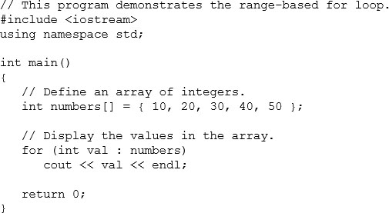
The Range-Based for Loop in Program 7-10

Slide 33
Modifying an Array with a Range-Based for Loop (1 of 2)
As the range-based for loop executes, its range variable contains only a copy of an array element.
You cannot use a range-based for loop to modify the contents of an array unless you declare the range variable as a reference.
To declare the range variable as a reference variable, simply write an ampersand (&) in front of its name in the loop header.
Program 7-12 demonstrates

Slide 34
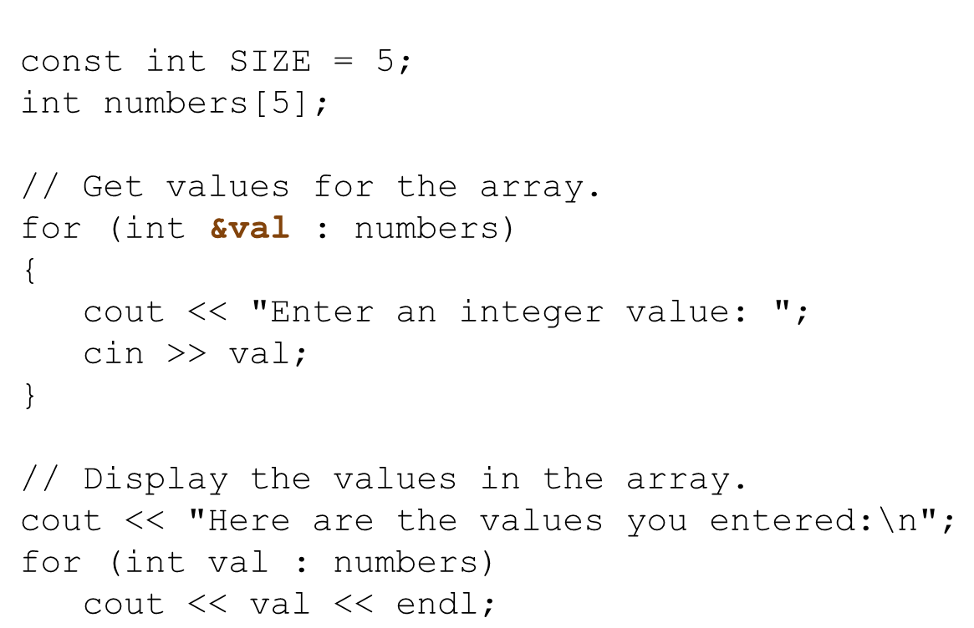
Modifying an Array with a Range-Based for Loop in Program 7-12

Slide 35

Modifying an Array with a Range-Based for Loop (2 of 2)
You can use the auto key word with a reference range variable. For example, the code in lines 12 through 16 in Program 7-12 could have been written like this:

Slide 36
The Range-Based for Loop Versus the Regular for Loop
The range-based for loop can be used in any situation where you need to step through the elements of an array, and you do not need to use the element subscripts.
If you need the element subscript for some purpose, use the regular for loop.

Slide 37
7.6 Processing Array Contents

Slide 38

Processing Array Contents
Array elements can be treated as ordinary variables of the same type as the array
When using ++, -- operators, don’t confuse the element with the subscript:

Slide 39

Array Assignment
To copy one array to another,
Don’t try to assign one array to the other:
Instead, assign element-by-element:

Slide 40

Printing the Contents of an Array (1 of 3)
You can display the contents of a character array by sending its name to cout:
But, this ONLY works with character arrays!

Slide 41

Printing the Contents of an Array (2 of 3)
For other types of arrays, you must print element-by-element:

Slide 42

Printing the Contents of an Array (3 of 3)
In C++ 11 you can use the range-based for loop to display an array’s contents, as shown here:

Slide 43
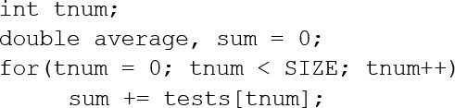
Summing and Averaging Array Elements (1 of 2)
Use a simple loop to add together array elements:
Once summed, can compute average:

Slide 44
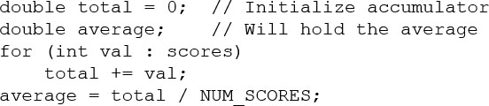
Summing and Averaging Array Elements (2 of 2)
In C++ 11 you can use the range-based for loop, as shown here:

Slide 45
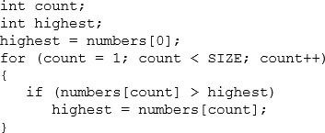
Finding the Highest Value in an Array
When this code is finished, the highest variable will contains the highest value in the numbers array.

Slide 46
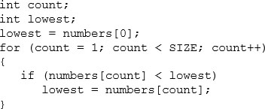
Finding the Lowest Value in an Array
When this code is finished, the lowest variable will contains the lowest value in the numbers array.

Slide 47
Partially-Filled Arrays
If it is unknown how much data an array will be holding:
Make the array large enough to hold the largest expected number of elements.
Use a counter variable to keep track of the number of items stored in the array.

Slide 48
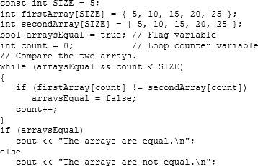
Comparing Arrays
To compare two arrays, you must compare element-by-element:

Slide 49
7.7 Using Parallel Arrays

Slide 50
Using Parallel Arrays
Parallel arrays: two or more arrays that contain related data
A subscript is used to relate arrays: elements at same subscript are related
Arrays may be of different types

Slide 51
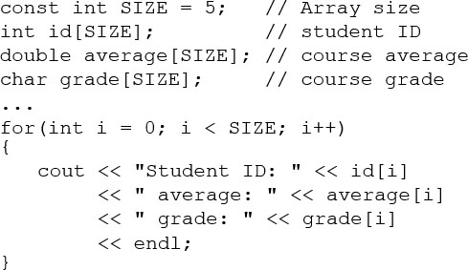
Parallel Array Example

Slide 52
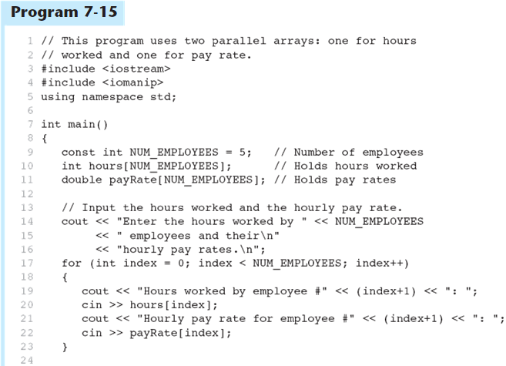
Parallel Arrays in Program 7-15 (1 of 3)

Slide 53
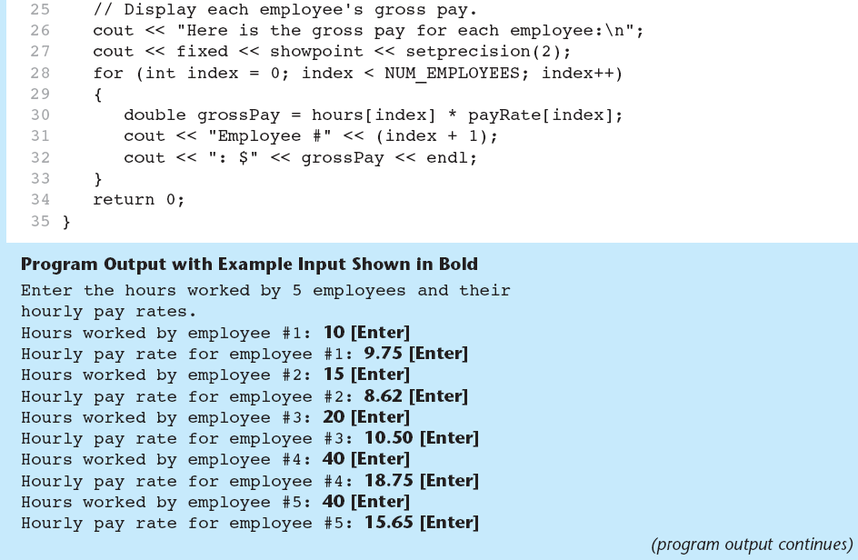
Parallel Arrays in Program 7-15 (2 of 3)

Slide 54
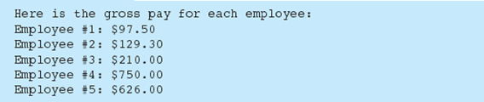
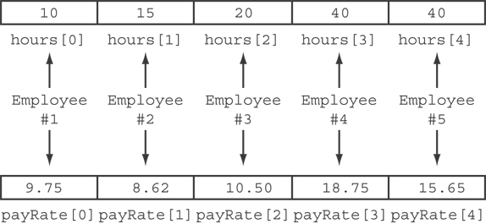
Parallel Arrays in Program 7-15 (3 of 3)
The hours and payRate arrays are related through their subscripts:

Slide 55
7.8 Arrays as Function Arguments

Slide 56

Arrays as Function Arguments (1 of 2)
To pass an array to a function, just use the array name:
To define a function that takes an array parameter, use empty [] for array argument:

Slide 57

Arrays as Function Arguments (2 of 2)
When passing an array to a function, it is common to pass array size so that function knows how many elements to process:
Array size must also be reflected in prototype, header:

Slide 58
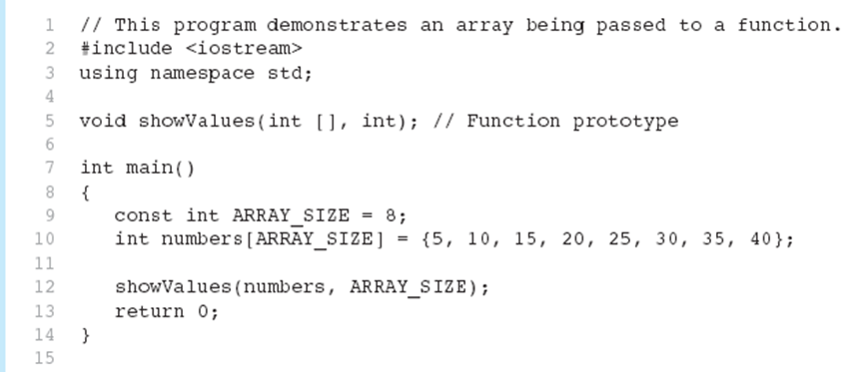
Passing an Array to a Function in Program 7-17 (1 of 2)

Slide 59
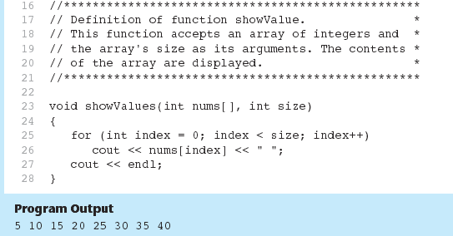
Passing an Array to a Function in Program 7-17 (2 of 2)

Slide 60
Modifying Arrays in Functions
Array names in functions are like reference variables – changes made to array in a function are reflected in actual array in calling function
Need to exercise caution that array is not inadvertently changed by a function

Slide 61
7.9 Two-Dimensional Arrays

Slide 62

Two-Dimensional Arrays
Can define one array for multiple sets of data
Like a table in a spreadsheet
Use two size declarators in definition:
First declarator is number of rows; second is number of columns

Slide 63
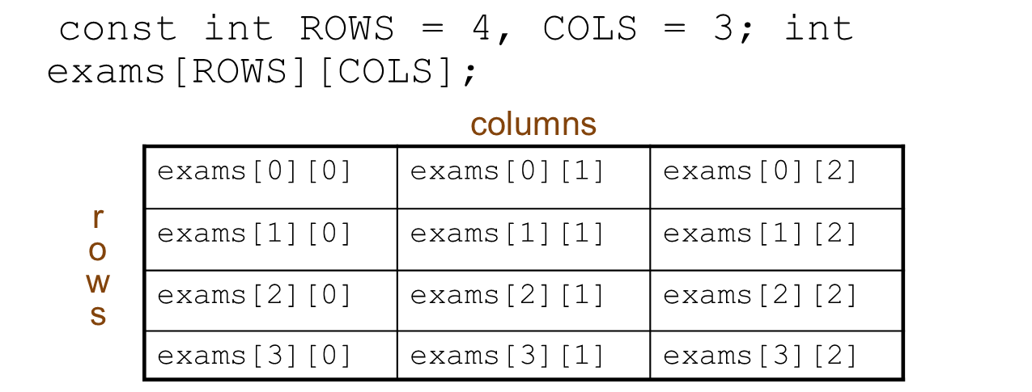
Two-Dimensional Array Representation
Use two subscripts to access element:

Slide 64
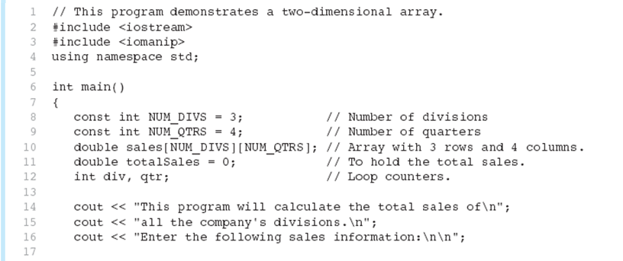
A Two-Dimensional Array in Program 7-21 (1 of 3)

Slide 65
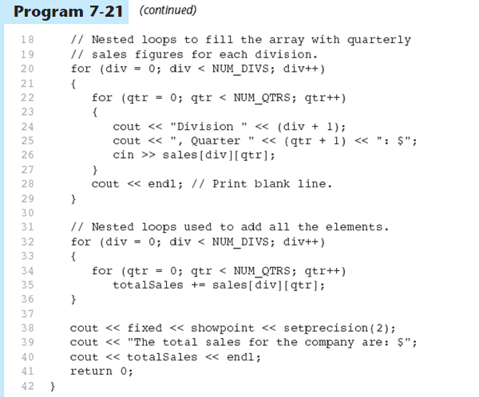
A Two-Dimensional Array in Program 7-21 (2 of 3)

Slide 66
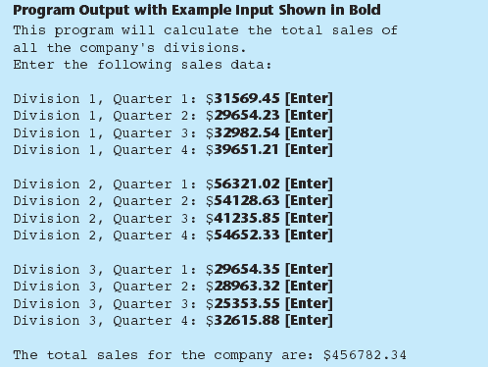
A Two-Dimensional Array in Program 7-21 (3 of 3)

Slide 67
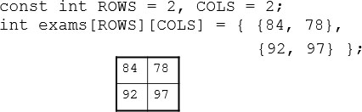
2D Array Initialization
Two-dimensional arrays are initialized row-by-row:
Can omit inner { }, some initial values in a row – array elements without initial values will be set to 0 or NULL

Slide 68
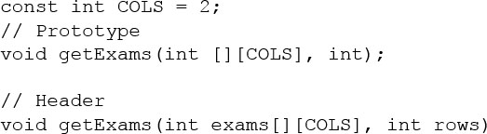
Two-Dimensional Array as Parameter, Argument
Use array name as argument in function call:
Use empty [] for row, size declarator for column in prototype, header:

Slide 69
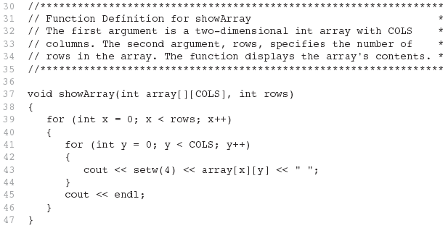
Example – The showarray Function from Program 7-22

Slide 70
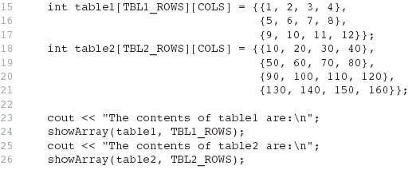
How showarray is Called

Slide 71
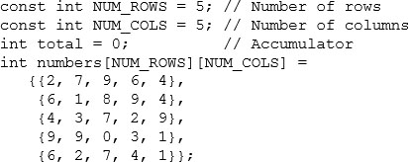
Summing All the Elements in a Two-Dimensional Array (1 of 2)
Given the following definitions:

Slide 72
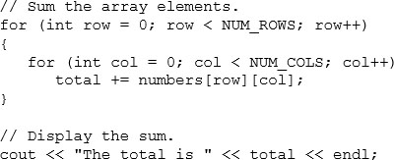
Summing All the Elements in a Two-Dimensional Array (2 of 2)

Slide 73
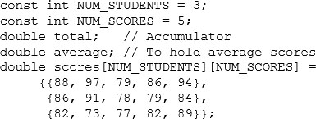
Summing the Rows of a Two-Dimensional Array (1 of 2)
Given the following definitions:

Slide 74
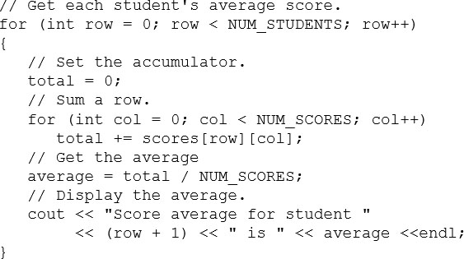
Summing the Rows of a Two-Dimensional Array (2 of 2)

Slide 75

Summing the Columns of a Two-Dimensional Array (1 of 2)
Given the following definitions:

Slide 76
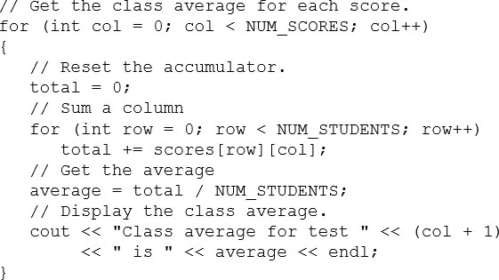
Summing the Columns of a Two-Dimensional Array (2 of 2)

Slide 77
7.10 Arrays with Three or More Dimensions

Slide 78

Arrays with Three or More Dimensions
Can define arrays with any number of dimensions:
When used as parameter, specify all but 1st dimension in prototype, heading:

Slide 79
7.12 Introduction to the S T L vector

Slide 80
Introduction to the S T L vector
A data type defined in the Standard Template Library (covered more in Chapter 16)
Can hold values of any type:
Automatically adds space as more is needed – no need to determine size at definition
Can use [] to access elements

Slide 81
Declaring Vectors
You must #include<vector>
Declare a vector to hold int element:
Declare a vector with initial size 30:
Declare a vector and initialize all elements to 0:
Declare a vector initialized to size and contents of another vector:

Slide 82
Adding Elements to a Vector
If you are using C++ 11, you can initialize a vector with a list of values:
Use push_back member function to add element to a full array or to an array that had no defined size:
Use size member function to determine size of a vector:

Slide 83
Removing Vector Elements
Use pop_back member function to remove last element from vector:
To remove all contents of vector, use clear member function:
To determine if vector is empty, use empty member function:

Slide 84
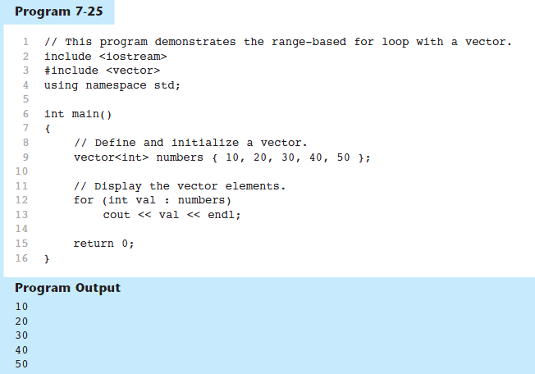
Using the Range-Based for Loop with a Vector in C++ 11

Slide 85
Other Useful Member Functions
Member Function | Description | Example
at(elt) | Returns the value of the element at position elt in the vector | Computer code has 2 lines. The lines read as follows. Line 1. c out left angle bracket, left angle bracket. Line 2, indented once. v e c l period a t left parenthesis i right parenthesis semicolon.
capacity() | Returns the maximum number of elements a vector can store without allocating more memory | Computer code has 2 lines. The lines read as follows. Line 1. m a x e l t s equals. Line 2. v e c l period capacity left parenthesis right parenthesis semicolon.
reverse() | Reverse the order of the elements in a vector | Computer code reads, v e c l period reverse left parenthesis right parenthesis semicolon.
resize (elts,val) | Add elements to a vector, optionally initializes them | Computer code reads, v e c l period resize left parenthesis 5 comma 0 right parenthesis semicolon.
swap(vec2) | Exchange the contents of two vectors | Computer code reads, v e c l period swap left parenthesis v e c 2 right parenthesis semicolon.

Slide 86

Copyright

