Slide 1
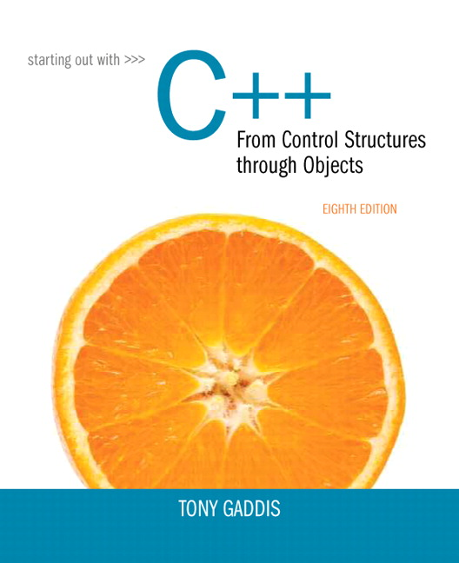
Starting out With C++: From Control Structures Through Objects
Eighth Edition
Chapter 8
Searching and Sorting Arrays
Copyright © 2015, 2012, 2009 Pearson Education, Inc. All Rights Reserved
Notes:
If this PowerPoint presentation contains mathematical equations, you may need to check that your computer has the following installed:
1) MathType Plugin
2) Math Player (free versions available)
3) NVDA Reader (free versions available)

Slide 2
8.1 Introduction to Search Algorithms

Slide 3
Introduction to Search Algorithms
Search: locate an item in a list of information
Two algorithms we will examine:
Linear search
Binary search

Slide 4
Linear Search (1 of 2)
Also called the sequential search
Starting at the first element, this algorithm sequentially steps through an array examining each element until it locates the value it is searching for.

Slide 5
Linear Search - Example
Array numlist contains:
17 | 23 | 5 | 11 | 2 | 29 | 3
Searching for the the value 11, linear search examines 17, 23, 5, and 11
Searching for the the value 7, linear search examines 17, 23, 5, 11, 2, 29, and 3

Slide 6
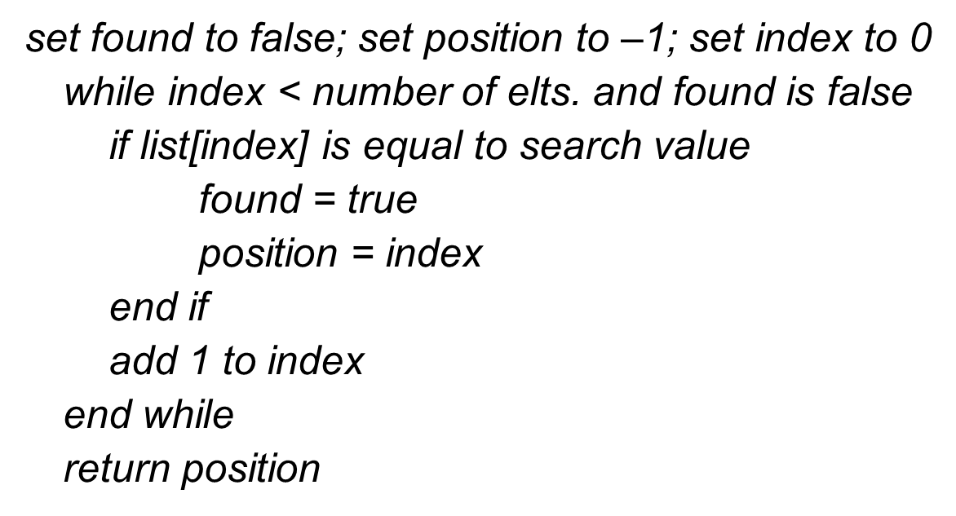
Linear Search (2 of 2)
Algorithm:

Slide 7
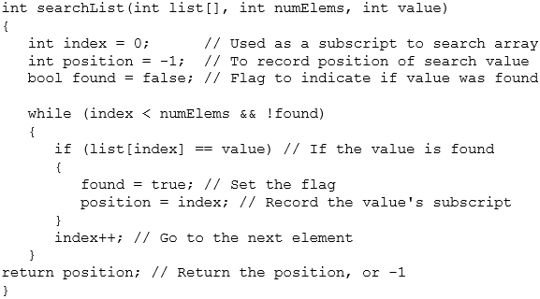
A Linear Search Function

Slide 8
Linear Search - Tradeoffs
Benefits:
Easy algorithm to understand
Array can be in any order
Disadvantages:
Inefficient (slow): for array of N elements, examines N/2 elements on average for value in array, N elements for value not in array

Slide 9
Binary Search (1 of 2)
Requires array elements to be in order
Divides the array into three sections:
middle element
elements on one side of the middle element
elements on the other side of the middle element
If the middle element is the correct value, done. Otherwise, go to step 1. using only the half of the array that may contain the correct value.
Continue steps 1. and 2. until either the value is found or there are no more elements to examine

Slide 10
Binary Search - Example
Array numlist2 contains:
2 | 3 | 5 | 11 | 17 | 23 | 29
Searching for the value 11, binary search examines 11 and stops
Searching for the value 7, linear search examines 11, 3, 5, and stops

Slide 11
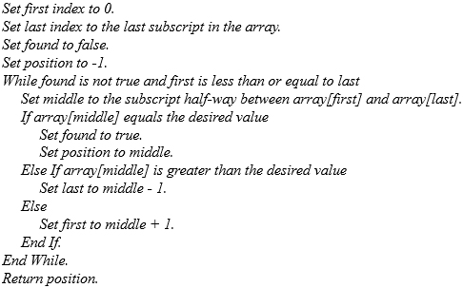
Binary Search (2 of 2)

Slide 12
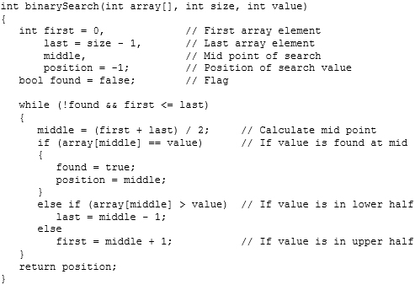
A Binary Search Function

Slide 13
Binary Search - Tradeoffs
Benefits:
Much more efficient than linear search. For array of N
elements, performs at most
comparisons
Disadvantages:
Requires that array elements be sorted

Slide 14
8.3 Introduction to Sorting Algorithms

Slide 15
Introduction to Sorting Algorithms
Sort: arrange values into an order:
Alphabetical
Ascending numeric
Descending numeric
Two algorithms considered here:
Bubble sort
Selection sort

Slide 16
Bubble Sort
Concept:
Compare 1st two elements
If out of order, exchange them to put in order
Move down one element, compare 2nd and 3rd elements, exchange if necessary. Continue until end of array.
Pass through array again, exchanging as necessary
Repeat until pass made with no exchanges

Slide 17
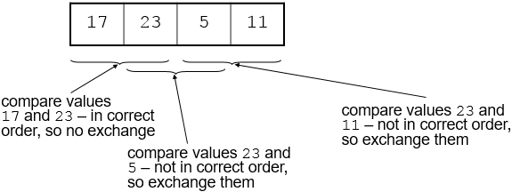
Example – First Pass
Array numlist3 contains:

Slide 18
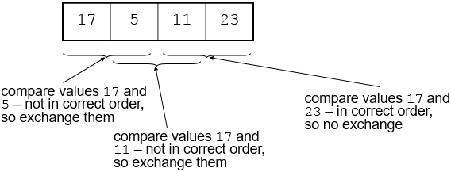
Example – Second Pass
After first pass, array numlist3 contains:

Slide 19
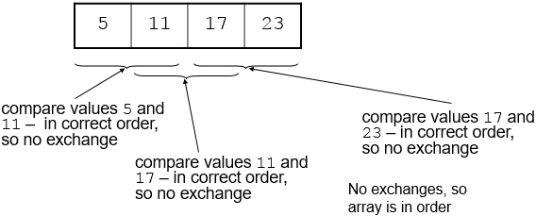
Example – Third Pass
After second pass, array numlist3 contains:

Slide 20
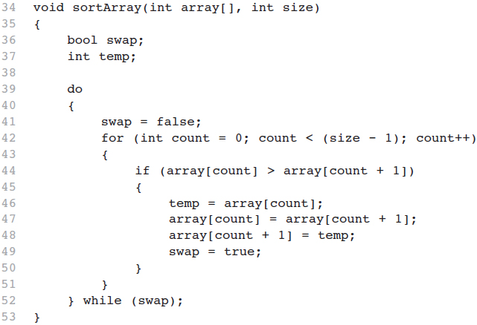
A Bubble Sort Function – from Program 8-4

Slide 21
Bubble Sort - Tradeoffs
Benefit:
Easy to understand and implement
Disadvantage:
Inefficient: slow for large arrays

Slide 22
Selection Sort
Concept for sort in ascending order:
Locate smallest element in array. Exchange it with element in position 0
Locate next smallest element in array. Exchange it with element in position 1.
Continue until all elements are arranged in order

Slide 23
Selection Sort - Example (1 of 2)
Array numlist contains:
11 | 2 | 29 | 3
Smallest element is 2. Exchange 2 with element in 1st position in array:
2 | 11 | 29 | 3

Slide 24
Selection Sort - Example (2 of 2)
Next smallest element is 3. Exchange 3 with element in 2nd position in array:
2 | 3 | 29 | 11
Next smallest element is 11. Exchange 11 with element in 3rd position in array:
2 | 3 | 11 | 29

Slide 25
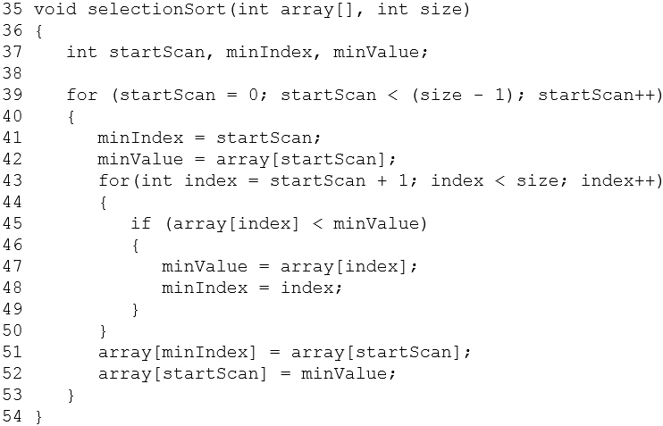
A Selection Sort Function – from Program 8-5

Slide 26
Selection Sort - Tradeoffs
Benefit:
More efficient than Bubble Sort, since fewer exchanges
Disadvantage:
May not be as easy as Bubble Sort to understand

Slide 27
8.5 Sorting and Searching Vectors

Slide 28
Sorting and Searching Vectors
Sorting and searching algorithms can be applied to vectors as well as arrays
Need slight modifications to functions to use vector arguments:
vector <type> & used in prototype
No need to indicate vector size – functions can use size member function to calculate

Slide 29

Copyright

