Slide 1
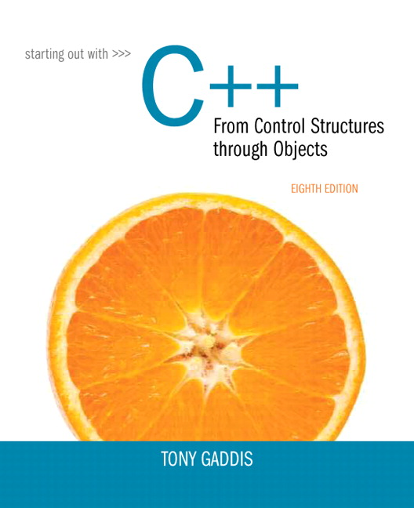
Starting out With C++: From Control Structures Through Objects
Eighth Edition
Chapter 10
Characters, C-Strings, and More About the string Class
Copyright © 2015, 2012, 2009 Pearson Education, Inc. All Rights Reserved
Notes:
If this PowerPoint presentation contains mathematical equations, you may need to check that your computer has the following installed:
1) MathType Plugin
2) Math Player (free versions available)
3) NVDA Reader (free versions available)

Slide 2
10.1 Character Testing

Slide 3
Character Testing
Requires cctype header file
Function | Meaning
isalpha | true if arg. is a letter, false otherwise
isalnum | true if arg. is a letter or digit, false otherwise
isdigit | true if arg. is a digit 0-9, false otherwise
islower | true if arg. is lowercase letter, false otherwise
isprint | true if arg. is a printable character, false otherwise
ispunct | true if arg. is a punctuation character, false otherwise
isupper | true if arg. is an uppercase letter, false otherwise
isspace | true if arg. is a whitespace character, false otherwise

Slide 4
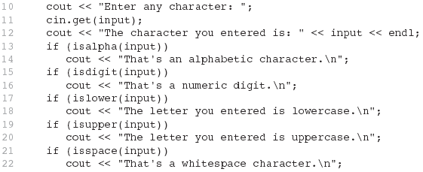
From Program 10-1

Slide 5
10.2 Character Case Conversion

Slide 6
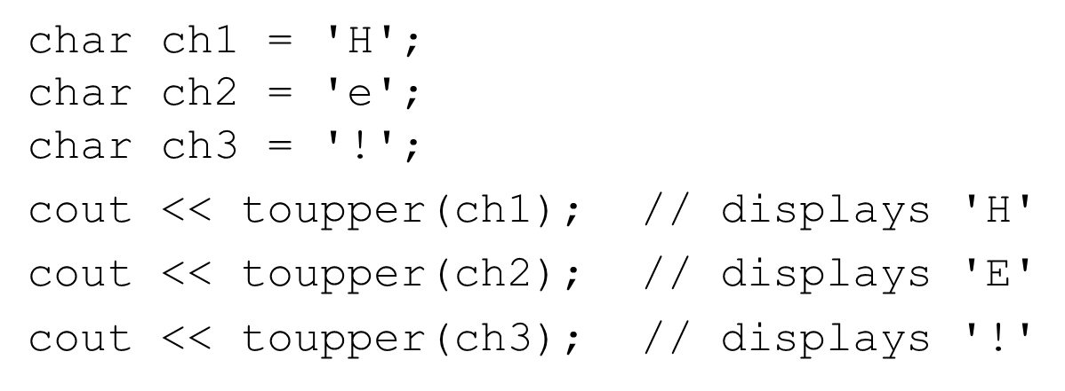
Character Case Conversion (1 of 2)
Require cctype header file
Functions:
toupper: if char argument is lowercase letter, return uppercase equivalent; otherwise, return input unchanged

Slide 7
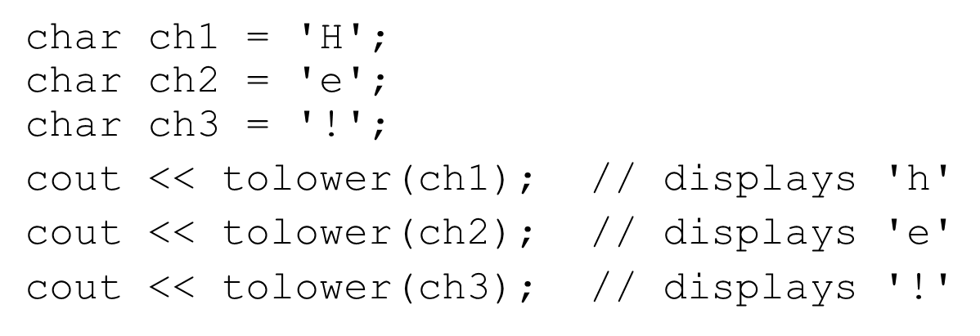
Character Case Conversion (2 of 2)
Functions:
tolower: if char argument is uppercase letter, return lowercase equivalent; otherwise, return input unchanged

Slide 8
10.3 C-Strings

Slide 9
C-Strings (1 of 2)
C-string: sequence of characters stored in adjacent memory locations and terminated by NULL character
String literal (string constant): sequence of characters enclosed in double quotes " " : "Hi there!"

Slide 10

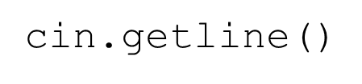
C-Strings (2 of 2)
Array of chars can be used to define storage for string:
Leave room for NULL at end
Can enter a value using
Input is whitespace-terminated
No check to see if enough space
For input containing whitespace, and to control amount of input, use

Slide 11
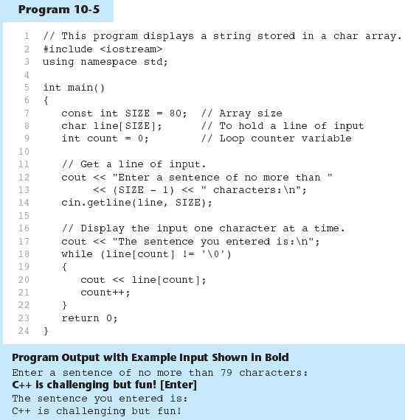
Using C-Strings in Program 10-5

Slide 12
10.4 Library Functions for Working with C-Strings

Slide 13
Library Functions for Working with C-Strings (1 of 3)
Require the cstring header file
Functions take one or more C-Strings as arguments. Can use:
C-stringname
pointer to C-string
literal string

Slide 14
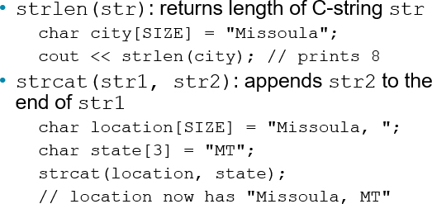
Library Functions for Working with C-Strings (2 of 3)
Functions:

Slide 15
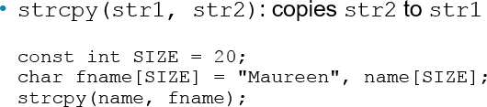
Library Functions for Working with C-Strings (3 of 3)
Functions:
Note: strcat and strcpy perform no bounds checking to determine if there is enough space in receiving character array to hold the string it is being assigned.

Slide 16
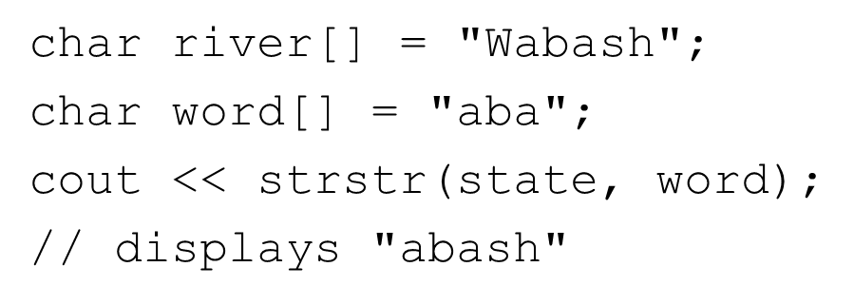
C-String Inside a C-String
Function:
finds the first occurrence of str2 in str1. Returns a pointer to match, or NULL if no match.

Slide 17
10.5 C-String/Numeric Conversion Functions

Slide 18
String/Numeric Conversion Functions (1 of 2)
Requires cstdlib header file
Function | Parameter | Action
atoi | C-string | converts C-string to an int value, returns the value
atol | C-string | converts C-string to a long value, returns the value
atof | C-string | converts C-string to a double value, returns the value
itoa | int,C-string, int | converts 1st int parameter to a C-string, stores it in 2nd parameter. 3rd parameter is base of converted value

Slide 19
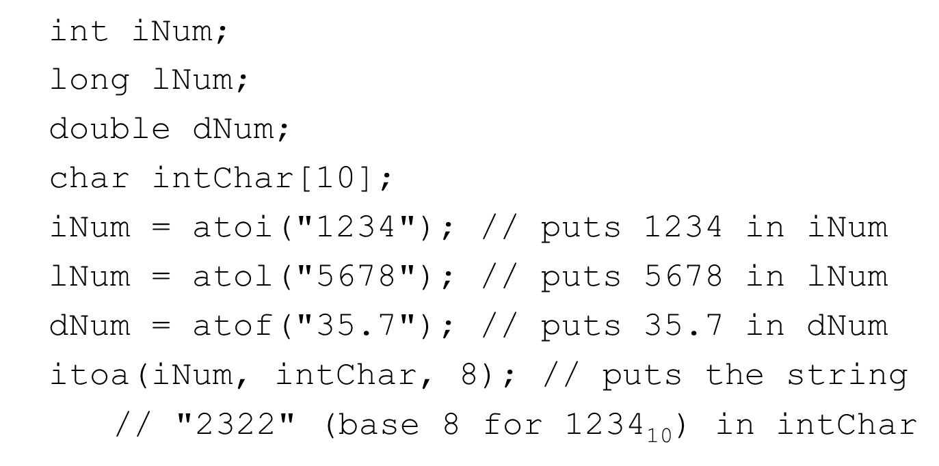
String/Numeric Conversion Functions (2 of 2)

Slide 20
String/Numeric Conversion Functions-Notes
if C-string contains non-digits, results are undefined
function may return result up to non-digit
function may return 0
itoa does no bounds checking–make sure there is enough space to store the result

Slide 21
10.6 Writing Your Own C-String Handling Functions

Slide 22
Writing Your Own C-String Handling Functions
Designing C-String Handling Functions
can pass arrays or pointers to char arrays
Can perform bounds checking to ensure enough space for results
Can anticipate unexpected user input

Slide 23
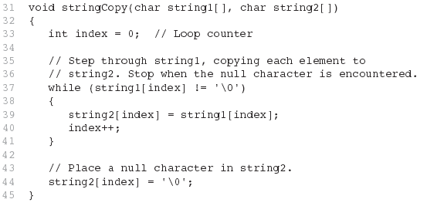
From Program 10-9

Slide 24
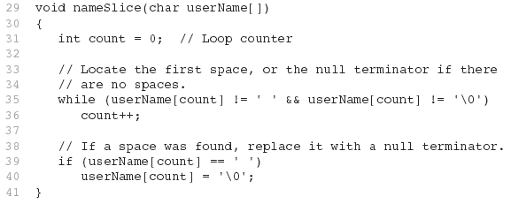
From Program 10-10

Slide 25
10.7 More About the C++ string Class

Slide 26
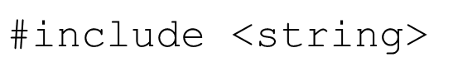
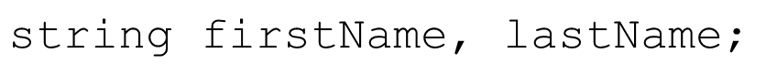
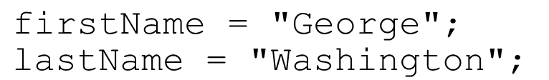
The C++ string Class
Special data type supports working with strings
Can define string variables in programs:
Can receive values with assignment operator:
Can be displayed via cout

Slide 27
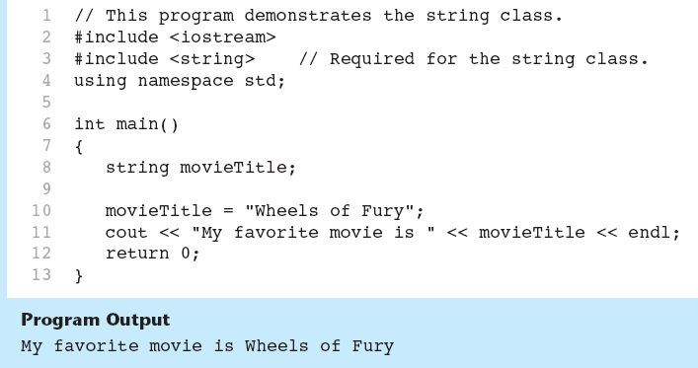
Using the string Class in Program 10-15

Slide 28

Input into a string Object (1 of 2)
Use
to read an item into a string:

Slide 29
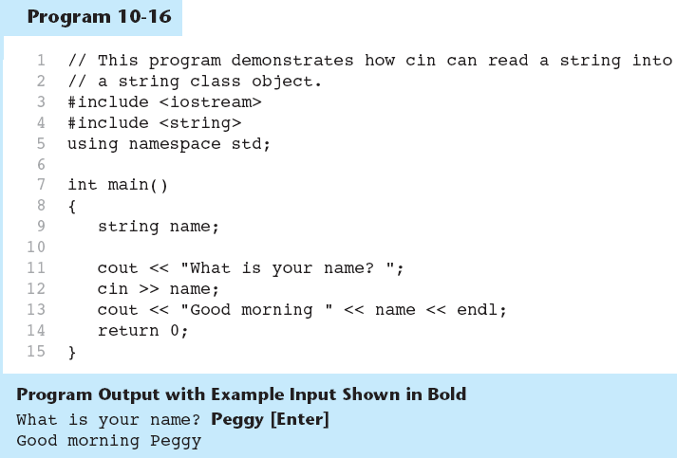
Using Cin and string Objects in Program 10-16

Slide 30
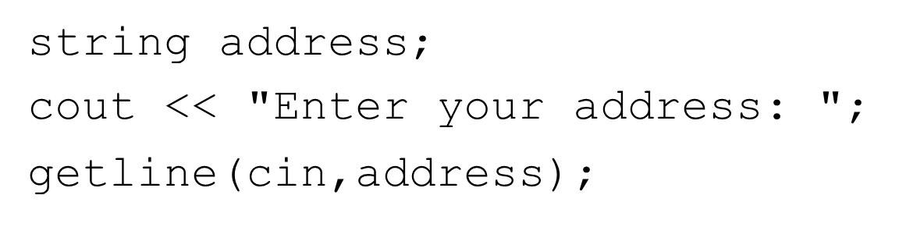
Input into a string Object (2 of 2)
Use getline function to put a line of input, possibly including spaces, into a string:

Slide 31
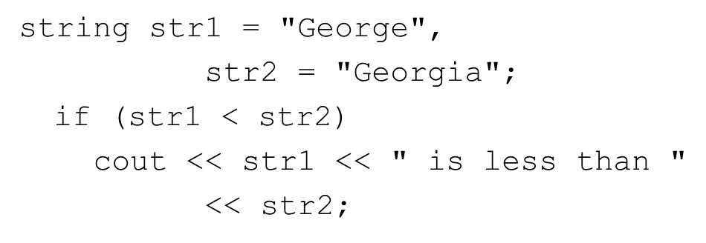
string Comparison
Can use relational operators directly to compare string objects:
Comparison is performed similar to strcmp function. Result is true or false

Slide 32
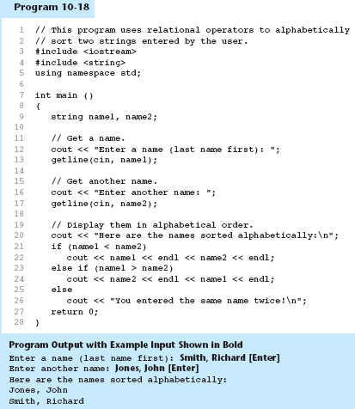
Program 10-18

Slide 33
Other Definitions of C++ strings
Definition | Meaning
string name; | defines an empty string object
string myname("Chris"); | defines a string and initializes it
string yourname(myname); | defines a string and initializes it
string aname(myname, 3); | defines a string and initializes it with first 3 characters of myname
string verb(myname,3,2); | defines a string and initializes it with 2 characters from myname starting at position 3
string noname(‘A’, 5); | defines string and initializes it to 5 'A' s

Slide 34
string Operators (1 of 2)
Operator | Meaning
right angle bracket right angle bracket | extracts characters from stream up to whitespace, insert into string
left angle bracket left angle bracket | inserts string into stream
= | assigns string on right to string object on left
plus equals | appends string on right to end of contents on left
+ | concatenates two strings
[] | references character in string using array notation
right angle bracket, right angle bracket equals, left angle bracket, left angle bracket equals, equals equals, exclamation mark equals | relational operators for string comparison. Return true or false

Slide 35
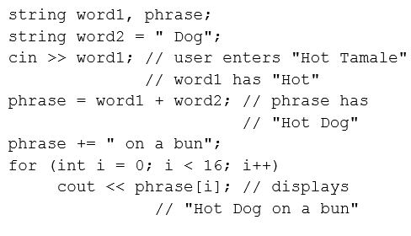
string Operators (2 of 2)

Slide 36
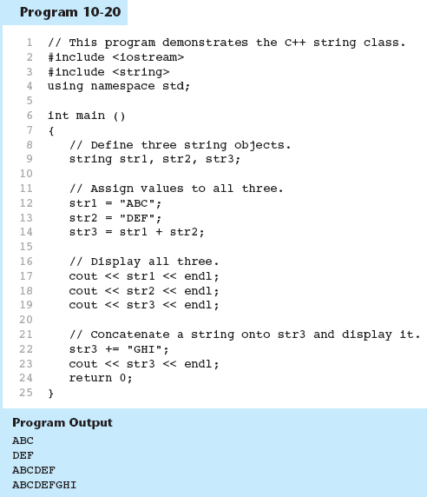
Program 10-20

Slide 37
string Member Functions (1 of 2)
Are behind many overloaded operators
Categories:
assignment: assign, copy, data
modification: append, clear, erase, insert, replace, swap
space management: capacity, empty, length, resize, size
substrings: find, front, back, at, substr
comparison: compare
See Table 10-8 (see slides 38-40) for a list of functions.

Slide 38
Table 10-8 Lists Many of the string Class Member Functions (1 of 3)
Member Function Example | Description
mystring.append(n, ‘z’); | Appends n copies of ‘z’ to mystring.
mystring.append(str); | Appends str to mystring. str can be a string object or character array.
mystring.append(str, n); | The first n characters of the character array str are appended to mystring.
mystring.append(str, x, n); | n number of characters from str, starting at position x, are appended to mystring. If mystring is too small, the function will copy as many characters as possible.
mystring.assign(n, ‘z’); | Assigns n copies of ‘z’ to mystring.
mystring.assign(str); | Assigns str to mystring. str can be a string object or character array.
mystring.assign(str, n); | The first n characters of the character array str are assigned to mystring.
mystring.assign(str, x, n); | n number of characters from str, starting at position x, are assigned to mystring. If mystring is too small, the function will copy as many characters as possible.
mystring.at(x); | Returns the character at position x in the string.
mystring.back(); | Returns the last character in the string. (This member function was introduced in C++ 11.)
mystring.begin(); | Returns an iterator pointing to the first character in the string. (For more information on iterators, see Chapter 16.)

Slide 39
Table 10-8 Lists Many of the string Class Member Functions (2 of 3)
Member Function Example | Description
mystring.c_str(); | Converts the contents of mystring to a C-string, and returns a pointer to the C-string.
mystring.capacity(); | Returns the size of the storage allocated for the string.
mystring.clear(); | Clears the string by deleting all the characters stored in it.
mystring.compare(str); | Performs a comparison like the strcmp function (see Chapter 4), with the same return values. str can be a string object or a character array.
mystring.compare(x, n, str); | Compares mystring and str, starting at position x, and continuing for n characters. The return value is like strcmp. str can be a string object or character array.
mystring.copy(str, x, n); | Copies the character array str to mystring, beginning at position x, for n characters. If mystring is too small, the function will copy as many characters as possible.
mystring.empty(); | Returns true if mystring is empty.
mystring.end(); | Returns an iterator pointing to the last character of the string in mystring. (For more information on iterators, see Chapter 16.)
mystring.erase(x, n); | Erases n characters from mystring, beginning at position x.
mystring.find(str, x); | Returns the first position at or beyond position x where the string str is found in mystring. str may be either a string object or a character array.

Slide 40
Table 10-8 Lists Many of the string Class Member Functions (3 of 3)
Member Function Example | Description
mystring.find(‘z’, x); | Returns the first position at or beyond position x where ‘z’ is found in mystring.
mystring.front(); | Returns the first character in the string. (This member function was introduced in C++ 11.)
mystring.insert(x, n, ‘z’); | Inserts ‘z’ n times into mystring at position x.
mystring.insert(x, str); | Inserts a copy of str into mystring, beginning at position x. str may be either a string object or a character array.
mystring.length(); | Returns the length of the string in mystring.
mystring.replace(x, n, str); | Replaces the n characters in mystring beginning at position x with the characters in string object str.
mystring.resize(n, ‘z’); | Changes the size of the allocation in mystring to n. If n is less than the current size of the string, the string is truncated to n characters. If n is greater, the string is expanded and ‘z’ is appended at the end enough times to fill the new spaces.
mystring.size(); | Returns the length of the string in mystring.
mystring.substr(x, n); | Returns a copy of a substring. The substring is n characters long and begins at position x of mystring.
mystring.swap(str); | Swaps the contents of mystring with str.

Slide 41
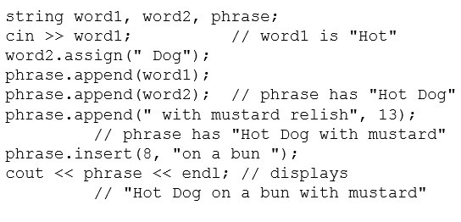
string Member Functions (2 of 2)

Slide 42
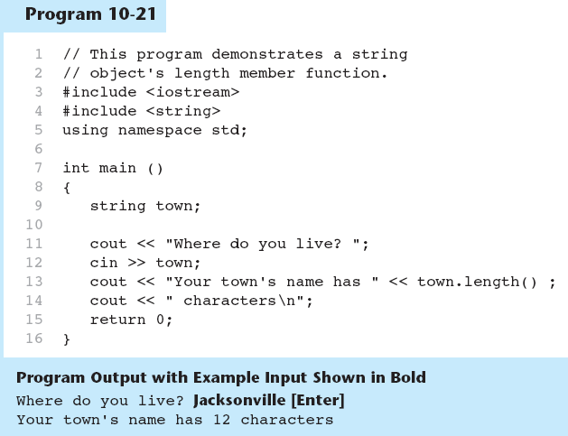
string Member Functions in Program 10-21

Slide 43

Copyright

