Slide 1

Starting out With C++: From Control Structures Through Objects
Eighth Edition
Chapter 12
Advanced File Operations
Copyright © 2015, 2012, 2009 Pearson Education, Inc. All Rights Reserved
Notes:
If this PowerPoint presentation contains mathematical equations, you may need to check that your computer has the following installed:
1) MathType Plugin
2) Math Player (free versions available)
3) NVDA Reader (free versions available)

Slide 2
12.1 File Operations

Slide 3
File Operations
File: a set of data stored on a computer, often on a disk drive
Programs can read from, write to files
Used in many applications:
Word processing
Databases
Spreadsheets
Compilers

Slide 4

Using Files
Requires fstream header file
use ifstream data type for input files
use ofstream data type for output files
use fstream data type for both input, output files
Can use
to read from, write to a file
Can use eof member function to test for end of input file

Slide 5

fstream Object
fstream object can be used for either input or output
Must specify mode on the open statement
Sample modes:
ios::in – input
ios::out – output
Can be combined on open call:

Slide 6
Table12.2 File Access Flags
File Access Flag | Meaning
ios::app | Append mode. If the file already exists, its contents are preserved and all output is written to the end of the file. By default, this flag causes the file to be created if it does not exist.
ios::ate | If the file already exists, the program goes directly to the end of it. Output may be written anywhere in the file.
ios::binary | Binary mode. When a file is opened in binary mode, data are written to or read from it in pure binary format. (The default mode is text.)
ios::in | Input mode. Data will be read from the file. If the file does not exist, it will not be created and the open function will fail.
ios::out | Output mode. Data will be written to the file. By default, the file’s contents will be deleted if it already exists.
ios::trunc | If the file already exists, its contents will be deleted (truncated). This is the default mode used by ios::out.

Slide 7
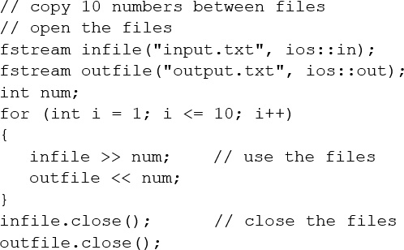
Using Files - Example

Slide 8
Default File Open Modes
ifstream:
open for input only
file cannot be written to
open fails if file does not exist
ofstream:
open for output only
file cannot be read from
file created if no file exists
file contents erased if file exists

Slide 9
More File Open Details
Can use filename, flags in definition:
File stream object set to 0 (false) if open failed:
Can also check fail member function to detect file open error:

Slide 10
12.2 File Output Formatting

Slide 11
File Output Formatting
Use the same techniques with file stream objects as with c out: showpoint, setw(x),showprecision(x), etc.
Requires iomanip to use manipulators

Slide 12
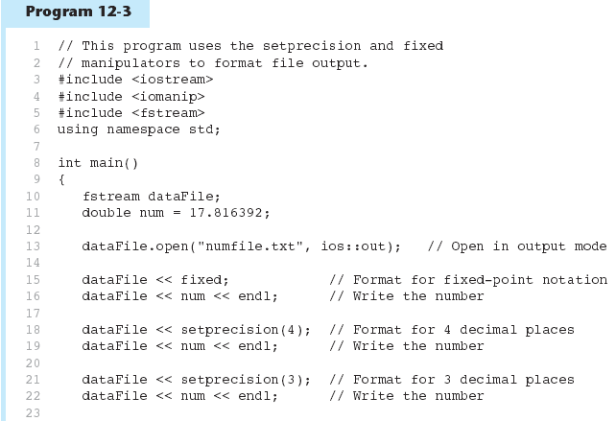
Program 12-3 (1 of 2)

Slide 13
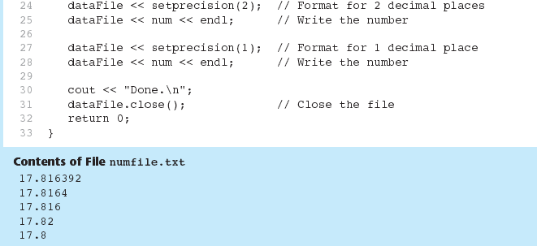
Program 12-3 (2 of 2)

Slide 14
12.3 Passing File Stream Objects to Functions

Slide 15
Passing File Stream Objects to Functions
It is very useful to pass file stream objects to functions
Be sure to always pass file stream objects by reference

Slide 16
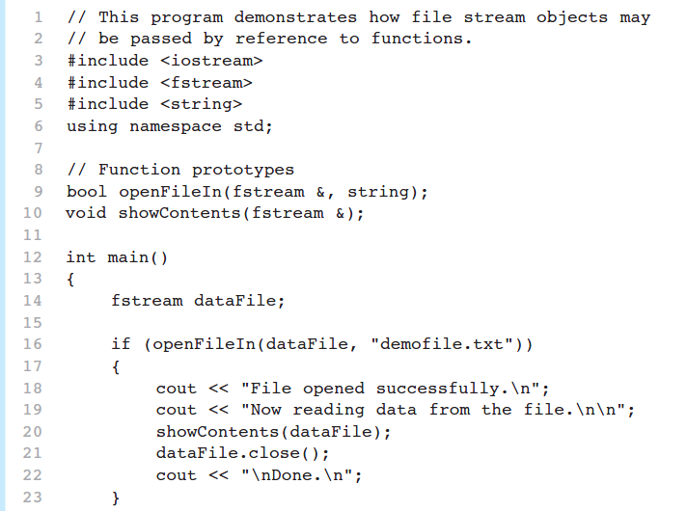
Program 12.5 (1 of 3)

Slide 17
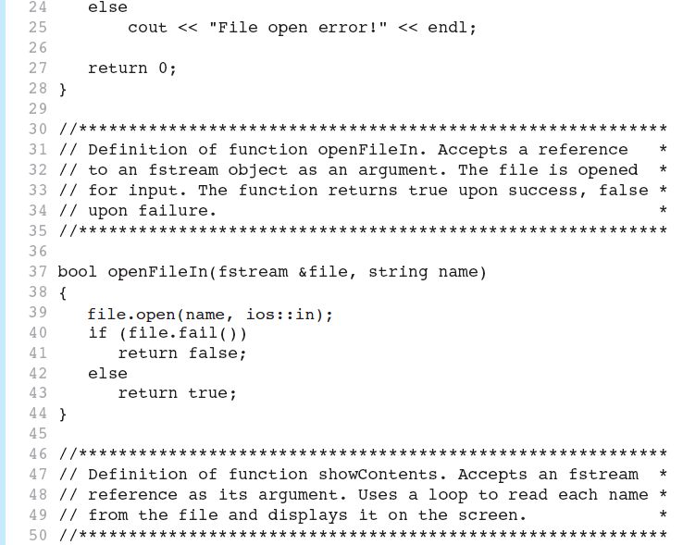
Program 12.5 (2 of 3)

Slide 18
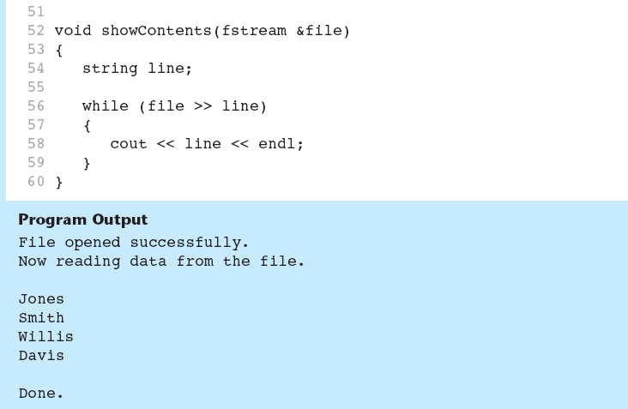
Program 12.5 (3 of 3)

Slide 19
12.4 More Detailed Error Testing

Slide 20
More Detailed Error Testing
Can examine error state bits to determine stream status
Bits tested/cleared by stream member functions
ios::eofbit | set when end of file detected
ios::failbit | set when operation failed
ios::hardfail | set when error occurred and no recovery
ios::badbit | set when invalid operation attempted
ios::goodbit | set when no other bits are set

Slide 21
Member Functions /Flags
eof() | true if eofbit set, false otherwise
fail() | true if failbit or hardfail set, false otherwise
bad() | true if badbit set, false otherwise
good() | true if goodbit set, false otherwise
clear() | clear all flags (no arguments), or clear a specific flag

Slide 22
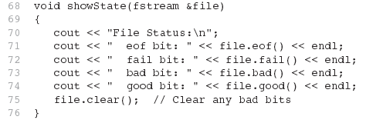
From Program 12-6

Slide 23
12.5 Member Functions for Reading and Writing Files

Slide 24
Member Functions for Reading and Writing Files
Functions that may be used for input with whitespace, to perform single character I/O, or to return to the beginning of an input file
Member functions:
getline: reads input including whitespace
get: reads a single character
put: writes a single character

Slide 25

The getline Function
Three arguments:
Name of a file stream object
Name of a string object
Delimiter character of your choice
Examples, using the file stream object myFile, and the string objects name and address:
If left out, '\n' is default for third argument

Slide 26
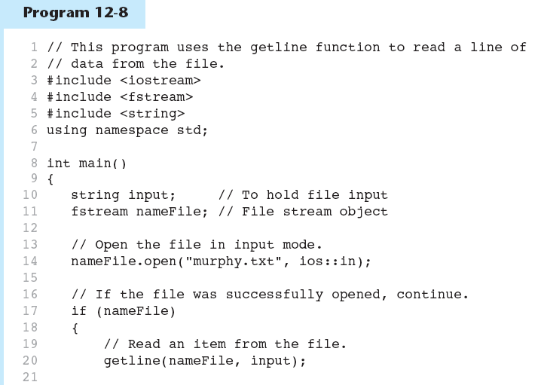
Program 12-8 (1 of 2)

Slide 27
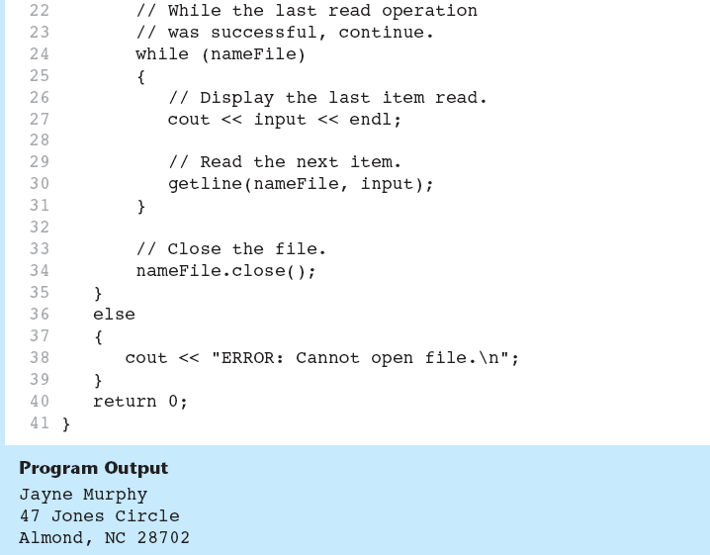
Program 12-8 (2 of 2)

Slide 28

Single Character I/O
get: read a single character from a file
Will read any character, including whitespace
put: write a single character to a file

Slide 29
12.6 Working with Multiple Files

Slide 30
Working with Multiple Files
Can have more than file open at a time in a program
Files may be open for input or output
Need to define file stream object for each file

Slide 31
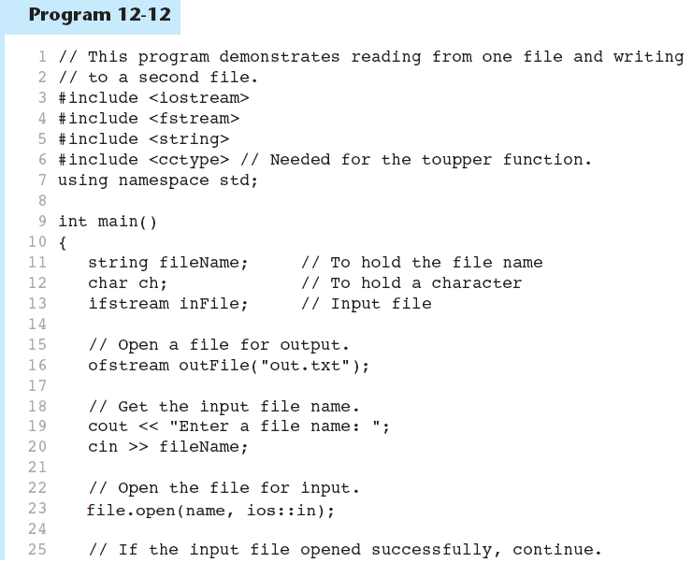
Program 12-12 (1 of 3)

Slide 32
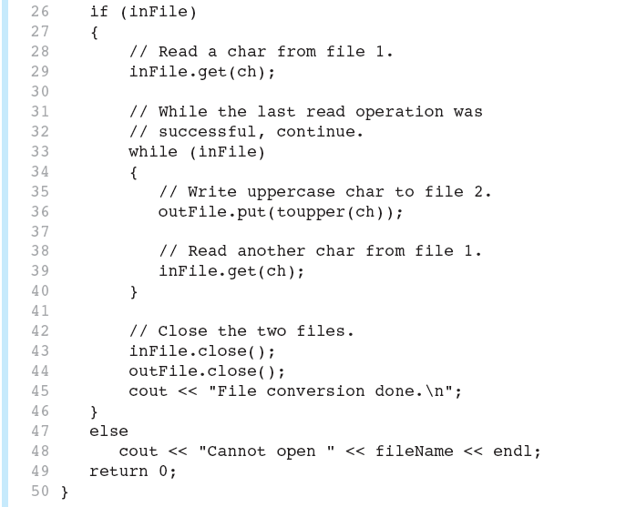
Program 12-12 (2 of 3)

Slide 33

Program 12-12 (3 of 3)

Slide 34
12.7 Binary Files

Slide 35

Binary Files (1 of 3)
Binary file contains unformatted, non-A S C I I data
Indicate by using binary flag on open:

Slide 36

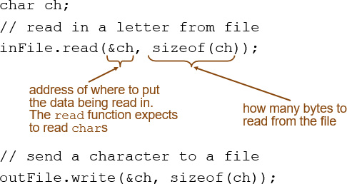
Binary Files (2 of 3)
Use read and write instead of

Slide 37
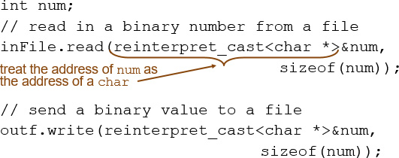
Binary Files (3 of 3)
To read, write non-character data, must use a typecast operator to treat the address of the data as a character address

Slide 38
12.8 Creating Records with Structures

Slide 39
Creating Records with Structures (1 of 2)
Can write structures to, read structures from files
To work with structures and files,
use ios::binary file flag upon open
use read, write member functions

Slide 40
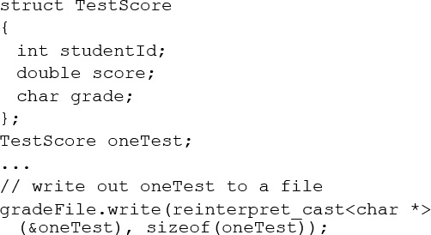
Creating Records with Structures (2 of 2)

Slide 41
12.9 Random-Access Files

Slide 42
Random-Access Files
Sequential access: start at beginning of file and go through data in file, in order, to end
to access 100th entry in file, go through 99 preceding entries first
Random access: access data in a file in any order
can access 100th entry directly

Slide 43
Random Access Member Functions (1 of 2)
seek g (seek get): used with files open for input
seek p (seek put): used with files open for output
Used to go to a specific position in a file

Slide 44
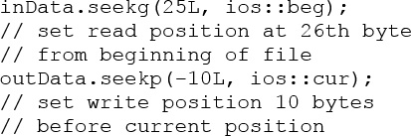
Random Access Member Functions (2 of 2)
seek g,seek p arguments:
offset: number of bytes, as a long
mode flag: starting point to compute offset
Examples:

Slide 45

Important Note on Random Access
If eof is true, it must be cleared before seek g or seek p:

Slide 46

Random Access Information
tell g member function: return current byte position in input file
tell p member function: return current byte position in output file

Slide 47
12.10 Opening a File for Both Input and Output

Slide 48

Opening a File for Both Input and Output
File can be open for input and output simultaneously
Supports updating a file:
read data from file into memory
update data
write data back to file
Use fstream for file object definition:
Can also use ios::binary flag for binary data

Slide 49

Copyright

