Slide 1
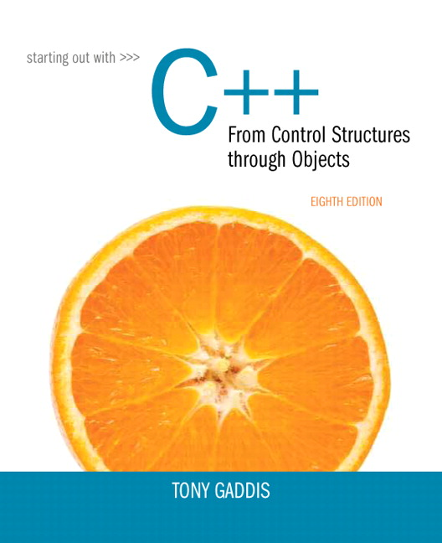
Starting out With C++: From Control Structures Through Objects
Eighth Edition
Chapter 13
Introduction to Classes
Copyright © 2015, 2012, 2009 Pearson Education, Inc. All Rights Reserved
Notes:
If this PowerPoint presentation contains mathematical equations, you may need to check that your computer has the following installed:
1) MathType Plugin
2) Math Player (free versions available)
3) NVDA Reader (free versions available)

Slide 2
13.1 Procedural and Object-Oriented Programming

Slide 3
Procedural and Object-Oriented Programming
Procedural programming focuses on the process/actions that occur in a program
Object-Oriented programming is based on the data and the functions that operate on it. Objects are instances of A D T s that represent the data and its functions

Slide 4
Limitations of Procedural Programming
If the data structures change, many functions must also be changed
Programs that are based on complex function hierarchies are:
difficult to understand and maintain
difficult to modify and extend
easy to break

Slide 5
Object-Oriented Programming Terminology (1 of 2)
class: like a struct (allows bundling of related variables), but variables and functions in the class can have different properties than in a struct
object: an instance of a class, in the same way that a variable can be an instance of a struct

Slide 6
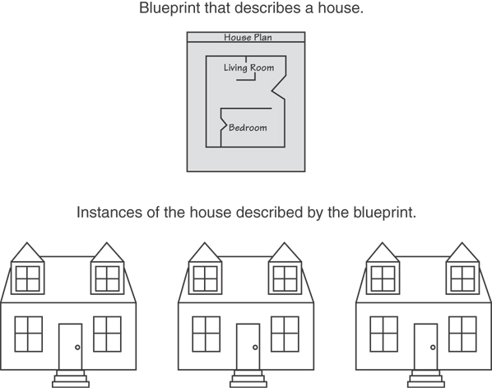
Classes and Objects
A Class is like a blueprint and objects are like houses built from the blueprint

Slide 7
Object-Oriented Programming Terminology (2 of 2)
attributes: members of a class
methods or behaviors: member functions of a class

Slide 8
More on Objects
data hiding: restricting access to certain members of an object
public interface: members of an object that are available outside of the object. This allows the object to provide access to some data and functions without sharing its internal details and design, and provides some protection from data corruption

Slide 9
13.2 Introduction to Classes

Slide 10
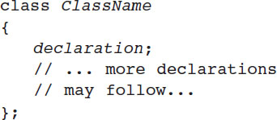
Introduction to Classes
Objects are created from a class
Format:

Slide 11
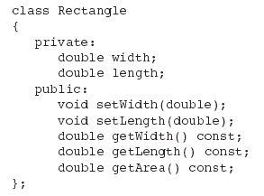
Class Example (1 of 2)

Slide 12
Access Specifiers
Used to control access to members of the class
public: can be accessed by functions outside of the class
private: can only be called by or accessed by functions that are members of the class

Slide 13
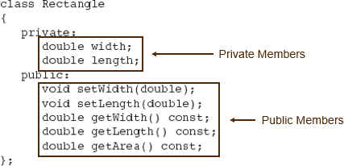
Class Example (2 of 2)

Slide 14
More on Access Specifiers
Can be listed in any order in a class
Can appear multiple times in a class
If not specified, the default is private

Slide 15

Using Const with Member Functions
const appearing after the parentheses in a member function declaration specifies that the function will not change any data in the calling object.

Slide 16
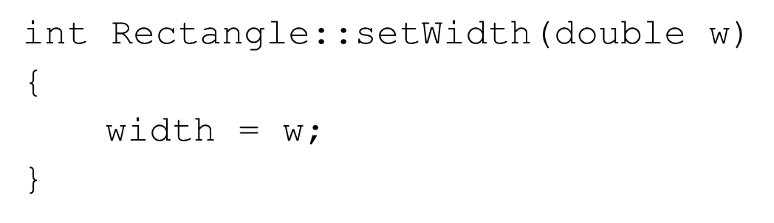
Defining a Member Function
When defining a member function:
Put prototype in class declaration
Define function using class name and scope resolution operator (::)

Slide 17
Accessors and Mutators
Mutator: a member function that stores a value in a private member variable, or changes its value in some way
Accessor: function that retrieves a value from a private member variable. Accessors do not change an object's data, so they should be marked const.

Slide 18
13.3 Defining an Instance of a Class

Slide 19

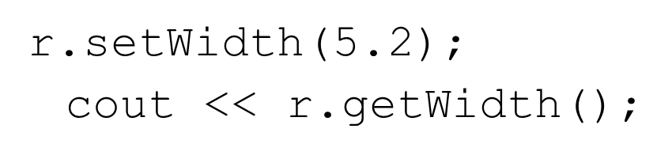
Defining an Instance of a Class
An object is an instance of a class
Defined like structure variables:
Access members using dot operator:
Compiler error if attempt to access private member using dot operator

Slide 20
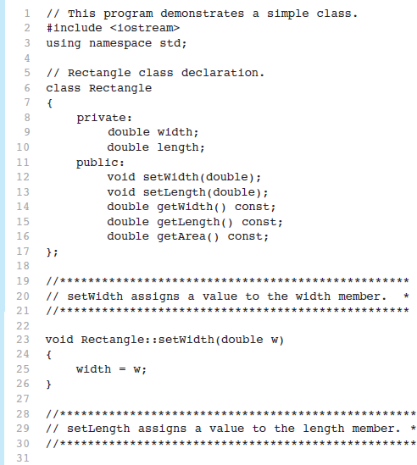
Program 13-1 (1 of 4)

Slide 21
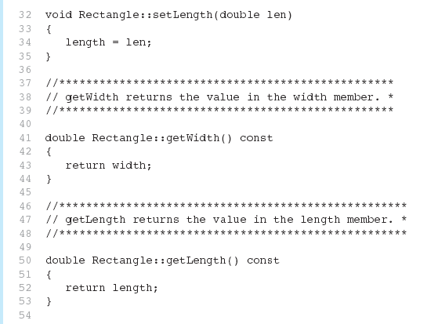
Program 13-1 (2 of 4)

Slide 22
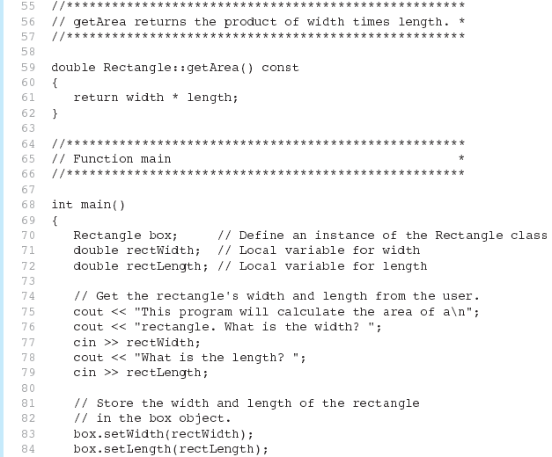
Program 13-1 (3 of 4)

Slide 23
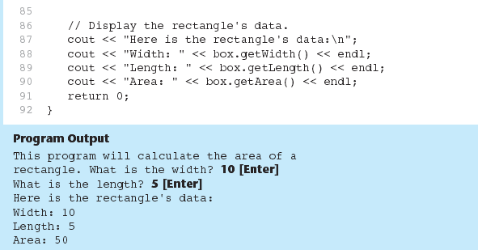
Program 13-1 (4 of 4)

Slide 24
Avoiding Stale Data
Some data is the result of a calculation.
In the Rectangle class the area of a rectangle is calculated.
length x width
If we were to use an area variable here in the Rectangle class, its value would be dependent on the length and the width.
If we change length or width without updating area, then area would become stale.
To avoid stale data, it is best to calculate the value of that data within a member function rather than store it in a variable.

Slide 25
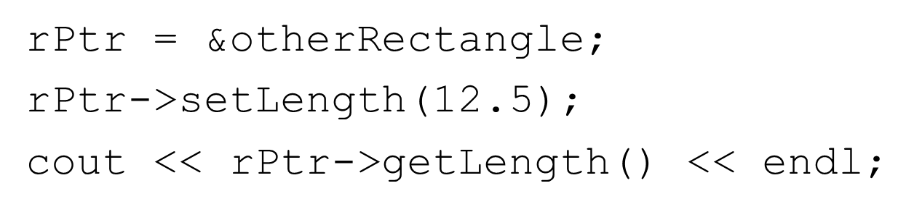
Pointer to an Object
Can define a pointer to an object:
Can access public members via pointer:

Slide 26
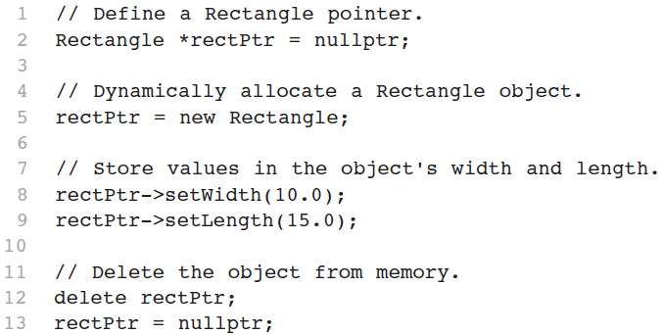
Dynamically Allocating an Object
We can also use a pointer to dynamically allocate an object.

Slide 27
13.4 Why Have Private Members?

Slide 28
Why Have Private Members?
Making data members private provides data protection
Data can be accessed only through public functions
Public functions define the class’s public interface

Slide 29
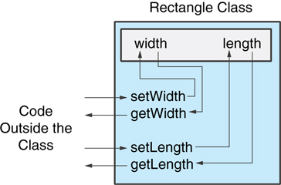
Code Outside the Class Must Use the Class’s Public Member Functions to Interact with the Object

Slide 30
13.5 Separating Specification from Implementation

Slide 31
Separating Specification from Implementation
Place class declaration in a header file that serves as the class specification file. Name the file ClassName.h, for example, Rectangle.h
Place member function definitions in ClassName.cpp, for example, Rectangle.cpp File should #include the class specification file
Programs that use the class must #include the class specification file, and be compiled and linked with the member function definitions

Slide 32
13.6 Inline Member Functions

Slide 33
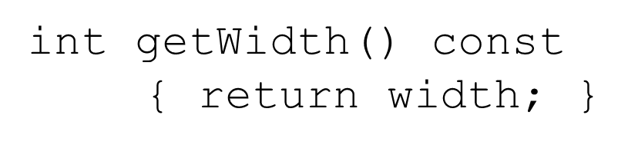
Inline Member Functions
Member functions can be defined
inline: in class declaration
after the class declaration
Inline appropriate for short function bodies:

Slide 34
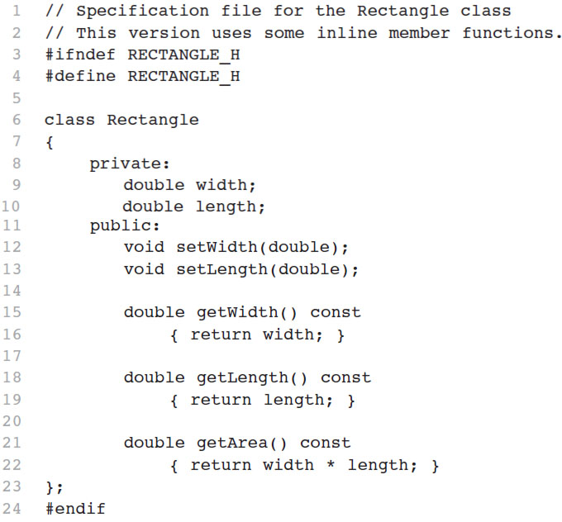
Rectangle Class with Inline Member Functions

Slide 35
Tradeoffs – Inline Vs. Regular Member Functions
Regular functions – when called, compiler stores return address of call, allocates memory for local variables, etc.
Code for an inline function is copied into program in place of call – larger executable program, but no function call overhead, hence faster execution

Slide 36
13.7 Constructors

Slide 37
Constructors
Member function that is automatically called when an object is created
Purpose is to construct an object
Constructor function name is class name
Has no return type

Slide 38
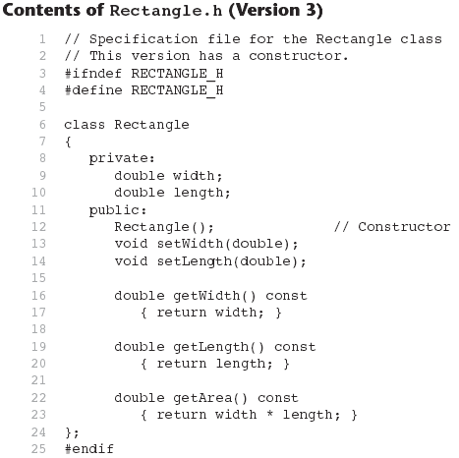
Contents of Rectangle.h (Version 3)

Slide 39
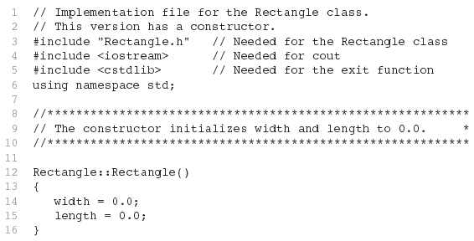
Contents of Rectangle.ccp Version3 (1 of 2)

Slide 40
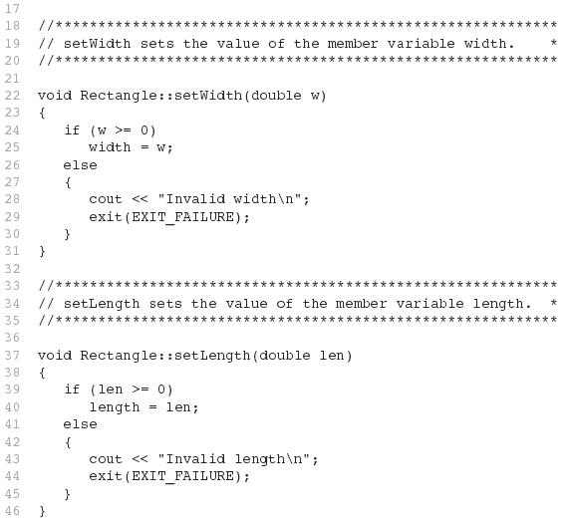
Contents of Rectangle.ccp Version3 (2 of 2)

Slide 41
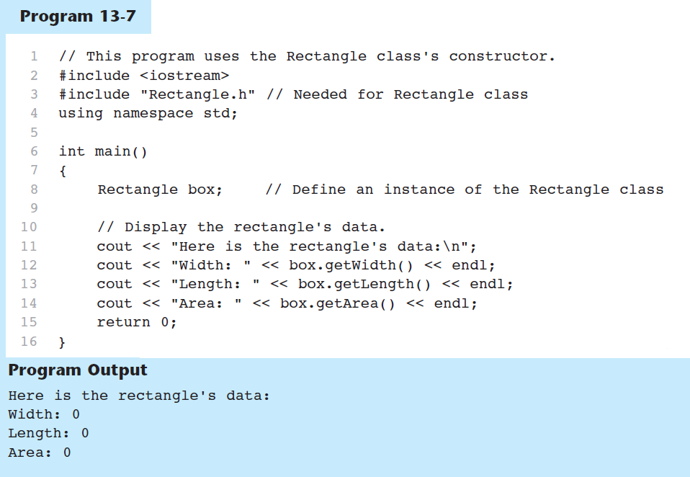
Program 13-7

Slide 42

Default Constructors
A default constructor is a constructor that takes no arguments.
If you write a class with no constructor at all, C++ will write a default constructor for you, one that does nothing.
A simple instantiation of a class (with no arguments) calls the default constructor:

Slide 43
13.8 Passing Arguments to Constructors

Slide 44

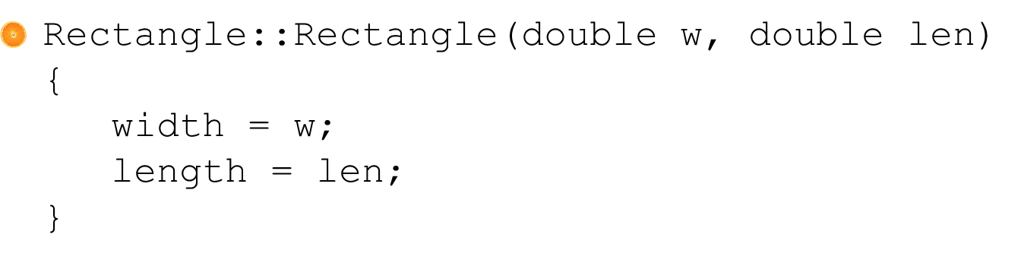
Passing Arguments to Constructors (1 of 2)
To create a constructor that takes arguments:
indicate parameters in prototype:
Use parameters in the definition:

Slide 45

Passing Arguments to Constructors (2 of 2)
You can pass arguments to the constructor when you create an object:

Slide 46
More About Default Constructors
If all of a constructor's parameters have default arguments, then it is a default constructor. For example:
Creating an object and passing no arguments will cause this constructor to execute:

Slide 47
Classes with No Default Constructor
When all of a class's constructors require arguments, then the class has N O default constructor.
When this is the case, you must pass the required arguments to the constructor when creating an object.

Slide 48
13.9 Destructors

Slide 49
Destructors
Member function automatically called when an object is destroyed
Destructor name is ~classname, e.g., ~Rectangle
Has no return type; takes no arguments
Only one destructor per class, i.e., it cannot be overloaded
If constructor allocates dynamic memory, destructor should release it

Slide 50
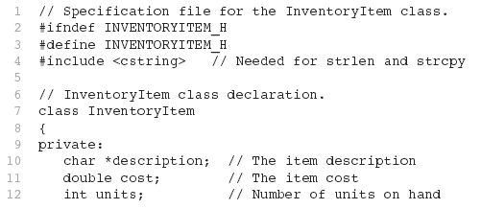
Contents of Inventoryitem.h Version1 (1 of 2)

Slide 51
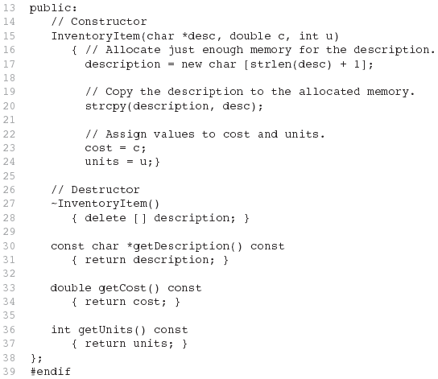
Contents of Inventoryitem.h Version1 (2 of 2)

Slide 52
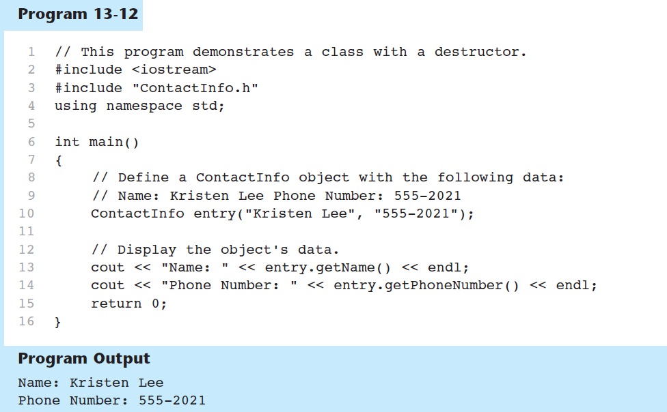
Program 13-12

Slide 53
Constructors, Destructors, and Dynamically Allocated Objects
When an object is dynamically allocated with the new operator, its constructor executes:
When the object is destroyed, its destructor executes:

Slide 54
13.10 Overloading Constructors

Slide 55
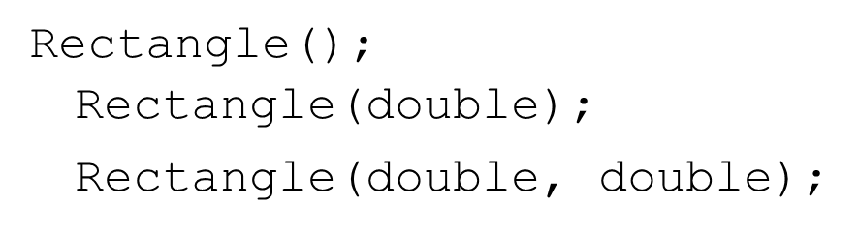
Overloading Constructors
A class can have more than one constructor
Overloaded constructors in a class must have different parameter lists:

Slide 56
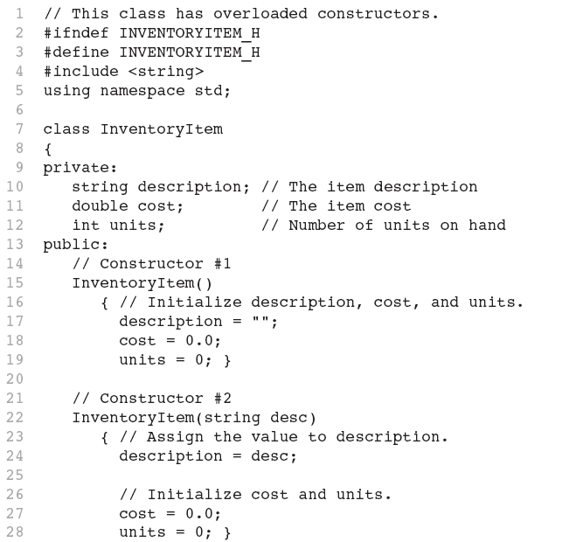
Contents of InventoryItem.h (1 of 2)

Slide 57
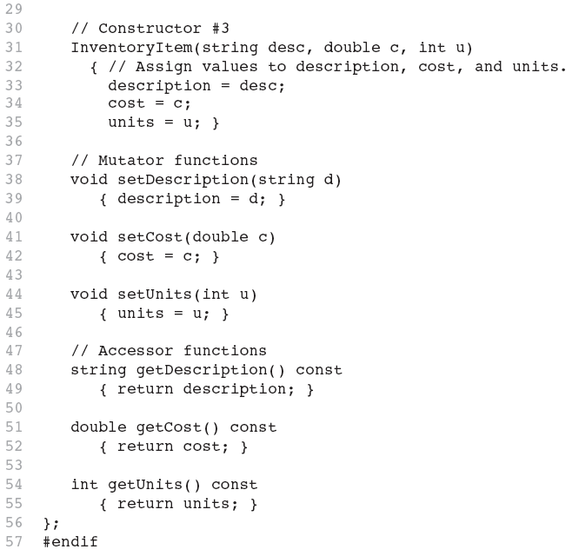
Contents of InventoryItem.h (2 of 2)

Slide 58

Only One Default Constructor and One Destructor
Do not provide more than one default constructor for a class: one that takes no arguments and one that has default arguments for all parameters
Since a destructor takes no arguments, there can only be one destructor for a class

Slide 59

Member Function Overloading
Non-constructor member functions can also be overloaded:
Must have unique parameter lists as for constructors

Slide 60
3.11 Using Private Member Functions

Slide 61
Using Private Member Functions
A private member function can only be called by another member function
It is used for internal processing by the class, not for use outside of the class
See the createDescription function in ContactInfo.h (Version 2)

Slide 62
13.12 Arrays of Objects

Slide 63
Arrays of Objects (1 of 4)
Objects can be the elements of an array:
Default constructor for object is used when array is defined

Slide 64

Arrays of Objects (2 of 4)
Must use initializer list to invoke constructor that takes arguments:

Slide 65

Arrays of Objects (3 of 4)
If the constructor requires more than one argument, the initializer must take the form of a function call:

Slide 66

Arrays of Objects (4 of 4)
It isn't necessary to call the same constructor for each object in an array:

Slide 67
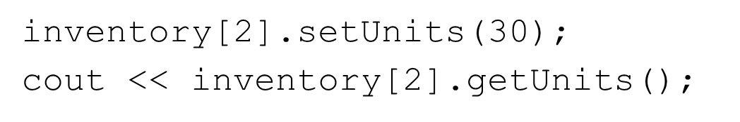
Accessing Objects in an Array
Objects in an array are referenced using subscripts
Member functions are referenced using dot notation:

Slide 68
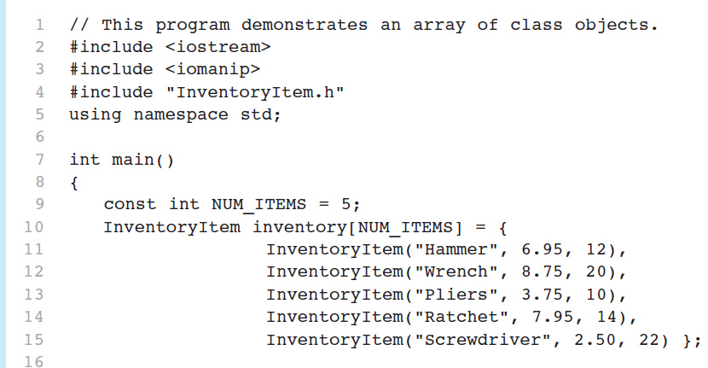
Program 13-14 (1 of 2)

Slide 69
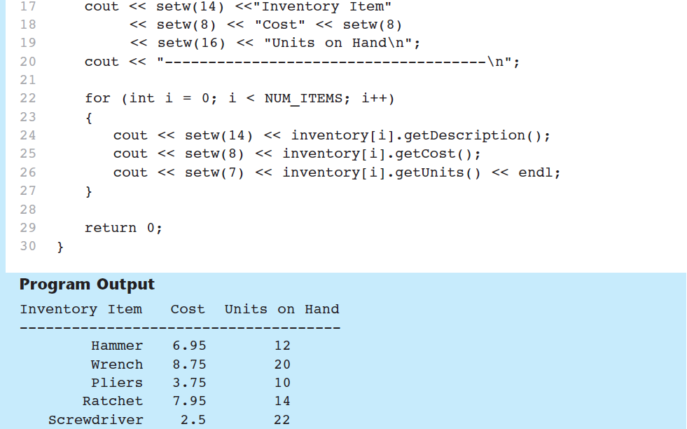
Program 13-14 (2 of 2)

Slide 70
13.16 The Unified Modeling Language

Slide 71
The Unified Modeling Language
U M L stands for Unified Modeling Language.
The U M L provides a set of standard diagrams for graphically depicting object-oriented systems

Slide 72
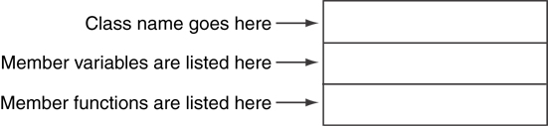
U M L Class Diagram
A U M L diagram for a class has three main sections.

Slide 73
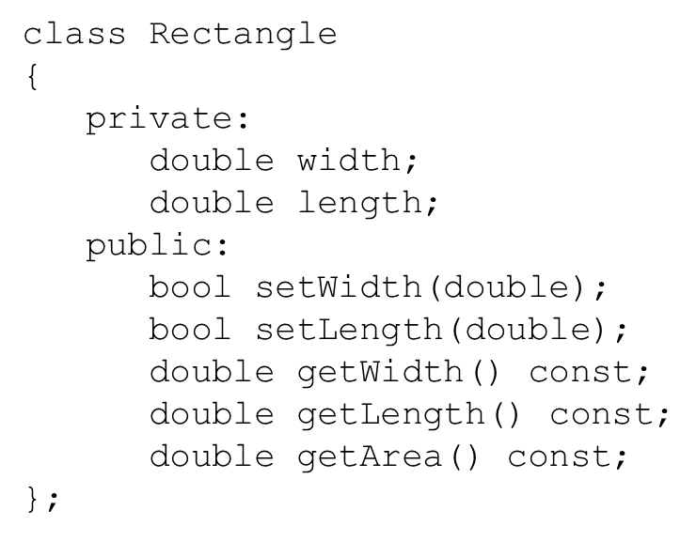
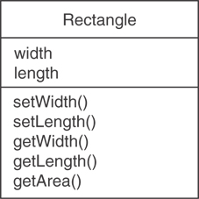
Example: A Rectangle Class

Slide 74
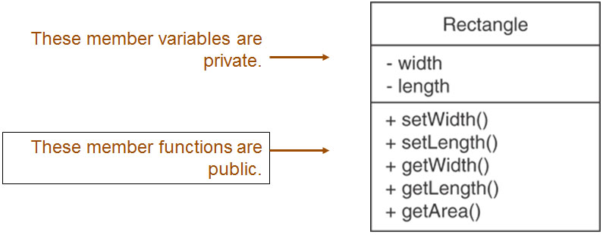
U M L Access Specification Notation
In U M L you indicate a private member with a minus (-) and a public member with a plus(+).

Slide 75

U M L Data Type Notation
To indicate the data type of a member variable, place a colon followed by the name of the data type after the name of the variable.

Slide 76
U M L Parameter Type Notation
To indicate the data type of a function’s parameter variable, place a colon followed by the name of the data type after the name of the variable.

Slide 77
U M L Function Return Type Notation
To indicate the data type of a function’s return value, place a colon followed by the name of the data type after the function’s parameter list.

Slide 78
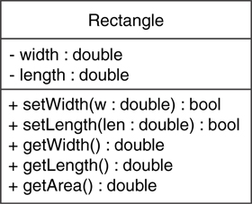
The Rectangle Class

Slide 79
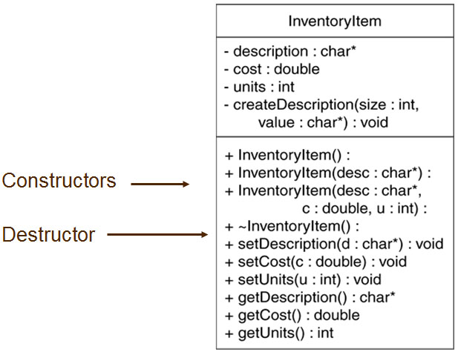
Showing Constructors and Destructors
No return type listed for constructors or destructors

Slide 80

Copyright

