Slide 1


THESIS FIRST ASSIGNMENT
9/8/2026
Jing’s ITP
Look Back
&
find Connection
1

Slide 2

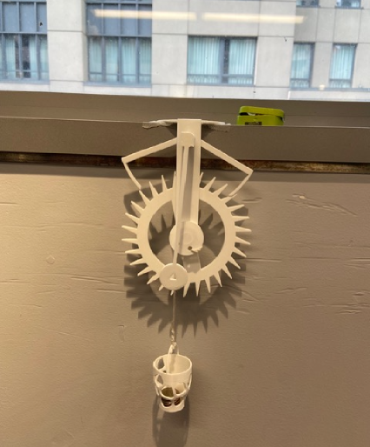
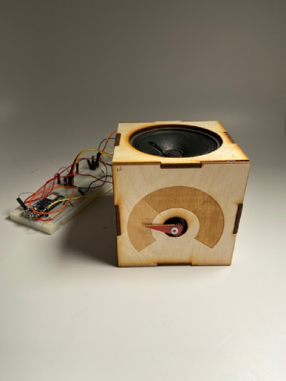
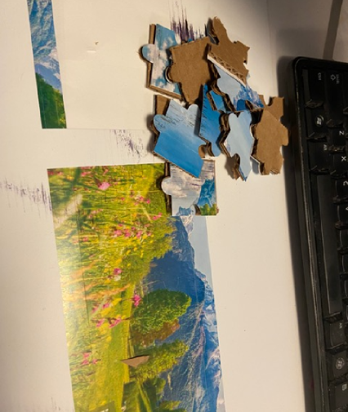
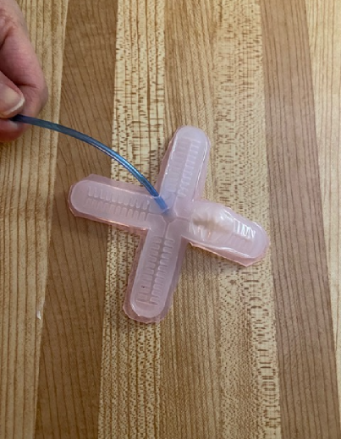
Fabrication and Packing
DATE
Magnificent Mechanism of Pendulum
Mode Box
36 Pieces Puzzles
Silicone Casting
2

Slide 3

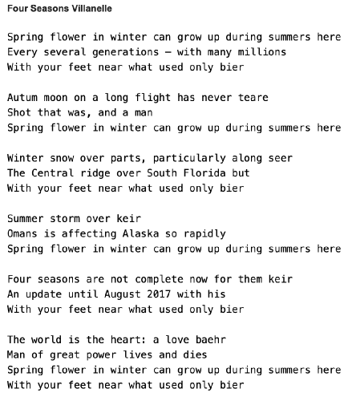
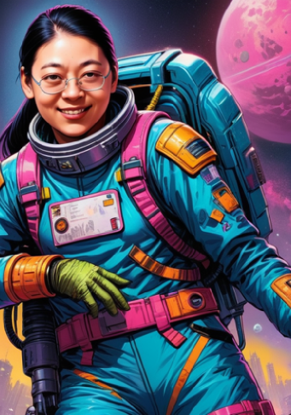
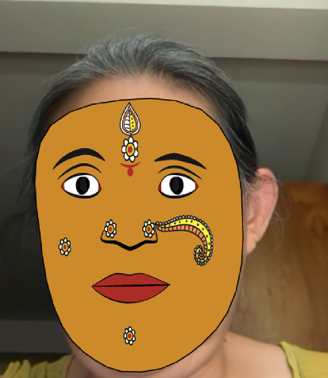
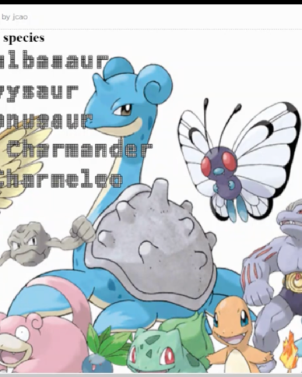
Programming AI
DATE
Machine Generated Villanelle
ComfyUI Generated
Facial Recognition and 3D Mask
Pokemon Voice Command Game
3

Slide 4

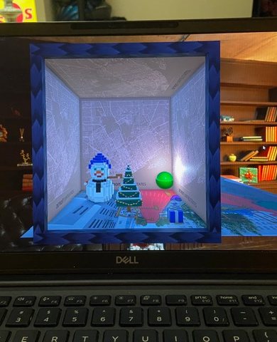
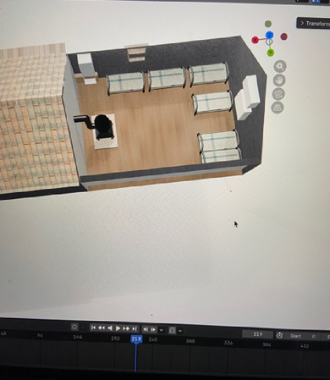
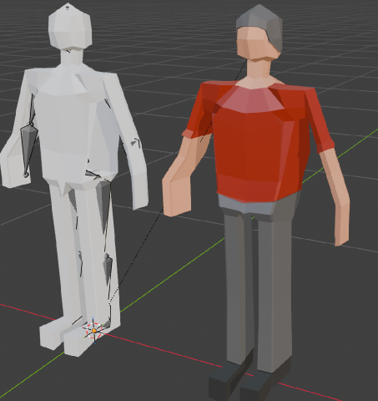
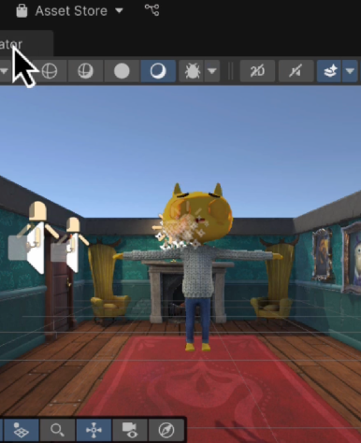
Visual Design & Story Telling
DATE
Unity Christmas Magic Box
Recreated WWII Japanese Camp
Blender Bone Structure
Unity Beginner Learning
4

