Slide 1
BIODIVERSITY
Biodiversity in National Parks.

Slide 2
INTRODUCTION
In this project we will analyze the biodiversity data in certain national parks, the data is divided into 2 files:
Observations.csv
Species_info.csv
The data worked (Observations.csv and Species_info.csv) in this project was provided by codecademy.com

Slide 3
Objective of the project
The objective is to ensure the survival of the species at risk, this in order to maintain a level of biodiversity in the parks mentioned in the data. The main thing I have to do is understand the characteristics and conservation status of the species, as well as its relationship to national parks.

Slide 4
Data will be analyzed, traced and an attempt will be made to answer the following questions:
What is the distribution of the State of Conservation in Species?
Is it probable that certain species are in danger of extinction?
Are the differences between the species and their conservation status significant?
What is the distribution of the species in each park?

Slide 5
What is the distribution of the State of Conservation in Species?

Slide 6
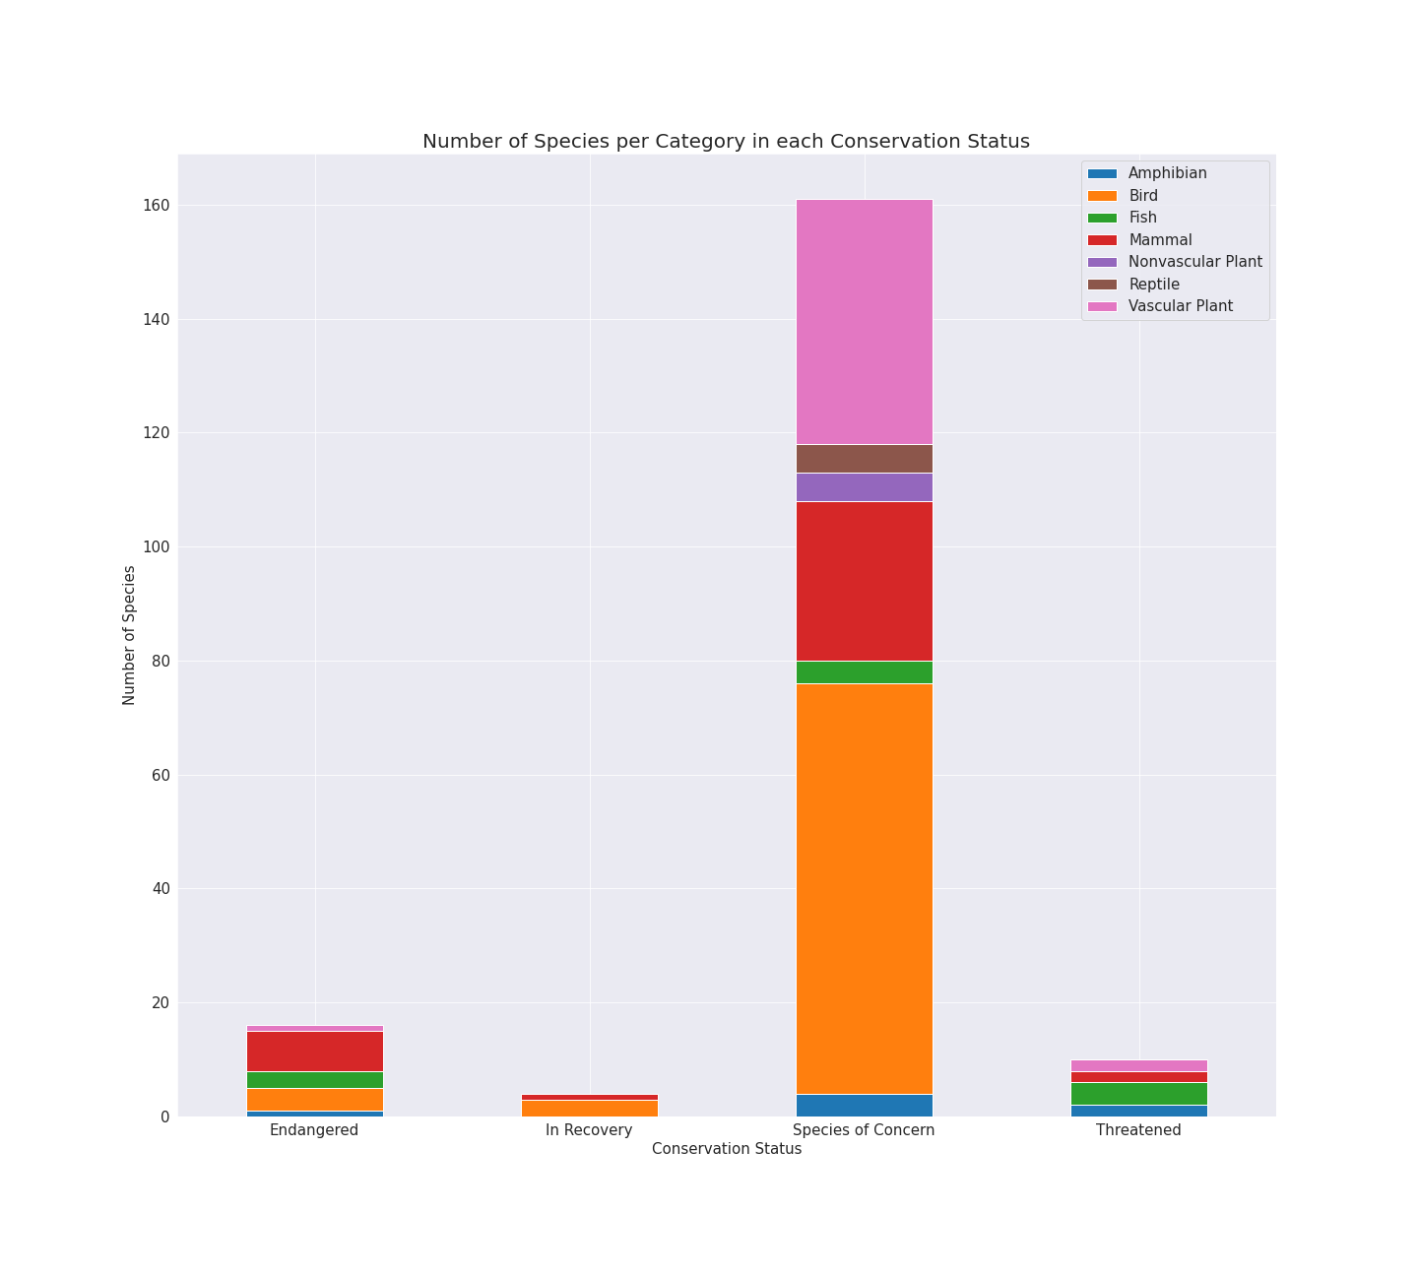

Slide 7
For this step, I created a bar chart using the data from Species.csv, Species.csv contains 4 columns and 5,824 rows {category: 5,824, scientific_names: 5,824, common_names: 5,824, preservation_state: 191} preservation_state has 191 full rows and 5,633 with NaN values that means that the species are not protected, for the bar diagram I used the columns [category and conservation_state].

Slide 8
Is it probable that certain species are in danger of extinction?

Slide 9
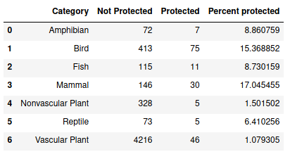

Slide 10
As we see in the graph, Mammals and Birds have the highest percentage of protected species, but if we look at Vascular [protected] Plants, we can see that the number of Protected is greater than Mammals, but this is not significant that the Vascular Plant has a higher percentage of protected species because the number of unprotected species is very high and, in theory, the percentage of protected species is very low compared to Mammals and Birds.

Slide 11
Are the differences between the species and their conservation status significant?

Slide 12
I did a function that took the protected and not protected values of 2 categories to do a contingency chi2 test and obtain the P value to determine if the pair that I wanted testing had a significant difference or not.

Slide 13
The results are:
The P-value for the test of Mammal & Bird is: 0.68759, therefore they don't have significance
The P-value for the test of Mammal & Reptile is: 0.03836, therefore they have significance
The P-value for the test of Vascular Plant & Nonvascular Plant is: 0.66234, therefore they don't have significance

Slide 14
The P-value for the test of Mammal & Amphibian is: 0.12758, therefore they don't have significance
The P-value for the test of Mammal & Fish is: 0.05615, therefore they don't have significance
The P-value for the test of Bird & Fish is: 0.07668, therefore they don't have significance
The P-value for the test of Reptile & Fish is: 0.74065, therefore they don't have significance
The P-value for the test of Bird & Reptile is: 0.05314, therefore they don't have significance

Slide 15
BIODIVERSITY
Biodiversity in National Parks.

Slide 16
INTRODUCTION
In this project we will analyze the biodiversity data in certain national parks, the data is divided into 2 files:
Observations.csv
Species_info.csv
The data worked (Observations.csv and Species_info.csv) in this project was provided by codecademy.com

Slide 17
Objective of the project
The objective is to ensure the survival of the species at risk, this in order to maintain a level of biodiversity in the parks mentioned in the data. The main thing I have to do is understand the characteristics and conservation status of the species, as well as its relationship to national parks.

Slide 18
Data will be analyzed, traced and an attempt will be made to answer the following questions:
What is the distribution of the State of Conservation in Species?
Is it probable that certain species are in danger of extinction?
Are the differences between the species and their conservation status significant?
What is the distribution of the species in each park?

Slide 19
What is the distribution of the State of Conservation in Species?

Slide 21
For this step, I created a bar chart using the data from Species.csv, Species.csv contains 4 columns and 5,824 rows {category: 5,824, scientific_names: 5,824, common_names: 5,824, preservation_state: 191} preservation_state has 191 full rows and 5,633 with NaN values that means that the species are not protected, for the bar diagram I used the columns [category and conservation_state].

Slide 22
Is it probable that certain species are in danger of extinction?

Slide 24
As we see in the graph, Mammals and Birds have the highest percentage of protected species, but if we look at Vascular [protected] Plants, we can see that the number of Protected is greater than Mammals, but this is not significant that the Vascular Plant has a higher percentage of protected species because the number of unprotected species is very high and, in theory, the percentage of protected species is very low compared to Mammals and Birds.

Slide 25
Are the differences between the species and their conservation status significant?

Slide 26
I did a function that took the protected and not protected values of 2 categories to do a contingency chi2 test and obtain the P value to determine if the pair that I wanted testing had a significant difference or not.

Slide 27
The results are:
The P-value for the test of Mammal & Bird is: 0.68759, therefore they don't have significance
The P-value for the test of Mammal & Reptile is: 0.03836, therefore they have significance
The P-value for the test of Vascular Plant & Nonvascular Plant is: 0.66234, therefore they don't have significance

Slide 28
The P-value for the test of Mammal & Amphibian is: 0.12758, therefore they don't have significance
The P-value for the test of Mammal & Fish is: 0.05615, therefore they don't have significance
The P-value for the test of Bird & Fish is: 0.07668, therefore they don't have significance
The P-value for the test of Reptile & Fish is: 0.74065, therefore they don't have significance
The P-value for the test of Bird & Reptile is: 0.05314, therefore they don't have significance

Slide 29
What is the distribution of the species in each park?

Slide 30
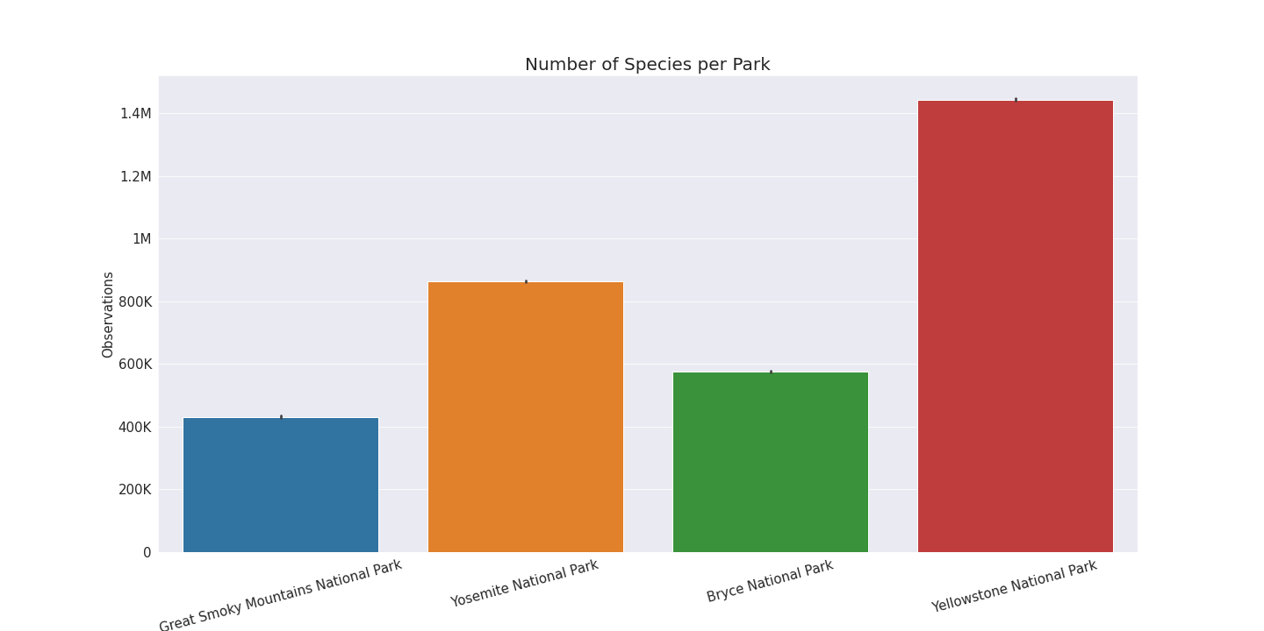

Slide 31
In the last step, I made a bar diagram of the distributions in the national parks. The data was obtained from Observations.csv which contains 3 columns with 23,286 rows {scientific_names: 23,296, park_name: 23,296, observations: 23,296}, and I used the columns [park_name and observations] to obtain the total of species that each park contains.

Slide 32
CONCLUSION
The distribution of the conservation status in Species is:
We were able to see that very few species have a conservation status and that the rest that have an is_null value is because they are not endangered and are not protected, the distribution is 5,633 non-endangered species and 191 protected species. with a total of 5,824 species, being Mammals, Birds and Vascular Plants with the highest species within the number of protected species.

Slide 33
Is it probable that certain species are in danger of extinction?
Yes, Mammal and Birds had the highest percents, Mammal with 17.04 and Birds with 15.36.
Are the differences between species and their conservation status significant?
'Mammals' and' Birds' have no significant difference, and 'Mammals' only has a significant difference with' Reptile ', and although the difference is very little with the threshold of significance' Birds' and 'Reptile' have no significant difference, ' Reptile 'and' Mammals' is the only pair that contains a fairly significant difference.

Slide 34
What is the distribution in the parks?
We can clearly see that "Yellowstone National Park" has an immense difference with the other 3 parks, and the one that is closest to it is "Yosemite National Park", and the one that is furthest from having the same amount of species is "Great Smoky Mountains National Park", this graph is the total of observations of species that have been made by each park.

