Slide 1

FOODMaps
A creative website for supermarket

Slide 2

Team 03
Team members
Kritpal Bhatti
(JC432439)
Erik Zhao
(JC454472)

Slide 3

Outline
1. Objective
2. Target Users
3. Data analysis
4.Website introduction
5. Responsibilities
6. Features
7. Summary

Slide 4
Objective
Our objective is to develop a user friendly website which has a rich data of different cuisines like Thai, Continental, Chinese, Indian and other multicultural cuisines, as well as helping the users with the information regarding where to buy the ingredients for the recipes mentioned.

Slide 5


Slide 6
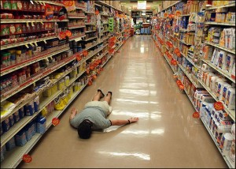


Slide 7
Vision
We want people to easily find the information regarding the recipes and the ingredients that they need. The goal of our website is to provide a pleasant experience that provides solid information and answers a visitor’s questions.

Slide 8
Target Users
Primary users
Local customers
Such as Students, Professionals, Food enthusiasts
A novice/beginner, Bag packers and tourists
Secondary users
Suppliers, People who want to be associated with us for marketing their product on our website.

Slide 9
The characteristics of the target users
No time to cook (working professionals)
Lack of cooking skills (students)
Not aware of the local market (tourists and bag packers)
Food enthusiasts
Suppliers who want to expand their market

Slide 10
Data requirements
Ingredients location
Approximate price
Recipes
The number of potential users

Slide 11
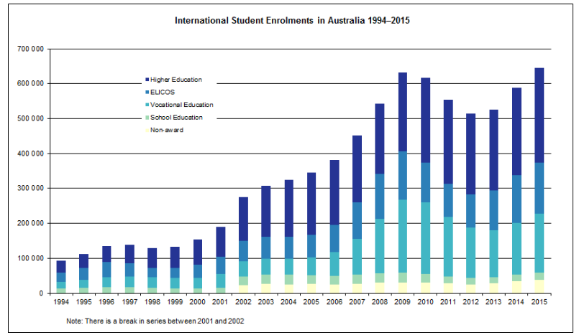

Slide 12
Enhance users experience
The users can tryout and learn new cuisines
Our website can effectively assist customers find out the item which they are looking for
Interactive user friendly website with the option of access to videos of recipes.
Responsive website, giving user the comfort to browse it in different devices ( mobile, tablet or desktop)

Slide 13
Blue Print
Main page
HOME
SOCIAL MEDIA
QUICK SEARCH
Products
ABOUT US
Features
Subscribe
Quick Prep
Vegetarian
Starters
Vegan
Multi cultural
Ingredients
Store
Coles
Woolies

Slide 14
Schedule
Week 5 – Final submission of the proposal and draft along with home page
Week 6 and 7 – Work on the individual pages
Location, Feature and About Us – Kritpal
Search, Contact Us and Product/recipe – Erik
Week 8 and 9 testing and fixing the Website
Week 10 – Final Submission

Slide 15


Technologies
Front end languages- HTML and CSS, JavaScript,
Back end language- PHP, MySQL

Slide 16
Responsibilities
Project Title & Objectives | Determine the objective Select idea | K E
Targets | Identify the need of the target users | K
Web design | Design the structure of the website Fix the outline and error | E K
Schedule | Organise each meeting and take notes | E
Data research | Images, videos, statistics, | K E

Slide 17
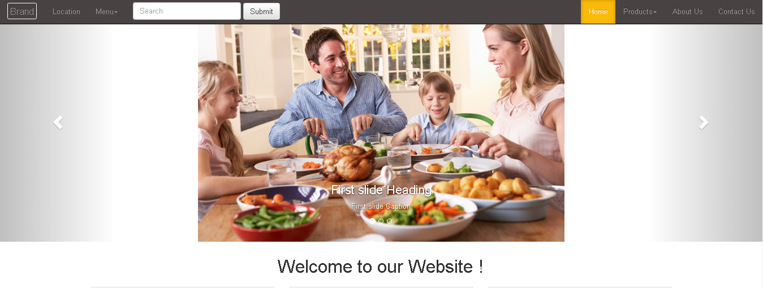

Slide 18
Basic features
Quick search –specials, navigation.
Multi – national recipes database.
Responsive and user friendly website that can be run on all standard devices.

Slide 19
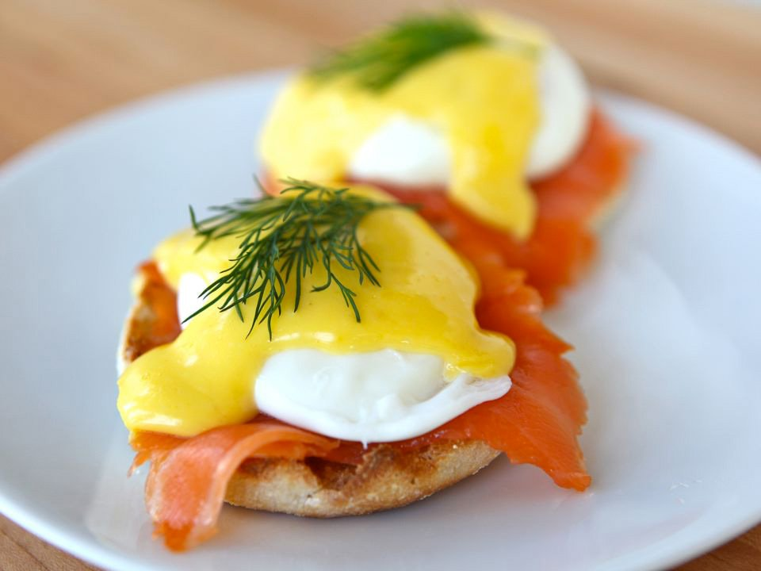
Eggs Benedict 1. 2-3 free-range eggs - Dairy Section 2. 3s ham speck or 4s smoke salmon - Freezer 3. 1/2 French toast – aisle 3 4. 15g butter - Freezer 5. 1/4 bunch fresh chives - aisle 1
Features 1 – Navigation

Slide 20
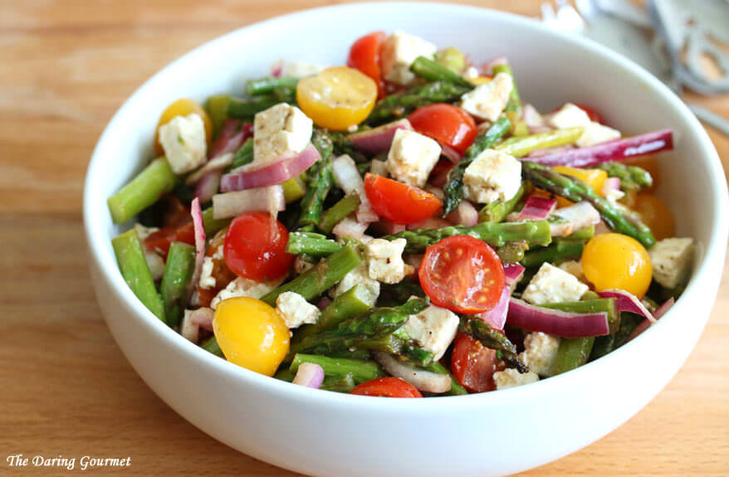
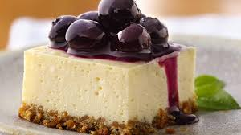
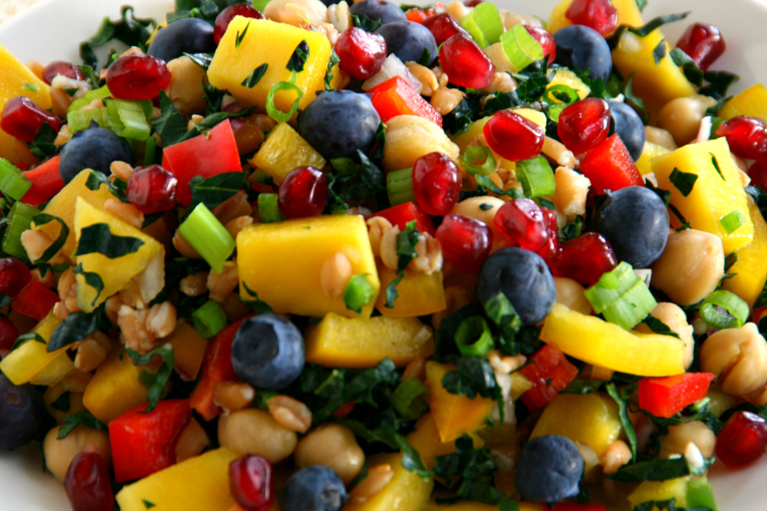
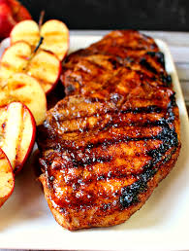
Feature 2 - International Recipes

Slide 21

Features 3 – For various size of device

Slide 22
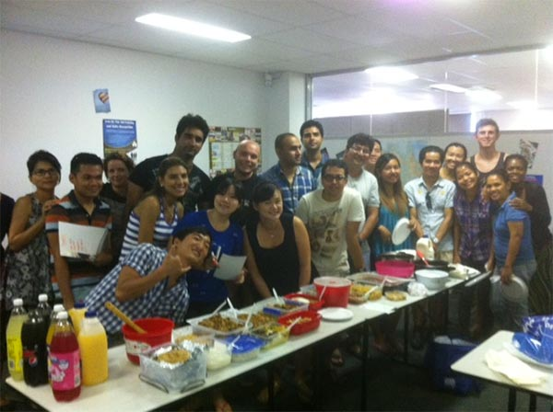

https://www.youtube.com/watch?v=z7ekIhwU8Pk

Slide 23

Summary
Beneficial on both supermarket customers and suppliers.
Establish a platform for multinational communication of cooking.
Community service

Slide 24

Summary (cont)
Make In-Store Shopping More efficiency and convenience
Bridge the culture between Australia and oversea countries

Slide 25

Thank you
Thanks for your attention
We wish you a Merry Christmas and a Happy New Year

