Slide 1

XDSY RENTAL PROPERTY RESPONSIVE WEBSITE
GROUP ASSIGNMENT

Slide 2
TEAM MEMBERS
TEAM NAME- Team02jul17
Xiting Jia
Yu liu
Dinithi Vithanage
Shemal Jayawardena

Slide 3
PROJECT TITLE
Rental Property Listings Website
Focus on designing a website for rental property listings mainly for students
Enables users to find houses, flats and apartments for lease with ease
On the go on mobile, tablets or even on desktop with the responsive design

Slide 4
GOALS OR OBJECTIVES
Develop a responsive user friendly website
Provide easily viewable mechanism for displaying and finding rental accommodation for students
Focused budget friendly accommodation options.
Allows users to seek partners/housemates for their properties
View and contact sellers who display second hand items for sale on the website.

Slide 5
TARGET USERS
Primary users
Students -Individuals or Families (above 16 )
User Characteristics:
Age and gender: above 16 male and female
Education: Secondary school or higher
Income- 4 week’s rental bank balance
Secondary users
Agent (Accommodation providers)
Second Hand items/appliance Resellers
Individuals seeking roommates/partners for accommodation

Slide 6
FEATURES
Responsive rental website accessible online on any device
Display range of rental options including homestay
Communication Bar for user communication or forums
Q and A section – For Frequently asked Questions
Enable Students to seek for house mate or second hand items available for resale.
Provide accommodation by area, suburb
Proper navigation assistance for users
Simple and easy to use page layout
Clear contact details

Slide 7
FEATURES
Usage of colour, font, text, image
Background-Color:#1676BC;
Color: white;
Usage of media
Images used for:
Rental properties
Villa
Apartment
Sharehouse
Townhouse
Home Stay
Second Hand Items Appliance resales
Logos etc.

Slide 8
INFORMATION ARCHITECTURE AND NAVIGATION SYSTEMS
Breadcrumbs
Page Titles
Highlighted Tabs
Search Icon
Global/Local Navigation Bars
Help/Contact Us/ FAQ’s/ Communication Bar or Forums

Slide 9
TECHNOLOGIES
Front end requirements:
Tools: HTML, CSS and JavaScript
Back end requirements:
Tools: SQL Server, PHP

Slide 10
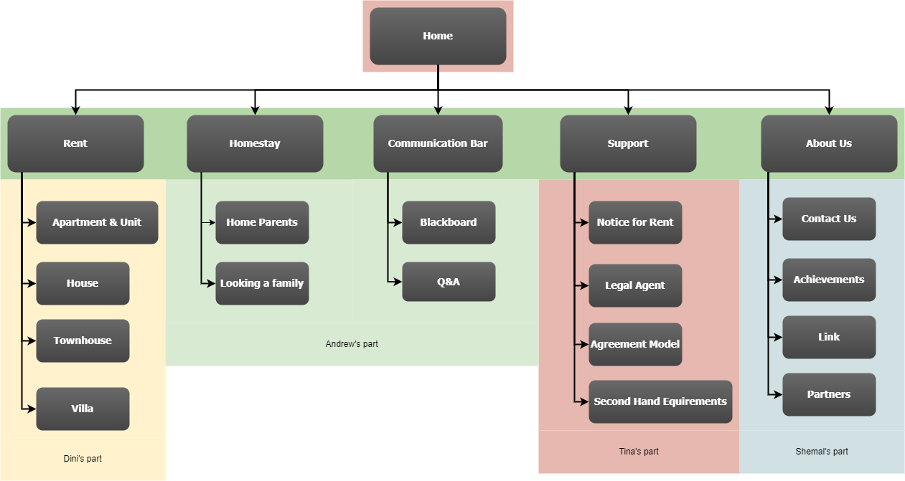
SITE DIAGRAM/BLUEPRINT

Slide 11
DATA REQUIREMENTS
Rental Property /Home Stay Information
Address of Property
Agent Name
Type of property
Prices- Bond and weekly rent
Number of bedroom/bathrooms/car spaces etc.
Details- Amenities
Available Dates
Second-hand items
Seller name and contact details
Product information- usage history and condition
Address to picked up from
Prices

Slide 12
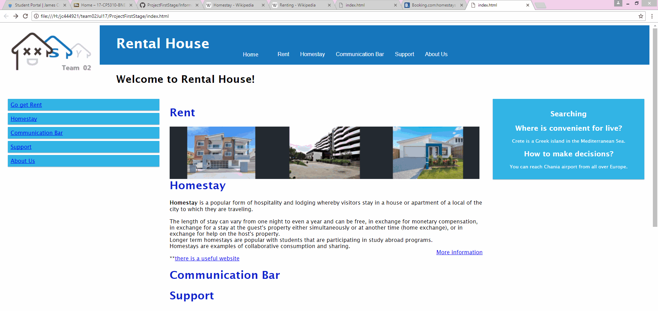
ABSTRACT VISUAL REPRESENTATION

Slide 13
RESPONSIBILITIES
STRENGTHS
Tina - Well versed about software tools for web development, focused and motivated.
Dinithi - Punctual and meets deadlines, previous experience in web designing. Organized and structured
Andrew - Experienced in creating a website himself with a similar structure. Creative in nature.
Shemal- Creative and has previous experience in web designing, motivated and a great team player.

Slide 14
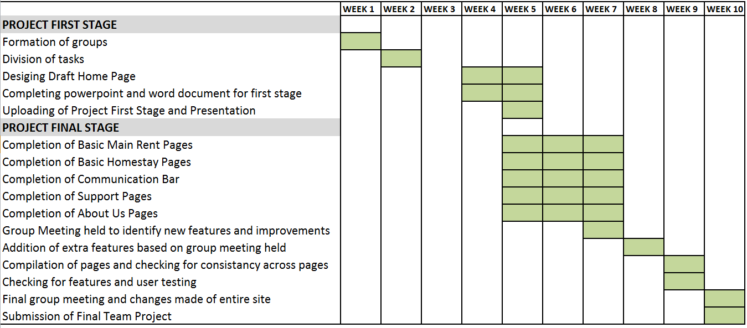
PROJECT PLAN

