Slide 1
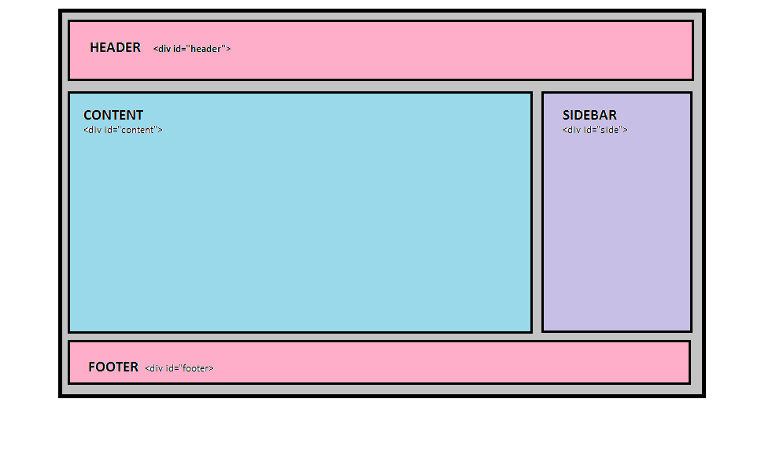
Page Layout

Slide 2
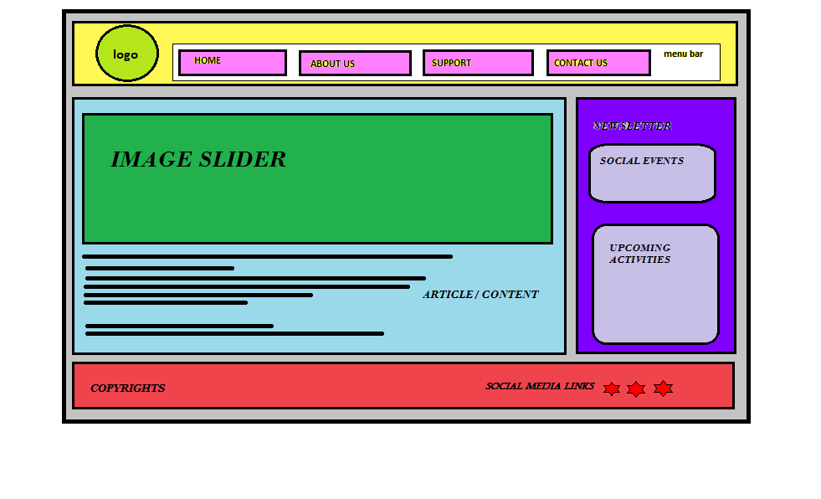
Home Page Layout

Slide 3
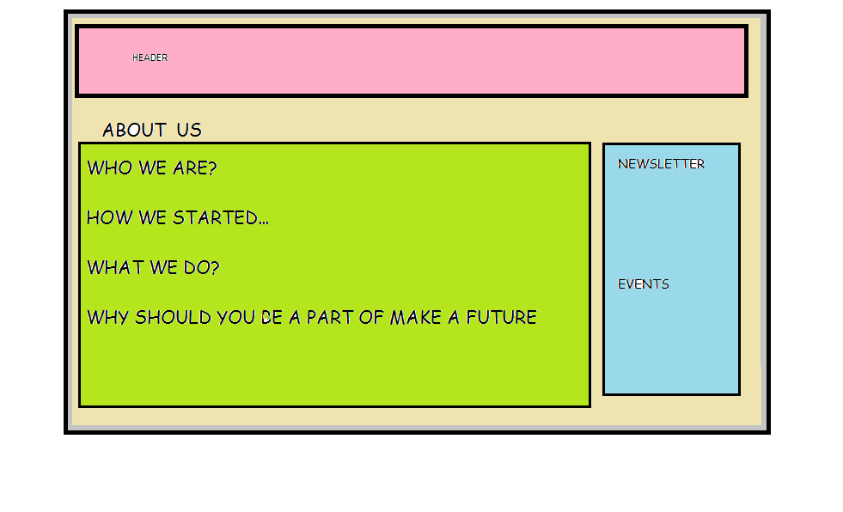
About Us Page Layout

Slide 4
Team Responsibilities & Project Milestone
Responsibilities
Neha:
Documentation
Sign-Up page
Database Creation(Adoptors)
Data Collection and Designing of Sign-Up Page
Tanveer:
Home Page:Header,Article
Database Creation(Client:Donors)
Data Collection for Home page
Bajinder
Login Page
Designing
Data Collection
Database Creation for Visitors
Harpal
Home Page:NewsLetter, ,Footer
Designing About Us & Our Mission Page
Database Creation For Paypal link
-- Schedule
Week 6: Blue print ,discussions about the concept of the project & Website Visual Design layout.
Week 7:Designing of all the following pages and assembling their database :
Home page
About us
Contact us
Support us
Donate
Adopt.
Week 8:Linking the Home, about us,contact us,support us,donate and adopt to the subsequent web pages:
Linking donation page to payment gateway.
Week 9:
Launching all the Pages for a visual and running blueprint of the website over the server.
Week 10:Final Website.

