Slide 1
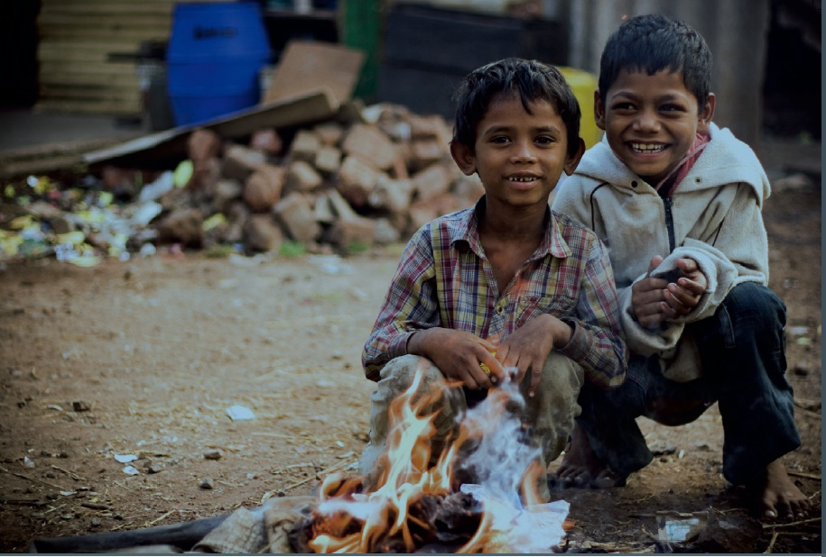
MAKE A FUTURE
TEAM02:
NEHA BISHT
TANVEER KAUR
BALJINDER KAUR
HARPAL SINGH

Slide 2
MAKE A FUTURE
Project title
Make A Future
The team
Tanveer Kaur
Harpal Singh
Baljinder Kaur
Neha Bisht
Goals or Objectives
To create a user friendly charitable website for Make A Future foundation.
Make A Future primarily works towards creating a bright future for the children who come from down-trodden parts of the society and are underprivileged. We help in giving them a ray of possible hope and strength that can enlighten their world with happiness by asking for donation and gathering eligible adopters.
Notes:
• State the project title and objectives of the project
A description of the proposed system in terms of a set of integrated ideas and concepts about what it should do, behave and look like, that will understandable by the users in the manner intended.
• Explain why this project idea is selected
• State what the importance/novelty of this project is

Slide 3
Users And Their Characterstics
Target Users
Primary users
Donors
Secondary users
Guests
Database Administrator
Volunteers
Notes:
Discuss the characteristics of the target users
Age: Users are likely to be under 25 …
Education
Gender
Computer experience, online shopping experience
…

Slide 4
Planning
Features
The basic features to be implemented
Enables people to give donation to the homeless children.
There is a online registration form for doners.
Enables people to help homeless and helpless children to making their future bright by giving them donation online.
The donation is just a click away where the users can register and donate money after filling a form and redirecting to money transfer.
The donors can also login to their accounts.
- Newsletter on the responsive Home web page consists of all the social charity news.

Slide 5

MAF Planning First Stage
Features
Features to enhance user experience
Consider any of the followings:
Menu bar consists of,
Home page
Support
About Us
Contact Us
Make A Future Logo:
Font style(Times New Roman),image on the home page and about us page.

Slide 6
Project First Stage: Planning (cont)
Technologies In Use
Front end requirements: HTML,CSS,,JAVASCRIPT,Dreamweaver.
Back end requirements:PHP.
List main functions or tasks or pages
Home page
About us
Contact us
Support us

Slide 7
Site diagram (Blueprint)
Home
The MAF Logo
Image
MAF Objective
About Us
Support
News Letter
Copyright
Contact Us
Registration Form
Login
: Component :Page
7

Slide 8
Project First Stage: Planning (cont)
Technologies
A series of sketched pages (home page and a few subsequent pages). They can even be an abstract visual representation of your site. To be sure that:
Users can easily find what they need (well-structured, meaningful and consistent links)
Users can move around the system easily
Provide feedback that tell users where they are
There is a consistent look throughout the system
Data requirements
Doner information , Adopter information , Data information visitors

Slide 9
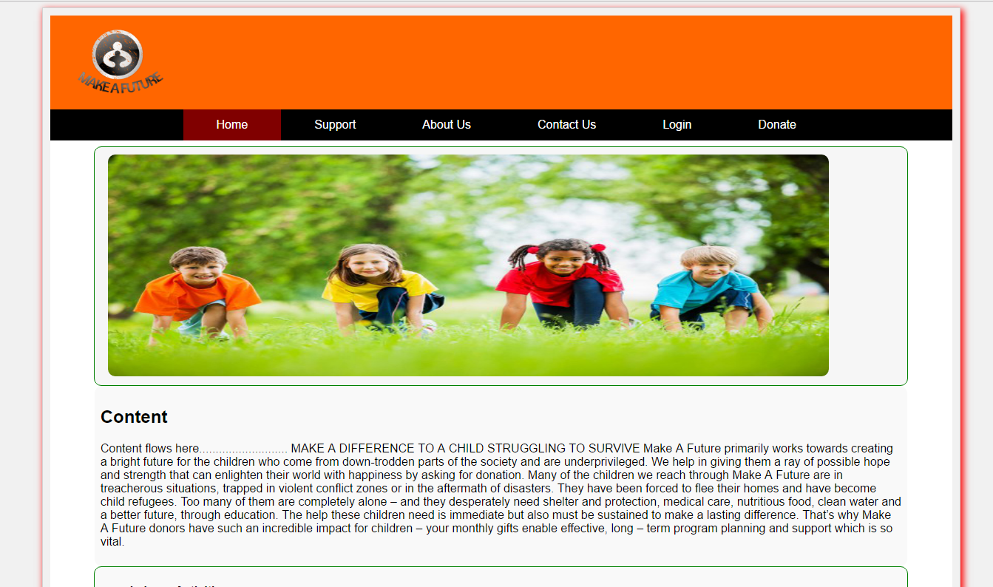
Web Pages
HomePage:
----

Slide 10
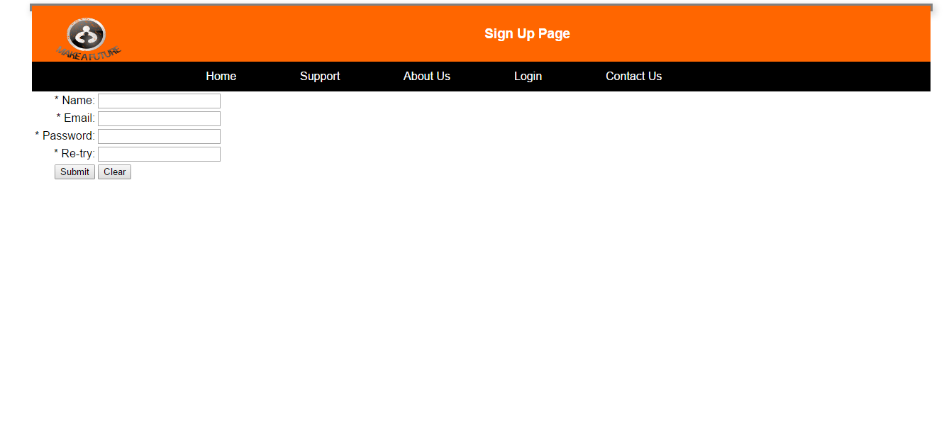
Web Pages
2) Sign Up Page:http://10.250.0.9/team02nov16/registration.html

Slide 11
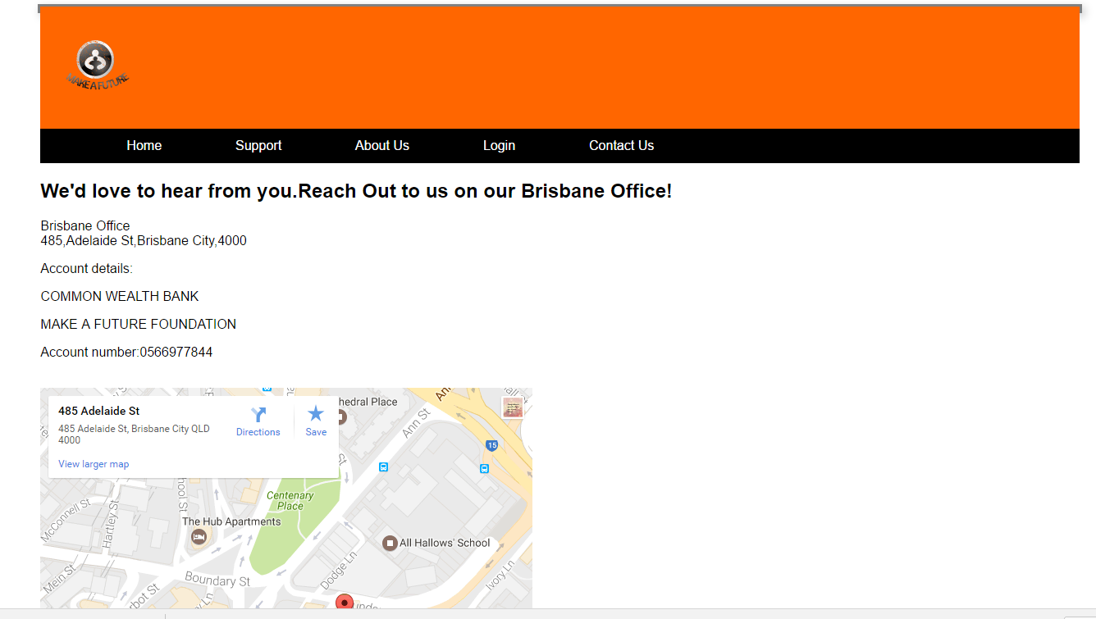
Web Pages
3) Contact Us: http://10.250.0.9/team02nov16/ContactUs.html

Slide 12
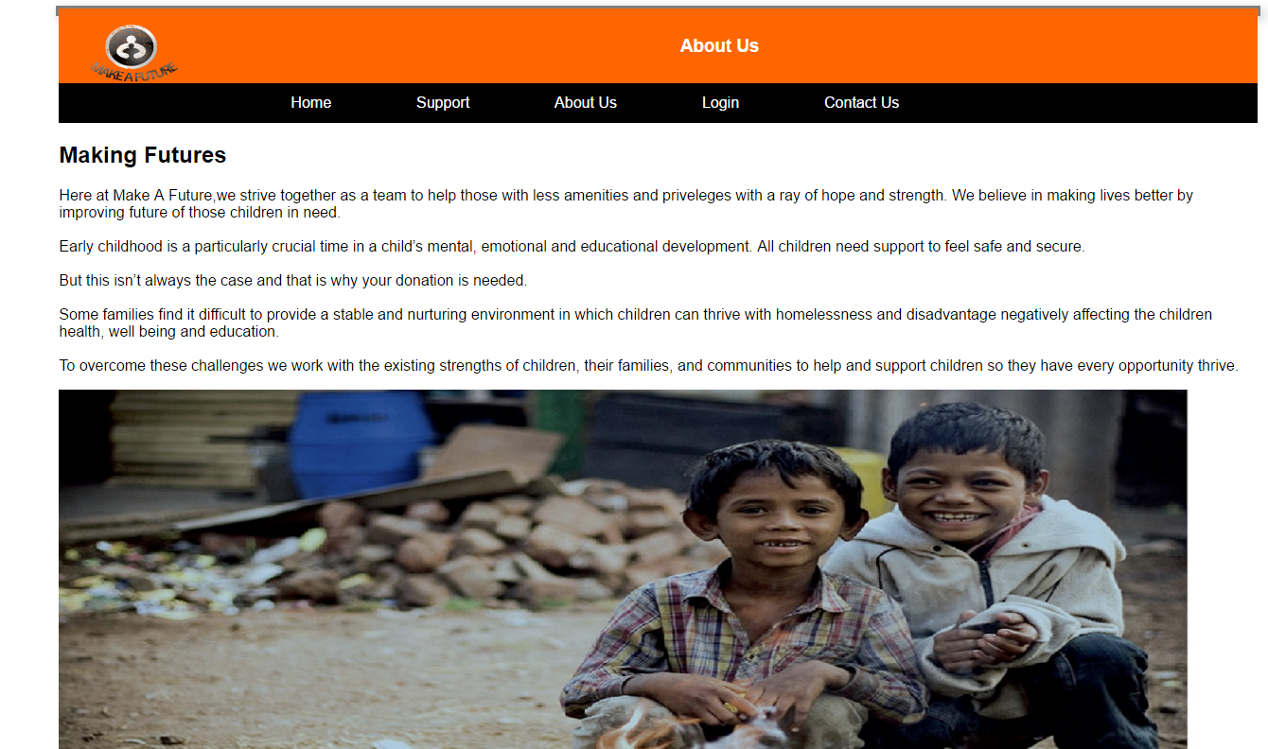
Web Pages
4) About Us: http://10.250.0.9/team02nov16/AboutUs.html

Slide 13
Team Responsibilities & Project Milestone
Responsibilities
Neha:
Documentation
Contact Us Page And Linking The Pages
Project Report/GitHub
Tanveer:
Database connectivity
Database Creation
Login Page
Log out page
Member only page
Bajinder
About us page
Designing
Data Collection For About Us Page
Footer
Harpal
Designing Home Page
designing SignUp Page
paypal linking
-- Schedule
Week 6: Blue print ,discussions about the concept of the project & Website Visual Design layout.
Week 7:Designing of all the following pages and assembling their database :
Home page
About us
Contact us
Support us
Donate
Week 8:Linking the Home, about us,contact us,support us
Week 9:
Launching all the Pages for a visual and running blueprint of the website over the server.
Week 10:Final Website.

