Slide 1
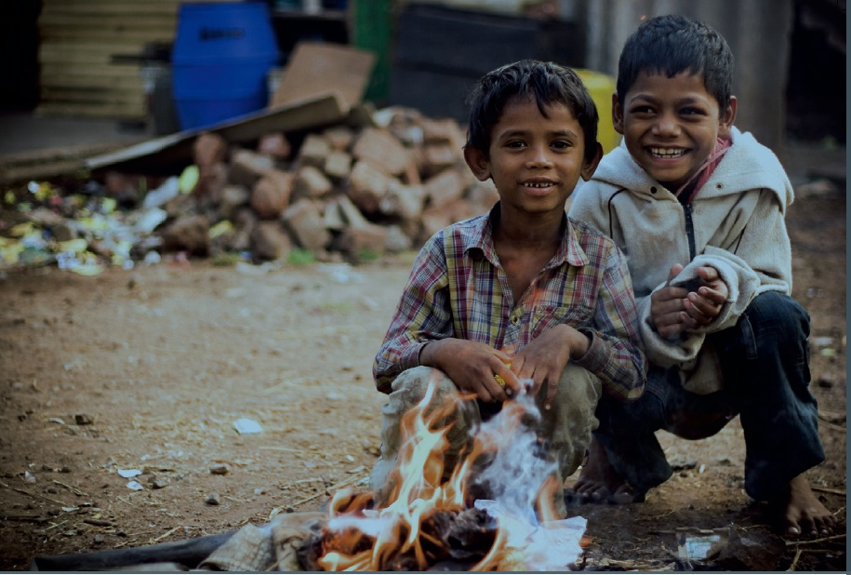
MAKE A FUTURE
TEAM02:
NEHA BISHT
TANVEER KAUR
BALJINDER KAUR
HARPAL SINGH

Slide 2
MAKE A FUTURE
Project title
Make A Future
The team
Tanveer Kaur
Harpal Singh
Baljinder Kaur
Neha Bisht
Goals or Objectives
To create a user friendly charitable website for Make A Future foundation.
Make A Future primarily works towards creating a bright future for the children who come from down-trodden parts of the society and are underprivileged. We help in giving them a ray of possible hope and strength that can enlighten their world with happiness by asking for donation and gathering eligible adopters.
Notes:
• State the project title and objectives of the project
A description of the proposed system in terms of a set of integrated ideas and concepts about what it should do, behave and look like, that will understandable by the users in the manner intended.
• Explain why this project idea is selected
• State what the importance/novelty of this project is

Slide 3
Users And Their Characterstics
Target Users
Primary users
Donors
Adopters
Secondary users
Guests
Database Administrator
Volunteers
Adopter’s characteristics
Applicant must be over 18 years.
Applicant for adoption must be a resident of Australia.
Ability to meet the cultural, ethnic, religious and educational needs of the child.
Notes:
Discuss the characteristics of the target users
Age: Users are likely to be under 25 …
Education
Gender
Computer experience, online shopping experience
…

Slide 4
Site diagram (Blueprint)
Home
The MAF Logo
Image Slider
Who we are?
What we do?
About Us
News Letter
Copyright
Contact Us
Support
Donate
Adopt
Login
SignUp
Login
SignUp
: Component :Page

Slide 5
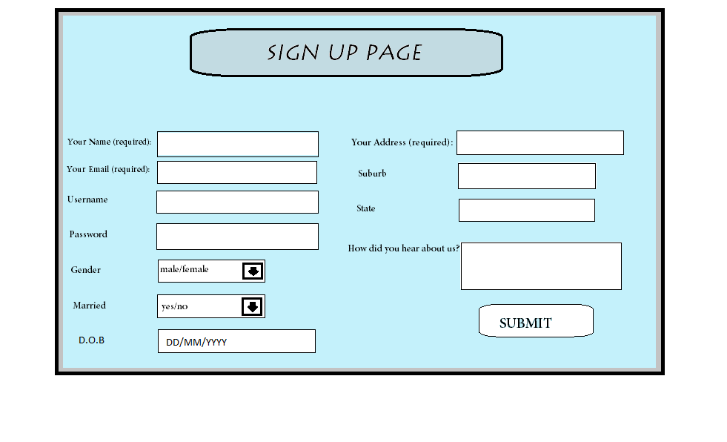
SIGN UP PAGE FOR ADOPTION

