Slide 1
Project First Stage: Planning (cont)
Technologies
A series of sketched pages (home page and a few subsequent pages). They can even be an abstract visual representation of your site. To be sure that:
Users can easily find what they need (well-structured, meaningful and consistent links)
Users can move around the system easily
Provide feedback that tell users where they are
There is a consistent look throughout the system
Data requirements
Doner information , Adopter information , Data information visitors

Slide 2
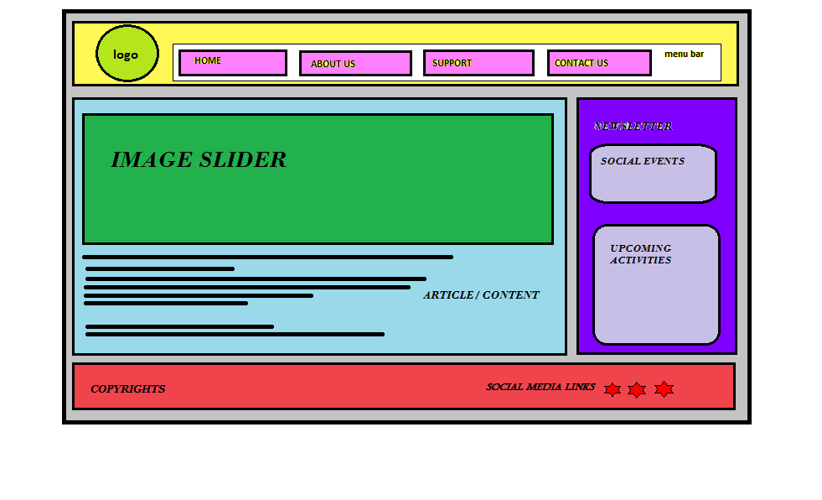
Home Page Layout

Slide 3
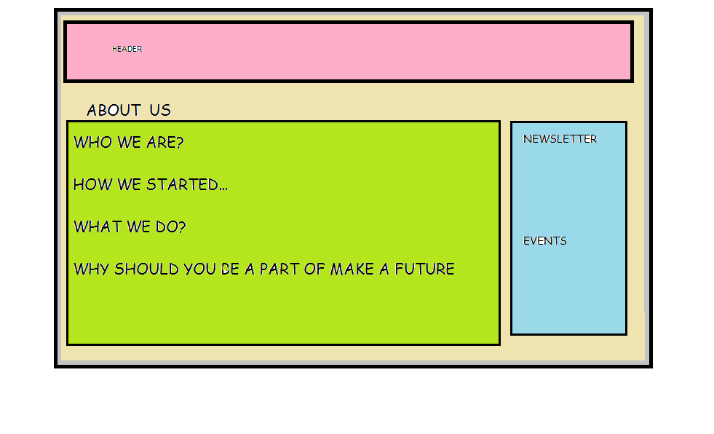
About Us Page Layout

