Slide 1
Planning
Features
  The basic features to be implemented
      Enables people to adopt a child and give donation to the homeless children.
      There is a online form for the adopter and the doners.
      Enables people to help homeless and helpless children to making their future bright by giving them donation online.
      Enables to get the information about the orphans children.
      The donation is just a click away where the users can register and donate money after filling a form and redirecting to money transfer.
      Newsletter on the responsive Home web page consists of all the upcoming and social charity events.

Slide 2
MAF Planning First Stage
Features
  Features to enhance user experience
    Consider any of the followings:
      Screen, menu, home page, MAF logo.
      Font style(Times New Roman), Drop down Menu,Radio Buttons image slider.

Slide 3
Project First Stage: Planning (cont)
Technologies In Use
  Front end requirements: HTML,CSS,XML,JAVASCRIPT,Dreamweaver.
  Back end requirements:,JQUERY,PL/SQL,PHP.
  List main functions or tasks or pages
  Home page
  About us
  Contact us
  Support us
  Donate
  Adopt.

Slide 4
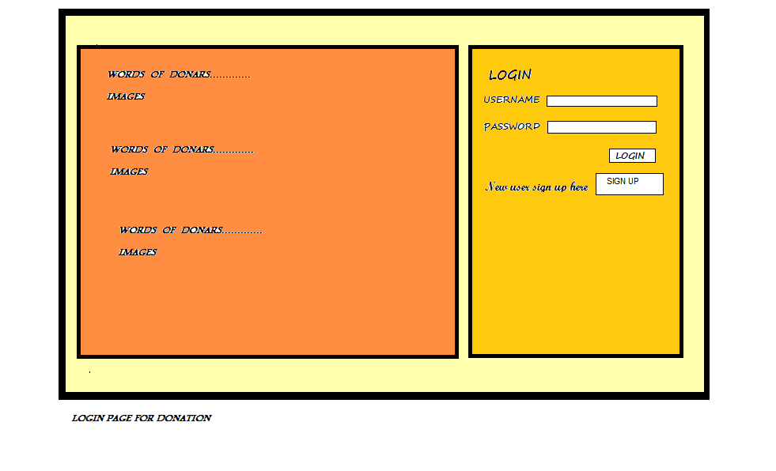
Login Page Layout

