Slide 1
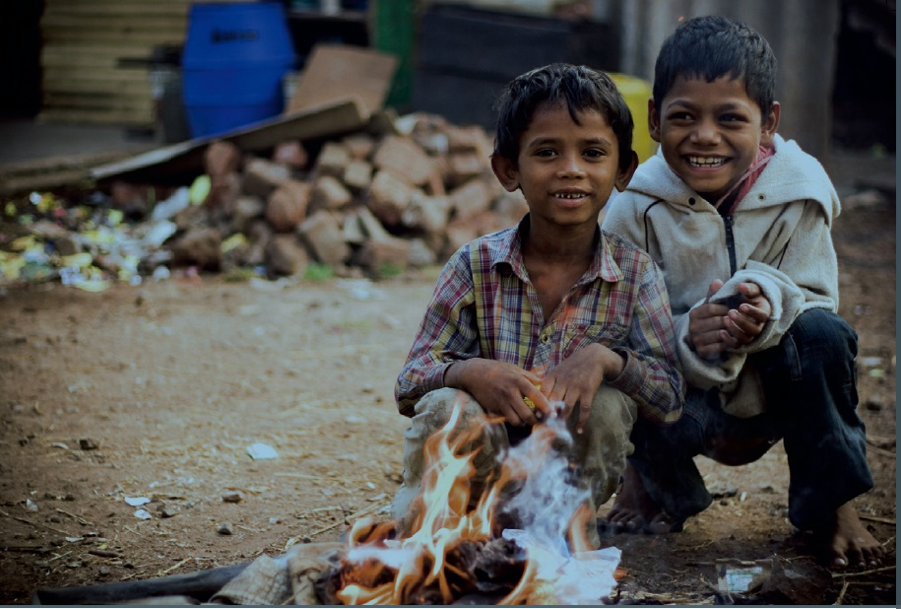
MAKE A FUTURE
TEAM02:
NEHA BISHT
TANVEER KAUR
BALJINDER KAUR
HARPAL SINGH

Slide 2
MAKE A FUTURE
Project title
Make A Future
The team
Tanveer Kaur
Harpal Singh
Baljinder Kaur
Neha Bisht
Goals or Objectives
To create a user friendly charitable website for Make A Future foundation.
Make A Future primarily works towards creating a bright future for the children who come from down-trodden parts of the society and are underprivileged. We help in giving them a ray of possible hope and strength that can enlighten their world with happiness by asking for donation and gathering eligible adopters.
Notes:
• State the project title and objectives of the project
A description of the proposed system in terms of a set of integrated ideas and concepts about what it should do, behave and look like, that will understandable by the users in the manner intended.
• Explain why this project idea is selected
• State what the importance/novelty of this project is

Slide 3
Users And Their Characterstics
Target Users
Primary users
Donors
Adopters
Secondary users
Guests
Database Administrator
Volunteers
Adopter’s characteristics
Applicant must be over 18 years.
Applicant for adoption must be a resident of Australia.
Ability to meet the cultural, ethnic, religious and educational needs of the child.
Notes:
Discuss the characteristics of the target users
Age: Users are likely to be under 25 …
Education
Gender
Computer experience, online shopping experience
…

Slide 4
Planning
Features
The basic features to be implemented
Enables people to adopt a child and give donation to the homeless children.
There is a online form for the adopter and the doners.
Enables people to help homeless and helpless children to making their future bright by giving them donation online.
Enables to get the information about the orphans children.
The donation is just a click away where the users can register and donate money after filling a form and redirecting to money transfer.
- Newsletter on the responsive Home web page consists of all the upcoming and social charity events.

Slide 5
MAF Planning First Stage
Features
Features to enhance user experience
Consider any of the followings:
Screen, menu, home page, MAF logo.
Font style(Times New Roman), Drop down Menu,Radio Buttons image slider.

Slide 6
Project First Stage: Planning (cont)
Technologies In Use
Front end requirements: HTML,CSS,XML,JAVASCRIPT,Dreamweaver.
Back end requirements:,JQUERY,PL/SQL,PHP.
List main functions or tasks or pages
Home page
About us
Contact us
Support us
Donate
Adopt.

Slide 7
Site diagram (Blueprint)
Home
The MAF Logo
Image Slider
Who we are?
What we do?
About Us
News Letter
Copyright
Contact Us
Support
Donate
Adopt
Login
SignUp
Login
SignUp
: Component :Page
7

Slide 8
Project First Stage: Planning (cont)
Technologies
A series of sketched pages (home page and a few subsequent pages). They can even be an abstract visual representation of your site. To be sure that:
Users can easily find what they need (well-structured, meaningful and consistent links)
Users can move around the system easily
Provide feedback that tell users where they are
There is a consistent look throughout the system
Data requirements
Doner information , Adopter information , Data information visitors

Slide 9
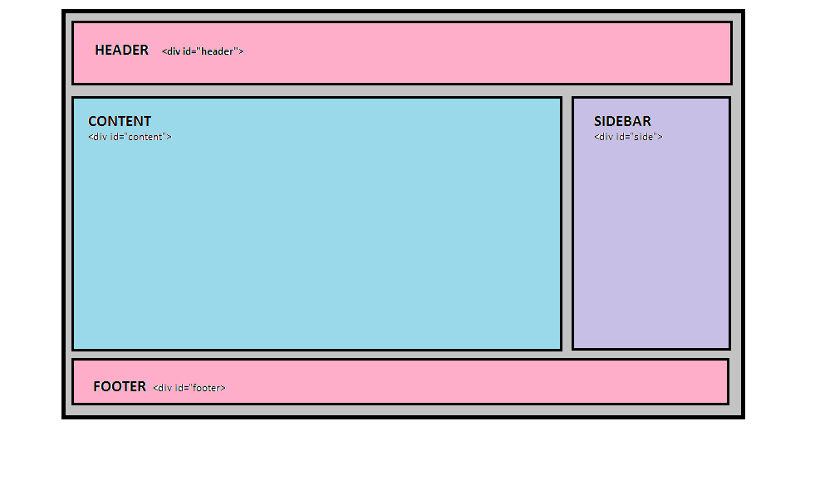
Page Layout

Slide 10
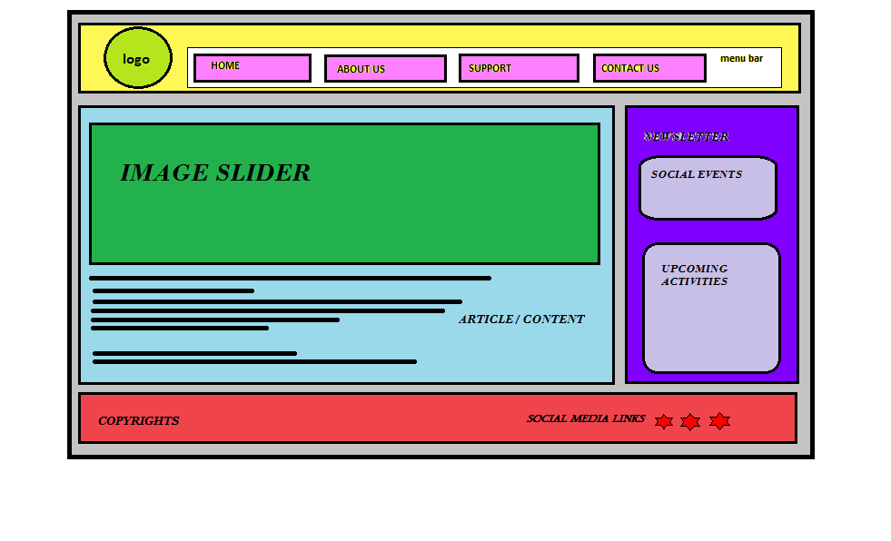
Home Page Layout

Slide 11
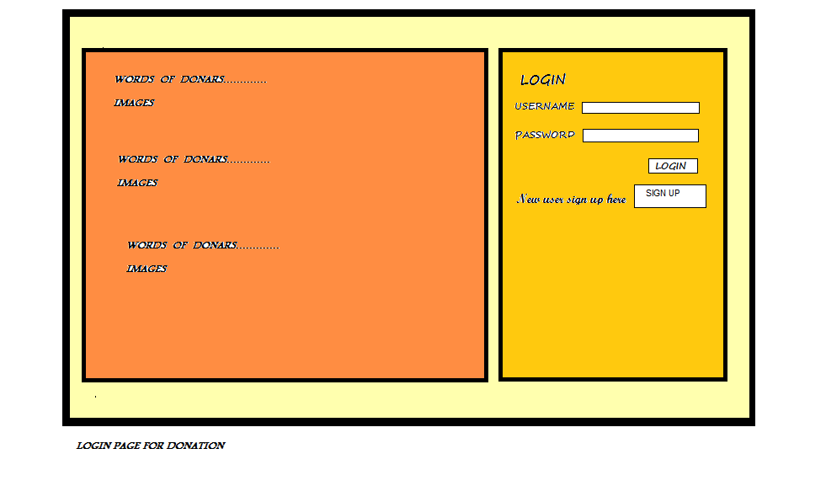
Login Page Layout

Slide 12
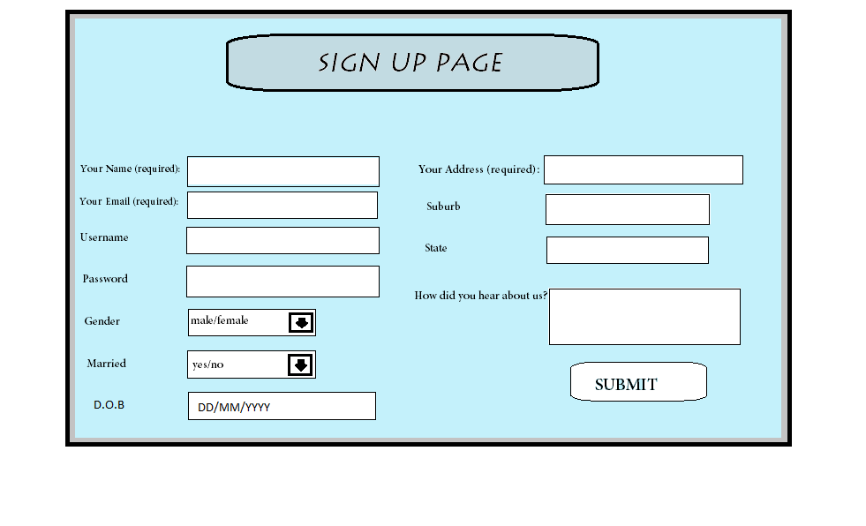
SIGN UP PAGE FOR ADOPTION

Slide 13
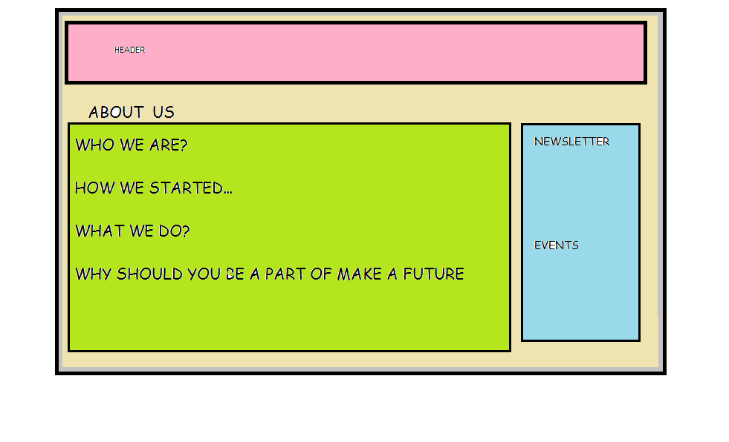
About Us Page Layout

Slide 14
Team Responsibilities & Project Milestone
Responsibilities
Neha:
Documentation
Sign-Up page
Database Creation(Adoptors)
Data Collection and Designing of Sign-Up Page
Tanveer:
Home Page:Header,Article
Database Creation(Client:Donors)
Data Collection for Home page
Bajinder
Login Page
Designing
Data Collection
Database Creation for Visitors
Harpal
Home Page:NewsLetter, ,Footer
Designing About Us & Our Mission Page
Database Creation For Paypal link
-- Schedule
Week 6: Blue print ,discussions about the concept of the project & Website Visual Design layout.
Week 7:Designing of all the following pages and assembling their database :
Home page
About us
Contact us
Support us
Donate
Adopt.
Week 8:Linking the Home, about us,contact us,support us,donate and adopt to the subsequent web pages:
Linking donation page to payment gateway.
Week 9:
Launching all the Pages for a visual and running blueprint of the website over the server.
Week 10:Final Website.

