Slide 1
Steps to upload your project On the server 10.250.0.7

Slide 2
Local Team Folder
Create a local team folder in your laptop, usb or network drive, for good practice:
Name your local team folder as your team username, for example, team01jul17 .
In your local team folder, make 2 subfolders ProjectFirstStage and ProjectFinalStage.

Slide 3
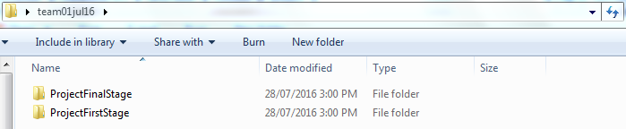
Local Team Folder (cont)
Your local team folder should be

Slide 4
ProjectFirstStage folder (cont)
Your ProjectFirstStage folder should contain:
The "Project idea and concept" document named as TeamxxFirstStage.html (or .doc)
The team presentation file
A draft homepage named index.html and some draft subsequent pages
Related files or folders, for examples, images, clips etc.
Your ProjectFirstStage must be completed and uploaded by Friday Week 05.

Slide 5
ProjectFinalStage folder(cont)
Your ProjectFinalStage folder should contain:
The final report named as TeamxxFinalStage.html (or .doc)
The final homepage named index.html and some other pages
All the pages/files/folders of the project
Your ProjectFinalStage must be completed and uploaded by Friday Week 10.

Slide 6
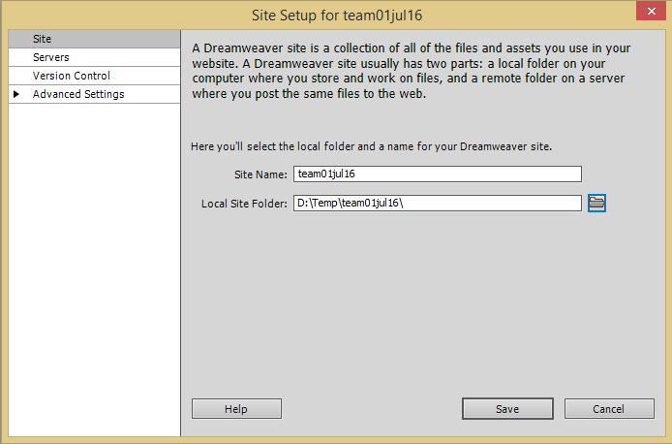
Make a team site with Dreamweaver
Run Dreamweaver→ click Site →New Site → Enter the followings:
Site name: your team username, for example, team01jul17
Local site folder: choose your local folder, for example, team01jul17
Click Servers

Slide 7
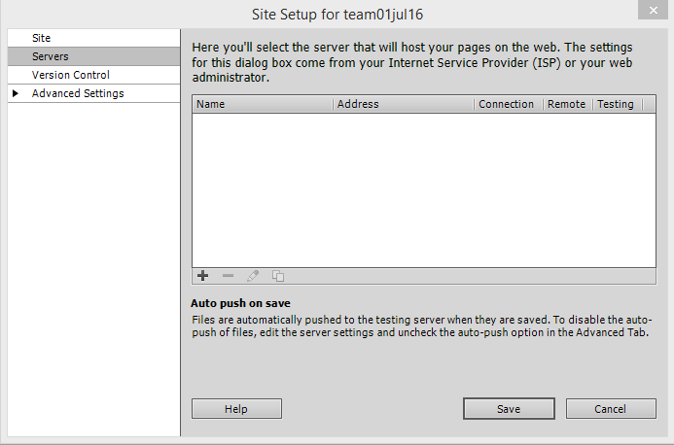
Make a team site with Dreamweaver (cont)
Click (+) to add a new server :

Slide 8
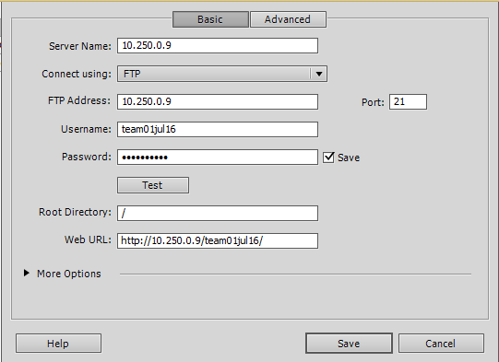
Make a team site with Dreamweaver (cont)
Server Name: 10.250.0.7
Connect using: FTP
FTP Address: 10.250.0.7 Port: 21
Username: your team username, for example, team01jul17
Password: your team password
Root Directory: /
Web URL: http://10.250.0.7/team_user_name, for example, http://10.250.0.7/team01jul17
Click button Test

Slide 9
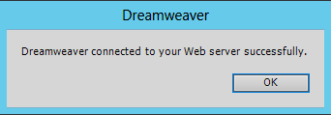
Make a team site with Dreamweaver (cont)
If done correctly you will see the message:
Click OK and click Save and then click Save again.

Slide 10
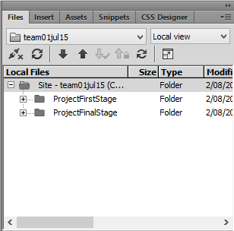
Make a team site with Dreamweaver (cont)
You have made a site with your username as the site name.
Make a connection click
Expand the view to show both local and remote folders click
To upload the ProjectFirstStage, select the folder and click the up-arrow button
Must be done by Friday week05
To upload the ProjectFinalStage, select the folder and click the up-arrow button
Must be done by Friday week10

