Slide 1



Plant Disease Classification
Under the guidance of
Ms. Anupama Arun
Adjunct Assistant Professor
Presented by
Jyotiraditya Chillal (112215081)
Dept. of Computer Science & Engineering
IIIT Pune
May 2026

Slide 2
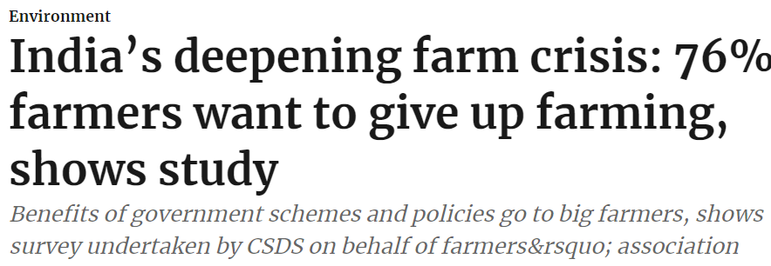
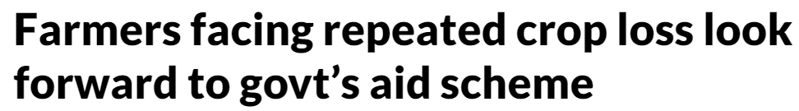
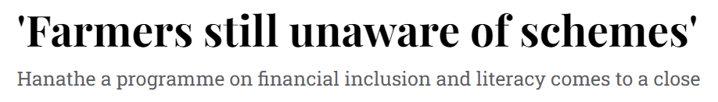
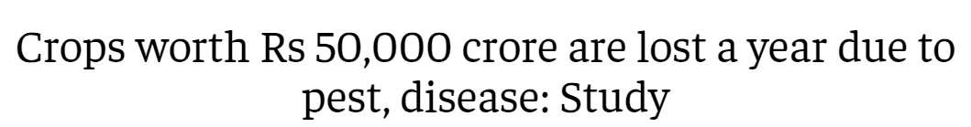
MOTIVATION
SOURCE
Hindustan Times
Deccan Herald
Economics Times

Slide 3
1
OVERVIEW
Problem Statement
Literature Review
Research Gap
Methodology
Implementation
Dataset
Results
Future Scope
References
IIIT Pune | 2026

Slide 4


PROBLEM STATEMENT
2
Agriculture plays a vital role in feeding the world’s population, and plays a major role in a nation’s economy.
But it is constantly challenged by plant diseases that can severely impact crop yield.
Early detection and identification of plant diseases are critical to ensuring food security and maintaining ecosystem balance.
Detecting the species accurately can also help us to prevent the disease by following appropriate practises.
With advancements in deep learning, we can now assist in detecting plant species and their associated diseases. This project aims to use the power of Various Neural Networks to analyze plant images.
Ref: AI generated Image
IIIT Pune | 2026

Slide 5
3
LITERARY REVIEW
AUTHOR | METHODOLOGY | LIMITATIONS | ACCURACY
MD. NAHIDUZZAMAN, ABIDA SULTANA, et al.. | Lightweight 2D CNN for tomato and cotton leaf disease detection using fewer parameters. Datasets: PlantVillage (tomato) | The model may struggle with new or evolving diseases and relies heavily on high-quality images, limiting real-world scalability. | 97.3%
NATASHA NIGAR, MUHAMMAD UMER, et al.. | EfficientNetB0, a deep learning model with 237 layers, for classifying 38 plant diseases | Limited dataset diversity and only four models tested; larger datasets and more models could enhance results. | 96.89%
R. Singh, A. Jain, et al. | CNN-based cotton leaf disease classification using feature extraction + deep learning | Small dataset size; model may overfit and lacks robustness in field conditions | 95.2%
DIANA SUSAN JOSEPH, KAUSTUBH CHAKRADEO, et al.. | A CNN model, MRW-CNN is proposed for detecting maize, rice, and wheat leaf diseases. | It does not explore the use of annotated images for advanced object detection models, which could enhance disease detection capabilities. | InceptionV3 on wheat- 94.68%
IIIT Pune | 2026

Slide 6
4
RESEARCH GAP
Many existing approaches, including lightweight CNN-based models, are designed for specific crops such as tomato and cotton. This restricts their applicability across diverse agricultural scenarios. There is a need for models that can generalize across multiple crop types and disease classes.
Existing models typically employ either additive (ResNet) or concatenation-based (DenseNet/Inception) feature fusion independently. There is limited exploration of hybrid fusion strategies that can simultaneously preserve information and maintain computational efficiency.
Lack of Diverse Crop Data
Existing Architectures
IIIT Pune | 2026

Slide 7
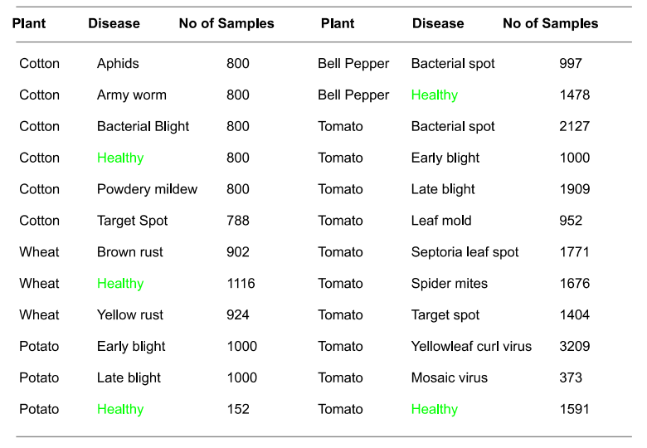


DATASET & TECH STACK
5
To develop an effective crop disease detection system, we utilized several key agricultural datasets:
PlantVillage Dataset:
Contains 20,639 images of Bell Pepper, Potato, and Tomato plants, both healthy and diseased. It includes common diseases like late blight and bacterial spot, offering diverse data for accurate disease detection.
CottonPlant Disease Dataset:
Features 4,788 images of Cotton crops, focusing on diseases like bacterial blight and leaf curl. This dataset is essential for cotton-specific disease identification.
Wheat Disease Dataset:
Comprises 2,942 images of Wheat crops affected by diseases such as leaf rust and powdery mildew, supporting precise classification of wheat diseases.
Technologies Used:
IIIT Pune | 2026

Slide 8
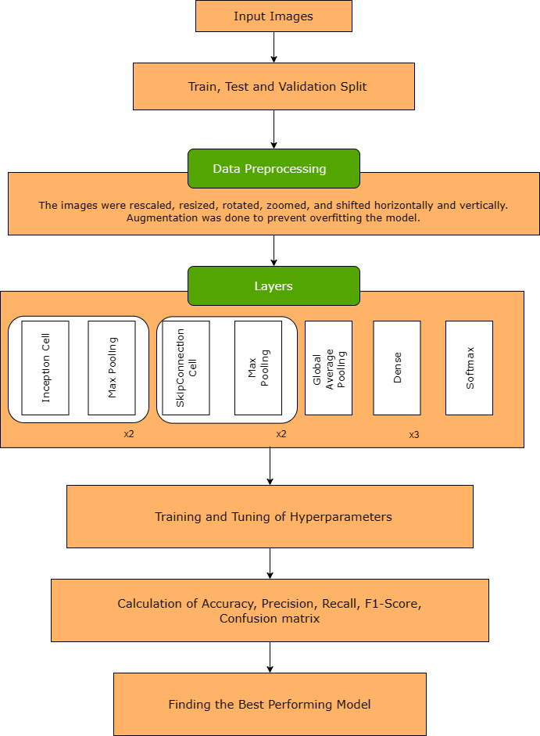
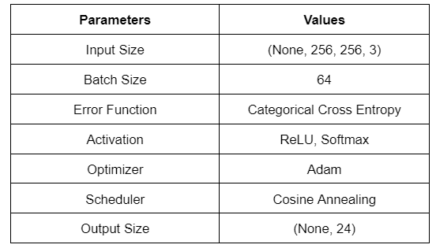
IMPLEMENTATION
6
Model Features
IIIT Pune | 2026

Slide 9
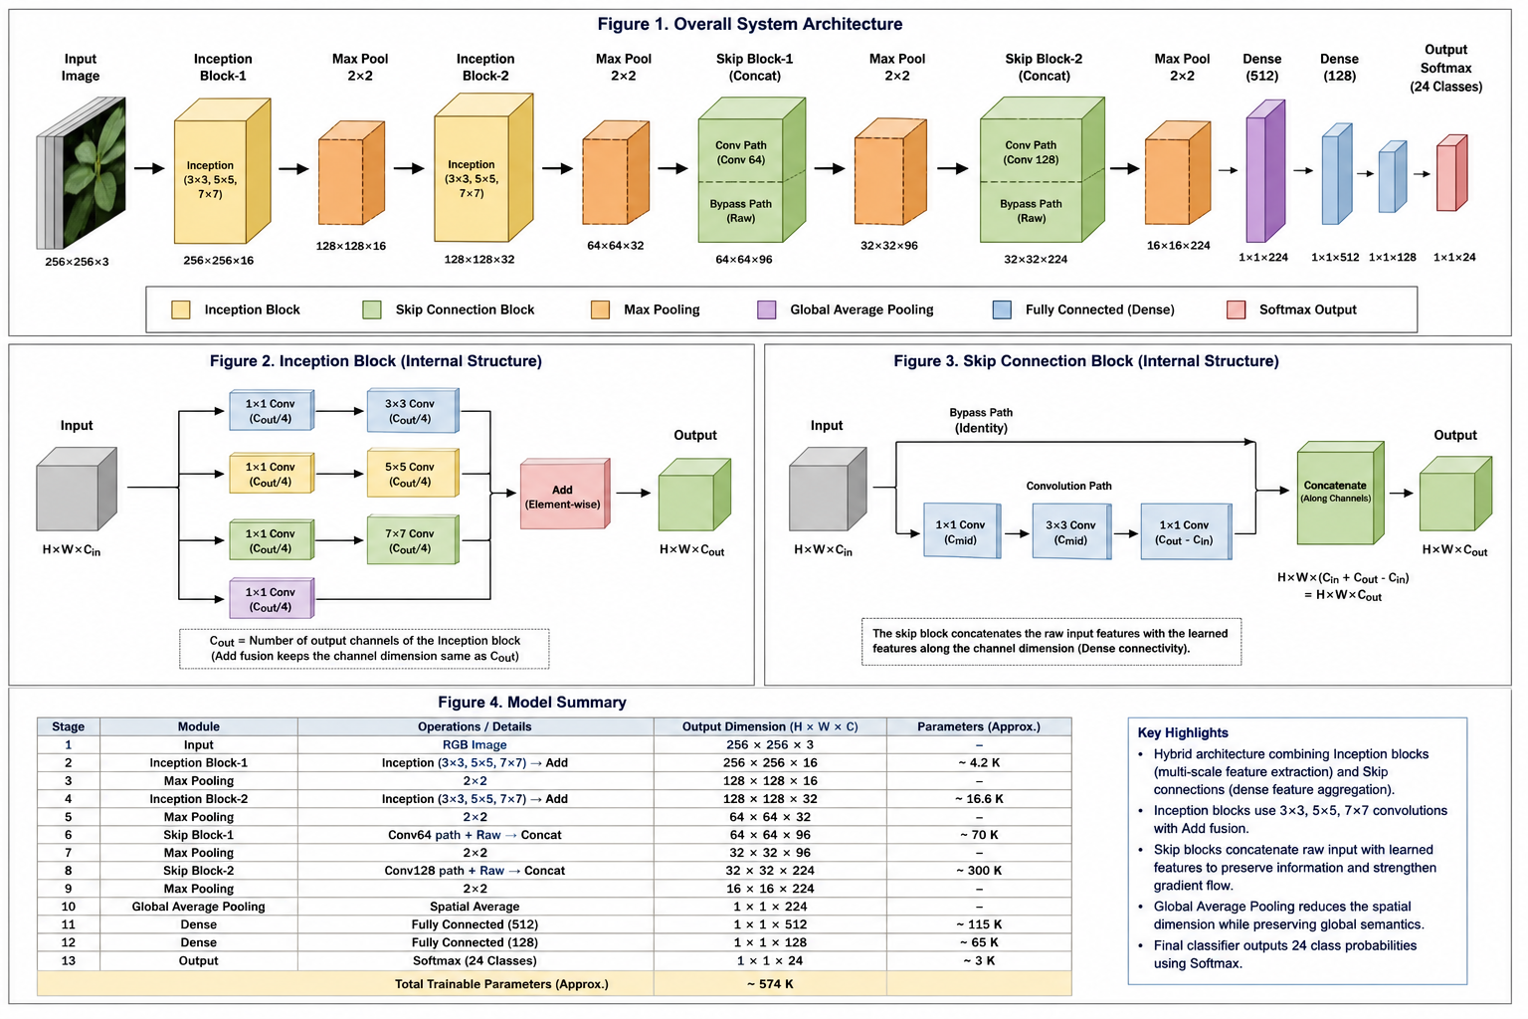
IMPLEMENTATION
7
IIIT Pune | 2026

Slide 10
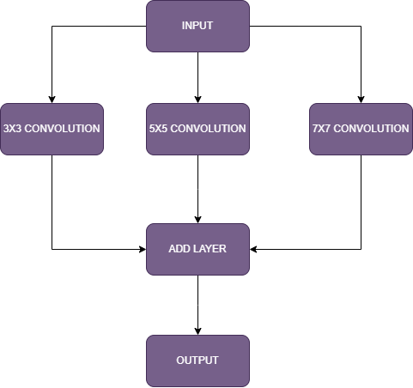
PROPOSED METHODOLOGY
8
Inception Cell
Skip Connection Cell
IIIT Pune | 2026

Slide 11
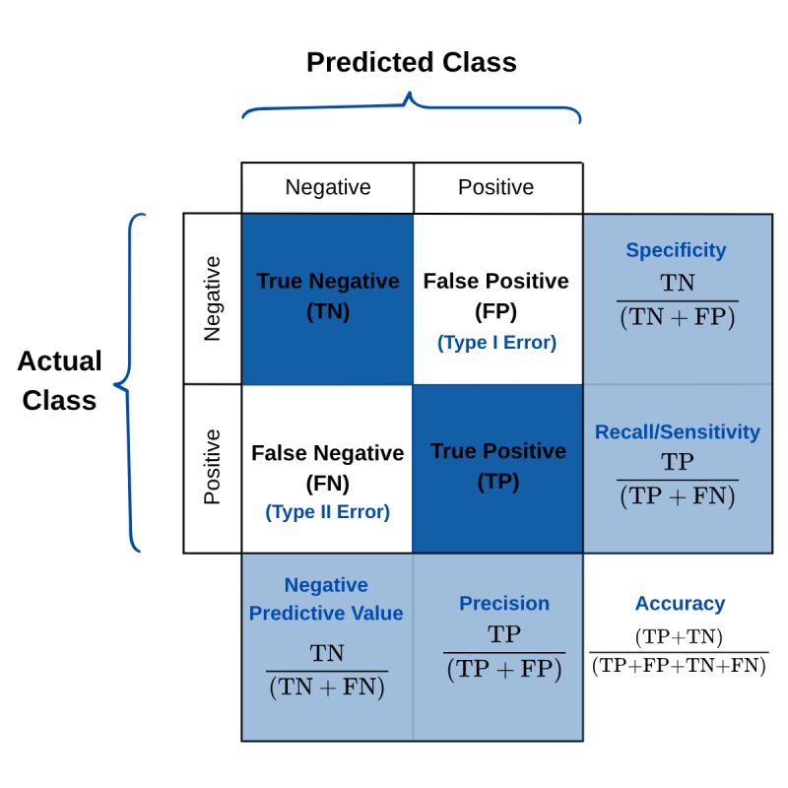
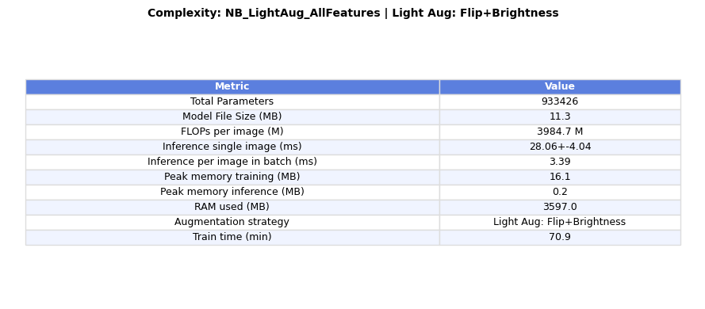
RESULTS
9
Flip+Brightness Aug
All Datasets
Only PlantVillage,Wheat
ACCURACY : 0.9706
PRECISION : 0.9707
RECALL : 0.9706
F1-SCORE : 0.9706
SPECIFICITY : 0.9987
ACCURACY : 0.9912
PRECISION : 0.9913
RECALL : 0.9912
F1-SCORE : 0.9912
SPECIFICITY : 0.9995
IIIT Pune | 2026

Slide 12
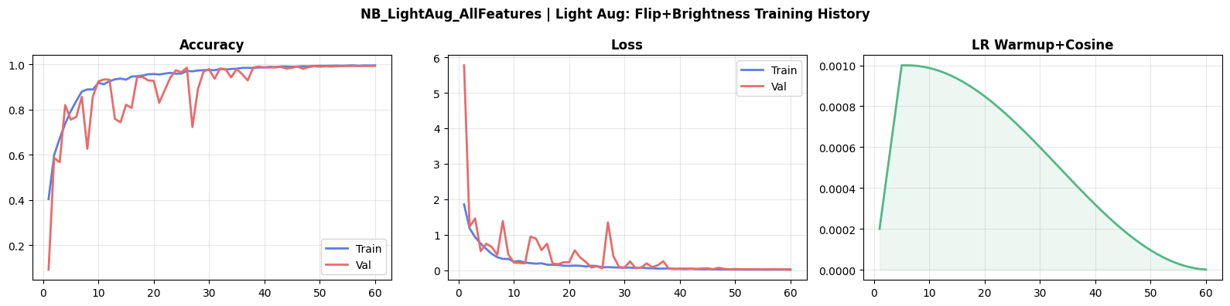
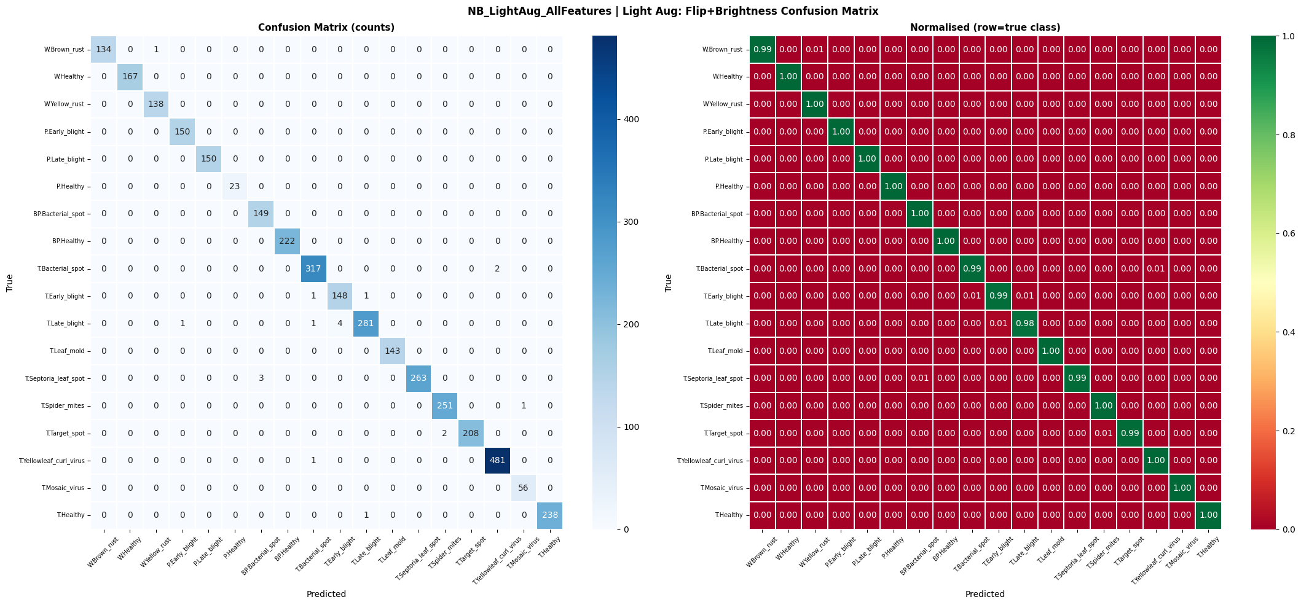
RESULTS
10

Slide 13
11
FUTURE SCOPE
Future work can focus on advanced regularization and data augmentation techniques to enhance generalization across unseen data while maintaining optimal parameters ,fast inference time
The model can be integrated with IoT-based monitoring systems, drones, or automated irrigation systems to enable early disease detection and decision support for precision farming.
Expanding the model to handle multiple crops and real-field conditions will improve robustness and make it more practical for real-world agricultural applications.
IIIT Pune | 2026

Slide 14
REFERENCES
12
M. Nahiduzzaman and A. Khandakar, "Plant Disease Classifier: Detection of Dual-Crop Diseases Using Lightweight 2D CNN Architecture," IEEE Access, vol. 11, pp. 1-12, Sep. 29, 2023, doi: 10.1109/ACCESS.2023.3320686.
N. Nigar and M. Umer, "Improving Plant Disease Classification With Deep-Learning-Based Prediction Model Using Explainable Artificial Intelligence," IEEE Access, vol. 12, pp. 1-15, Jul. 15, 2024, doi: 10.1109/ACCESS.2024.3428553.
A. Anagnostis and G. Asiminari, "A Convolutional Neural Networks Based Method for Anthracnose Infected Walnut Tree Leaves Identification," Applied Sciences, vol. 10, no. 2, pp. 469-480, Nov 2023, doi: 10.3390/app10020469.
D. S. Joseph and D. K. Chakradeo, Pranav "Real-Time Plant Disease Dataset Development and Detection of Plant Disease Using Deep Learning," IEEE Access, vol. 12, pp. 1-8, Feb. 2, 2024, doi: 10.1109/ACCESS.2024.3358333.
L. Li and S. Zhang, "Plant Disease Detection and Classification by Deep Learning—A Review," IEEE Access, vol. 9, pp. 112020-112035, Apr. 19, 2021, doi: 10.1109/ACCESS.2021.3069646.
IIIT Pune | 2026

Slide 15
IIIT PUNE | 2026
THANK YOU

