Slide 1
Terraform
Write terraform plan to output file

Slide 2
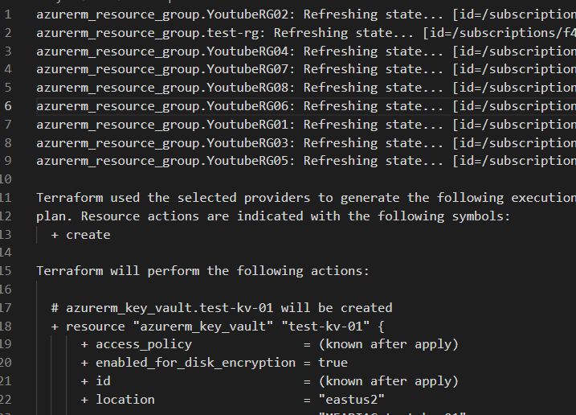
Method 1
Terraform plan –no-color > output.txt
This is captures the ENTIRE output of running ‘terraform plan’ including the portion in which it takes inventory of current state already deployed.

Slide 3
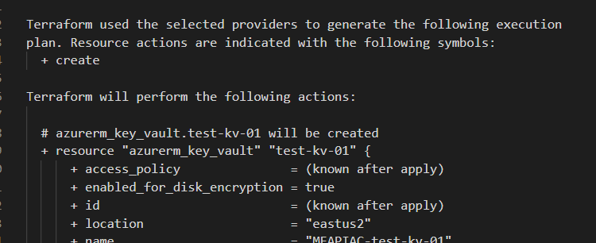
Method 2
Terraform plan –out=tfplan
Terraform show –no-color tfplan > tfplan.txt
(Optional) terraform apply tfplan
This method will write your terraform plan to a output file and then use terraform show and ‘>’ operater to write it to a text file.
The reason why this is a good method is because you can also run ‘Terraform apply tfplan’ where ‘tfplan’ is the name of the output file. So its easy to grab the expected outcome of terraform plan, have it reviewed as a text file, and if all is good, you can run it immediately with the output file, in this case, ‘tfplan’.

