Slide 1
Week 3 09/22
uva10929
uva10035(5%)
uva10221(6.27%)
uva10812
uva11388
jschung@mcu_2022Spring

Slide 2
上週作業注意事項
注意特殊測資
2³² = 4,294,967,296
int (-2^31 ~ 2^32-1)
unsigned int (0 ~ 2^32-1)
long long (-2^63 ~ 2^64-1)
abs()函數無法使用
類型名稱 | 位元組 | 值的範圍 | 格式化字串
int | 4 | -2,147,483,648 至 2,147,483,647 | %d
unsigned int | 4 | 0 到 4,294,967,295 | %u
short | 2 | -32,768 至 32,767 | %hd
unsigned short | 2 | 0 到 65,535 | %hu
long | 4 | -2,147,483,648 至 2,147,483,647 | %ld
unsigned long | 4 | 0 到 4,294,967,295 | %lu
long long | 8 | -9,223,372,036,854,775,808 至 9,223,372,036,854,775,807 | %lld
unsigned long long | 8 | 0 到 18,446,744,073,709,551,615 | %llu

Slide 3
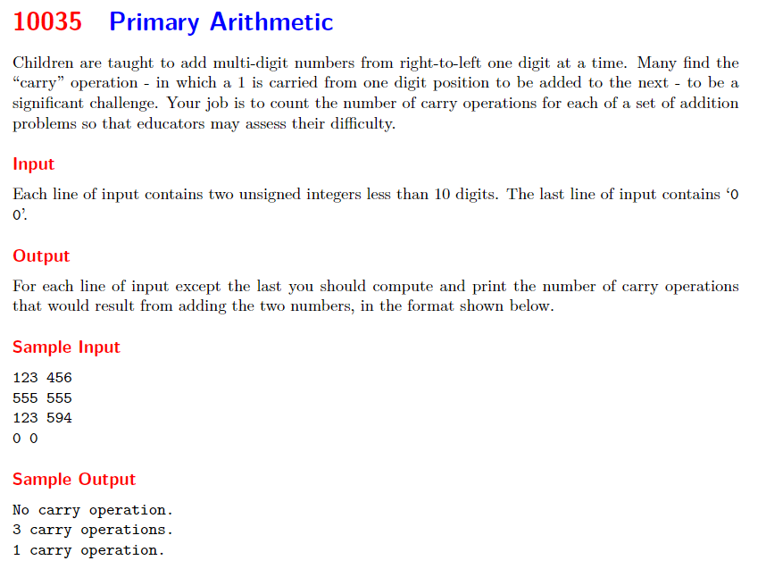

Slide 4
瞭解題目
二個unsigned int相加，計算發生幾次進位(carry)
輸入二數，小於 10 位的數字
如果讀到 0 , 0 則程式停止執行
輸出格式，如果
count=0，印出「No carry operation.」
count=1，印出「1 carry operation.」
count>1，印出「n carry operations.」

Slide 5
加法運算
每次計算完向左移位
千萬
百萬
十萬
萬
千
百
十
個
1
1
1
1
0
0
0
0
進
位
1
4
8
7
6
5
5
A
+
2
9
7
6
4
1
3
1
B
3
1
3
5
1
7
8
6

Slide 6
解題概念
宣告 A, B 為 unsigned int
宣告 carry, count 為 int
while (讀取 A, B 二數){
if A=B=0 ➔ break;
設定 na, nb 為暫時變數
carry = 0, count=0
while (nA <> 0 || nB <> 0){ //注意邏輯運算
計算數字的最右邊數 A_rbit, B_rbit; // A%10, B%10
c = A_rbit + B_rbit + carry;
if c >= 10, carry = 1 && count++;
else carry = 0;
更新 nA, nB; // nA = nA/10, nB = nB/10
}
依規則列印結果;
}

Slide 7
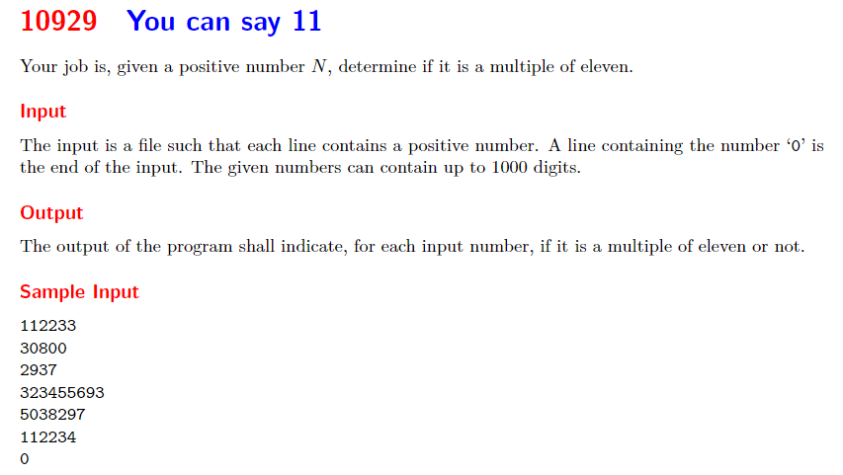
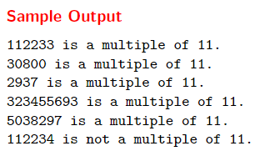
沒有辦法讀進整數的方式處理

Slide 8
判別一個正整數是否是11的倍數
數字的「奇數位數字和」與「偶數位數字和」的差若為11的倍數

Slide 9
8 7 6 5 4 3 2 1 0
N =
3
2
3
4
5
5
6
9
3
3+6+5+3+3 = 20
9+5+4+2 = 20
0
32345569 is a multiple of 11.

Slide 10
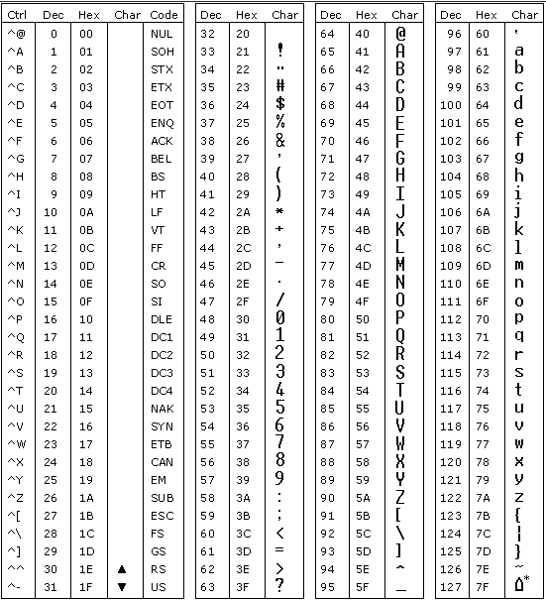
解題演算
定義 N 為數字字串，n1, n2 為 int
while (讀取 N){
if N = ‘0’ ➔ break;
n1 = n2 = 0;
計算 N 字串長度 (len) //strlen(str)
for (i=0; i<len; i++){
int c = N[i] – 48; //將字元轉換為數字
if i%2==0 ➔ n1 = n1+i;
else ➔ n2 = n2+i;
}
int d = abs(n1-n2); //stdlib.h
if c%11 == 0 ➔ 印出 “N is a multiple of 11”
else ➔ 印出 “N is not a multiple of 11”
}

Slide 11
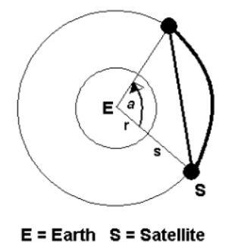
10221 Satellites
The radius of earth is 6440 Kilometer. There are many Satellites and Asteroids moving around the earth. If two Satellites create an angle with the center of earth, can you find out the distance between them? By distance we mean both the arc and chord distances. Both satellites are on the same orbit (However, please consider
that they are revolving on a circular path rather
than an elliptical path)
弧長
衛星沿地球軌道飛行時，兩個衛星間的弦長及弧長
弦長

Slide 12
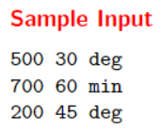
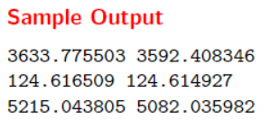
Input
The input file will contain one or more test cases. Each test case consists of one line containing two-integer s
and a, and a string ‘min’ or ‘deg’. Here s is the distance of the satellite from the surface of the earth and a is
the angle that the satellites make with the center of earth. It may be in minutes (′) or in degrees (◦).
Remember that the same line will never contain minute and degree at a time.
Output
For each test case, print one line containing the required distances i.e. both arc distance and chord distance
respectively between two satellites in Kilometer. The distance will be a floating-point value
with six digits after decimal point
角度換算1度=60分
1 (徑度) = 180/π (角度)
π為圓周率，運用 C 程式庫 math.h 中的 M_PI
影響計算結果精度

Slide 13
解題概念
sin(a/2) = (d/2)/(r+s)
d/2 = (r+s)sin(a/2)
d = 2(r+s)sin(a/2)
弦長(d) = 2*(r+s)*sin(a/2) ， a是徑度
弧長 = (r+s)* a （ a是徑度）
d/2

Slide 14
解題步驟
while (讀取 s, a, u != EOF) { //衛星高度，夾角，角度單位
檢查 u 為「min」或「deg」//使用 strcmp()
If u 為 「min」將 min 轉換為 deg
u=min ➔ A = (a/60.0) * M_PI/180.0 //M_PI在math.h中定義, A徑度量角
u=deg ➔ A = a*M_PI/180.0
d (弦長) = 2*(r+s)*sin(a/2)
len (弧長)= (r+s)*a
}

Slide 15
strcmp()
include <string.h>
int strcmp(char* str1, char*str2)
0 (str1與str2相等)
> 0 (ASCII碼較大)
< 0 (ASCII碼較小)

Slide 16
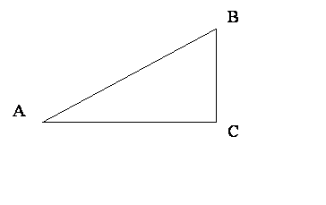
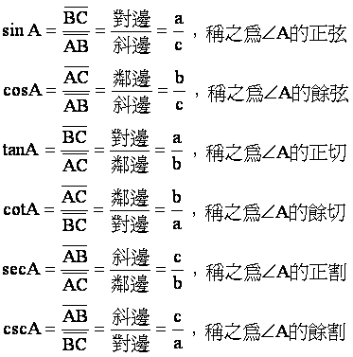
math.h中的三角函數及常數
include <math.h>
M_PI 圓周率
sin(a) //a 為徑度
cos(a)
tan(a)
…
exp(x)
pow(x, y), pow(x)
sqrt(x)
log(x), log10(x)
abs(x), fabs(x)
c (斜邊)
a (對邊)
b(鄰邊)

Slide 17
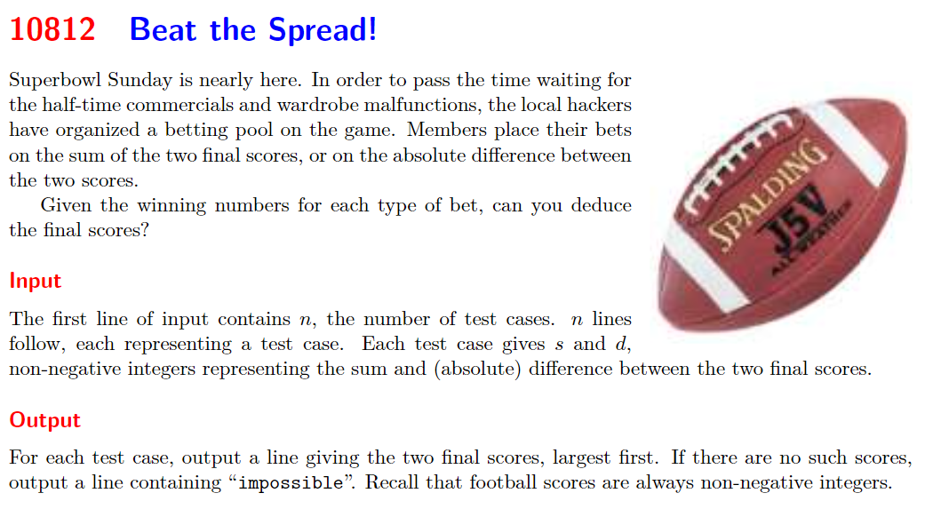
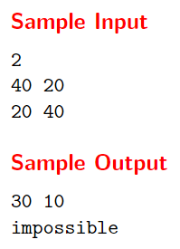

Slide 18
題意
Given s (二隊比分和)，d (二隊比分差)
請推論出二隊比分
二隊比分一定為非負整數
➔ (s+d)一定能被2整除
a + b = s (1)
|a – b| = d
a – b = d (2)
b – a = d (3)
由 (1), (2)
2a = s+d ➔ a = (s+d)/2
b = s – (s+d)/2 = (s – d)/2
由 (1), (3)
2b = s + d ➔ b = (s + d)/2
a = s – b = s – (s + d)/2 = (s – d)/2

Slide 19
解題演算
讀取 n (案例數)
For (i=1 to n){
讀取 s, d
計算 s + d 及 s – d
檢查 (s + d)須被2整除 與 (s – d) 須 ≥ 0
列印 (s+d)/2 (s-d)/2
否則
列印 impossible
}

Slide 20
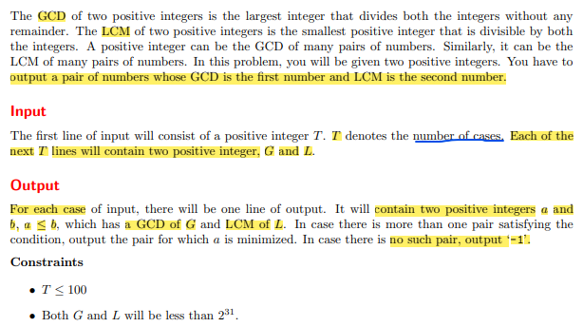
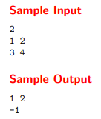
uva11388

Slide 21
題意
已知 a, b兩數的最大公因數(GCD)及最小公倍數(LCM)，找出可能的a, b值
輸入
T 組案例 (T <= 100)
G, L 表示 a, b的最大公因數(GCD)及最小公倍數(LCM) (G , L < 2^31)
輸出
若找出 a, b 則列印 a b
否則列印 -1

Slide 22
GCD與LCM關聯性
G = gcd(a, b) ➔ a = G*m, b = G*n
L = lcm(a, b) ➔ L/a = p, L/b = q
L = a*p = b*q
L = G*m*p = G*n*q
L = G*X = G*Y
L可以整除G ➔ L%G == 0
gcd(a, b) = G
lcm(a, b) = L
由於 a = x * G, b = y * G
所以 gcd(x, y) = 1
為求 a 最小值 ➔ x = 1 ➔ a = G
因為 G*L = a*b ➔ b = L

Slide 23
解題演算
宣告 n, G, L
讀取 n
for (i=1 to n){
讀取 G, L
if (L%G==0) //檢查是否有解？
print G L //a = G, b = L
else
print -1
}

Slide 24

C 語言字串
宣告字串
char str[] = “abcd”;
char str[5] = “abcd”;
char str[5];
不可做的事
char str[5];
str = “abcd”;
a
b
c
d
\0
strcpy(str, “abcd”);

Slide 25
讀取字串
scanf(“%s”, str);
“1 2 3 4 5”
➔ 1
char *fgets(char *str, int size, file *stream)
fgets(str, 10, stdin) 由鍵盤讀入9個字元到str中
char *gets(char *s)
DO NOT use gets since we do not know how many characters will be read from the stdin.

Slide 26
常用 C 字串函數
include from string.h
char *strcat(char *dest, const char *src)
src 指向結尾的字符串的字符串附加到指向dest。
int strcmp(const char *str1, const char *str2)
比較字符串str1 指向 字符串str2。
char *strcpy(char *dest, const char *src)
複製字符串src指向到dest
size_t strlen(const char *str)
計算字符串str的長度，但不包括終止空字符
char *strtok(char *str, const char *delim)
分解字符串str中的令牌使用delimitrer分隔轉換為一係列

