Slide 1
Week 16
11150
10409
10415
118

Slide 2
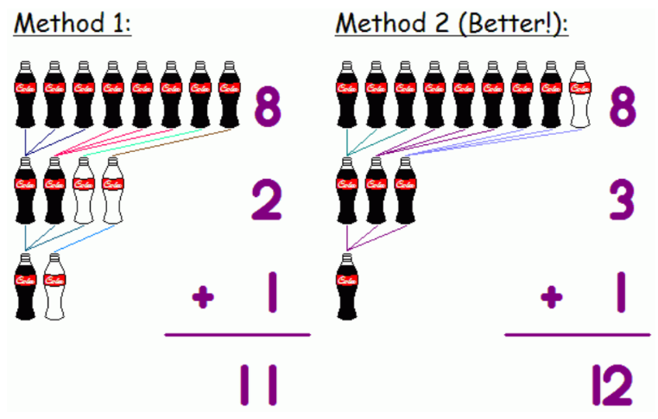
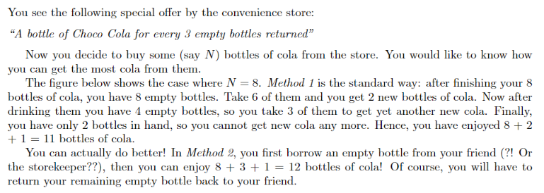
UVA11150

Slide 3
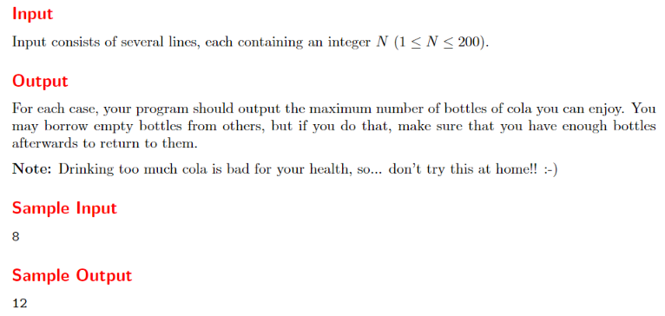

Slide 4
題意
輸入 N 瓶可樂，3 瓶可樂空瓶可以換 1 瓶可樂，問總共可以喝到幾瓶可樂？（最後剩下兩瓶可樂空瓶時，可以多借一瓶空瓶，最後當然要還回去！！）

Slide 5
解法
read in n
sum=0, emp=0 //sum 喝的瓶數，emp 剩餘空瓶
while (n+emp > 2){
sum = sum + n //拿到n瓶
emp = emp+n //空瓶數=之前空瓶+喝完 n 瓶
n = emp/3 //n瓶中，3瓶換1瓶
emp = emp%3 //剩下空瓶數
}
sum = sum+n //最後一次換的可樂將不會喝到，所以補喝
if (n+emp==2) // 如果空瓶數為 2 ，可以借一個空瓶，換一瓶可樂，所以喝的可樂數 +1
sum = sum+1
print sum
可樂 | 空瓶 | 已喝
55 | 0 | 0
18 | 1 | 55
6 | 0 | 73
2 | 0 | 79
0 | 2(可借1) | 81
1 | 0 | 82

Slide 6
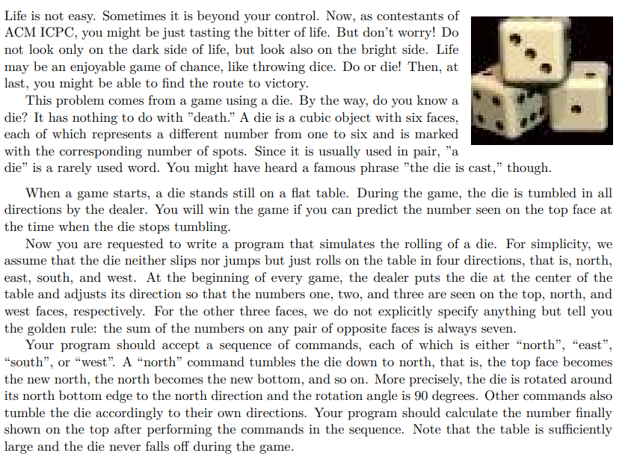
10409 –(Die Game)

Slide 7
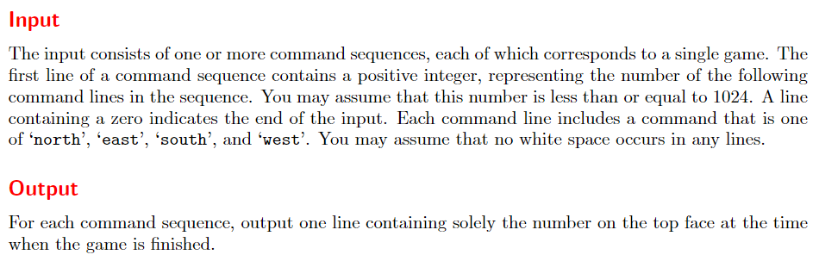
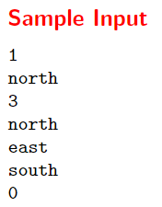


Slide 8
想法
初始狀態
top = 1, north = 2, west = 3, bottom = , south = , east =
每次轉動90度，可能「東」「南」「西」「北」向
轉「北」: top → north, south → top
轉「南」: top → south, north → top
轉「西」: top → west, west → bottom
轉「東」: top → east, east → bottom
南北轉動時，東西面內容不變；東西轉動時，南北面內容不變
南北、東西的點數相加 = 7

Slide 9

推演
T
N
W
E
S
B
Initial state
1
2
3
4
5
6
Turn North
5
1
3
4
6
2
Top→North, South→Top
Turn East
3
1
2
5
6
4
Top→East, West→Top
Turn South
1
4
2
5
3
6
Top→South, North→Top
Turn West
4
6
2
5
1
3
Top→West, East→Top

Slide 10
轉換規則 (初始狀態 )
0 | 1 | 2 | 3 | 4 | 5
Top | North | West | East | South | Bottom
1 | 2 | 3 | 4 | 5 | 6
If rolling to North (rule ‘N’)
diceState[1]=diceState[0]
diceState[0]=diceState[4]
diceState[4]=7-diceState[1]
diceState[5]=7-diceState[0]
If rolling to South (rule ‘S’)
diceState[4]=diceState[0]
diceState[0]=diceState[1]
diceState[1]=7-diceState[4]
diceState[5]=7-diceState[0]
If rolling to East (rule ‘E’)
diceState[3]=diceState[0]
diceState[0]=diceState[2]
diceState[2]=7-diceState[3]
diceState[5]=7-diceState[0]
If rolling to West (rule ‘W’)
diceState[2]=diceState[0]
diceState[0]=diceState[3]
diceState[3]=7-diceState[2]
diceState[5]=7-diceState[0]

Slide 11
演算步驟
read n
scanf(“%d”, &n);
while (n != 0){
while (n--){
read dir
根據 dir 執行「轉換規則」
}
print number on top
}

Slide 12
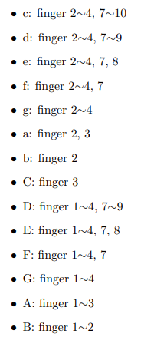
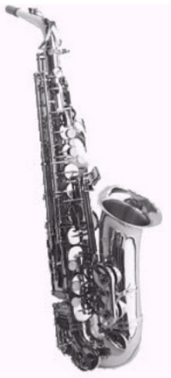
uva10415
Do you like Saxophone(薩克斯風)? I have a Eb Alto Saxophone, shown on the right. My fingers move A LOT when playing some music, and I’m quite interested in how many times each finger PRESS the button. Assume that the music is composed of only 8 kinds of note. They are: C D E F G A B in one octave and C D E F G A B in a higher octave. We use c,d,e,f,g,a,b,C,D,E,F,G,A,B to represent them. Write a program to help count the number of times each finger presses the button. A finger presses a button if it is needed in a note, but not used in the last note. Also, if it is the first note, every finger required presses the button.
(Note that every finger is controlling a specified button,
different fingers are controlling different buttons.)

Slide 13
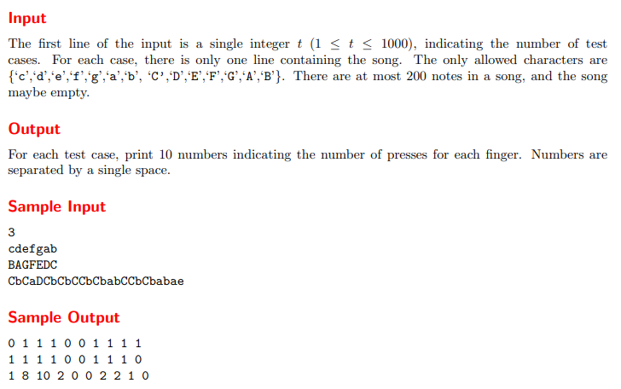

Slide 14
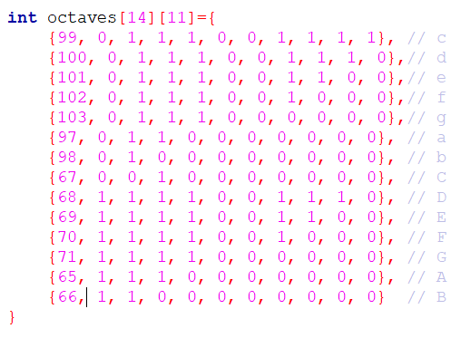
ASCII | 字符 | ASCII | 字符
65 | A | 97 | a
66 | B | 98 | b
67 | C | 99 | c
68 | D | 100 | d
69 | E | 101 | e
70 | F | 102 | f
71 | G | 103 | g

Slide 15
Case I (cdefgab)
 | 0 | 1 | 2 | 3 | 4 | 5 | 6 | 7 | 8 | 9 | 10
initial | 0 | 0 | 0 | 0 | 0 | 0 | 0 | 0 | 0 | 0 | 0
c | 0 | 0 | 1 | 1 | 1 | 0 | 0 | 1 | 1 | 1 | 1
d | 0 | 0 | 1 | 1 | 1 | 0 | 0 | 1 | 1 | 1 | 0
e | 0 | 0 | 1 | 1 | 1 | 0 | 0 | 1 | 1 | 0 | 0
f | 0 | 0 | 1 | 1 | 1 | 0 | 0 | 1 | 0 | 0 | 0
g | 0 | 0 | 1 | 1 | 1 | 0 | 0 | 0 | 0 | 0 | 0
a | 0 | 0 | 1 | 1 | 0 | 0 | 0 | 0 | 0 | 0 | 0
b | 0 | 0 | 1 | 0 | 0 | 0 | 0 | 0 | 0 | 0 | 0
total | 0 | 0 | 1 | 1 | 1 | 0 | 0 | 1 | 1 | 1 | 1
手指按 7 下

Slide 16
Case II (babCCbC)
 | 0 | 1 | 2 | 3 | 4 | 5 | 6 | 7 | 8 | 9 | 10
inital | 0 | 0 | 0 | 0 | 0 | 0 | 0 | 0 | 0 | 0 | 0
b | 0 | 0 | 1 | 0 | 0 | 0 | 0 | 0 | 0 | 0 | 0
a | 0 | 0 | 1 | 1 | 0 | 0 | 0 | 0 | 0 | 0 | 0
b | 0 | 0 | 1 | 0 | 0 | 0 | 0 | 0 | 0 | 0 | 0
C | 0 | 0 | 0 | 1 | 0 | 0 | 0 | 0 | 0 | 0 | 0
C | 0 | 0 | 0 | 1 | 0 | 0 | 0 | 0 | 0 | 0 | 0
b | 0 | 0 | 1 | 0 | 0 | 0 | 0 | 0 | 0 | 0 | 0
C | 0 | 0 | 0 | 1 | 0 | 0 | 0 | 0 | 0 | 0 | 0
total | 0 | 0 | 2 | 3 | 0 | 0 | 0 | 0 | 0 | 0 | 0

Slide 17
針對一首音樂，如 music = “babCCbC”
octaves[14][11] //音階
counts[10] = {0};
priState[10] //前次指法
curState[10] //目前指法
priState={0,0,0,0,0,0,0,0,0,0} //初始狀態
讀入音符與指法
檢查每一個目前指法與前次指法是否差 1 ? Yes → count[n]++
更新 priState ← curState
回到步驟 6

Slide 18
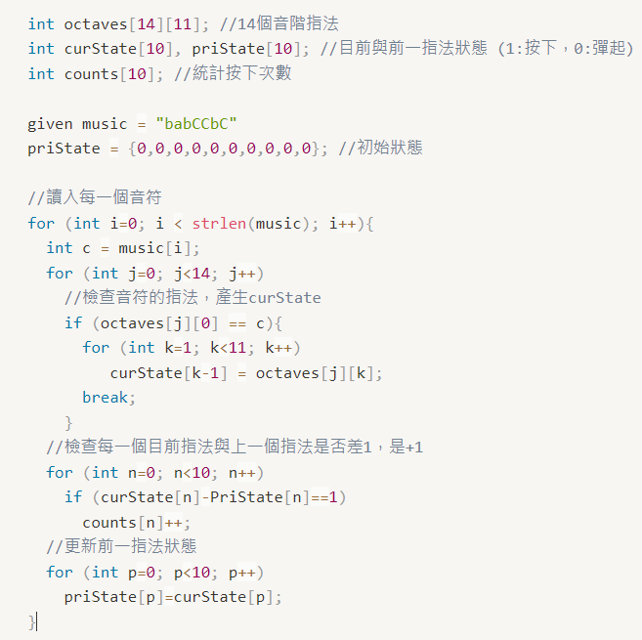

Slide 19
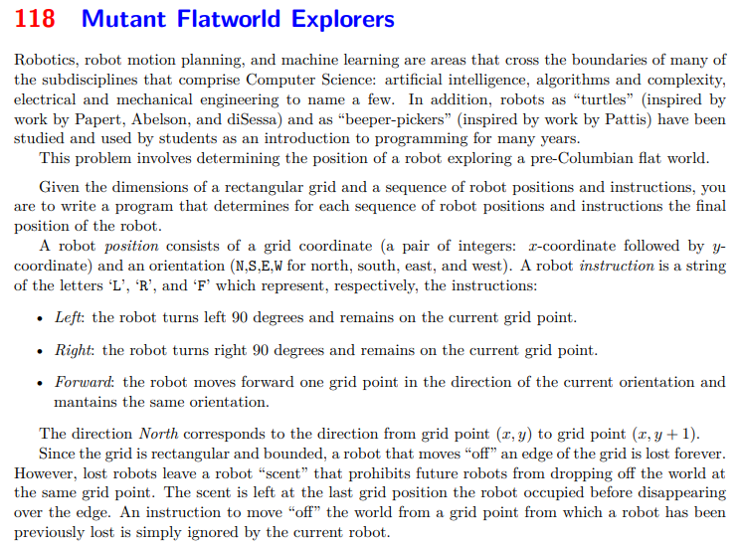

Slide 20
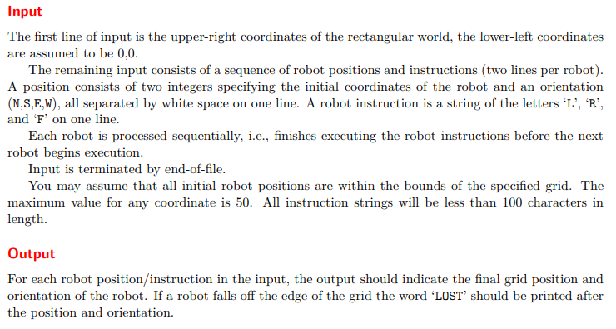
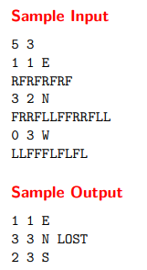

Slide 21
題意
給定一塊矩形土地的長寬(右上角座標，左下角座標 0,0)
機器人面向 N , S , E , W 來分別代表北、南、東、西
一個機器人的指令集，由字母 ' L ' ， ' R ' ， 和 ' F ‘ 代表
左轉（Left）：機器人在原地往左轉 90 度。
右轉（Right）: 機器人在原地往右轉 90 度。
前進（Forward）: 機器人往其面向的方向向前走一格，且不改變其面向之方向。

Slide 22
輸入第一列2個正整數，代表這個矩形右上角頂點的坐標
接下來若干組有關機器人的初始位置狀況和指令，每個機器人2列。
第一列為位置狀況，包括兩個整數和一個字元（ N , S , E 或 W ）代表機器人初始的位置坐標及機器人最初所面對的方向。
第二列則是指令集，是一個由 ' L ' ， ' R ' 和 ' F ' 所組成的字串。
輸入以 end-of-file 作為結束。
每一個機器人，你都必須輸出其最後所在的坐標和面對的方向。
如果一個機器人會掉落出此世界外，你必須先輸出他在掉落前，最後的所在位置和面對的方向，再多加一個字： LOST 。

Slide 23
機器人面向轉換
左轉 (Left, L)
N ➔ W
S ➔ E
E ➔ N
W ➔ S
右轉 (Right, R)
N ➔ E
S ➔ W
E ➔ S
W ➔ N

Slide 24
機器人移動座標轉換
robotHeading「北 N」➔ (x, y) → (x, y+1)
robotHeading 「南 S」➔ (x, y) → (x, y-1)
robotHeading 「東 E」➔ (x, y) → (x+1, y)
robotHeading 「西 W」➔ (x, y) → (x-1, y)

Slide 25
robotHeading = N, (S, E, W) //北、南、東、西
if robotCom == ‘L’
switch (robotHeading){
case ‘N’:
robotHeading=‘W’; break;
case ‘S’:
robotHeading=‘E’; break;
case ‘E’:
robotHeading=‘N’; break;
case ‘W’:
robotHeading=‘S’; break
}
if robotCom == ‘R’
switch (robotHeading){
case ‘N’:
robotHeading=‘E’; break;
case ‘S’:
robotHeading=‘W’; break;
case ‘E’:
robotHeading=‘S’; break;
case ‘W’:
robotHeading=‘N’; break
}

Slide 26
計算座標
if robotCom==“F”
if robotHeading == ‘N’
x = x, y = y+1
if robotHeading == ‘S’
x = x, y = y-1
if robotHeading == ‘E’
x = x+1, y = y
if robotHeading == ‘W’
x = x-1, y = y

Slide 27
5
4
3
2
1
0 1 2 3 4 5
行動命令➔LLFFFLFLFL

