Slide 1

GitHub Copilot Hackathon
Team Name- Team CODERS
Team Leader Name- JATIN KUMAR GUPTA
Team Leader Email Address- Jatinkgupta2003@gmail.com

Slide 2

Brief Summary of Project:
The goal of this project is to create a command-line tool that retrieves the current weather forecast for a given city by leveraging the OpenWeatherMap API. The tool should handle API usage, data parsing, and error handling effectively.

Slide 3
Business Challenge /Use Cases
The business challenge is to provide a simple and convenient way for users to access weather information for a specific city. By creating a command-line tool, users can quickly obtain the current weather forecast without needing to navigate through a website or use a separate application.

Slide 4
Proposed Solution
The proposed solution is to develop a command-line tool in Python that interacts with the OpenWeatherMap API. Users can input the name of a city, and the tool will retrieve the current weather data for that location. The solution should be user-friendly, robust, and capable of handling errors that may occur during the API request and data parsing processes.

Slide 5
Technology/Tool Stack Used:
The proposed solution utilizes the following technologies:
Python: The programming language used to develop the command-line tool.
OpenWeatherMap API: An external API that provides weather data for various locations.
requests: A Python library for making HTTP requests to interact with the OpenWeatherMap API.
argparse: A Python library for parsing command-line arguments and options.
GitHub Copilot: An AI-powered code completion tool that assists with API usage, data parsing, and error handling during the development process.

Slide 6
Mention of usage of Github Copilot
API Usage:
When making HTTP requests to the OpenWeatherMap API, GitHub Copilot provides suggestions for the necessary syntax and structure. For instance, it suggests using the requests.get() method with the appropriate URL and query parameters.
Copilot also assists with handling API responses. It suggests checking the HTTP status code using response.status_code and provides the response.raise_for_status() method to handle potential errors.
The AI model can help with incorporating the API key in the request URL and managing the necessary authentication parameters.
Data Parsing:
GitHub Copilot assists in parsing the API response by suggesting the appropriate syntax for accessing specific data fields. For example, it can suggest accessing the weather description or temperature from the JSON response.
Copilot can also provide suggestions for transforming and formatting the data before displaying it to the user. This could involve converting temperature units or formatting the output in a more readable way.
Error Handling:
When it comes to error handling, Copilot provides suggestions for catching and handling different types of exceptions. For example, it suggests using requests.exceptions.HTTPError to handle HTTP-related errors and requests.exceptions.RequestException to handle general request errors.
Copilot can also provide suggestions for logging or displaying error messages to the user, helping to improve error reporting and debugging capabilities.
Intelligent Code Completion:
GitHub Copilot's AI model has been trained on a vast codebase and can provide context-aware code completions. It analyzes the code being written and offers suggestions based on common coding patterns and best practices, which can significantly speed up development and reduce the chances of introducing errors.

Slide 7
Source code in zip file / Github link :
https://github.com/jc8223/WeatherApp

Slide 8
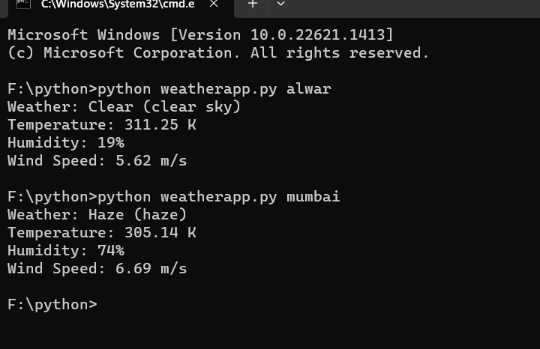
Execution Demo(Video/Screenshots) showing usage of the GitHub Copilot Platform :

Slide 9
Additional comments (optional):
Install the required dependencies, including requests and argparse, using pip install

Slide 10
THANK YOU

