Slide 1




How inhomogeneities enhance the manipulability of Ge spin qubits
Phys. Rev. B 106, 235426 (2022) | arXiv:2212.03691 (2022)
JOSÉ CARLOS ABADILLO-URIEL, BIEL MARTINEZ, ESTEBAN RODRIGUEZ, YANN-MICHEL NIQUET
CEA GRENOBLE
Now Comfuturo fellow at icmm-csic

Slide 2
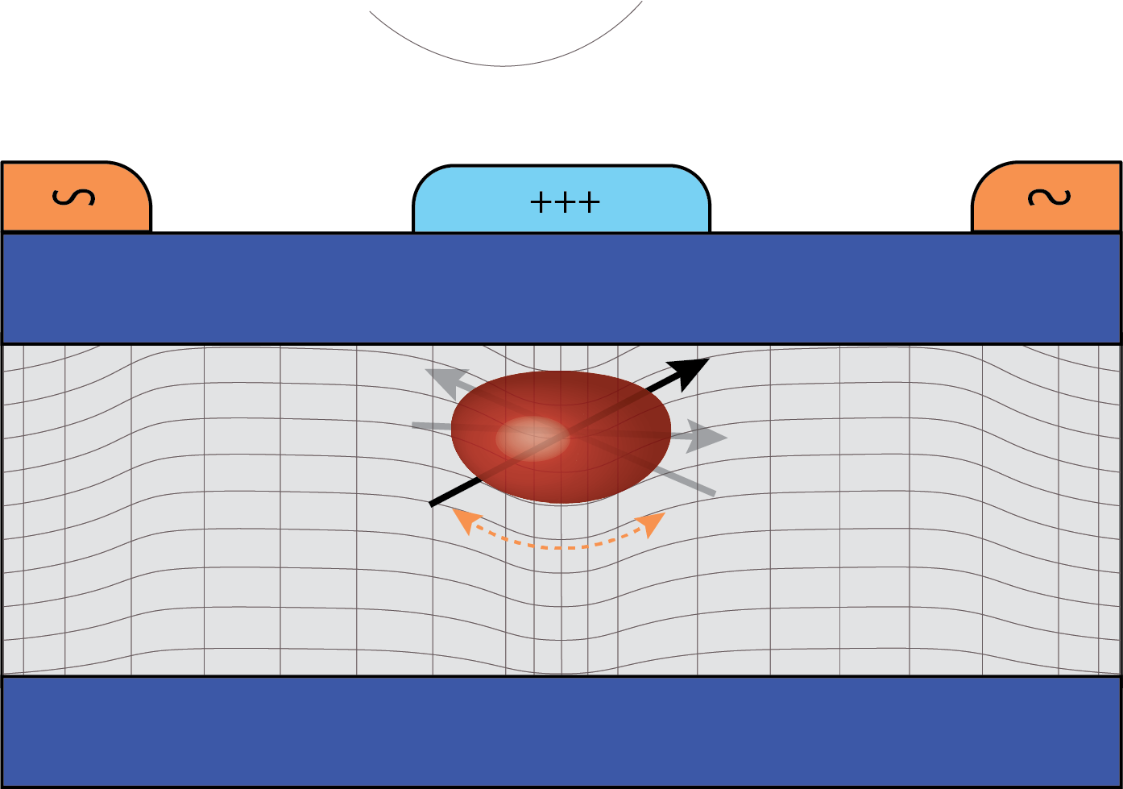
outline
Introduction to semi & hole qubits
Usual manipulation of hole qubits
Inhomogeneous electric fields
Inhomogeneous strains
Conclusions

Slide 3

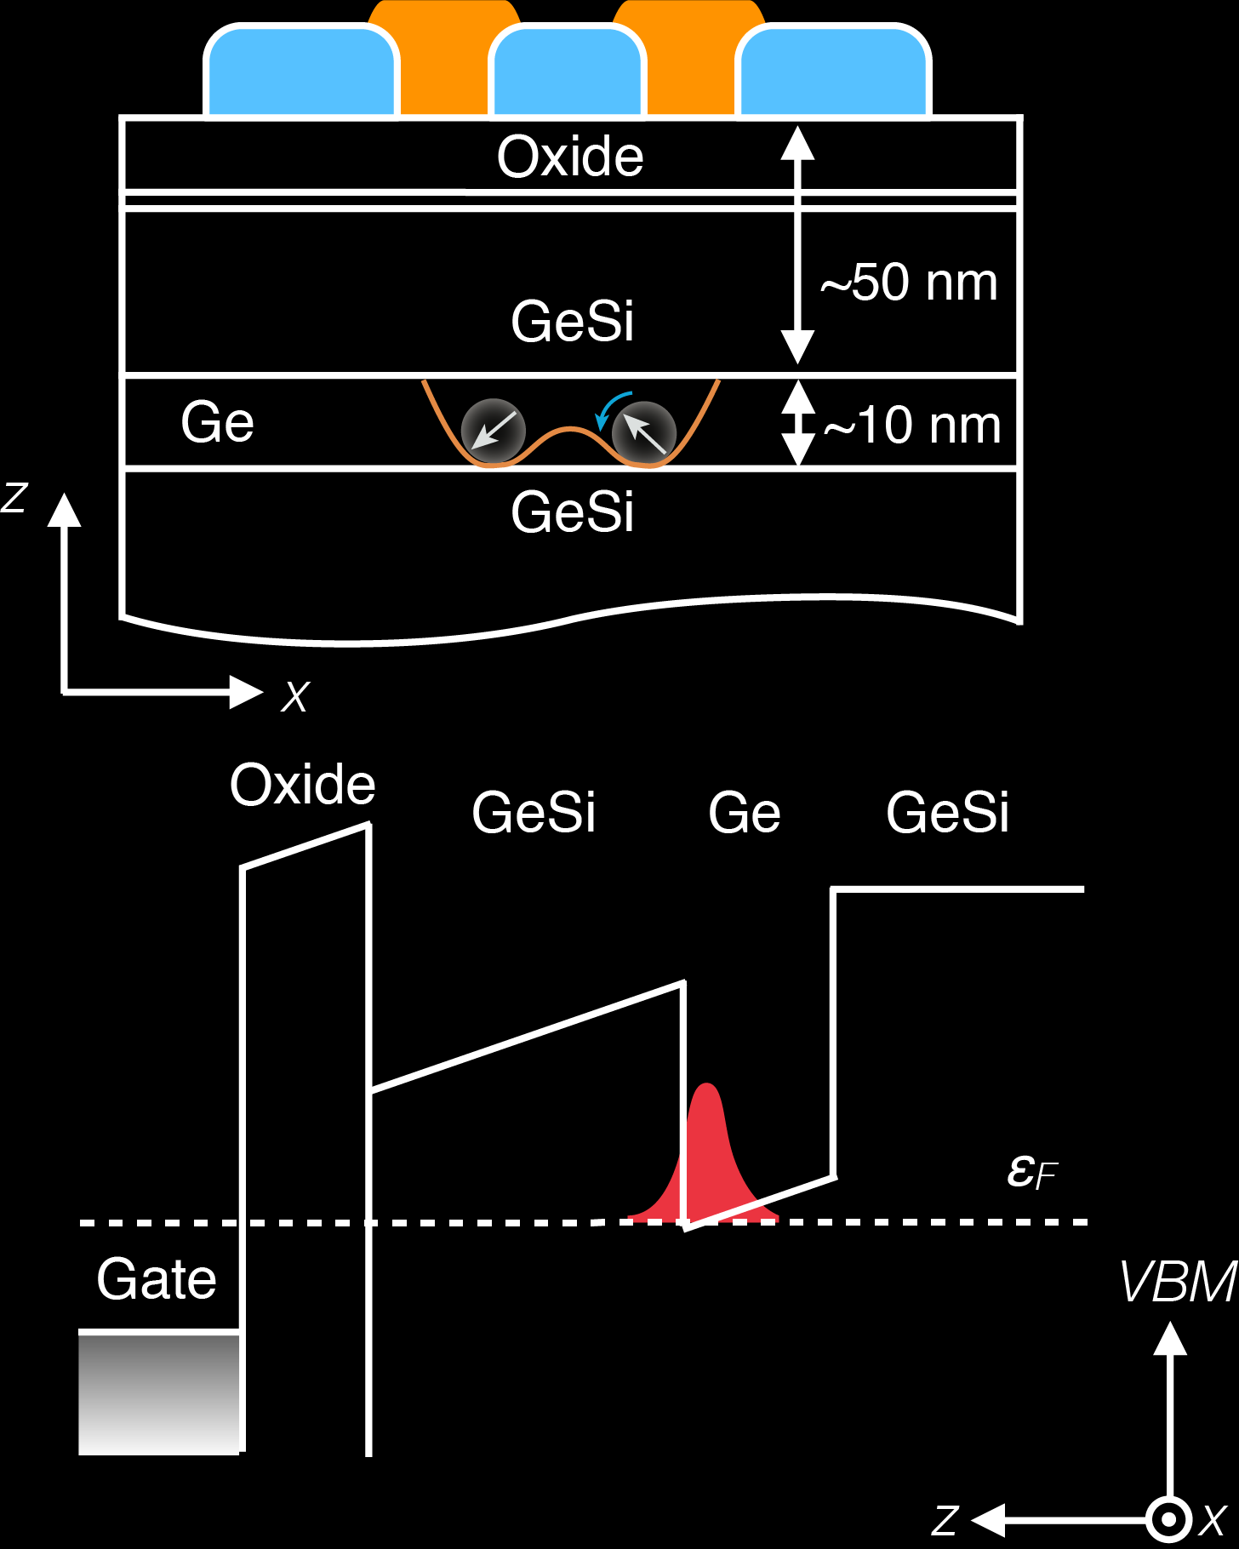
Why semiconductor qubits?
From Chatterjee et al., Nature Reviews Physics, 3, 157-177 (2021)
Semiconductor Industrially compatible
Good coherence times & gate manipulability
Prospects of scalability (small unit cell)
Possible avenue for high-temperature operation (4K)
see, e.g. Nature 580, 355-359 (2020)

Slide 4
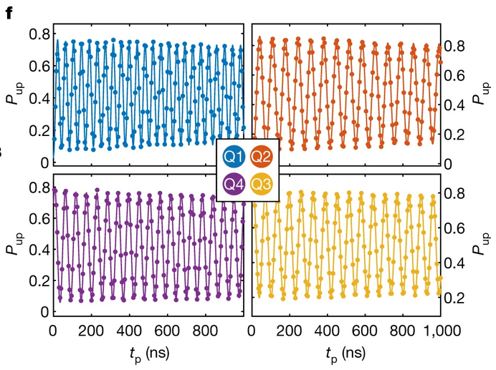
Why hole spin qubits?
High SOC : fast all-electrical manipulation
Qubit properties are highly tunable through gate voltages
Cool physics: anisotropic g-matrices, Rashba SOC, sweet spots
State of the art
4-qubit processor: single-qubit gates above 99.9% and
two-qubit above 99% (Hendrickx et al., Nature 591, 580–585 (2021))
Large coherence T₂*~90 μs (Piot et al., Nat. Nano (2022))
“Hot”-qubit operation ~ 4K (Carmenzind et al., Nat. Electronics 5, 178–183 (2022))
Spin-photon coupling of 330 MHz in hybrid Si-cQED system (Yu et al., Nature Nanotechnology (2023))
Hendrickx et al., Nature 591, 580–585 (2021)

Slide 5
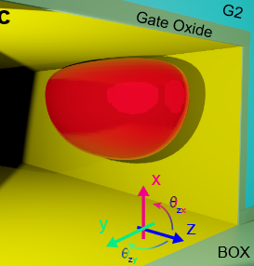
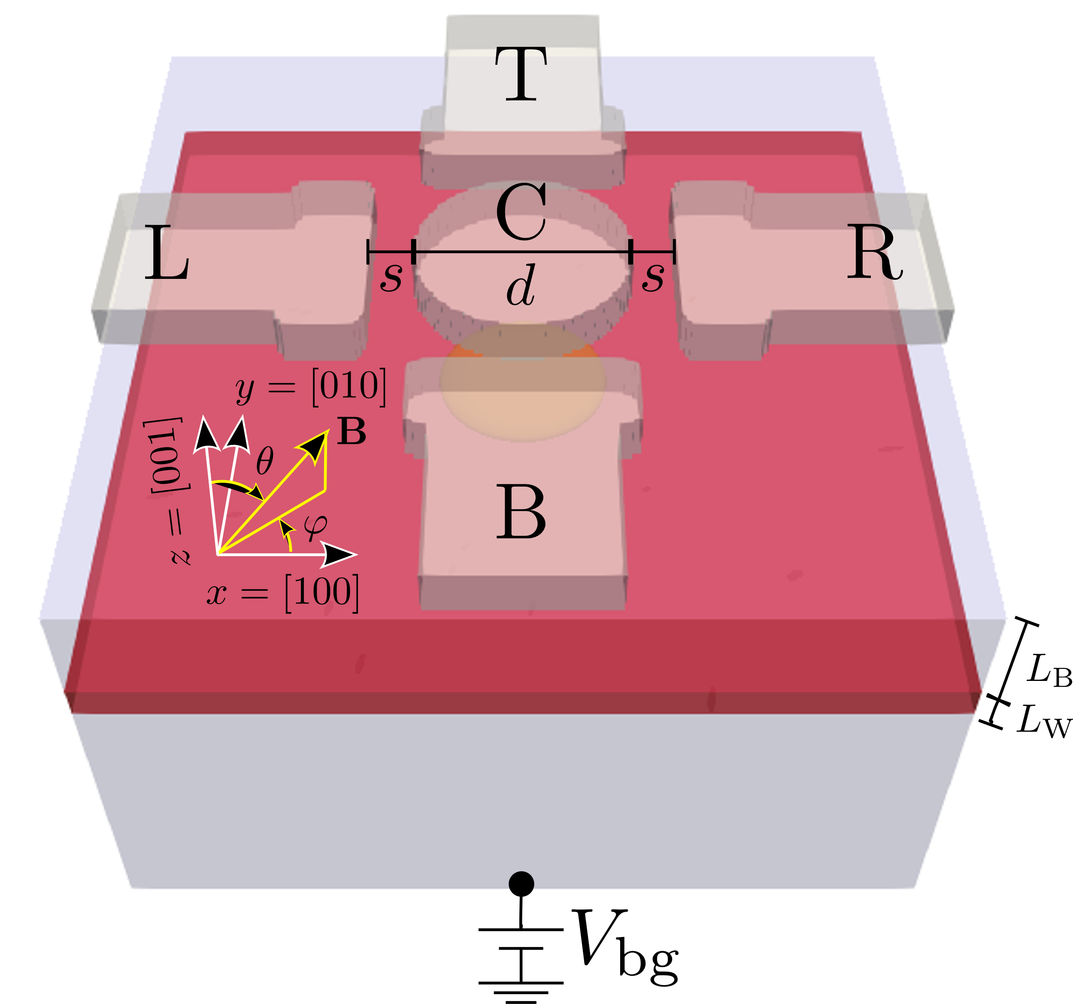
Manipulating hole spins
-Hole spin is coupled to its motion
-We focus on planar dots (isotropic in-plane confinement)
-Hamiltonian of a hole under a magnetic field
for holes in Ge, g_x ~ g_y ~ 0.15 g_z ~ 13.5

Slide 6


Rashba spin-orbit coupling
-Lack of inversion symmetry. Determined by geometry and gates
-Nanowire or anisotropic dots (linear Rashba).
See Golovach et al. (2006) PRB 74
$H_{SO} \sim \frac{ℏ}{ml_{so}}p_{x}σ_{y}$
Michal et al., Phys. Rev. B 103, 045305 (2021)
Bosco et al., Phys. Rev. B 104, 115425 (2021)
-Planar isotropic dots (cubic Rashba)
$p_{±}=p_{x}±ip_{y}$
$H_{SO}=α_{O}p_{−}^{3}σ_{+}+α_{\text{□}}p_{+}p_{−}p_{+}σ_{+}+h.c.$
Only effective when magnetic field is vertical B_{z}
In the experiments the magnetic field is in-plane B_{x}

Slide 7
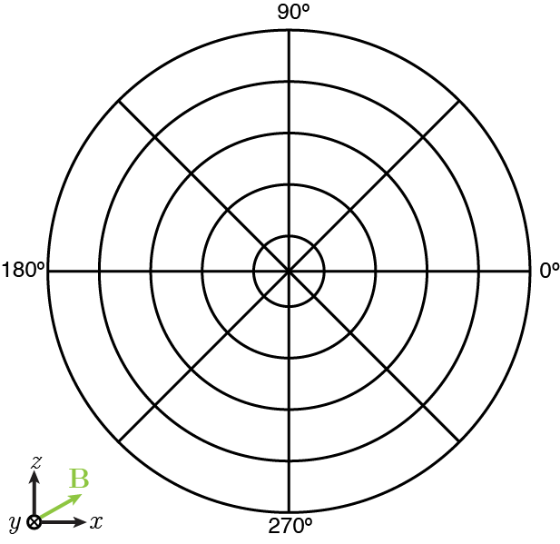

g-tmr
g(V(t))
2
θ_{xz}
1.5
1
0.5
-g-factor is anisotropic. By driving g-tensor the hole feels a time-dependent magnetic field
-Deforming the dot with electric fields induces changes in the g-tensor
Effective when
$$f_{R}=\frac{{μ_{B}BV}_{ac}}{2hg^{∗}}|\left(g⋅b\right)×\left(g^{′}⋅b\right)|$$
Crippa et al. (2018) PRL 120
Kato et al. (2003) Science 229

Slide 8
Explaining hole experimental data
In the experiment, they use in-plane magnetic fields which are inefficient for both cubic Rashba and gTMR
Is there some missing mechanism?
Reviewing the usual assumptions:
-Separable and homogeneous confinement field
-Biaxial strains

Slide 9

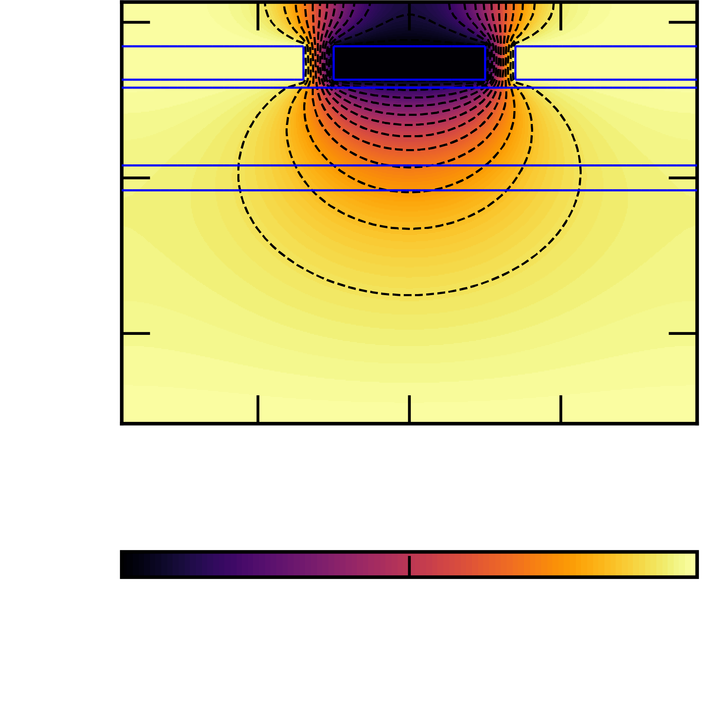
INHOMOGENEOUS & NON-SEPARABLE CONFINEMENT FIELDS
Gates have finite size and are separated a certain distance away from the hole

Slide 10
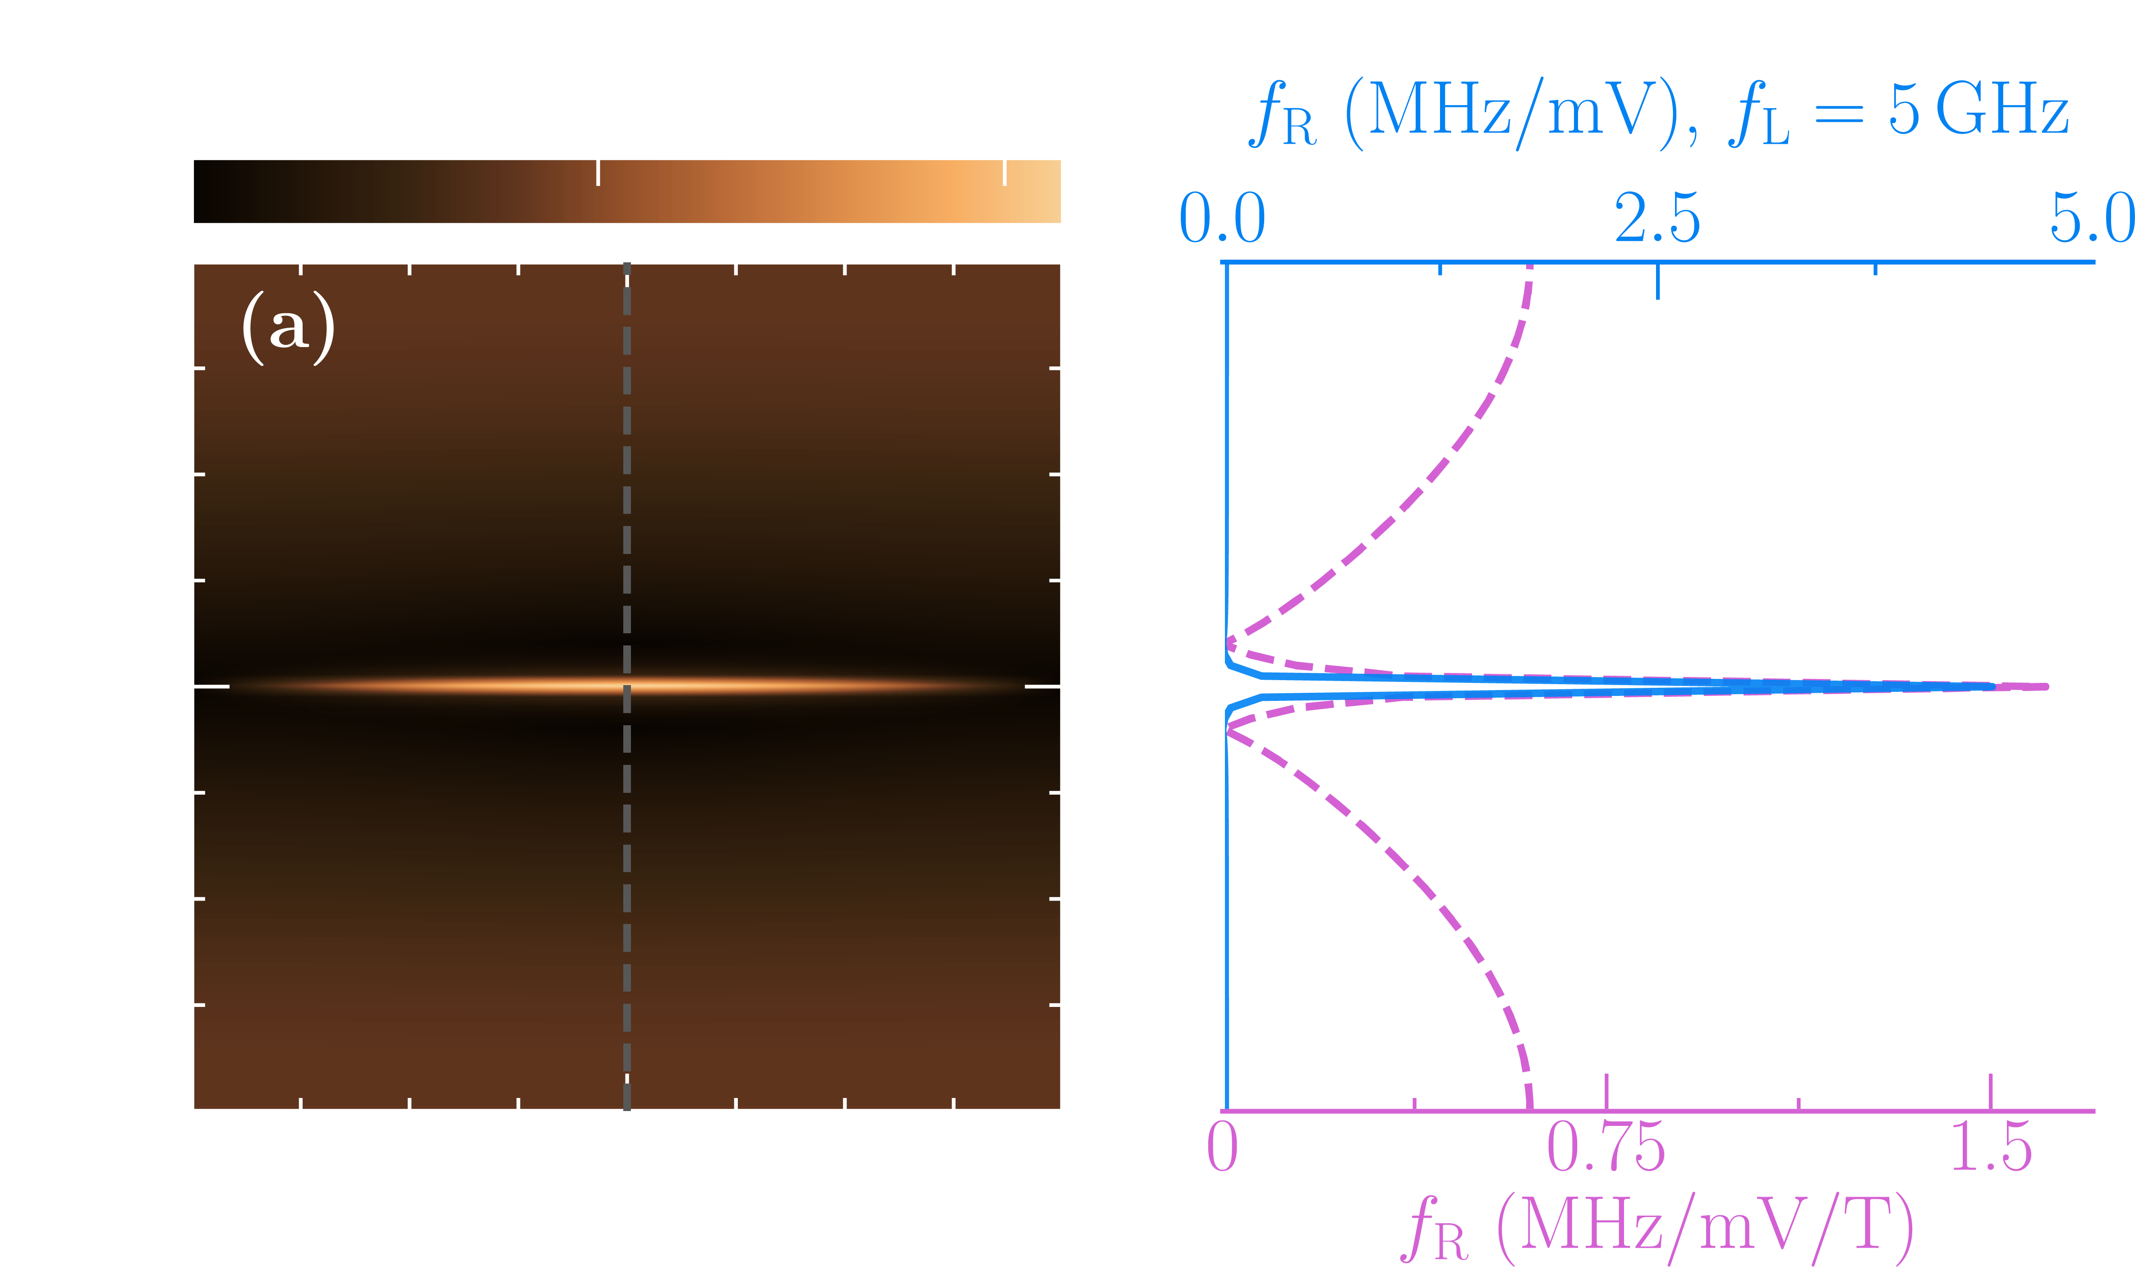
Non-separable field allows in-plane manipulation
z
x
y
Cubic Rashba
Non-separable feature
Still, Rabi frequencies are low. What’s missing?

Slide 11
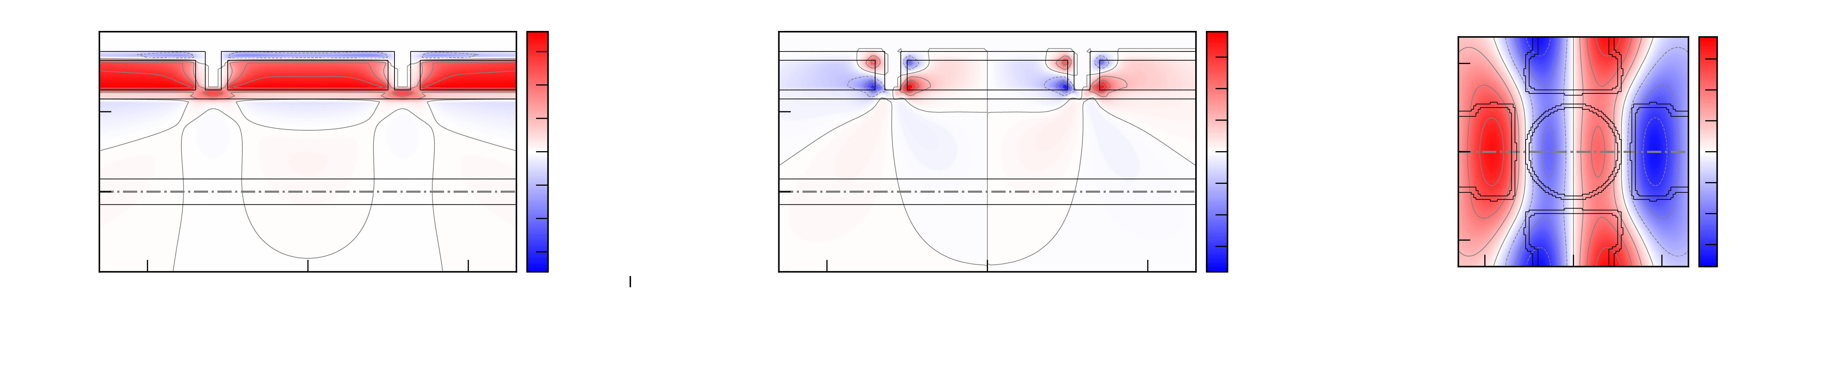
INHOMOGENEOUS STRAIn
Strain is assumed to be biaxial due to barrier & well lattice mismatch
Device is made with different materials with different expansion coefficients
Numerically minimizing the elastic energy density at low T, leads to inhomogeneities commensurate with the gate stack

Slide 12
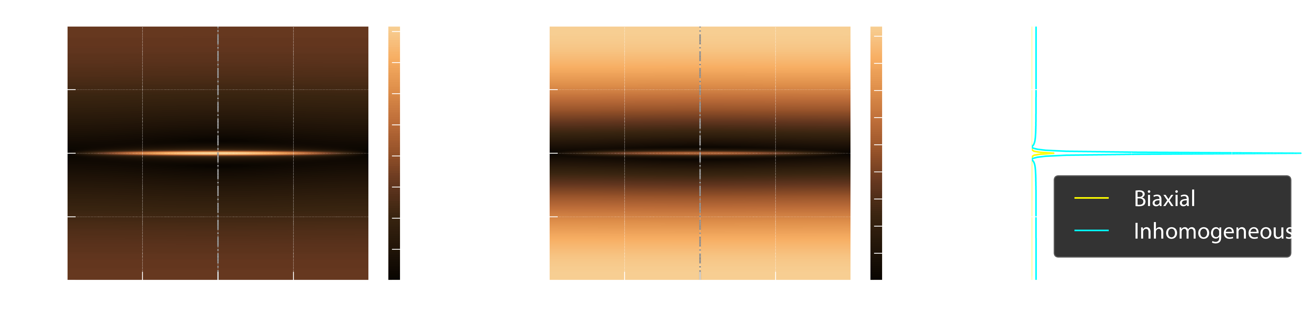

STRAIN INDUCES NEW GTMR AND RASHBA MECHANISMS
z
y
Linearized Rashba
x
Enhanced in-plane feature
Rabi frequencies now match the experiment

Slide 13

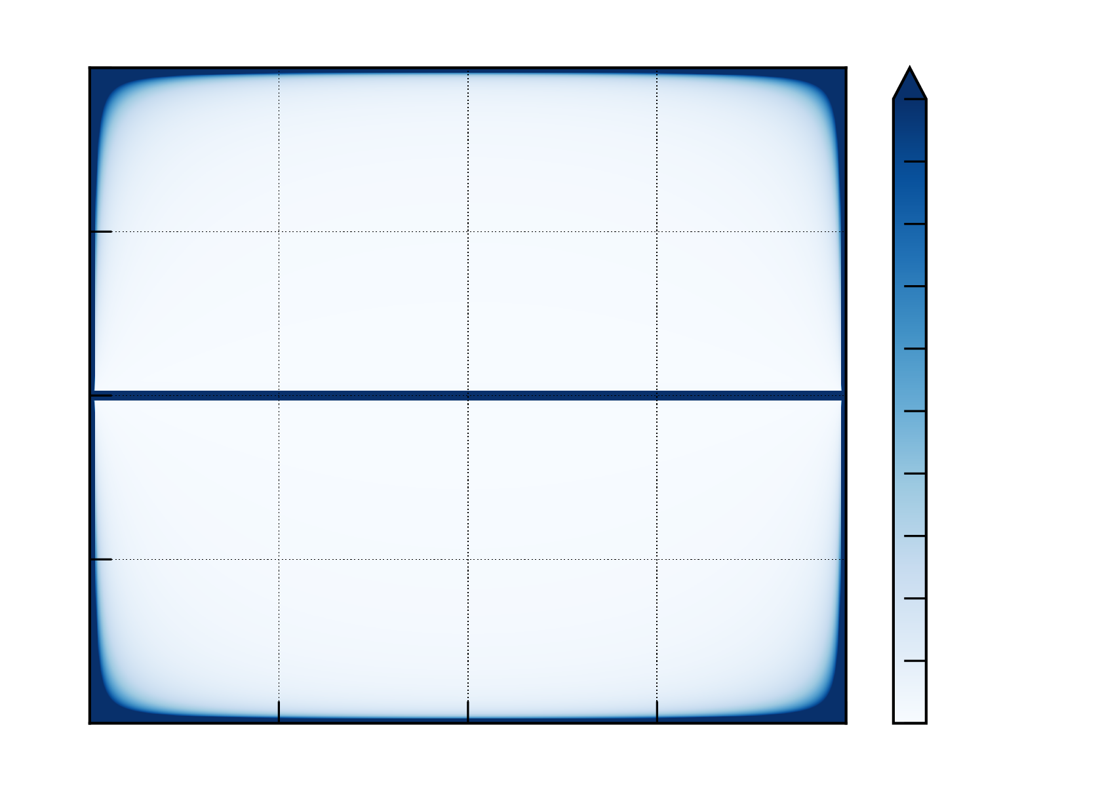
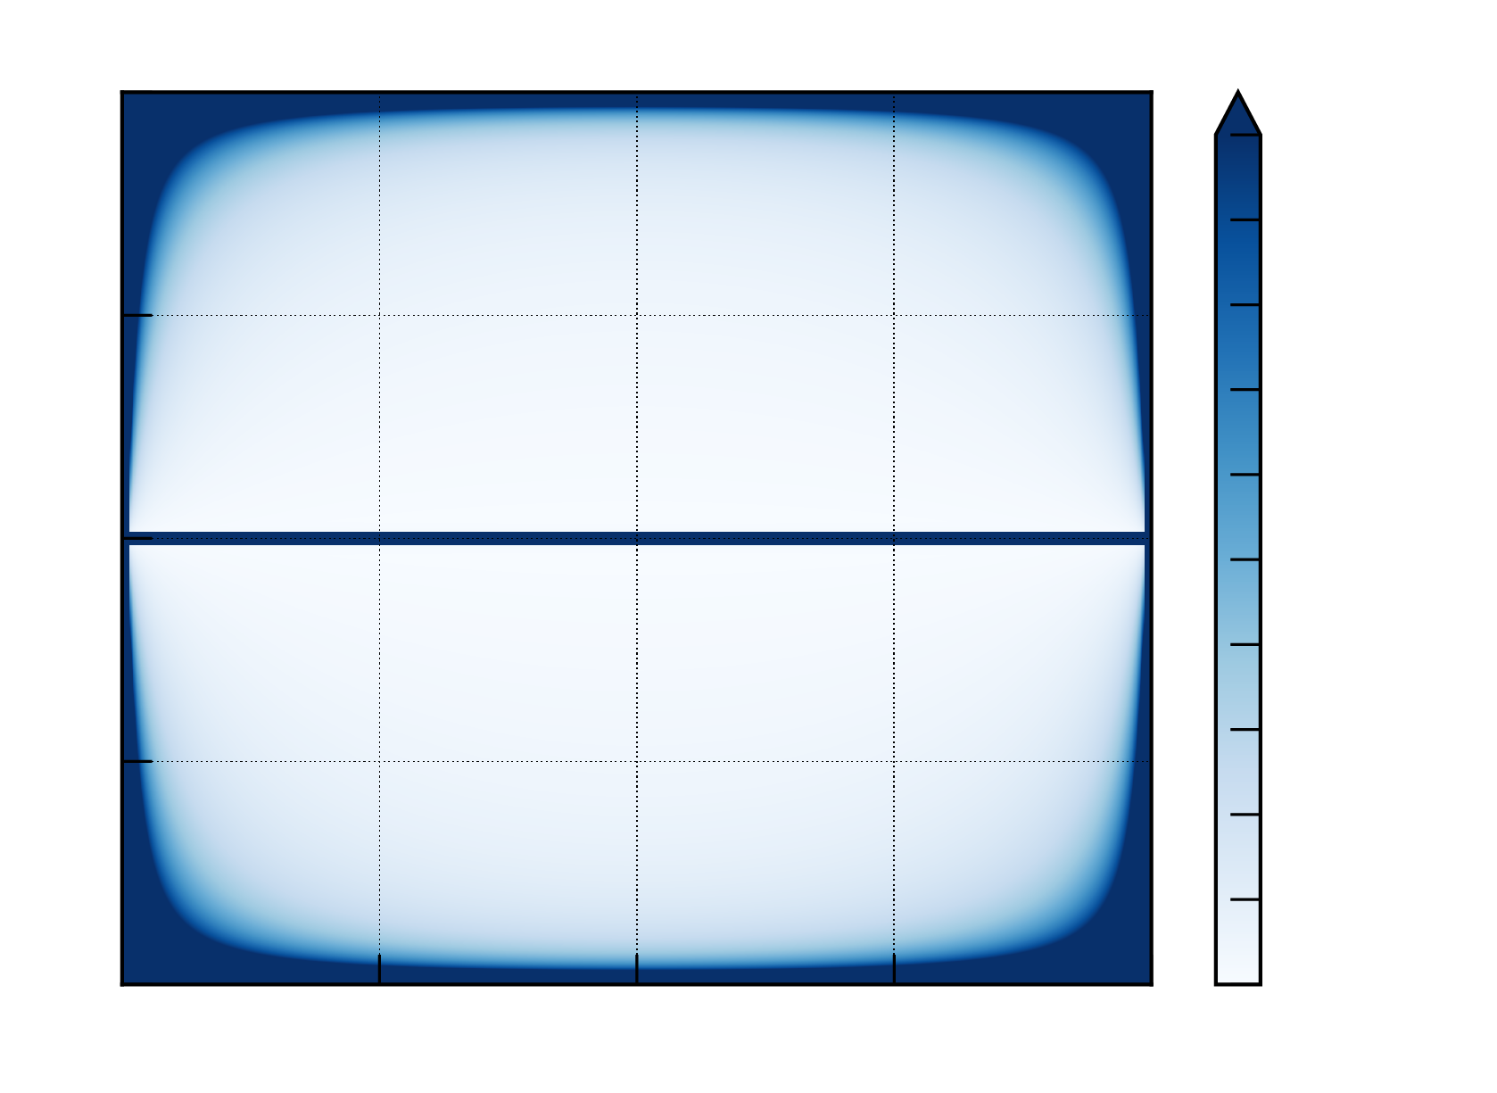
STRAIN slightly improves quality factors
In-plane sweet spot
Out-of-plane quasi-sweet spot

Slide 14
Conclusions
Ge hole spin qubits are a promising platform for quantum computation
Holes exhibit interesting physics, some of it still to be unveiled
We found that non-separable field and inhomogeneous strains lead to new manipulation mechanisms
Optimal operation with in-plane magnetic fields for fixed qubit frequency
Manipulability is improved by these mechanisms while coherence is mostly unaffected at sweet spots

Slide 17
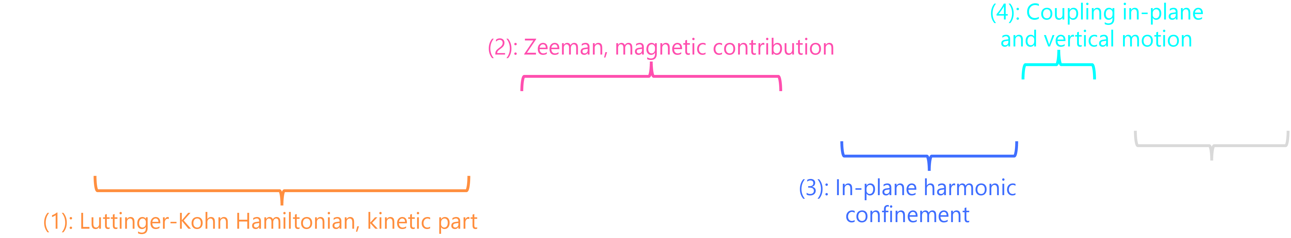

We can capture the physics with a non separable potential
The effective Hamiltonian for GS heavy-hole subspace can be obtained through Schrieffer-Wolff transformation. The subbands couple through
Physically, it is similar to a gTMR mechanism
When the potential is separable $λ_{x,y}=0$

