Slide 1
Software clone detection
MG1933027 蒋承
MF1933059 刘冀
DZ1933023 汤沁予
MG1833044 李雪健
Research
Proposal

Slide 2
CONTENTS
01
Problem Formulation
02
Related work
03
Methodology
04
Timetable Formulation
05
Experiment Design

Slide 3
Problem Formulation
软件系统中克隆代码的检测与管理是软件工程中的基本问题之一。
程序员为了提高开发效率经常对软件系统的源代码进行拷贝粘贴及修改，这种重用机制通常会导致在源代码中出现很多相同或相似的代码段，这类代码段被称为克隆代码
克隆代码导致源代码的规模增大即冗余，增加了资源的需求，这对嵌入式系统和手持设备的影响尤为明显。
克隆一段含有未知BUG的代码,可能会导致BUG的繁育。
维护者修改一段代码时,需对这段代码的所有克隆进行一致的修改,若修改不一致则会引入新的BUG。
/01
Software clone detection, aiming at identifying out code fragments with similar functionalities, has played an important role in software maintenance and evolution.

Slide 4
Problem Formulation
Code Representation
Similarity Analysis
Clone Report

Slide 5
Related work
2007 DECKARD: Scalable and Accurate Tree-based Detection of Code Clones
2014 Towards a Big Data Curated Benchmark of Inter-Project Code Clones
2015 SourcererCC: Scaling Code Clone Detection to Big Code
2016 Deep Learning Code Fragments for Code Clone Detection
2017 CCLearner: A Deep Learning-Based Clone Detection Approach
2017 Supervised Deep Features for Software Functional Clone Detection by Exploiting Lexical and Syntactical Information in Source Code
2018 DeepSim: Deep Learning Code Functional Similarity
2018 Oreo: Detection of Clones in the Twilight Zone
2018 Positive and Unlabeled Learning for Detecting Software Functional Clones with Adversarial Training
2019 Learning-based Recursive Aggregation of Abstract Syntax Trees for Code Clone Detection
2019 Capturing Source Code Semantics via Tree-based Convolution over API- enhanced AST
2019 Neural Detection of Semantic Code Clones via Tree-Based Convolution
/02

Slide 6
Related work
Deep
Text here
Clone detection
RNN
CNN
AST

Slide 7
Methodology
AST
CNN/RNN
Use AST to represent the Code fragment
Embedding the Code fragment by TreeCNN or TreeRNN
Keyword
BigCloneBench
PyTorch
Implementation based on PyTorch
Evaluate the model by BigCloneBench dataset
/03

Slide 8
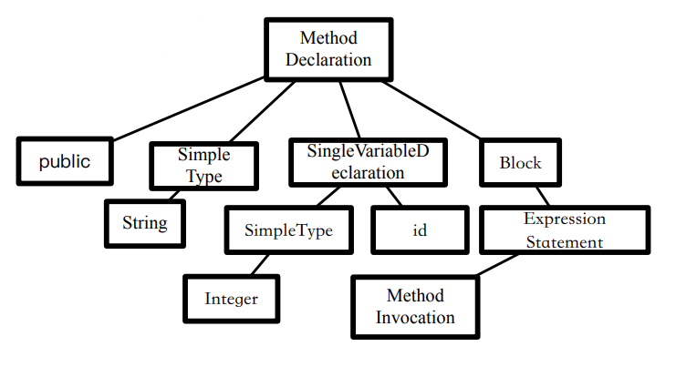
AST

Slide 9
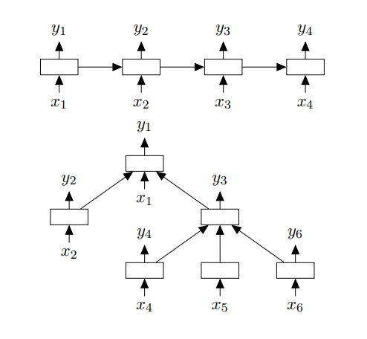
TreeRNN

Slide 10
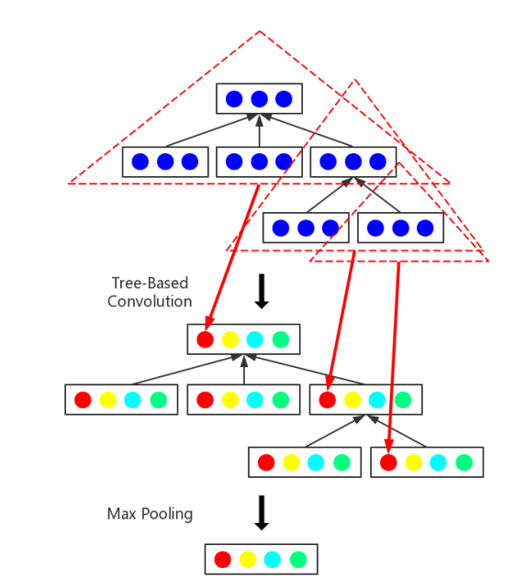
TreeCNN

Slide 11
Timetable Formulation
DDL
11.25
11.15
Conclusion
11.01
Discussion
/Experiment 04
Proposal
/04

Slide 12
/Experiment Design 04
Discussion
RQ
Training and Evaluation
PyTorch
Model Design
TreeCNN or TreeRNN
Big Clone Benchmark
Java Code > AST Tree
JavaParser, JavaLang
/05
Data PreProcess

Slide 13
Discussion
RQ1
Q4
Whether the structural information and semantic information of the code can be extracted through deep learning technology ?
RQ2
Q3
Whether the AST a code representation structure conducive to deep learning model learning?
Q2
RQ3
Compared to TreeCNN and TreeRNN, who has a better representation of AST ?
Q1
RQ4
In addition to code cloning detection, what other areas can deep learning technology be applied to software engineering?

Slide 14
Thanks
MG1933027 蒋承
MF1933059 刘冀
DZ1933023 汤沁予
MG1833044 李雪健

