Slide 1
Fast and Exact computation of geodesic distances on Triangular mesh
Adrien Matricon & Jean Caillé

Slide 2
Roadmap
Motivation & Existing Method
The algorithm
Implementation
Results
Possible ameliorations & extensions

Slide 3
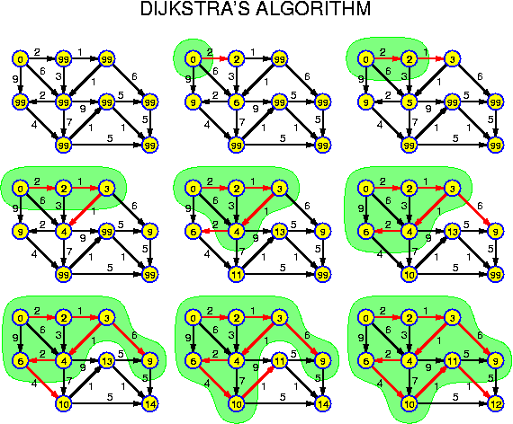
Motivation & Existing methods
Dijkstra Algorithm

Slide 4
Motivation & Existing methods
Dijkstra Algorithm
Not precise enough

Slide 5
Motivation & Existing methods
Dijkstra Algorithm
Not precise enough
Need to subdivide and recompute

Slide 6
The algorithm
Continuous Dijkstra

Slide 7
The algorithm
Continuous Dijkstra
Window

Slide 8
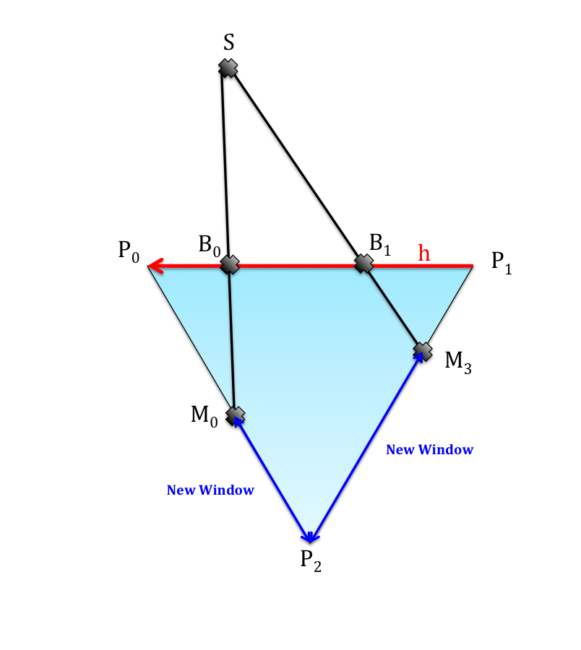
The algorithm
Continuous Dijkstra
Window
Propagation

Slide 9
The algorithm
Continuous Dijkstra
Window
Propagation
Merging

Slide 10
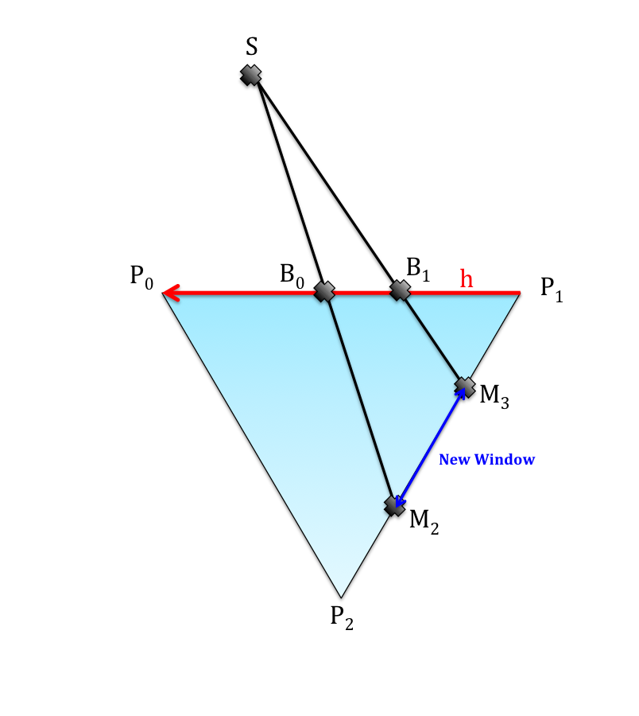
Implementation – Window
Custom data-structure
WINDOW
Halfedge<Point_3> | edge
Double | B0
Double | B1
Double | D0
Double | D1
Int | Tau
Double | Sigma

Slide 11

Implementation – Window
Custom data-structure
Clarity over complexity

Slide 12
Implementation – Propagation
Simple in most cases

Slide 13
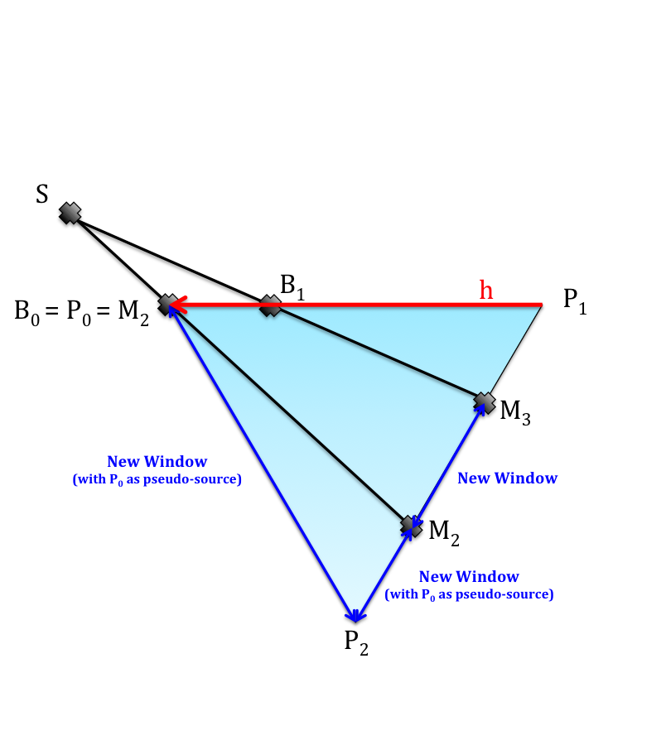
Implementation – Propagation
Simple in most cases
Edge cases

Slide 14
Implementation – Merging
Need to conserve information

Slide 15
Implementation – Merging
Need to conserve information
Clarity and correctness over optimisation

Slide 16
Implementation – Distance Field
Easy cases

Slide 17
Implementation – Distance Field
Easy cases
What if P is inside the face ?

Slide 18
Implementation – Subdivision
Complete distance field

Slide 19

Implementation – Subdivision
Complete distance field
Subdivide

Slide 20
Implementation – Subdivision
Complete distance field
Subdivide
No need to recompute windows.

Slide 21
Results
DEMO TIME!

Slide 22
Possible ameliorations & extensions
Better precision

Slide 23
Possible ameliorations & extensions
Better precision
Understand why High Genus has the blues

Slide 24
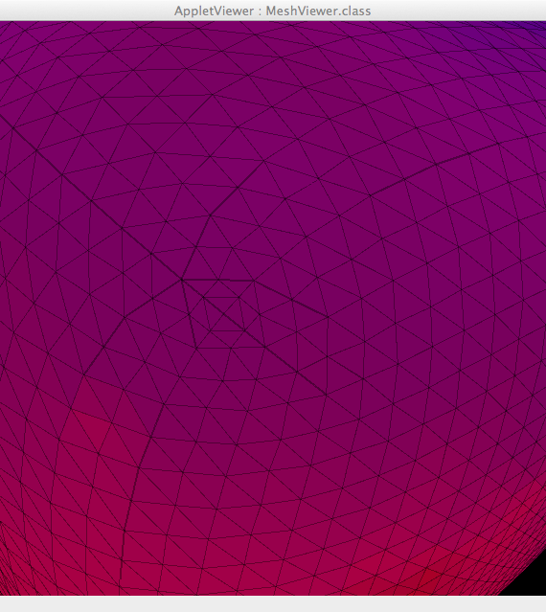
Possible ameliorations & extensions
Better precision
Understand why High Genus has the blues
Better subdivision

Slide 25
Thank you for listening!

