Slide 1
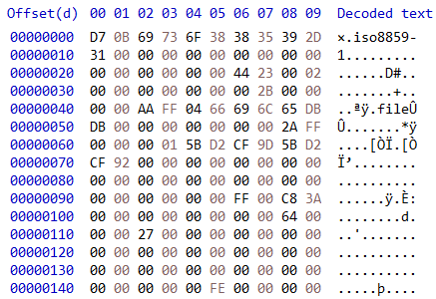
Uint16:prolib format
Null terminated string of 24 bytes (ASCII?):charset to use to decode file path
Uint16:pl header CRC (17443)
Raw file content (here 1 byte AA)
Uint16:nb files + 1
Uint64:offset at which to find the first file (here 43)
FF(255)=read file
FE(254)=skip all bytes until next FF or end of file
The file path (max lgt 255)
Uint16:file CRC
Uint64:offset at which to find this file DATA (42)
Uint32:Pack date
Length of the file path (if 0 = skip this file)
Uint32:File date
24 null bytes
This “explain” the +1 in the file count. It seems this extra “file” is needed to make prolib understand that we should stop listing files. Note that we can put NULL bytes until the next FE and it is absolutely fine. This is because the file path length is 0 so the file is skipped anyway.
Uint32:File size
24 null bytes
FE(254)=skip all bytes until next FF or end of file

Slide 2
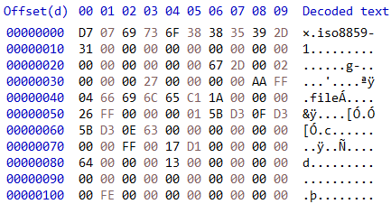
Uint16:prolib format
Null terminated string of 24 bytes (ASCII?):charset to use to decode file path
Uint16:pl header CRC (17443)
Raw file content (here 1 byte AA)
Uint16:nb files + 1
FF(255)=read file
FE(254)=skip all bytes until next FF or end of file
Uint32:offset at which to find the first file (here 39)
Uint16:file CRC
Uint32:offset at which to find this file DATA (38)
Length of the file path (if 0 = skip this file)
Uint32:Pack date
8 null bytes
This “explain” the +1 in the file count. It seems this extra “file” is needed to make prolib understand that we should stop listing files
The file path (max lgt 255)
Uint32: File size
8 null bytes
Uint32:File date
FE(254)=skip all bytes until next FF or end of file

Slide 3
Uint16:pl header CRC (17443)
Compute header CRC from this byte array

Slide 4
Uint16:file CRC
Compute file CRC from this byte array

