Slide 1
IMS Presentation
James Callender QA Academy

Slide 2
Approach
I analysed all the relevant user stories and put them into Shortcut (which is a web based project management board).
I made a risk assessment, and then made a list of tasks that I needed to complete (which were: creating items, and orders domains, controllers and DAOs (data access objects), creating the SQL schema, thinking carefully about database issues, creating an orders_item table, creating unit tests.

Slide 3
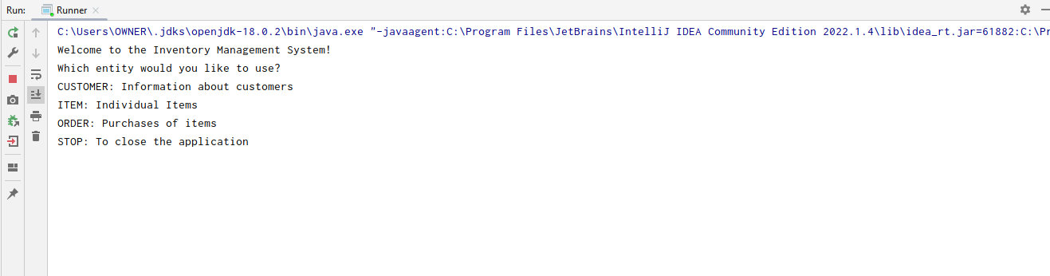
IDE
I used Intellij IDE and Maven build tool. Here is a screenshot of the program console running.

Slide 4
Git
I used Git as version control system, and followed the
feature-branch model, whereby new feature branches were created to commit code to, and then these branches were merged to dev, which was in turn merged to main.

Slide 5
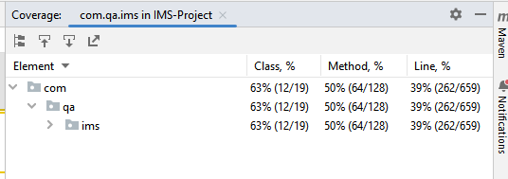
Testing
I managed to achieve 63% test coverage, I would have liked to improve that, but it was difficult given the testing methodology I had to hand.

Slide 6
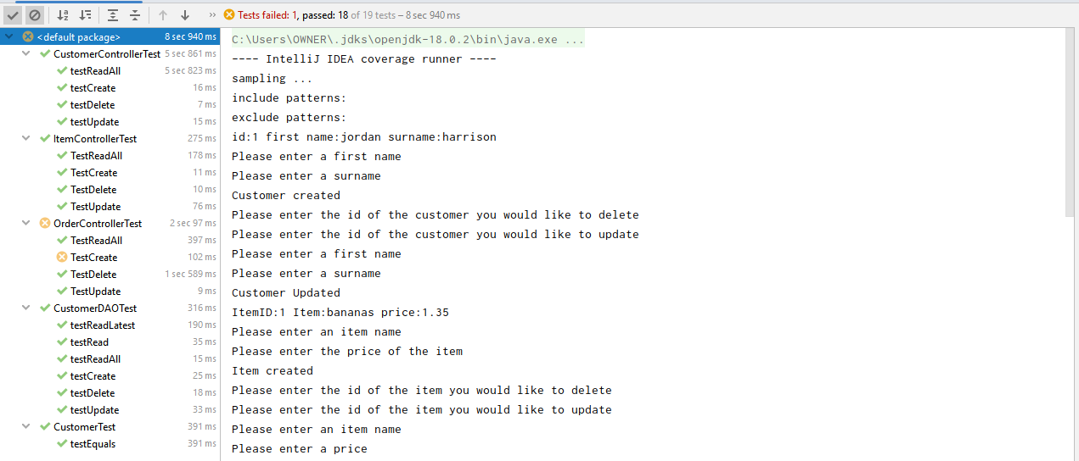
There was a error on customer create test, but this seemed to relate to an issue with the field default value in SQL, I tried repeatedly to fix this without success.

Slide 7
Thank you for viewing my presentation, more information can be found from my audio recording.

