Slide 1
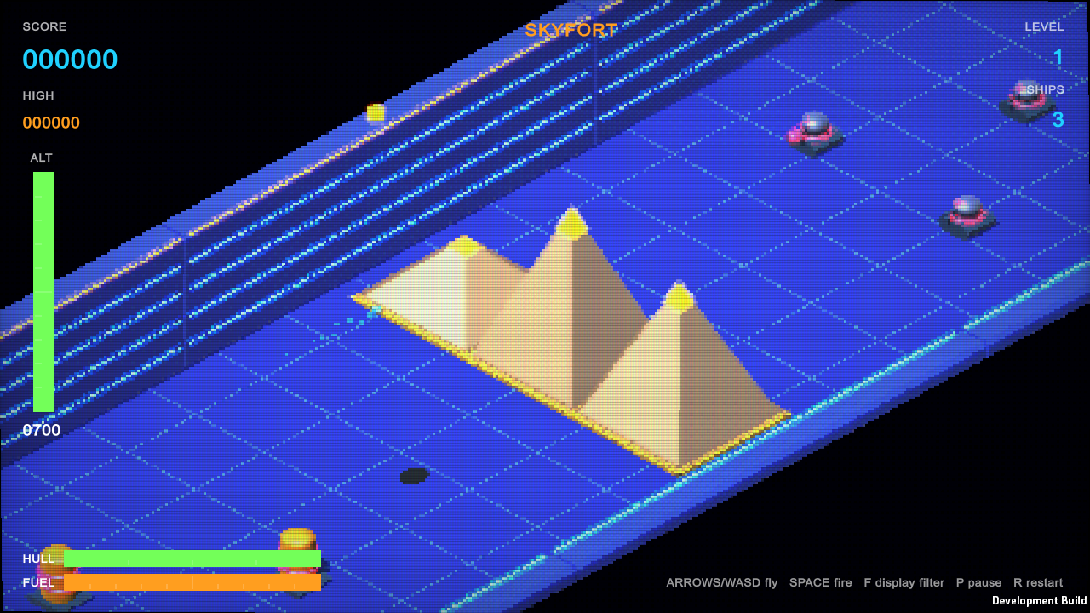
Skyfort Strike
An isometric altitude shooter built in Unity 6
3 themed levels · hull damage · 5 power-ups · CRT filters
Notes:
Skyfort Strike is an original isometric, forward-scrolling shooter in the style of classic altitude shooters. This deck covers how it plays, what changed in the latest update (hull damage, power-ups and two new levels), the Unity 6 features it uses, and how the project is organized.

Slide 2
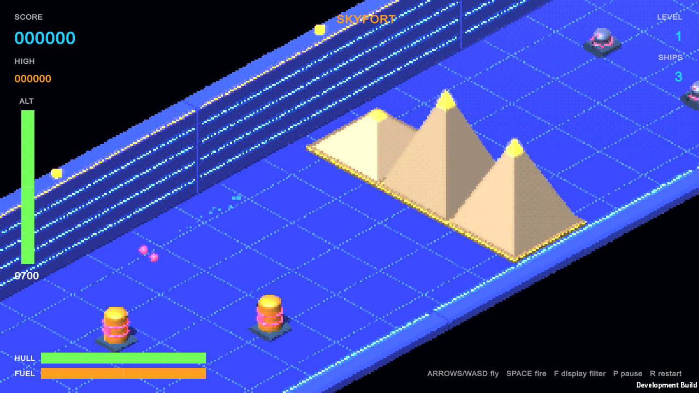
Fly low, read your height, shoot
1
The fighter flies itself
You steer left/right and climb or dive.
2
Altitude is everything
The shadow and ALT gauge show height.
3
Lasers fire at your height
Dive low to hit turrets, tanks and radar.
Skyfort in the default 16-BIT look: pyramids, fuel tanks, turrets
4
Beat the Warden
Each level ends with a boss: hit its eye.
Notes:
The core loop: the ship moves forward automatically, so the player's job is positioning in two axes. In an isometric view height is hard to judge, so the game gives three cues: the ground shadow straight below the ship, the ALT gauge, and glowing rungs on the far wall. Lasers travel at the ship's current altitude, which is what makes diving for ground targets the central skill.

Slide 3
Controls
A / D or ← / →
W / S or ↑ / ↓
Space (J, Z, Ctrl)
Steer left and right
Climb and dive
Fire lasers
F
P or Esc
R
Switch display filter
Pause
Restart
Notes:
Keyboard only, using the classic Input Manager. Holding fire auto-repeats; the Spread Shot power-up also raises the fire rate.

Slide 4
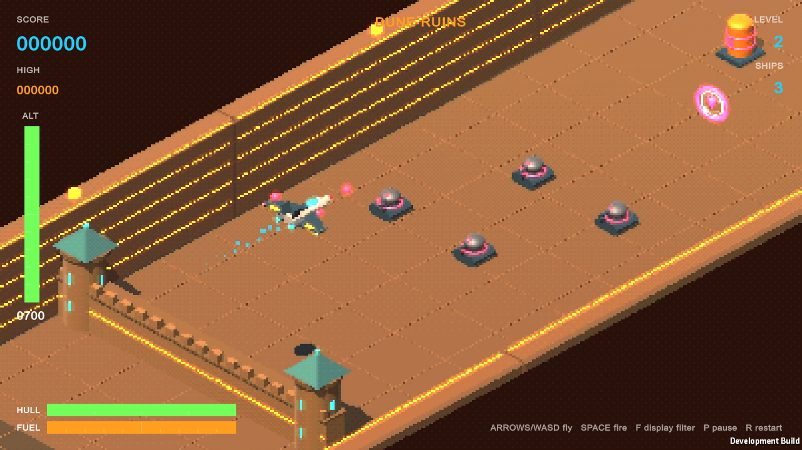
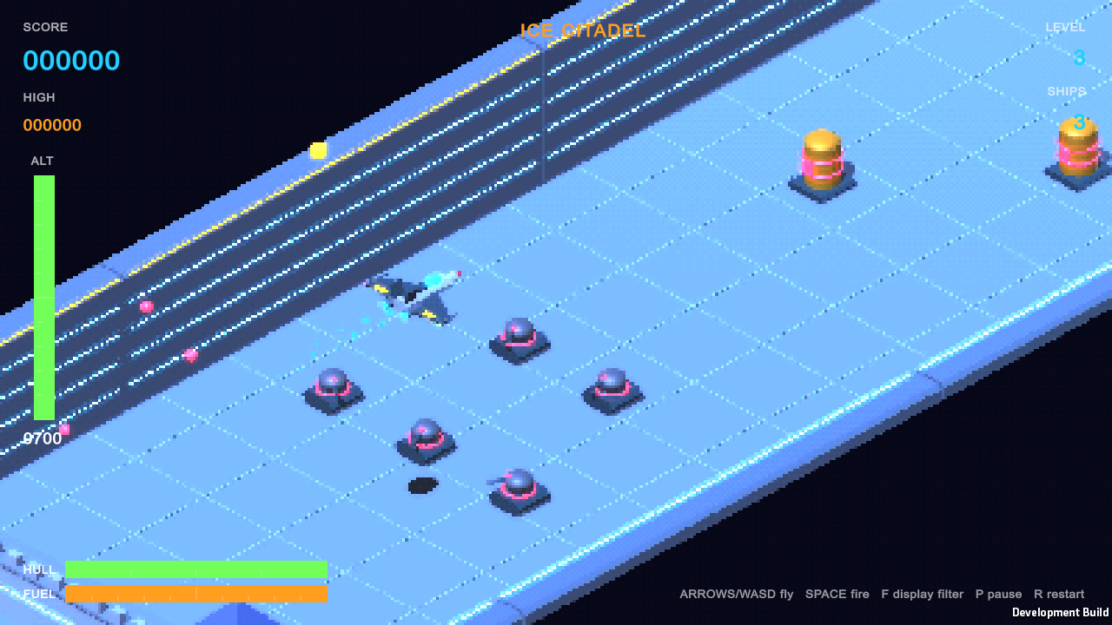
Three levels, three worlds
1 · SKYFORT
2 · DUNE RUINS
3 · ICE CITADEL
Pyramids, castle walls and keeps, force fields
Pyramid fields, obelisk needles, sandstone forts
Crystal ice spires, ice castles, force fields
Mid-level: Open Space
Mid-level: Sandstorm Flats
Mid-level: Aurora Field
Notes:
Each level has its own theme: deck, wall and obstacle colors, sky color, sunlight and ambient light, which blend smoothly as you cross into the next level. Each also has its own obstacle mix and mid-level drone zone. After level 3 the cycle repeats with more speed and more enemies. Themes are plain data in SkyfortThemes.cs, so adding a fourth is mostly picking colors and an obstacle list.

Slide 5
Easier: damage before defeat
4
1.4 s
0
hits per ship
safe blink
damage from bumps
Each enemy shot takes a quarter of the HULL gauge
After a hit, the ship blinks and can't be hit again
Hitting scenery bounces you off and up instead
Below two points the ship trails smoke and sparks. Only an empty hull or empty fuel tank costs a ship, and a new ship starts fully repaired. Fuel also burns a little slower now.
Notes:
Before this update, a single enemy shot destroyed the ship. Now the hull absorbs four hits, with a short invulnerability window after each so a spread of shots can't take the whole hull at once. Collisions with obstacles were already non-lethal: the ship bounces back and up. The HUD shows a HULL gauge that turns red when critical, and a notice such as HULL DAMAGED appears under the level name.

Slide 6
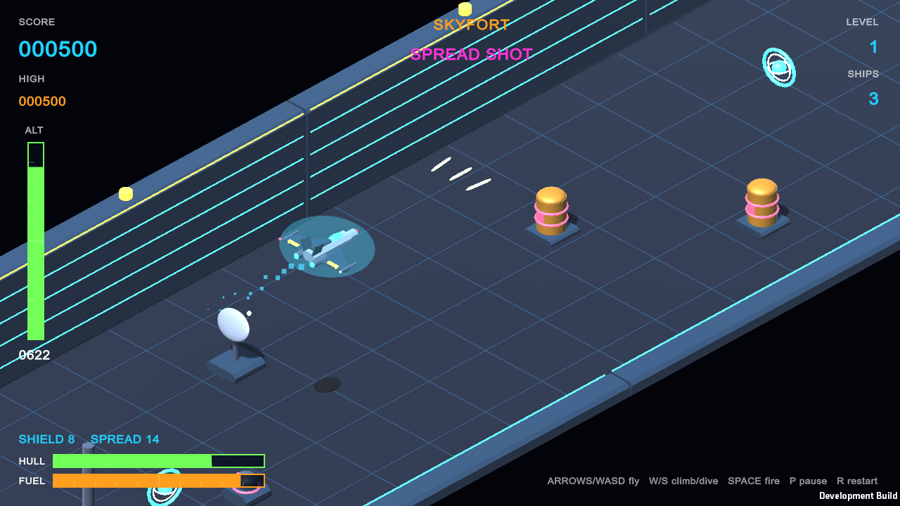
Five power-ups
+
Repair
+2 hull points
F
Fuel
+40 fuel
S
Shield
Blocks all fire for 10 s
3
Spread Shot
Triple lasers, faster, 15 s
Shield bubble and three-way Spread Shot, with timers above the HULL gauge
1UP
Extra Ship
+1 ship (rare)
Notes:
Power-ups are spinning halos you fly through. They float in the corridor (about one in three sections), and destroyed targets can drop them: radar dishes always do, turrets and drones sometimes. Repairs become more likely the more damaged you are, and fuel cells when you are low. Each pickup is a prefab in Assets/Prefabs generated by the scene builder.

Slide 7
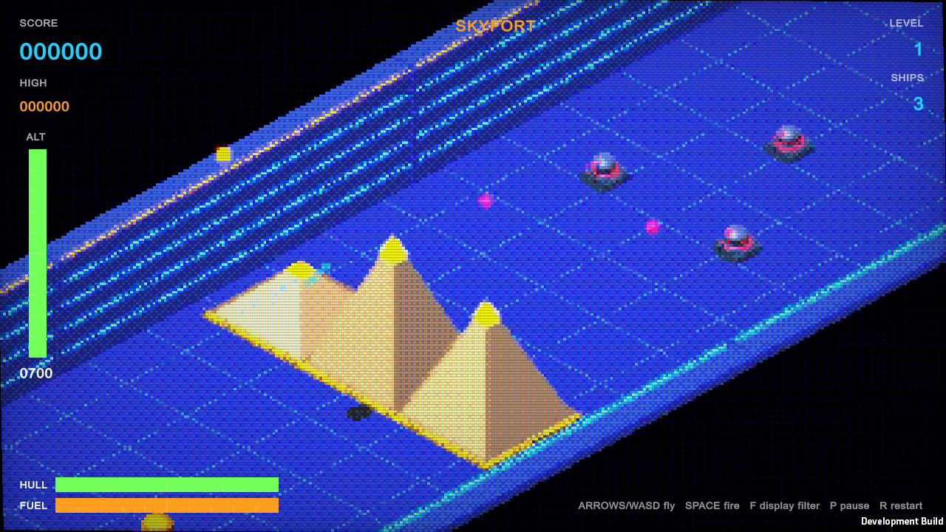
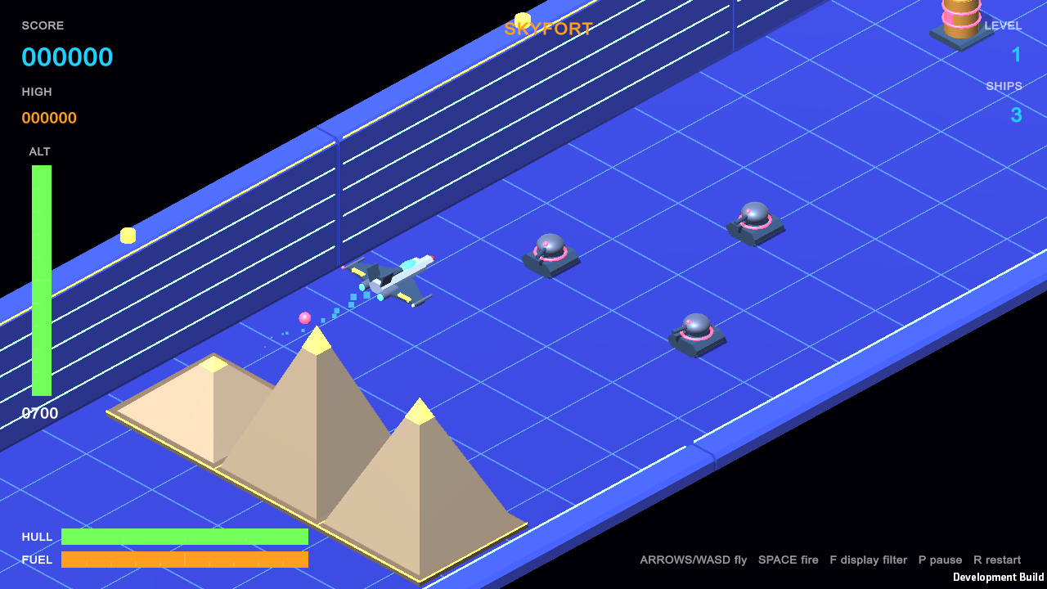
A retro look, with a CRT option
16-BIT
CRT
ARCADE
MODERN
224-line pixels, 15-bit color, light dither (default)
Adds scanlines, curved glass, RGB mask and glow
Chunkier pixels, 8-level color, heavy dither
No filter: full-resolution rendering
Press F in game to cycle the modes; the choice is remembered. Level 1 now uses a saturated royal-blue fortress palette with hard shadows, inspired by early-80s arcade isometric shooters and 16-bit consoles.
Notes:
The look is a single image-effect shader on the camera (SkyfortRetroFilter with Assets/Shaders/SkyfortRetro.shader). It samples the scene on a low-resolution pixel grid, applies a 4x4 Bayer ordered dither, quantizes each color channel, and optionally adds scanlines, barrel curvature, an RGB aperture-grille mask, a cheap glow and a vignette. The HUD is drawn by UI Toolkit afterwards, so text stays sharp in every mode.

Slide 8
Built on Unity 6 features
UI Toolkit data binding
[UxmlElement] controls
Awaitable threading
The HUD binds to a [CreateProperty] state object and updates only on change
Custom gauges drawn with the Painter2D vector API
All sounds are synthesized on a worker thread, then handed back
InstantiateAsync
Async game flow
Rigidbody.linearVelocity
Laser and enemy-bolt pools are prewarmed in one async batch
Countdowns, respawns and boss sequences use Awaitable + cancellation
Unity 6 physics API drives the fighter's motion
Notes:
Everything here is in Unity 6 core, with no extra packages. The HUD uses runtime data binding with converters, for example bool to display style for the boss bar and Color to text color for notices. Audio has no files: every effect is generated in code on a background thread with Awaitable.BackgroundThreadAsync, then Awaitable.MainThreadAsync returns to create the AudioClips.

Slide 9
How the project is organized
In the scene
In the code
Camera, key light, explosion flash and effects
Strike Fighter with its shield bubble
The Warden boss, placed where it fights
HUD (UI Toolkit document)
Level and pool parents, filled at runtime
SkyfortStrike.cs
Flight, level streaming, boss
…PowerUps.cs
Hull damage, pickups, atmosphere
SkyfortThemes.cs
The three level themes
SkyfortHud.cs
Data-bound HUD and gauges
SkyfortAudio.cs
Synthesized sound
SkyfortRetroFilter.cs
Pixel and CRT filter
SkyfortSceneBuilder.cs
Builds scene and prefabs
Notes:
The scene is laid out ahead of time so it can be explored in the Hierarchy. The Editor menu item Skyfort > Rebuild Scene and Prefabs regenerates the scene objects, the enemy, projectile and power-up prefabs, and their meshes and materials from code. Only the level corridor itself is generated during play, because it is random each run.

Slide 10
Tested in a real player build
✓
Scripts compile with 0 errors and 0 warnings
Try it
✓
Hull took 4 hits before a ship was lost, then respawned full
Open the project in Unity 6000.3
Open Assets/Scenes/SkyfortStrike.unity
Press Play
✓
All 5 power-ups collected and applied correctly
✓
Skyfort, Dune Ruins and Ice Citadel all render and stream
✓
All 4 display filters render in every level
✓
No exceptions in any test run
Notes:
Verification used a Windows development build with a temporary test hook (removed afterwards) that logged hull, fuel, power-up timers and level, and captured the screenshots in this deck. The test spawned each power-up on the ship and checked its effect; it also forced level changes to confirm all three themes.

