Slide 1

Akamai’s Localization Challenge
8/11/2019
Jeremy Callinan
University of the people

Slide 2

About Akamai
Akamai, the Hawaiian word for “smart” or “clever,” was founded in 1998 by Tom Leighton, a professor of applied mathematics from MIT, and Danny Lewin, a recent graduate in computer science from the Israel Institute of Technology (Technion).
In 2000, global expansion began with the United Kingdom, Germany and France.
From: https://www.fiercevideo.com/video/akamai-builds-more-content-security-into-its-edge-platform

Slide 3
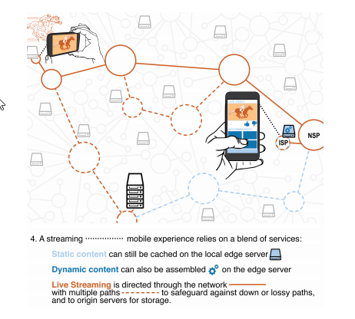
#1 – Problem Statement
Akamai needed to go global, by going local.
Akamai’s business was developed in the United States, and even though they had global-class technology, they did not have global-class infrastructure – either in technology, or supporting sales, marketing and support
At the same time, Amazon, Microsoft, IBM and Google are developing cloud solutions.
Image from: Lessard - https://mitsloan.mit.edu/LearningEdge/CaseDocs/16-175.AkamaiLocalizationChallenge.pdf

Slide 4
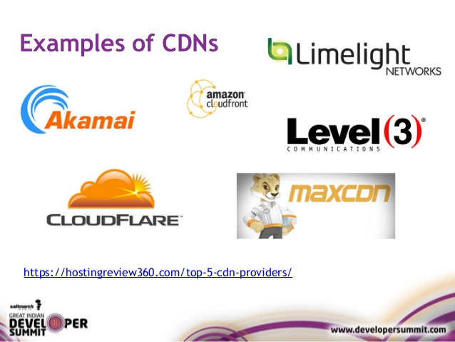
CDN: Content Delivery Network
CDNs provide stable, fast and global access to their customers content
They are a combination of the FedEx of the Internet and the movie house of the Internet
Image from: http://hostingreview360.com

Slide 5
CDNs and Caching
Content Server
Data Item 1
Data Item 2
Caching Server
Data Item 1
Caching Server
Data Item 1
Data Item 2

Slide 6
#2 – Literature Review
Mobile CDNs are a great opportunity for Akamai, and also, its competitors, experiencing growth in the US, Europe, Asia, India, Central and South America in the next five years (Bhawsar 2019)
MarketsandMarkets forecasts the CDN services market will grow from $7.5 billion in 2017 to $30 billion in 2022, as CDN providers focus on security, compression, video, web optimization and data duplication features (DerGurhan 2019)

Slide 7
#2 – Literature Review
Competitor Nitrogen is classifying Akamai as legacy product, capital intensive because it requires servers all over the world, Nitrogen moves away from the commoditized network optimization layer and leases the best telecom pipes in different locations, and then provides their service at the application layer (Nair 2019)
As more applications are integrated and development is integrated with operations (“DevOps”), dynamic micro services, Continuous Integration and Continuous Delivery, along with performance and security, will define the next generation of CDNs (Ramsinghani 2019)
Akamai themselves have discussed moving to the ‘edge’, value added services, as the CDN market itself will continue to grow (Ozalp 2019)

Slide 8
#3 – Case Elements
Competition and Market Share / Market Niche
Other CDNs
Cloud Competitors
Onward Pace of Technology
AI / CDN Hybrids
Optimized services like Nitrogen
More people streaming than using traditional TV or satellite
More gaming , video , and other high-bandwidth services

Slide 9
Competition SWOT Analysis
More Convenient
Telco CDNs
Nitrogen
More Expensive
Less Expensive
Edgecast
Open Source CDNs
HP Cloud Services
Cloud Services (Amazon, Microsoft, Google)
Less Convenient

Slide 10
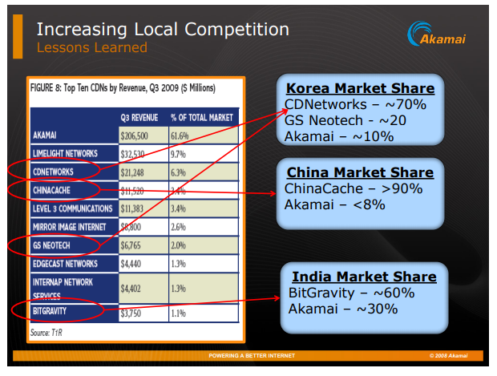
#4 – Case Solution
Local market awareness for:
Products and Sales Targets
Pricing
Branding
Global processes for:
Procurement
Finance
Other administrative

Slide 11
Localization Example – Sales Targets
Country | Work Week (hours)
US | 40
Germany | 37.5
France | 35
All three sales teams had the same targets, with varying work weeks.

Slide 12
Localization Example #2 - France
“The ISP market had recently consolidated from four dominant players to just two, and Akamai had a network relationship with just one. Dublin recalled one French engineer explaining that the company was getting killed by the local competition which was in both networks and that meeting sales targets would only be possible if Akamai was also in both ISPs operating in France. (Lessard 2017)”
From: https://mitsloan.mit.edu/LearningEdge/CaseDocs/16-175.AkamaiLocalizationChallenge.pdf

Slide 13
#5 – Case Conclusions
Certain decisions and management objectives need to be localized
Some operational process can remain global
Constant vigilance when it comes to new technology
New types of CDNs are a threat and opportunity
More bandwidth usage globally means continued industry strength
Many opportunities, but customers are becoming cost concious

Slide 14
References
Lessard, Donald and Cate Reavis Akamai’s Localization Challenge September 22, 2017 . MIT Management Sloan School. Retrieved from https://mitsloan.mit.edu/LearningEdge/CaseDocs/16-175.AkamaiLocalizationChallenge.pdf
HostingReview360.com Top 5 CDN Providers Retrieved from https://hostingreview360.com/top-5-cdn-providers/

