Slide 1
Predetermined Motion Time Systems (PMTS)
CHAPTER 10

Slide 2
Predetermined Motion Time Systems
Predetermined motion time system (PMTS) is a work measurement technique whereby times established for basic human motions are used to build up the time for a job at a defined level of performance.
PMTS also called predetermined time system (PTS), is a database of basic motion elements and their associated normal time values, together with a set of procedures for applying the data to analyze manual tasks and establish standard times for the tasks.
The PMTS database is most readily conceptualized as a set of tables listing time values that correspond to the basic motion elements, the lowest level in our hierarchy of manual work activity
They include motions such as reach, grasp, move, and release.

Slide 3
The Predetermined Motion Time Systems Concept
The concept is similar to constructing a building. A building is composed of elements-Doors, walls, beams, bricks, plumbing. The structure is the sum of the elements.
Likewise, a job is also considered to consist of elements, the total of which is the sum of the elements.
In formal words, the assumption is that each job element is independent and additive; that is, each element does not affect what happens before or after it - independence and additivity.

Slide 4
What are Predetermined Motion Time Systems?
A collection of basic motion times.
Technique for obtaining a standard time by:
    analyzing and subdividing a task into elemental motions
    assigning pre-set standard times for motions and summing these to obtain a standard time for the whole task.

Slide 5
Popular Predetermined Motion Time Systems
Methods -Time Measurement
Work-Factor
Predetermined Time Standards Systems – Meyers
MOST

Slide 6
Methods Time Measurement (MTM)
MTM is a procedure which analyzes any manual operation or method into the basic motions required to perform it, and assigns to each motion a predetermined time standard which is determined by the nature of the motion and the conditions under which it is made.
MTM gives values for the fundamental motions of:
reach, move, turn, grasp, position, disengage, and release.

Slide 7
Methods Time Measurement (MTM)
Most predetermined motion time systems use time measurement units (TMU) instead of seconds for measuring time. One TMU is defined to be 0.00001 hours, or 0.036 seconds. These smaller units allow for more accurate calculations without the use of decimals. 1 hr = 100,000 TMU
MTM studies provided the following kinds of information
  Developing effective work methods prior to production
  Improving existing methods to increase production and decrease labor cost per unit
  Establishing time standards as basis for wages and incentive plans
  Developing time formulas or standard data for future use
  Guiding product design for most efficient manufacture
  Developing effective tool designs for most efficient manufacture
  Selecting effective equipment for most efficient manufacture

Slide 8
Advantages of PMTS systems
PMT systems offer a number of advantages over stop-watch time study. With PMT systems one time is indicated for a given motion, irrespective of where such a motion is performed.
A PMT system, which avoids both rating and direct observation, can lead to more reliability in setting standard times.
PMT systems are not too difficult to apply and can be less time consuming than other methods.
PMT systems are particularly useful for very short repetitive time cycles such as assembly work in the electronics industry.

Slide 9
PMTS Levels and Generations
Chronologically, first-level PMT systems were the first to be developed, and then second - and higher - level systems were subsequently constructed based on the first-level systems.
Because of this chronological development of the systems, the level of the system usually corresponds to the generation of the system.
First-level PMT systems are called first generation systems, and the subsequent systems are second and third generations.
For example, MTM-1 is first generation MTM-2 is second generation and is based on MTM-1. MTM-3 is a third generation MTM system.

Slide 10
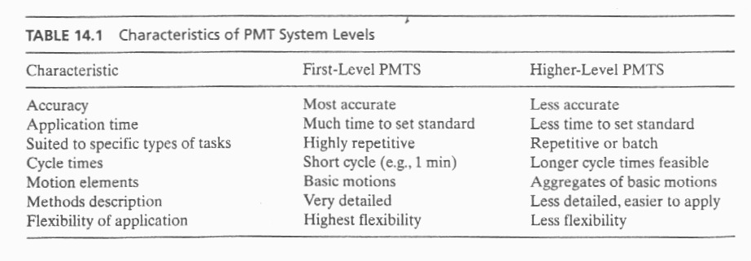
Characteristics of PMT system levels
Work Systems and the Methods, Measurement, and Management of Work
by Mikell P. Groover, ISBN 0-13-140650-7.
©2007 Pearson Education, Inc., Upper Saddle River, NJ. All rights reserved.

Slide 11
MTM-1
In our hierarchy of work activity, MTM-1 operates at the basic motion element level, as illustrated in Figure 14.1.
Most of the MTM-1 basic motions involve hand and arm movements, although elements are also provided for eye, leg, foot, and body actions.
Time units in MTM are called TMUs (time measurement units).
MTM was developed by studying motion pictures of work activity, and the time units for MTM were originally defined as the time per frame of motion picture film, and defined as
1 TMU = 0.00001 hr = 0.0006 min = 0.036 sec
    100,000 TMUs in 1 hour,
    1667 TMUs in 1 min, and
    27.8 TMUs in 1 sec.
Table 14.3 defines the MTM-1 motion elements, and Table 14.4 presents a tabulation of their time values.

Slide 12
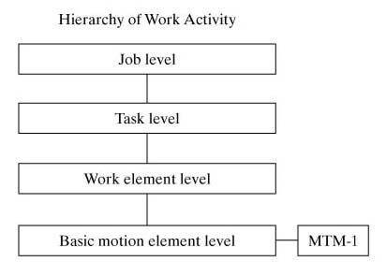
Figure 14.1 The position of MTM motion elements in our work hierarchy.

Slide 13
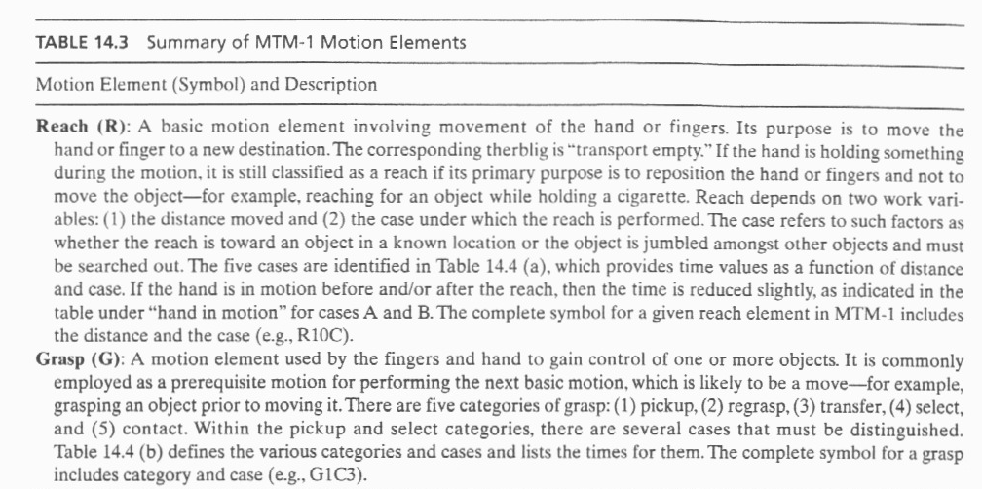
Work Systems and the Methods, Measurement, and Management of Work
by Mikell P. Groover, ISBN 0-13-140650-7.
©2007 Pearson Education, Inc., Upper Saddle River, NJ. All rights reserved.

Slide 14
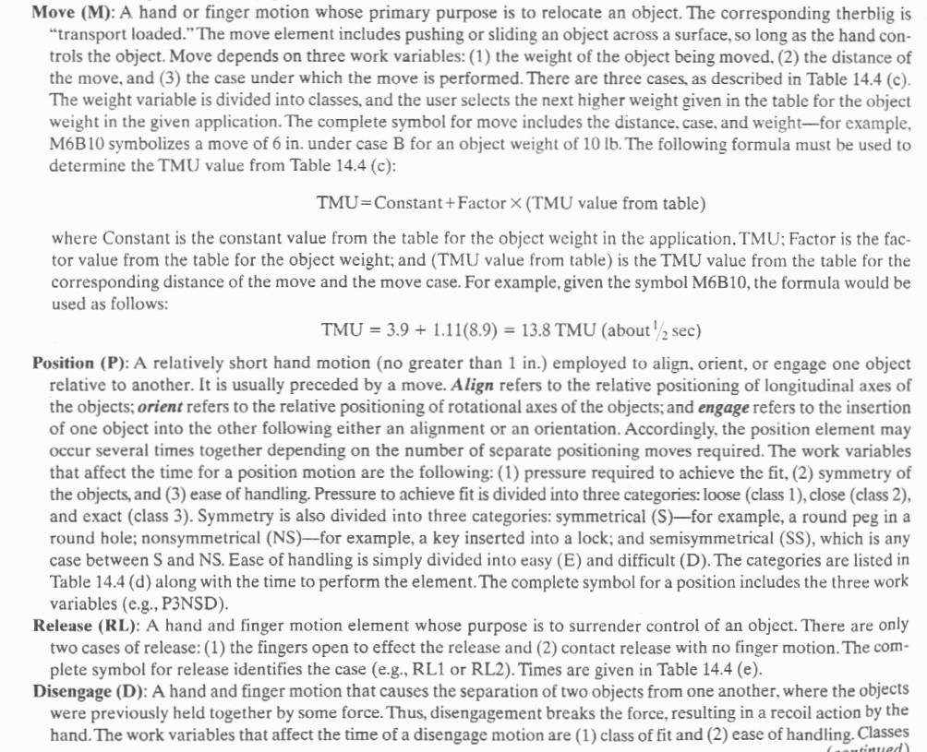
Work Systems and the Methods, Measurement, and Management of Work
by Mikell P. Groover, ISBN 0-13-140650-7.
©2007 Pearson Education, Inc., Upper Saddle River, NJ. All rights reserved.

Slide 15
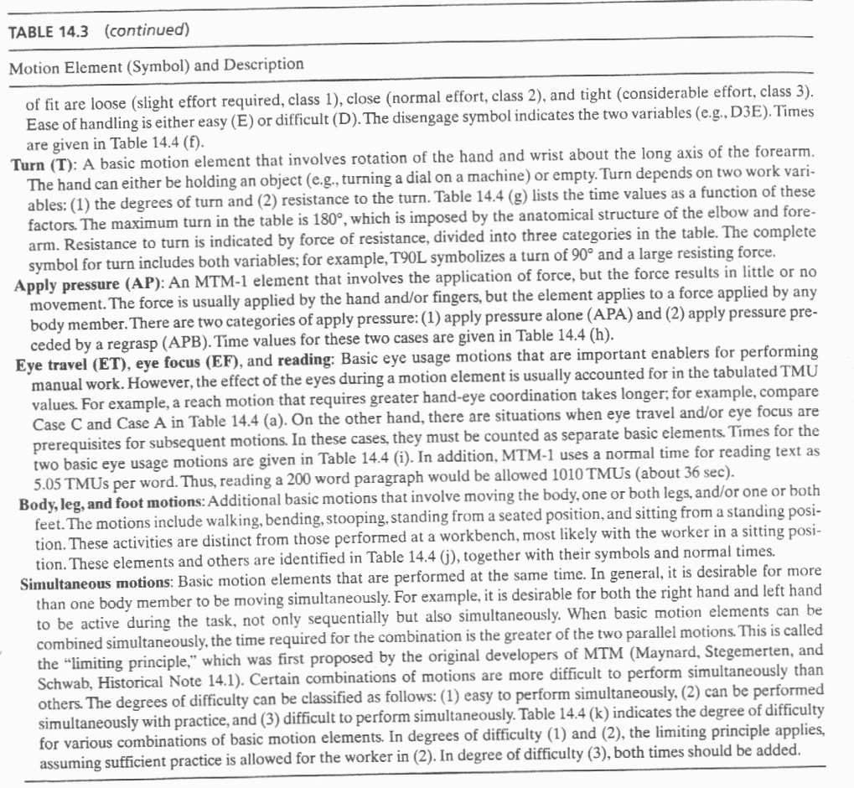
Work Systems and the Methods, Measurement, and Management of Work
by Mikell P. Groover, ISBN 0-13-140650-7.
©2007 Pearson Education, Inc., Upper Saddle River, NJ. All rights reserved.

Slide 16
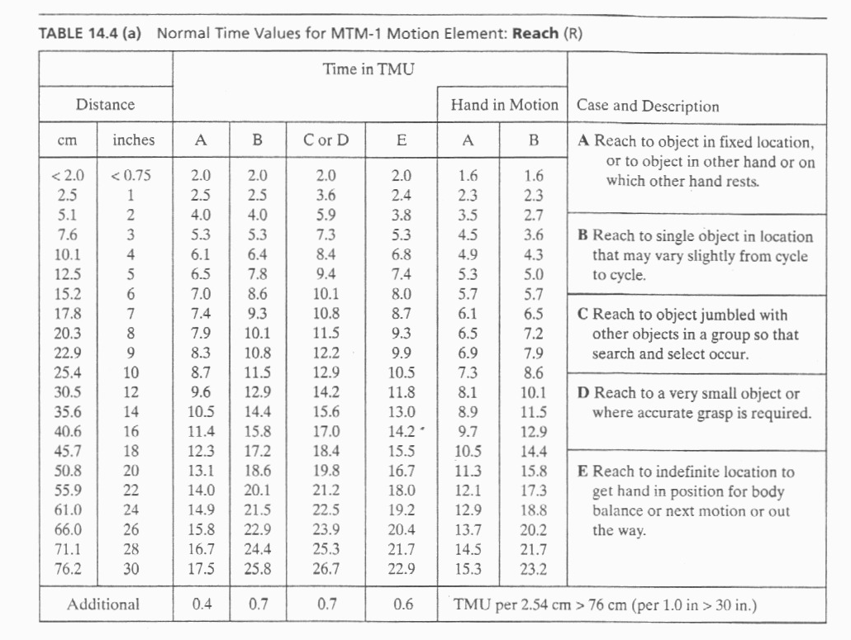
Work Systems and the Methods, Measurement, and Management of Work
by Mikell P. Groover, ISBN 0-13-140650-7.
©2007 Pearson Education, Inc., Upper Saddle River, NJ. All rights reserved.

Slide 17
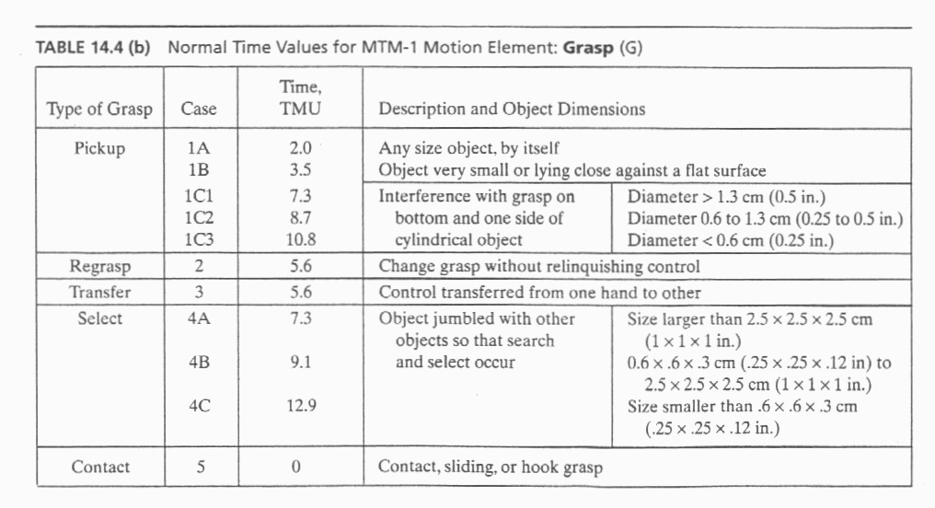
Work Systems and the Methods, Measurement, and Management of Work
by Mikell P. Groover, ISBN 0-13-140650-7.
©2007 Pearson Education, Inc., Upper Saddle River, NJ. All rights reserved.

Slide 18
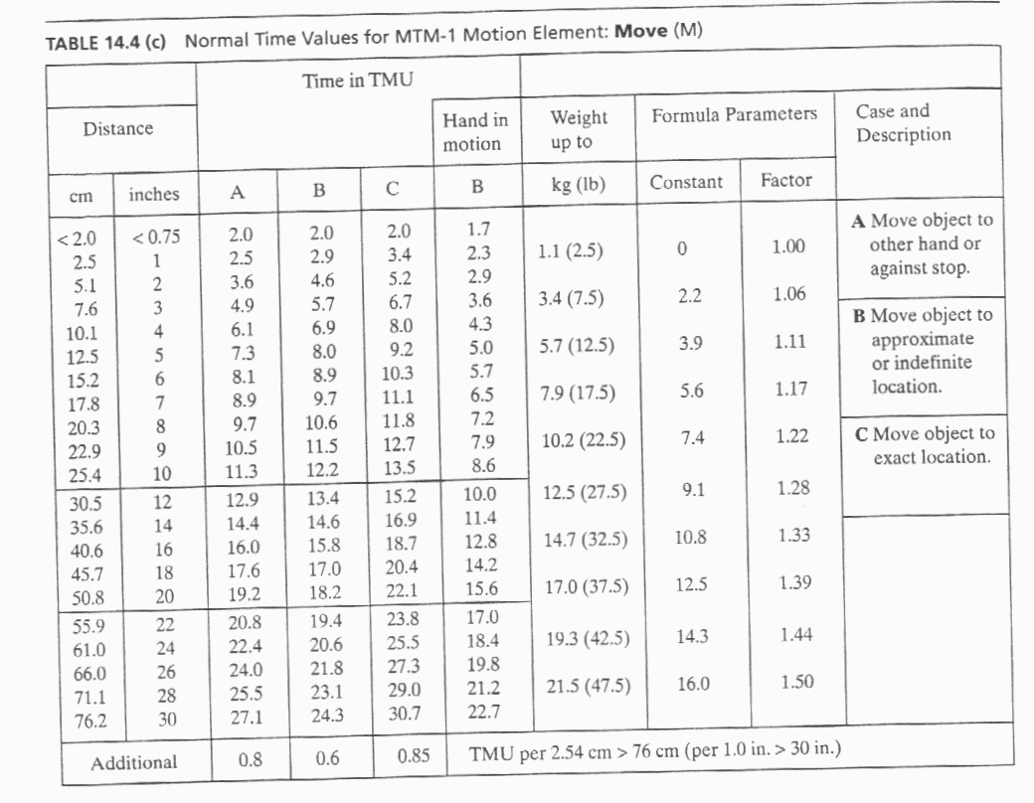

Slide 19
Other MTM Systems
Other members of the MTM family satisfy various user needs.
MTM-2 – Second-level PMTS in which basic motion elements are combined into motion aggregates
  GET – combines Reach and Grasp
  PUT – combines Move and Position
MTM-3 – Third-level PMTS which has four motion categories
  Handle
  Transport
  Step and foot motions
  Bend and arise
Table 14.5 lists many of these MTM systems with a brief description of each.

Slide 20
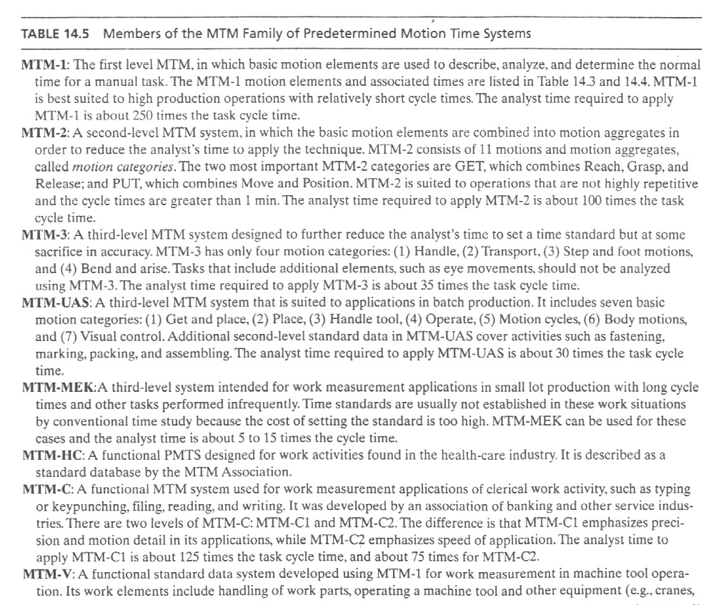
Work Systems and the Methods, Measurement, and Management of Work
by Mikell P. Groover, ISBN 0-13-140650-7.
©2007 Pearson Education, Inc., Upper Saddle River, NJ. All rights reserved.

Slide 21
Maynard Operation Sequence Technique (MOST)
The Maynard Operation Sequence Technique (MOST) is a high-level predetermined motion time system (PMTS) that is based on MTM.
MOST is a work measurement technique that concentrates on the movement of objects. It is used to analyze work and to determine the normal time that it would take to perform a particular process /operation.
The basic version of MOST which is now referred to as Basic MOST.

Slide 22
Maynard Operation Sequence Technique (MOST)
More specifically, MOST is used to:
  1. Break down the operation/process into smaller steps/units
  2. Analyze the motions in each step/unit by using a standard
  MOST method sequence
  3. Assign indices to the parameters constituting the method
  sequence for each task
  4. Sum up the indices to arrive at a time value for each step/unit
  5. Sum up the time values for all the steps/units to arrive at the ‘normal time’ required to perform that operation/process

Slide 23

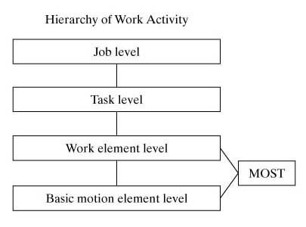
Figure 14.2 The position of the Basic MOST activity sequence model in our work hierarchy

Slide 24
Basic MOST
The focus of Basic MOST is on work activity involve the movement of objects. The majority of industrial manual work does involve moving objects (e.g., parts, tools) from one location to another in the workplace.
Basic MOST uses motion aggregates (collections of basic motion elements) that are concerned with moving things. The motion aggregates are called activity sequence models in Basic MOST.
There are three activity sequence models in Basic MOST, each of which consists of a standard sequence of actions:
  General move. This sequence model is used when an object is moved freely through space from one location to the next (e.g., picking something up from the floor and placing it on a table).
  Controlled move. This sequence model is used when an object is moved while it remains in contact with a surface (e.g., sliding the object along the surface) or the object is attached to some other object during its movement (e.g., moving a lever on a machine).
  Tool use. This sequence model applies to the use of a hand tool (e.g., a hammer or screwdriver).

Slide 25
The actions in an activity sequence model, called sequence model parameters in Basic MOST, are similar to basic motion elements in MTM. Let us examine the three sequence models and indicate the standard sequence of model parameters for each.
General Move. The General Move sequence is applicable when an object is moved through the air from one location to another. There are four parameters (actions) in the General Move, symbolized by letters of the alphabet:
A — Action distance, usually horizontal. This parameter is used to describe movements of the fingers, hands, or feet (e.g., walking). The movement can be per formed either loaded or unloaded.
B — Body motion, usually vertical. This parameter defines vertical body motions and actions (e.g., sitting, standing up).
G — Gain control. This parameter is used for any manual actions involving the fingers, hands, or feet to gain physical control of one or more objects. ft is closely related to the grasp motion element in MTM (e.g., grasp the object).
P — Placement. The placement parameter is used to describe the action involved to lay aside, position, orient, or align an object after it has been moved to the new location (e.g., position the object).

Slide 26
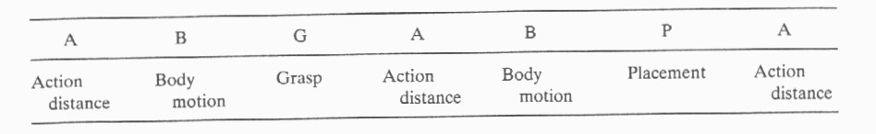
These parameters occur in the following standard sequence in the General Move:
where the first three parameters (A B G) represent basic motions to get an object, the next three parameters (A B P) represent motions to put or move the object to a new location, and the final parameter (A) applies to any motions at the end of the sequence, such as return to original position.
To complete the activity sequence model, each parameter is assigned a numerical value in the form of a subscript or index number that represents the time to accomplish that action.

Slide 27
The value of the index number depends on the type of action, its motion content, and the conditions under which it is performed. Table 14.6 lists the parameters and possible circumstances for the action, together with the corresponding values of the index numbers.
When the index values have been entered for all parameters, the time for the sequence model is determined by summing the index values and multiplying by 10 to obtain the total TMUs. The procedure is illustrated in the following example.
Example: General Move
Develop the activity sequence model and determine the normal time for the following work activity: A worker walks 5 steps, picks up a small part from the floor, returns to his original position, and places the part on his worktable.

Slide 28
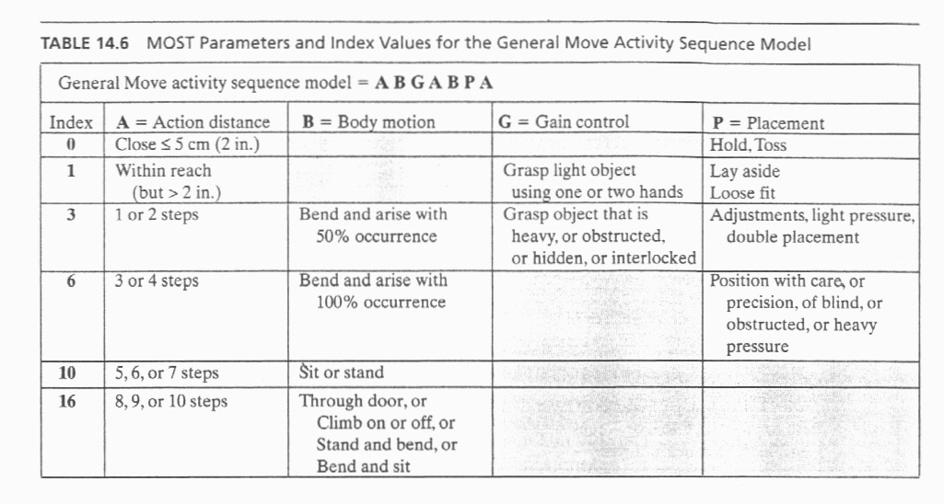
Solution: Referring to Table 14.6, the indexed activity sequence model for this work activity would be the following:
A₁₀ B₆ G₁ A₁₀ B₀ P₁ A₀
where A₁₀ = walk 5 steps, B₆ = bend and arise, G₁ = control of small part, A₁₀ = walk back to original position, B₀ = no body motion, P₁ = lay aside part on table, and A₀ = no motion. The sum of the index values is 28. Multiplying by 10, we have 280 TMUs (about 10 sec).

